Slide 1



Natural Language Understanding for
Soft Information Fusion
Stuart C. Shapiro and Daniel R. Schlegel
Department of Computer Science and Engineering
Center for Multisource Information Fusion
And Center for Cognitive Science
University at Buffalo, The State University of New York

Slide 2
Outline
Introduction
The Syntactic and Enhanced Syntactic KBs
Syntax-Semantics Mapping
Evaluation
Acknowledgments

Slide 3
Tractor
Input:
  Short English intelligence message.
Output:
  Semantic knowledge base (KB)
  representing contents of message.

Slide 4
Context: Hard & Soft Information Fusion
Information from multiple
  Soft information sources
    English messages
  Hard information sources
    RADAR, SONAR, LIDAR, …
are fused for situation assessment.
=> Requirement:
  Capture semantic content of each message
  as completely and correctly as possible.

Slide 5
Approach
Not: Information Extraction
  Look for prespecified
    classes of
      Entities
      Events
    Properties.
Instead: Natural Language Understanding
(Semantic Analysis)
  Translate
    Entities, Events, Properties, Relations, …
    Expressed in the text
    Into a formal Knowledge Representation (KR) language
    that supports reasoning.

Slide 6
Tractor Architecture
English
Message
Syntactic Processing in GATE
Tokenizer &
Sentence Splitter
Named-Entity
Recognizers
Co-Referencers
option
POS Tagger
& Parser
Morphological
Analyzer
Co-Reference
Editor
Cyc
Ontology
GEOnet
Names
Server
Syntactic
KB
Propositionalizer
Annotations
Enhanced
Syntactic
KB
Syntax-Semantics
Mapper
Semantic
KB
CBIR

Slide 7
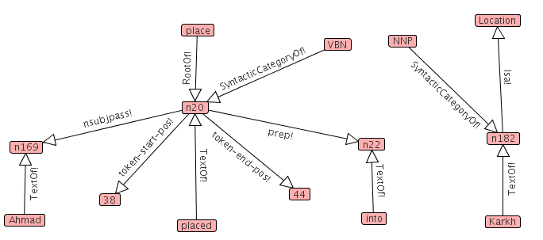
Part of a Syntactic Knowledge Base
Semantic
information
Logical form: (TextOf Ahmad n169)
194. 03/03/10 - Dhanun Ahmad has been placed into custody
by the Iraqi police and transferred to a holding cell in Karkh;
news of his detainment is circulated in his neighborhood of Rashid

Slide 8
Some Syntactic Relations/Assertions
(TextOf x y) token y is an occurrence of word x
(RootOf x y) x is the root form of the word of token y
(SyntacticCategoryOf x y) x is the part-of-speech of y
(nsubj x y) the subject of x is y
(nsubjpass x y) the passive subject of x is y
(dobj x y) the direct object of x is y
(prep x y) x is modified by a PP headed by y
(nn x y) the head noun x is modified by the noun y
(token-start-pos x i) token x begins with character i
(token-end-pos x i) token x ends just before character i

Slide 9

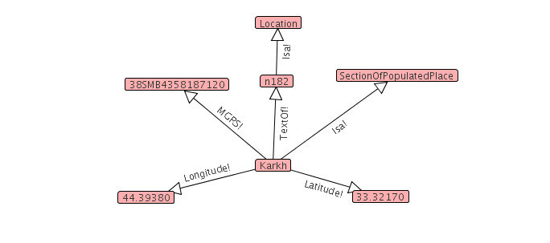
CBIR Enhancement
From GEOnet Names Server

Slide 10
Some Semantic Relations/Assertions
(Isa x y) x is an instance of category y
(MemberOf x y) x is a member of group y
(Type x y) The category x is a subcategory of category y
(hasName x y) The name of x is y
(per-religion x y) The religion of the person x is y
(age x y) The age of x is y
(agent x y) The agent of the action x is y
(theme x y) The theme (what is acted upon) of the action x is y

Slide 11
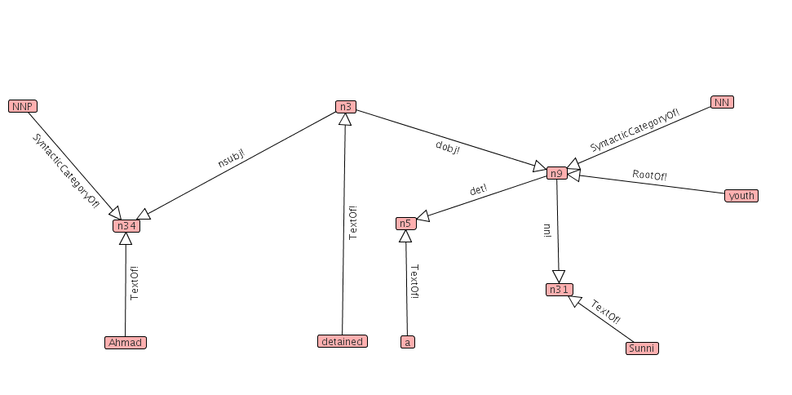
Examples of Syntax-Semantics Mapping
“Ahmad detained a Sunni youth.”
4 syntax-semantics mapping rules will be shown
with before & after graphs.

Slide 12
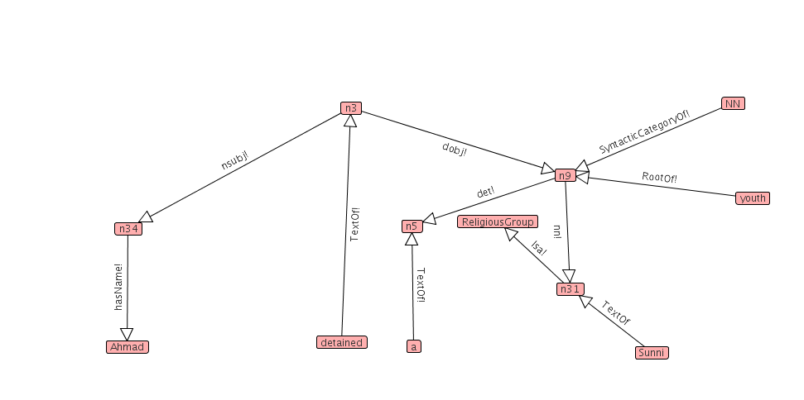
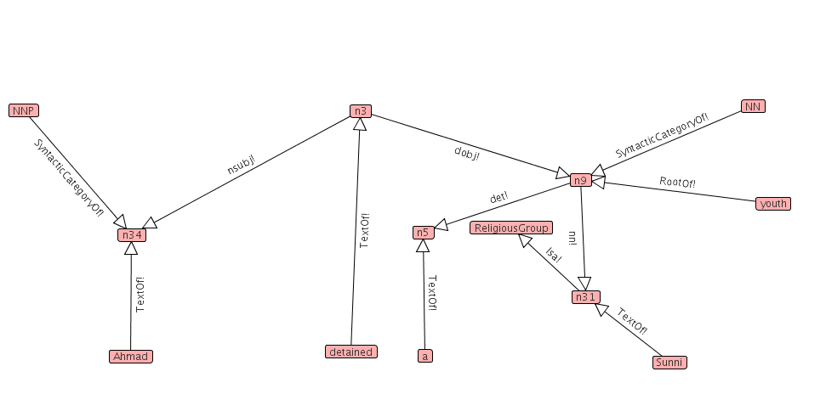
properNounToName
(defrule properNounToName
(SyntacticCategoryOf NNP ?token)
(TextOf ?text ?token)
=>
(assert `(hasName ,?token ,?text))
(unassert `(SyntacticCategoryOf NNP ,?token))
(unassert `(TextOf ,?text ,?token)))

Slide 13
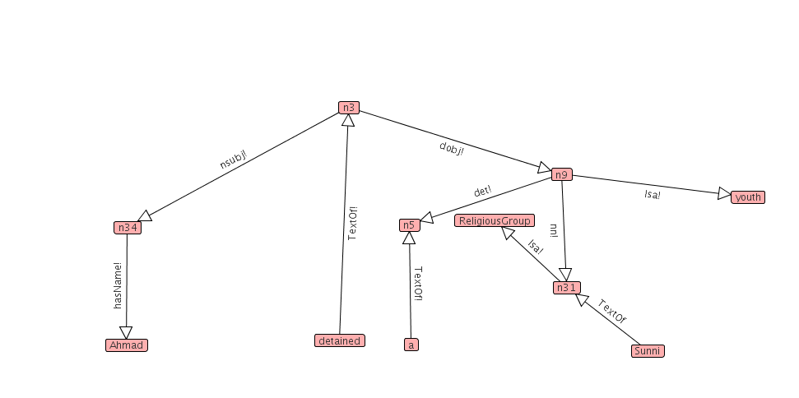
nounPhraseToInstance
(defrule nounPhraseToInstance
(SyntacticCategoryOf NN ?nn)
(:when (isNPhead ?nn))
(RootOf ?root ?nn)
(:unless (numberTermp ?root))
=>
(assert `(Isa ,?nn ,?root))
(unassert `(SyntacticCategoryOf NN ,?nn))
(unassert `(RootOf ,?root ,?nn)))

Slide 14
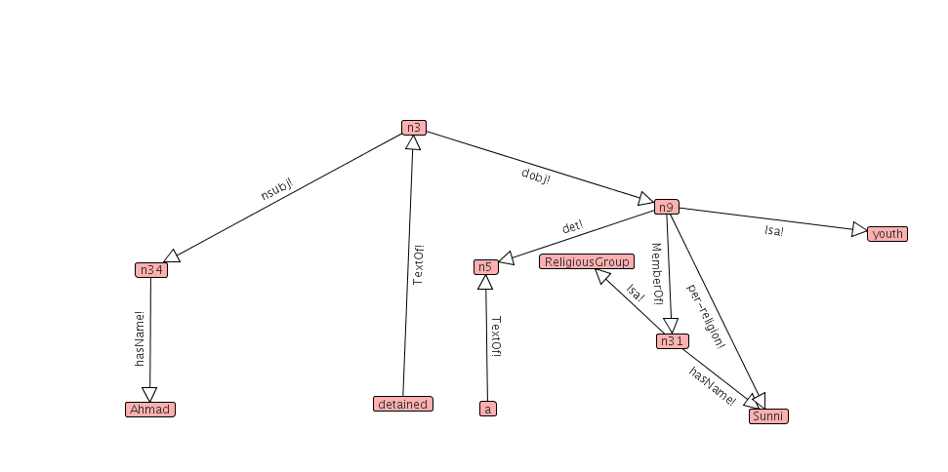
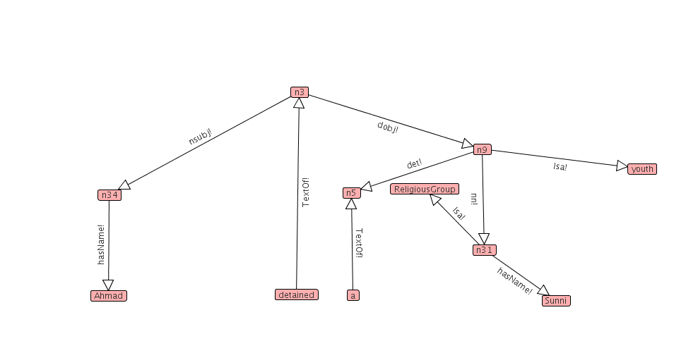
hasReligion
(defrule hasReligion
(Isa ?religiongrp ReligiousGroup)
(nn ?per ?religiongrp)
(hasName ?religiongrp ?religion)
=>
(assert (MemberOf ?per ?religiongrp))
(assert (per-religion ?per ?religion))
(unassert (nn ?per ?religiongrp)))

Slide 15
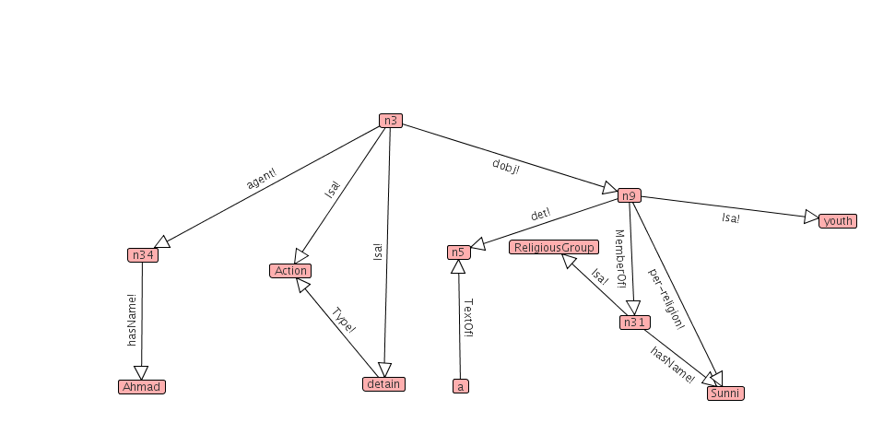

subjAction
(defrule subjAction
(nsubj ?action ?subj)
(Isa ?action Action)
=>
(assert `(agent ,?action ,?subj))
(unassert `(nsubj ,?action ,?subj)))

Slide 16
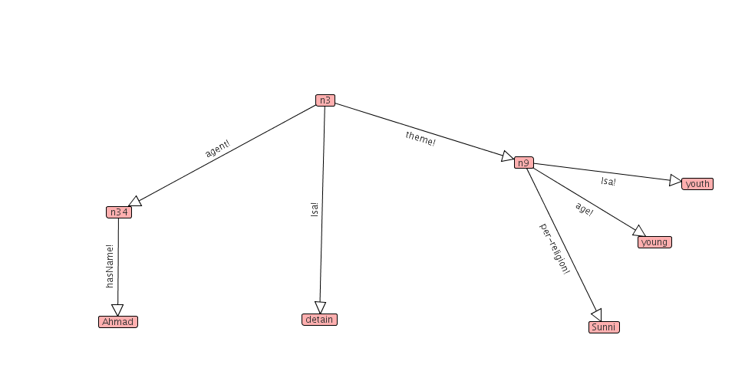
Final Semantic Graph (KB)
“Ahmad detained a Sunni youth.”
There is a detain action, with someone named Ahmad as agent,
and some youth as theme.
The age of the youth is young.
The religion of the youth is Sunni.

Slide 17
Evaluation
Mapping Rules developed using training messages.
Evaluated using test messages.
Questions
  How general are the rules?
  How thorough are the rules?
  Are the rules too general?

Slide 18
How General are the rules?
Rule firings on test messages
Type | Count | # Fired | % Fired | Times Fired | Times Per Msg
CBIR | 1 | 1 | 100% | 474 | 8.32
SYN | 23 | 13 | 56.5% | 1,596 | 28.00
SEM | 5 | 5 | 100% | 328 | 5.75
SYNSEM | 99 | 56 | 56.6% | 2,904 | 50.95
INFER | 9 | 8 | 88.9% | 135 | 2.37
CLEAN | 10 | 8 | 80% | 6,492 | 113.89
TOTAL | 147 | 91 | 61.9% | 11,929 | 209.28
Conclusion: Reasonably general.

Slide 19
How thorough are the rules?
Syntactic vs. Semantic Assertions
KB | Syntactic Assertions | Semantic Asertions | % Semantic
Syntactic | 2469 | 1,149 | 31.76%
Semantic w/ CBIR | 538 | 48,561 | 98.90%
Semantic w/o CBIR | 538 | 5,646 | 91.30%
Observation: Rules convert from 68% syntactic to 91% semantic w/o CBIR assertions
Conclusion: Very thorough.

Slide 20
Are the rules too general?
Rule firings on correct parses in test messages
Type | # Fired | Times Fired | # Correct | % Correct
CBIR | 1 | 474 | 474 | 100%
SYN | 13 | 1,567 | 1,548 | 98.8%
SEM | 5 | 328 | 328 | 100%
SYNSEM | 56 | 2,651 | 2,431 | 91.7%
INFER | 8 | 85 | 72 | 84.7%
CLEAN | 5 | 6,492 | 6,492 | 100%
TOTAL | 88 | 11,597 | 11,345 | 97.8%
Conclusion: Not too general.

Slide 21
Conclusions
Tractor’s purpose:
  Semantic Analysis of short English messages
  for fusion with other soft and hard information.
Syntactic analysis of message creates syntactic KB.
Syntactic KB enhanced
with ontological and geographical information.
Mapping rules map syntactic KB into semantic KB.
Mapping rules developed with training messages
generalize well to test messages.
Syntactic KBs average 68% syntactic;
Final Semantic KBs average 99% semantic.

Slide 22
Acknowledgments
This work has been supported by a Multidisciplinary University Research Initiative (MURI) grant (Number W911NF-09-1-0392) for "Unified Research on Network-based Hard/Soft Information Fusion", issued by the US Army Research Office (ARO) under the program management of Dr. John Lavery.

