Slide 1
CSE 486/586 Distributed Systems
Socket Programming and Android
Steve Ko
Computer Sciences and Engineering
University at Buffalo

Slide 2
Last Time
What to put on top of physical networks?
  Layers providing survivability
Where to put functionalities?
  Fate-sharing & end-to-end arguments
  IP layer doesn’t provide much
  TCP handles most of the survivability issues
TCP & UDP: the two transport protocols of the Internet
What interface do applications see?
  Socket API

Slide 3
Today
Today: background for programming assignments
  Socket programming, Android, and project overviews
  It’s imperative that you try yourself!
If you have no clue at the end of the lecture, please stop by my office.
Goal: today’s really about transferring basic knowledge, less about design decisions.

Slide 4
Today’s Question
TCP provides a reliable, byte-stream connection as an abstraction.
UDP gives raw access to what the IP network provides without all the overhead of TCP.
So, how do we program applications on top of these abstractions?

Slide 5


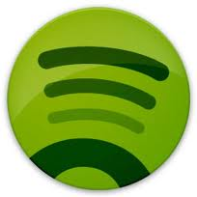

What Applications See
App
Socket API
TCP
UDP
OS
IP
Device Drivers
Network Interface

Slide 6
UNIX Socket API
Socket interface
  Originally provided in Berkeley UNIX
  Later adopted by all popular operating systems
  Simplifies porting applications to different OSes
In UNIX, everything is like a file
  All input is like reading a file
  All output is like writing a file
  File is represented by an integer file descriptor
API implemented as system calls
  E.g., socket(), connect(), listen(), read(), write(), close(), …
  Will look at the details of these system calls

Slide 7


So, Let’s Consider a Scenario
What is the server address?
  IP address
How do we identify the Web server?
  Port number
Socket API
Socket API
OS
OS
IP network

Slide 8
Using Ports to Identify Services
Server host 128.2.194.242
Service request for
128.2.194.242:80
(i.e., the Web server)
Client host
Web server
(port 80)
Client
OS
Echo server
(port 7)
Service request for
128.2.194.242:7
(i.e., the echo server)
Web server
(port 80)
Client
OS
Echo server
(port 7)

Slide 9
Knowing What Port Number To Use
Popular applications have well-known ports
  E.g., port 80 for Web and port 25 for e-mail
  See http://www.iana.org/assignments/port-numbers
Well-known vs. ephemeral ports
  Server has a well-known port (e.g., port 80)
    Between 0 and 1023
  Client picks an unused ephemeral (i.e., temporary) port
    Between 1024 and 65535
Uniquely identifying the traffic between the hosts
  Two IP addresses and two port numbers
  Underlying transport protocol (e.g., TCP or UDP)

Slide 10
Typical Client Program
E.g. browser
Prepare to communicate
  Create a socket
  Determine server IP address and port number (e.g., for a Web server)
  Initiate the connection to the server
Exchange data with the server
  Write data to the socket
  Read data from the socket
  Do stuff with the data (e.g., render a Web page)
Close the socket

Slide 11
Servers Differ From Clients
Passive open
  Prepare to accept connections
  … but don’t actually establish
  … until hearing from a client
Hearing from multiple clients
  Allowing a backlog of waiting clients
  ... in case several try to communicate at once
Create a socket for each client
  Upon accepting a new client
  … create a new socket for the communication

Slide 12
Typical Server Program
E.g., a Web server
Prepare to communicate
  Create a socket
  Associate local address and port with the socket
Wait to hear from a client (passive open)
  Indicate how many clients-in-waiting to permit
  Accept an incoming connection from a client
Exchange data with the client over new socket
  Receive data from the socket
  Do stuff to handle the request (e.g., get a file)
  Send data to the socket
  Close the socket
Repeat with the next connection request

Slide 13
Putting it All Together
Server
socket()
bind()
Client
listen()
socket()
establish
connection
accept()
connect()
block
send request
write()
read()
process
request
send response
write()
read()

Slide 14
Client Creating a Socket: socket()
Client
Operation to create a socket
  int socket(int domain, int type, int protocol)
  Returns a descriptor (or handle) for the socket
  Originally designed to support any protocol suite
Domain: protocol family
  PF_INET for the Internet
Type: semantics of the communication
  SOCK_STREAM: reliable byte stream
  SOCK_DGRAM: message-oriented service
Protocol: specific protocol
  UNSPEC: unspecified
  (PF_INET and SOCK_STREAM already implies TCP)
socket()
connect()
write()
read()

Slide 15
Client: Learning Server Address/Port
Server typically known by name and service
  E.g., “www.cnn.com” and “http”
Need to translate into IP address and port #
  E.g., “64.236.16.20” and “80”
Translating the server’s name to an address
  struct hostent *gethostbyname(char *name)
  Argument: host name (e.g., “www.cnn.com”)
  Returns a structure that includes the host address
Identifying the service’s port number
  struct servent *getservbyname(char *name, char *proto)
  Arguments: service (e.g., “ftp”) and protocol (e.g., “tcp”)

Slide 16
Client: Connecting Socket to the Server
Client contacts the server to establish connection
  Associate the socket with the server address/port
  Acquire a local port number (assigned by the OS)
  Request connection to server, who will hopefully accept
Establishing the connection
  int connect(int sockfd, struct sockaddr *server_address, socketlen_t addrlen)
  Arguments: socket descriptor, server address, and address size
  Returns 0 on success, and -1 if an error occurs
Client
socket()
connect()
write()
read()

Slide 17
Client: Sending and Receiving Data
Sending data
  ssize_t write(int sockfd, void *buf, size_t len)
  Arguments: socket descriptor, pointer to buffer of data to send, and length of the buffer
  Returns the number of characters written, and -1 on error
Receiving data
  ssize_t read(int sockfd, void *buf, size_t len)
  Arguments: socket descriptor, pointer to buffer to place the data, size of the buffer
  Returns the number of characters read (where 0 implies “end of file”), and -1 on error
Closing the socket
  int close(int sockfd)
Client
socket()
connect()
write()
read()

Slide 18
Server: Server Preparing its Socket
Server creates a socket and binds address/port
  Server creates a socket, just like the client does
  Server associates the socket with the port number
  (and hopefully no other process is already using it!)
Create a socket
  int socket(int domain, int type, int protocol)
Bind socket to the local address and port number
  int bind (int sockfd, struct sockaddr *my_addr, socklen_t addrlen)
  Arguments: socket descriptor, server address, address length
  Returns 0 on success, and -1 if an error occurs
Server
socket()
bind()
listen()
accept()

Slide 19
Server: Allowing Clients to Wait
Many client requests may arrive
  Server cannot handle them all at the same time
  Server could reject the requests, or let them wait
Define how many connections can be pending
  int listen(int sockfd, int backlog)
  Arguments: socket descriptor and acceptable backlog
  Returns a 0 on success, and -1 on error
What if too many clients arrive?
  Some requests don’t get through
  The Internet makes no promises…
  And the client can always try again
Server
socket()
bind()
listen()
accept()

Slide 20
Server: Accepting Client Connection
Now all the server can do is wait…
  Waits for connection request to arrive
  Blocking until the request arrives
  And then accepting the new request
Accept a new connection from a client
  int accept(int sockfd, struct sockaddr *addr, socketlen_t *addrlen)
  Arguments: socket descriptor, structure that will provide client address and port, and length of the structure
  Returns descriptor for a new socket for this connection
Server
socket()
bind()
listen()
accept()

Slide 21
Client and Server: Cleaning House
Once the connection is open
  Both sides and read and write
  Two unidirectional streams of data
  In practice, client writes first, and server reads
  … then server writes, and client reads, and so on
Closing down the connection
  Either side can close the connection
  … using the close() system call
What about the data still “in flight”
  Data in flight still reaches the other end
  So, server can close() before client finishing reading

Slide 22
One Annoying Thing: Byte Order
Hosts differ in how they store data
  E.g., four-byte number (byte3, byte2, byte1, byte0)
Little endian (“little end comes first”) ← Intel PCs!!!
  Low-order byte stored at the lowest memory location
  Byte0, byte1, byte2, byte3
Big endian (“big end comes first”)
  High-order byte stored at lowest memory location
  Byte3, byte2, byte1, byte 0
Makes it more difficult to write portable code
  Client may be big or little endian machine
  Server may be big or little endian machine

Slide 23
IP is Big Endian
But, what byte order is used “on the wire”
  That is, what do the network protocol use?
The Internet Protocols picked one convention
  IP is big endian (aka “network byte order”)
Writing portable code require conversion
  Use htons() and htonl() to convert to network byte order
  Use ntohs() and ntohl() to convert to host order
Hides details of what kind of machine you’re on
  Use the system calls when sending/receiving data structures longer than one byte
Notes:
htons == host to network (short)
htonl == host to network (long)
ntohs == network to host (short)
ntohl == network to host (long)

Slide 24
CSE 486/586 Administrivia
Recitations will begin from next Monday.
  Will mainly cover project 0
Project 0 description will be out today.
  Will talk about this more at the end of the lecture today
  Will use the submit script
  The deadline is 2/6/12 (Monday).
Please use Piazza; all announcements will go there.
  If you want an invite, let me know.
Please come to my office during the office hours!
  Give feedback about the class, ask questions, etc.

Slide 25
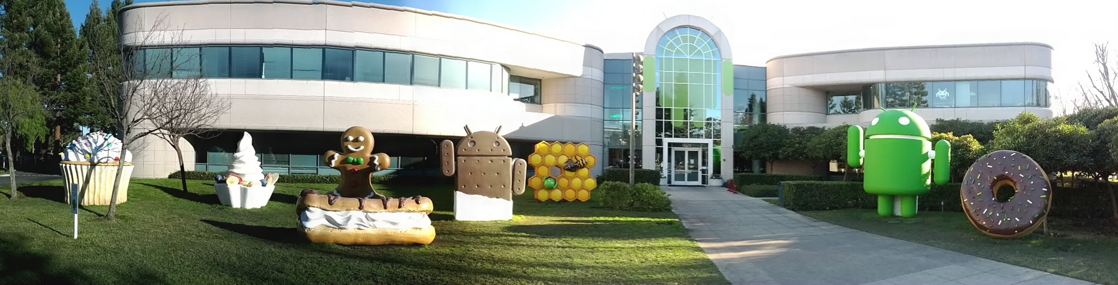
Android
Android is a software stack for mobile devices that includes an operating system, middleware and key applications.
The Android SDK provides the tools and APIs necessary to begin developing applications on the Android platform using the Java programming language.

Slide 26
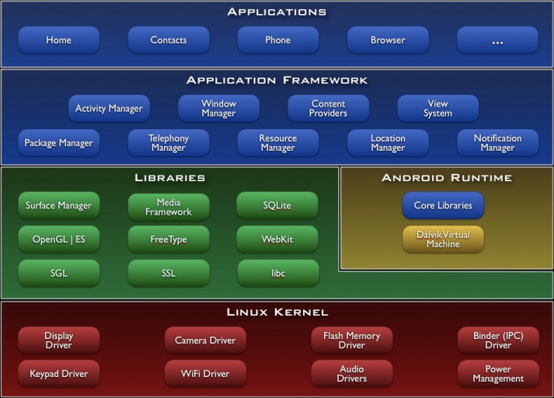
Android Architecture

Slide 27
Android Programming
Using the Android APIs and implementing your logic
Android expects programmers to write their code in the “Android way”.
  You need to implement application building blocks defined by Android.
  Your logic will be largely event-driven: reaction to something happened, e.g., a button touch, a received message, etc.
A lot of the times, you’ll struggle with the APIs.
It’s necessary to learn how to navigate the API documents and how to quickly find the APIs yourself!
One of the goals of this course
  It’s a necessary skill to learn for any other programming you will do in the future.

Slide 28
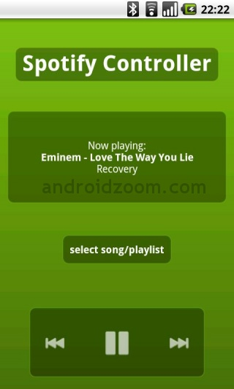
Application Building Blocks
Activities: an activity is a single screen with a user interface.
  Subclass of android.app.Activity

Slide 29
Application Building Blocks
Services: a service runs in the background with no UI for long-running operations.
  Playing music, sending/receiving network messages, …
  Subclass of android.app.Service
Content providers: a content provider manages a shared set of application data.
  Provides a customized storage beyond what Android provides (e.g., contacts, calendar, …)
  Subclass of android.content.ContentProvider
Broadcast receivers: a broadcast receiver responds to system-wide broadcast announcements.
  Screen off, battery low, picture captured, …
  Subclass of android.content.BroadcastReceiver

Slide 30
Communication
Intent: building blocks communicate through it.
  android.content.Intent
Intent
public class PlayService extends Service {
….
}

Slide 31
Application Registration
AndroidManifest.xml file (the "manifest" file) defines a number of things about the application. Mainly,
  Components (activity, service, etc.)
  Permission
  Letting the system know about the application
<?xml version="1.0" encoding="utf-8"?>
<manifest ... >
<application android:icon="@drawable/app_icon.png" ... >
<activity android:name="com.example.project.ExampleActivity"
android:label="@string/example_label" ... >
</activity>
...
</application>
</manifest>

Slide 32
Project 0
A simple messenger program
  Two android devices (emulators) sending messages to each other
  Official project description will be out today.
Step 1: Installation (Eclipse & Android SDK)
  Use 4.0.3 (API 15)
Step 2: Android Dev Guide
  http://developer.android.com/guide/index.html
  Read “Android Basics”
  Read “Actitivies” & “Services” under “Framework Topics”
Step 3: Tutorials from Android Developers
  Minimum: HelloWorld & HelloViews
Step 4: Messenger

Slide 33
Project 0
Messenger
  A user of one device should be able to write a message to the other device.
  The other device should be able to display what was received.
  And vice versa.
  You need to use the socket API (PF_INET & SOCK_STREAM, i.e., TCP).
Design document
  What components you designed and what they do
  Difficulties you faced (what things took time to figure out, …)
  (Rough) # of hours you put

Slide 34
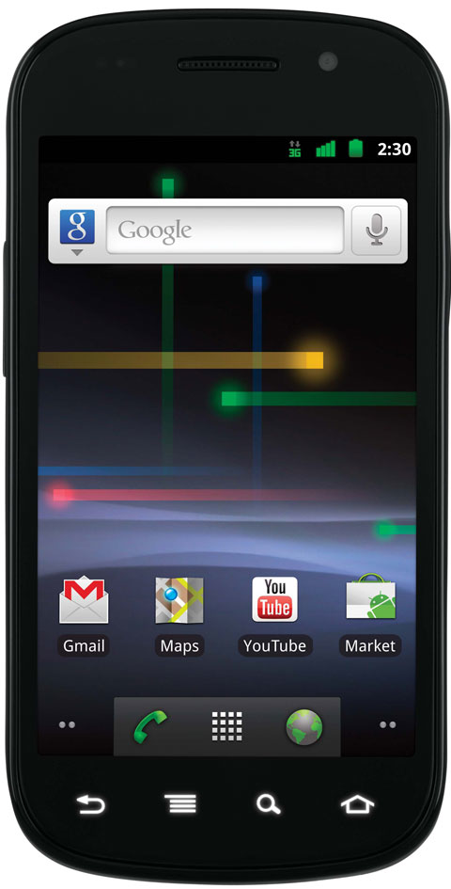
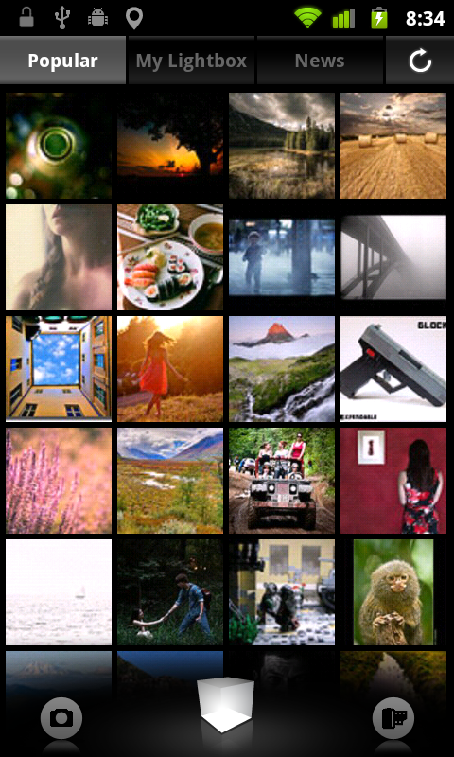
Brief Overview: Project 1 ~ Project 3
Distributed key-value store on Android in 3 steps
A stripped-down version of Amazon’s Dynamo, a backend storage for Amazon’s services
Key: vacation_photo, Value: vacation.jpg

Slide 35
Acknowledgements
These slides contain material developed and copyrighted by
  Indranil Gupta at UIUC
  Mike Freedman and Jen Rexford at Princeton

