Slide 1
CSE 486/586 Distributed Systems Graph Processing
Steve Ko
Computer Sciences and Engineering
University at Buffalo

Slide 2
Recap
Byzantine generals problem
They must decide on a common plan of action.
But, some of the generals can be traitors.
Requirements
All loyal generals decide upon the same plan of action (e.g., attack or retreat).
A small number of traitors cannot cause the loyal generals to adopt a bad plan.
Impossibility result
In general, with less than 3f + 1 nodes, we cannot tolerate f faulty nodes.

Slide 3
Today
Distributed Graph Processing
Google’s Pregel system
Inspiration for many newer graph processing systems: Piccolo, Giraph, GraphLab, PowerGraph, LFGraph, X-Stream, etc.

Slide 4
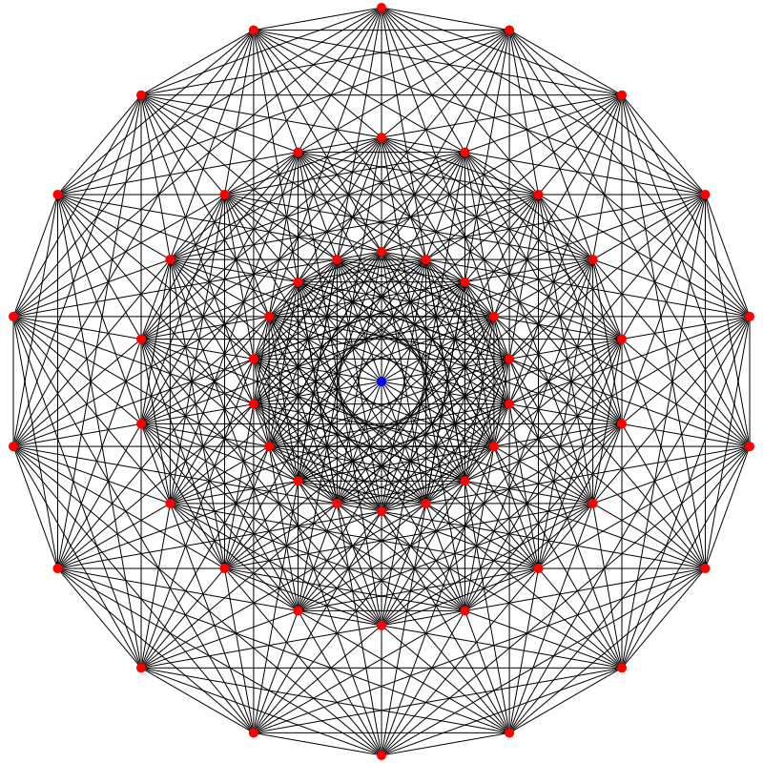
What Graphs?
Large graphs are all around us
Internet Graph: vertices are routers/switches and edges are links
World Wide Web: vertices are webpages, and edges are URL links on a webpage pointing to another webpage
Called “Directed” graph as edges are uni-directional
Social graphs: Facebook, Twitter, LinkedIn
Biological graphs: DNA interaction graphs, ecosystem graphs, etc.

Slide 5
What Graph Analysis?
Need to derive properties from these graphs
Need to summarize these graphs into statistics
E.g., find shortest paths between pairs of vertices
Internet (for routing)
LinkedIn (degrees of separation)
E.g., do matching
Dating graphs in match.com (for better dates)
PageRank
Web Graphs
Google search, Bing search, Yahoo search: all rely on this
And many (many) other examples!

Slide 6
What Are the Difficulties?
Large!
Human social network has 100s Millions of vertices and Billions of edges
WWW has Millions of vertices and edges
Hard to store the entire graph on one server and process it
Slow on one server (even if beefy!)
Need a distributed solution

Slide 7
Example
Are C and D connected?
Can we get all connected pairs?
C
B
A
D
E
Notes:
What are some of the algorithms that give us the answers to these questions?
People have been doing these kinds of graph processing for a long time. And they discovered a common pattern for graph processing (next slide).

Slide 8
Typical Graph Processing
B
C
A
D
Works in iterations
Each vertex assigned a value
In each iteration, each vertex:
Gathers values from its immediate neighbors (vertices who join it directly with an edge). E.g., @A: B→A, C→A, D→A,…
Does some computation using its own value and its neighbors values.
Updates its new value and sends it out to its neighboring vertices. E.g., A→B, C, D, E
Graph processing terminates after: i) fixed iterations, or ii) vertices stop changing values
E
Notes:
Pretty much any graph processing algorithm can be solved this way. Any algorithm can be cast to this model.
Now the question we want to ask is, can we design a system that supports this model naturally?

Slide 9
Example
Are C and D connected?
C
B
A
D
E
Notes:
Can we solve this problem using the common model in the previous slide?

Slide 10
One Possible Way
Each vertex has two Boolean variables.
Cflag: true/false
Dflag: true/false
Goal
Cflag: Am I connected to C?
Dflag: Am I connected to D?
If both are true at any of the vertices, C and D are connected.
Initially all false, except at C and D.
Every iteration:
Propagates its values to neighboring vertices.
Collects the values from other vertices.
Updates the variables with OR, i.e., if any one of the values is true, it’s true.
Iterate N times, where N is the length of the longest path in the entire graph.
Notes:
Once again, the question we want to ask is, can we design a system that supports this model naturally?
It should work in a distributed fashion, since the data is too much to store in one server.
At least for me, whenever I think of a distributed solution, I think of MapReduce. So let’s see if that works first.

Slide 11
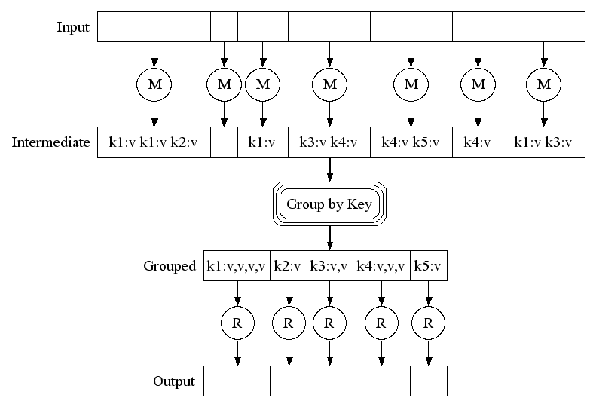
Recall MapReduce?
Map phase
Shuffle phase
Reduce phase

Slide 12
Can We Use MapReduce?
Run MapReduce N times, where N is the length of the longest path. Goal for each iteration:
Propagate each vertex’s Cflag & Dflag values to their neighboring vertices.
Collect Cflag & Dflag values from other vertices.
Update each of the Cflag & Dflag variables with OR, i.e., if any one of the values is true, it’s true.
Map
Input (key, value)? Computation? Output list of (intermediate key, intermediate value)?
Shuffle: Grouping based on intermediate keys.
Each intermediate key will get a list of intermediate values.
Reduce
Input (intermediate key, list of intermediate values)? Computation? Output (final key, final value)?
Notes:
This might be a bit difficult question to ask, but let’s try.

Slide 13
MapReduce
Run MapReduce N times
Map
Input (key, value): (vertex id, (current Cflag & Dflag values))
Computation: nothing.
Output list of (intermediate key, intermediate value): list of (neighboring vertex id, current Cflag & Dflag values)
For each neighboring vertex, propagate Cflag & Dflag values
Shuffle
Grouping based on vertex ids.
Reduce
Input (intermediate key, intermediate value): (vertex id, list of neighbors’ current Cflag & Dflag values)
Computation: OR
Output (key, value): (vertex id, updated Cflag & Dflag values)
Notes:
Map does it for each vertex.
Reduce’s focus is now shifted from a vertex of Map to one of its neighboring vertices.
But the question is, do you want to do this?
Can we design something else that’s more natural?

Slide 14
Pros and Cons
Pros
Well-known
The system is there.
It works.
Cons
Not quite a good fit
Need to re-think in terms of keys, values, maps, and reduces.
Question
Can we provide a system that is a better fit for graph processing?
Notes:
How about other things? Plain C++/Java? Not quite good fits either.

Slide 15
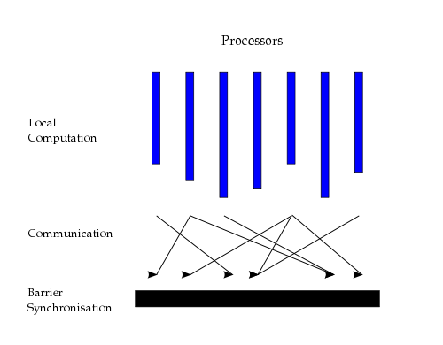
Bulk Synchronous Parallel Model
Originally by Valiant (1990)

Slide 16
Better Programming Model
Vertex-centric programming
In each iteration, each vertex performs Gather-Apply-Scatter for all its assigned vertices
Gather: get all neighboring vertices’ values
Apply: compute own new value from own old value and gathered neighbors’ values
Scatter: send own new value to neighboring vertices

Slide 17
Google Pregel
Gives simple APIs for easier graph processing
Vertex-centric programming
Developer’s code subclasses Vertex class
Implements Compute() method.
Vertex class allows a developer to:
Get/set vertex values
Get/set outgoing edge values (e.g., for weighted graphs)
Send/receive messages to any vertex
Gather-apply-scatter
Gather is done automatically (with scatter from the previous iteration)
Apply is done by Compute()
Scatter is done by explicit message passing
Notes:
This is really about vertices. A developer needs to think what a vertex needs to do and what messages it should propagate to other vertices.

Slide 18
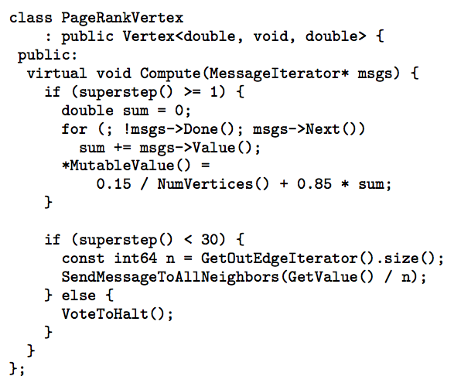
Page Rank Example
Notes:
These examples are not meant to be understood line-by-line. Just to show how short a graph processing algorithm can be.

Slide 19
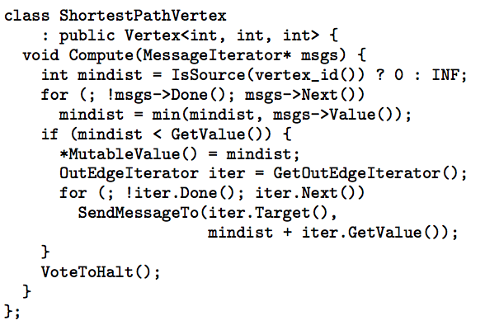
Shortest Path Example

Slide 20
Google Pregel
Pregel uses the master/worker model
Master (one server)
Maintains list of worker servers
Monitors workers; restarts them on failure
Provides Web-UI monitoring tool of job progress
Worker (rest of the servers)
Processes its vertices
Communicates with the other workers
Naturally captures a graph structure (vertex per worker)
Persistent data is stored as files on a distributed storage system (such as GFS or BigTable)
Temporary data is stored on local disk

Slide 21
Pregel Execution
Many copies of the program begin executing on a cluster
The master assigns a partition of input (vertices) to each worker
Each worker loads the vertices and marks them as active
The master instructs each worker to perform a iteration
Each worker loops through its active vertices & computes for each vertex
Messages can be sent whenever, but need to be delivered before the end of the iteration (i.e., the barrier)
When all workers reach iteration barrier, master starts next iteration
Computation halts when, in some iteration: no vertices are active and when no messages are in transit
Master instructs each worker to save its portion of the graph

Slide 22
Summary
Lots of (large) graphs around us
Need to process these
MapReduce not a good match
Distributed Graph Processing systems: Pregel by Google

Slide 23
Acknowledgements
These slides contain material developed and copyrighted by Indranil Gupta (UIUC).

