Slide 1
CSE 486/586 Distributed Systems Global States
Steve Ko
Computer Sciences and Engineering
University at Buffalo

Slide 2
Last Time
Ordering of events
Many applications need it, e.g., collaborative editing, distributed storage, etc.
Logical time
Lamport clock: single counter
Vector clock: one counter per process
Happens-before relation shows causality of events
Today: An important algorithm related to the discussion of time

Slide 3
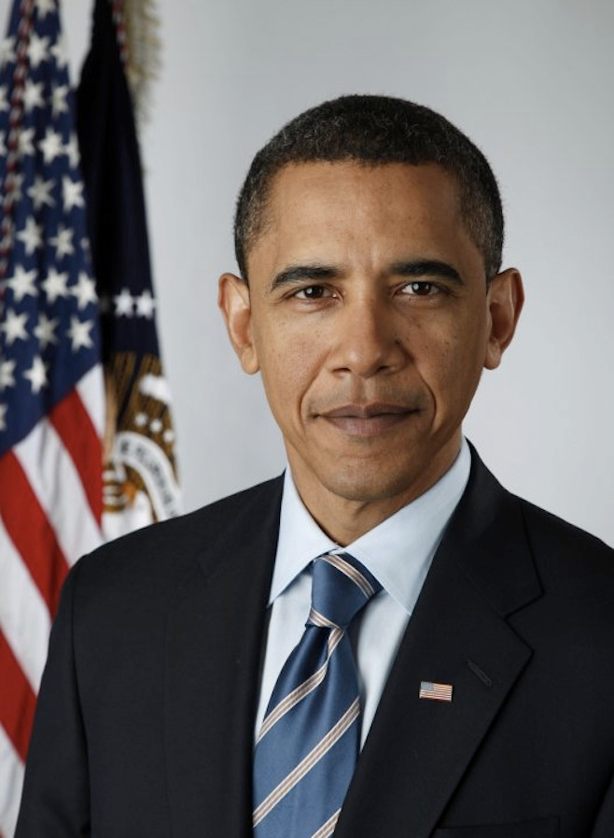
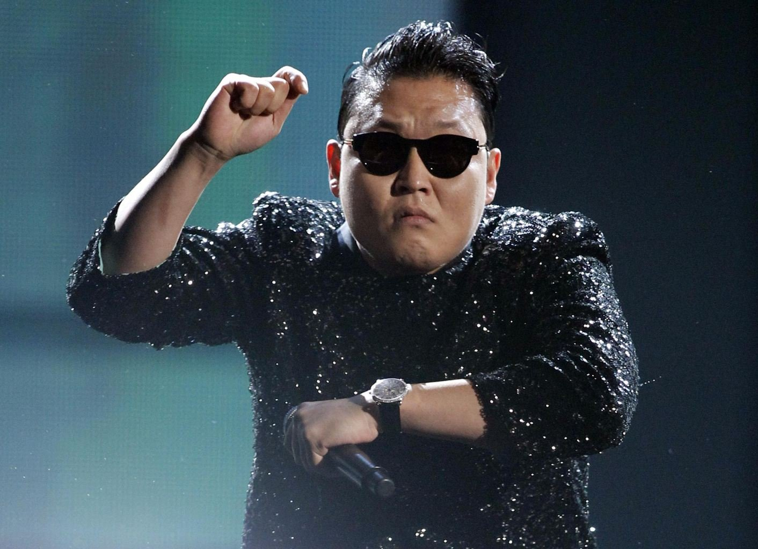
Today’s Question
Example question: who has the most friends on Facebook?
Challenges to answering this question?
It changes!
What do we need?
A snapshot of the social network graph at a particular time

Slide 4
Today’s Question
Distributed debugging
How do you debug this?
Log in to one machine and see what happens
Collect logs and see what happens
Taking a global snapshot!
P0
P1
P2
Both waiting…
Deadlock!

Slide 5
What is a Snapshot?
Single process snapshot
Just a snapshot of the local state, e.g., memory dump, stack trace, etc.
Multi-process snapshot
Snapshots of all process states
Network snapshot: All messages in the network

Slide 6
What Do We Want?
A “cut”
e₁⁰
e₁¹
e₁²
e₁³
P1
e₂¹
P2
e₂⁰
e₂²
P3
e₃⁰
e₃¹
e₃²
Would you say this is a good snapshot?
“Good”: we can explain all the causality, including messages
No because e₂¹ might have been caused by e₃¹.
Three things we want.
Per-process state
Messages that are causally related to each and every local snapshot and in flight
All events that happened before each event in the snapshot

Slide 7
Obvious First Try
Synchronize clocks of all processes
Ask all processes to record their states at known time t
Problems?
Time synchronization possible only approximately
Another issue?
Does not record the state of messages in the channels
Again: synchronization not required – causality is enough!
What we need: logical global snapshot
The state of each process
Messages in transit in all communication channels
P0
P1
P2
msg

Slide 8
How to Do It? Definitions
e₁⁰
e₁¹
e₁²
e₁³
P1
e₂¹
P2
e₂⁰
e₂²
P3
e₃⁰
e₃¹
e₃²
For a process P_{i} , where events e_{i}⁰, e_{i}¹, … occur,
history(P_{i}) = h_{i} = <e_{i}⁰, e_{i}¹, … >
prefix history(P_{i}^{k}) = h_{i}^{k} = <e_{i}⁰, e_{i}¹, …,e_{i}^{k} >
S_{i}^{k} : P_{i} ’s state immediately after k^{th} event
For a set of processes P₁ , …,P_{i} , …. :
Global history: H = ∪_{i} (h_{i})
Global state: S = ∪_{i} (S_{i}^{k}i)
A cut C ⊆ H = h₁^{c1} ∪ h₂^{c2} ∪ … ∪ h_{n}^{cn}
The frontier of C = {e_{i}^{ci}, i = 1,2, … n}

Slide 9
Consistent States
A cut C is consistent if and only if
∀_{e ∈ C} (if f → e then f ∈ C)
A global state S is consistent if and only if
it corresponds to a consistent cut
e₁⁰
e₁¹
e₁²
e₁³
P1
e₂¹
P2
e₂⁰
e₂²
P3
e₃⁰
e₃¹
e₃²
Inconsistent cut
Consistent cut

Slide 10
Why Consistent States?
#1: For each event, you can trace back the causality.
#2: Back to the state machine (from the last lecture)
The execution of a distributed system as a series of transitions between global states: S0 → S1 → S2 → …
…where each transition happens with one single action from a process (i.e., local process event, send, and receive)
Each state (S0, S1, S2, …) is a consistent state.

Slide 11
CSE 486/586 Administrivia
PA2-A deadline: This Friday
Please come and ask questions during office hours.

Slide 12
The Snapshot Algorithm: Assumptions
There is a communication channel between each pair of processes (@each process: N-1 in and N-1 out)
Communication channels are unidirectional and FIFO-ordered (important point)
No failure, all messages arrive intact, exactly once
Any process may initiate the snapshot
Snapshot does not interfere with normal execution
Each process is able to record its state and the state of its incoming channels (no central collection)

Slide 13
Single Process vs. Multiple Processes
Single process snapshot
Just a snapshot of the local state, e.g., memory dump, stack trace, etc.
Multi-process snapshot
Snapshots of all process states
Network snapshot: All messages in the network
Two questions:
#1: When to take a local snapshot at each process so that the collection of them can form a consistent global state? (Process snapshot)
#2: How to capture messages in flight? (Network snapshot)

Slide 14
The Snapshot Algorithm
Clock-synced snapshot (instantaneous snapshot)
Process snapshots and network messages at time t
Need to capture:
Local snapshots of P1 & P2
Messages in the network (message a, since message a is causally related to P2’s snapshot)
We can’t quite do it due to (i) imperfect clock sync and (ii) no help from the network.
P1
a
b
P2

Slide 15
The Snapshot Algorithm
Logical snapshot (not instantaneous)
Goal: capturing causality (events and messages)
A process tells others to take a snapshot by sending a message (see the diagram). But there’s a delay in doing so.
Need to capture all network messages during the delay (not at an instantaneous moment)
We need to capture:
Local snapshots of P1 & P2 (same as before but now at two different times).
Messages in flight that are causally related to each and every local snapshot, e.g., messages a and b for P2’s snapshot.
How?
P1
M
b
a
P2
Notes:
If P1 & P2 take a snapshot at the same time, then the only message causally related to the P2’s local snapshot is message a.
Since the send event for message b is included in P2’s snapshot, we need to capture message b as well (for message causality). In other words, if P2 takes a snapshot at a different time, then there can be messages created by events (between P1’s snapshot time and P2’s snapshot time) included in P2’s snapshot.

Slide 16
The Snapshot Algorithm
P1 needs to record all causally-related messages.
All the messages already in the network.
All the messages sent during the delay.
For messages already in the network,
P1 starts recording as soon as it sends a marker, since the messages already in the network will arrive to P1 eventually.
For messages sent during the delay,
P2 sends a marker again to tell P1 that a local snapshot has been taken. This marks the end of the delay.
FIFO ensure that the marker is the last message received.
P1
M
b
a
M
P2

Slide 17
The Snapshot Algorithm
Basic idea: marker broadcast & recording
The initiator broadcasts a “marker” message to everyone else
If a process receives a marker for the first time, it takes a local snapshot, starts recording all incoming messages, and broadcasts a marker again to everyone else.
A process stops recording for each channel, when it receives a marker for that channel.
P1
M
M
M
M
a
P2
M
M
b
P3

Slide 18
The Snapshot Algorithm
1. Marker sending rule for initiator process P₀
After P₀ has recorded its own state
for each outgoing channel C, send a marker message on C
2. Marker receiving rule for a process P_{k}
on receipt of a marker over channel C
if P_{k} has not yet recorded its own state
record P_{k}’s own state
record the state of C as “empty”
for each outgoing channel C, send a marker on C
turn on recording of messages over other incoming channels
else
record the state of C as all the messages received over C since P_{k} saved its own state; stop recording state of C

Slide 19
Chandy and Lamport’s Snapshot
Marker receiving rule for process p_{i}
On p_{i}’s receipt of a marker message over channel c:
if (p_{i} has not yet recorded its state) it
records its process state now;
records the state of c as the empty set;
turns on recording of messages arriving over other incoming channels;
else
p_{i} records the state of c as the set of messages it has received over c
since it saved its state.
end if
Marker sending rule for process p_{i}
After p_{i} has recorded its state, for each outgoing channel c:
p_{i} sends one marker message over c
(before it sends any other message over c).

Slide 20
Exercise
e₁⁰
e₁^{1,2}
e₁³
e₁⁴
e₁³
P1
M
M
a
M
e₂³
e₂⁴
M
P2
e₂⁰
e₂^{1,2,3}
M
M
b
P3
e₃⁰
e₃^{2,3,4}
e₃¹
1- P1 initiates snapshot: records its state (S1); sends Markers to P2 & P3; turns on recording for channels C21 and C31
2- P2 receives Marker over C12, records its state (S2), sets state(C12) = {} sends Marker to P1 & P3; turns on recording for channel C32
3- P1 receives Marker over C21, sets state(C21) = {a}
4- P3 receives Marker over C13, records its state (S3), sets state(C13) = {} sends Marker to P1 & P2; turns on recording for channel C23
5- P2 receives Marker over C32, sets state(C32) = {b}
6- P3 receives Marker over C23, sets state(C23) = {}
7- P1 receives Marker over C31, sets state(C31) = {}

Slide 21
One Provable Property
The snapshot algorithm gives a consistent cut
Meaning,
Suppose e_{i} is an event in P_{i}, and e_{j} is an event in P_{j}
If e_{i} → e_{j}, and e_{j} is in the cut, then e_{i} is also in the cut.
Proof sketch: proof by contradiction
Suppose e_{j} is in the cut, but e_{i} is not.
Since e_{i} → e_{j,} there must be a sequence M of messages that leads to the relation.
Since e_{i} is not in the cut (our assumption), a marker should’ve been sent before e_{i}, and also before all of M.
Then P_{j} must’ve recorded a state before e_{j}, meaning, e_{j} is not in the cut. (Contradiction)

Slide 22
Summary
Global states
A union of all process states
Consistent global state vs. inconsistent global state
The “snapshot” algorithm
Take a snapshot of the local state
Broadcast a “marker” msg to tell other processes to record
Start recording all msgs coming in for each channel until receiving a “marker”
Outcome: a consistent global state

Slide 23
Acknowledgements
These slides contain material developed and copyrighted by Indranil Gupta at UIUC.

