Slide 1
CSE 486/586 Distributed Systems Mid-Semester Overview
Steve Ko
Computer Sciences and Engineering
University at Buffalo

Slide 2
We’re at a Mid-Point: What We’ve Discussed So Far
Main communication infrastructure: the Internet
Communication between two processes
Socket API
Failure detection
Concept of time in distributed systems
Communication between multiple processes
Multicast algorithms
Organization of distributed systems
Server-client
Peer-to-peer, DHTs
Impossibility of consensus

Slide 3
The Other Half of the Semester
Consensus algorithms: mutual exclusion, leader election, paxos
Distributed storage basics: transactions and consistency
Distributed storage case studies: Amazon Dynamo, NFS, Facebook Haystack, Facebook f4
Remote procedure call
Security
BFT (Byzantine Fault Tolerance)

Slide 4
CSE 486/586 Administrivia
Midterm: 3/15 (Wednesday) in class
Everything up to the last lecture
1-page cheat sheet is allowed.
Blue or black ink pen
Best way to prepare
Read the textbook & go over the slides.
Go over the previous exams.
PA2-B due this Friday
Please remember that we’ll be running code similarity checkers (automatic F if found too similar).

Slide 5
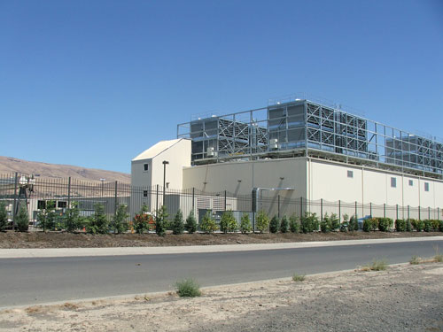
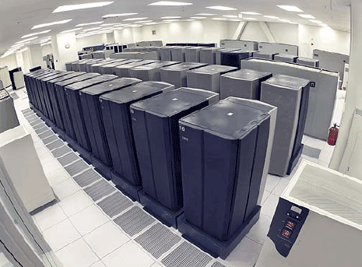
Data Centers
Buildings full of machines

Slide 6
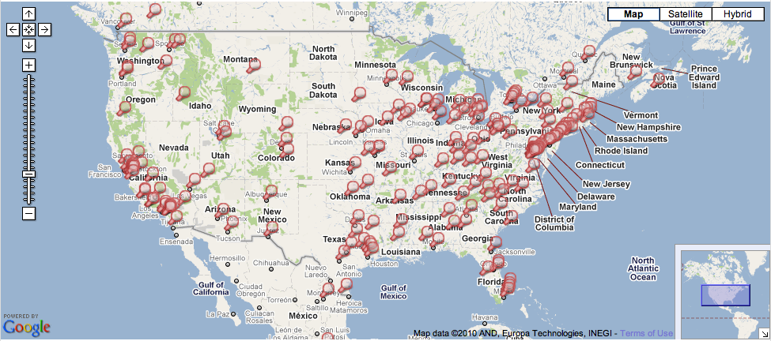
Data Centers
Hundreds of Locations in the US

Slide 7
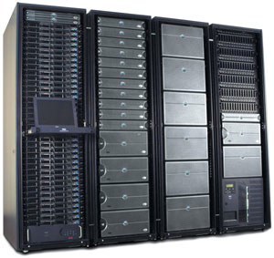
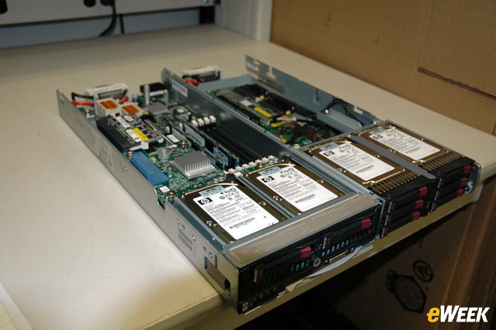
Inside
Servers in racks
Usually ~40 blades per rack
ToR (Top-of-Rack) switch
Incredible amounts of engineering efforts
Power, cooling, etc.

Slide 8
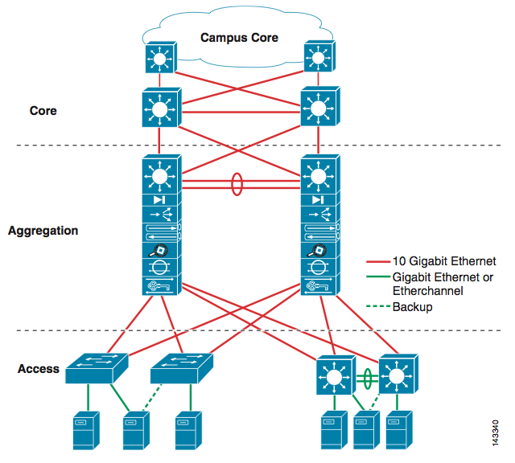
Inside
Network

Slide 9
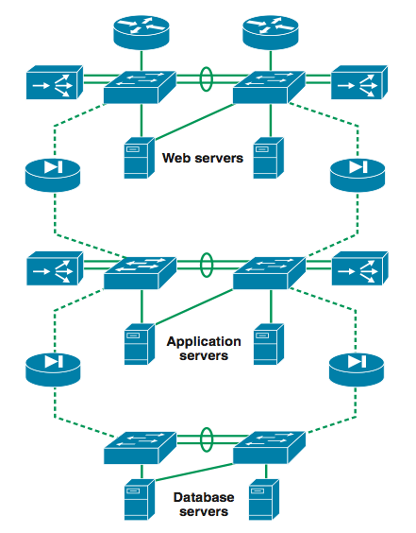
Inside
3-tier for Web services

Slide 10
Web Services
Amazon, Facebook, Google, Twitter, etc.
World-wide distribution of data centers
Load balance, fault tolerance, performance, etc.
Replicated service & data
Each data center might be a complete stand-alone web service. (It depends though.)
At the bare minimum, you’re doing read/write.
What needs to be done when you issue a read req?
Server selection
What needs to be done when you issue a write req?
Server selection
Replicated data store management

Slide 11
Server Selection Primer
Can happen at multiple places
Server resolution process: DNS -> External IP -> Internal IP
DNS
www.facebook.com
69.63.181.11
69.63.181.12
North Carolina
www.facebook.com
69.63.187.17
69.63.187.18
69.63.187.19
California

Slide 12
IP Anycast
BGP (Border Gateway Protocol) level
Hey, I know where 69.63.187.17 is…
in New York
Hey, I know where 69.63.187.17 is…
in California

Slide 13
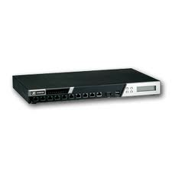
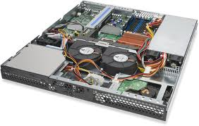
Inside
Load balancers
69.63.176.13
10.0.0.1
10.0.0.2
10.0.0.200
Web Servers

Slide 14
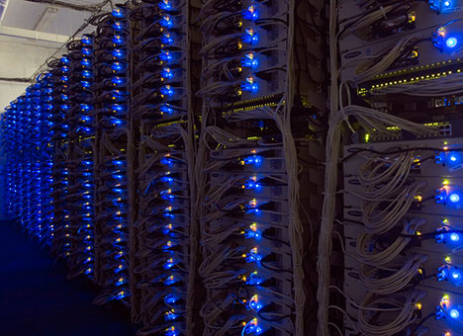
Example: Facebook
www.facebook.com
69.63.176.13
69.63.176.14
Oregon
69.63.181.11
69.63.181.12
North Carolina
69.63.187.17
69.63.187.18
69.63.187.19
California

Slide 15
Example: Facebook Geo-Replication
(At least in 2008) Lazy primary-backup replication
All writes go to California, then get propagated.
Reads can go anywhere (probably to the closest one).
Ensure (probably sequential) consistency through timestamps
Set a browser cookie when there’s a write
If within the last 20 seconds, reads go to California.
http://www.facebook.com/note.php?note_id=23844338919

Slide 16
Core Issue: Handling Replication
Replication is (almost) inevitable.
Failures, performance, load balance, etc.
We will spend most of our time looking at this in the second half of the semester.
Data replication
Read/write can go to any server.
How to provide a consistent view? (i.e., what consistency guarantee?) linearizability, sequential consistency, causal consistency, etc.
What happens when things go wrong?
State machine replication
How to agree on the instructions to execute?
How to handle failures and malicious servers?

Slide 17
Acknowledgements
These slides contain material developed and copyrighted by Indranil Gupta (UIUC).

