Slide 1
CSE 486/586 Distributed Systems Global States
Steve Ko
Computer Sciences and Engineering
University at Buffalo

Slide 2
Last Time
Ordering of events
Many applications need it, e.g., collaborative editing, distributed storage, etc.
Logical time
Lamport clock: single counter
Vector clock: one counter per process
Happens-before relation shows causality of events

Slide 3
Today’s Topic
Global snapshots
An “application” of logical time
Today’s topic will deepen your understanding about causality and the abstract view of distributed systems.

Slide 4
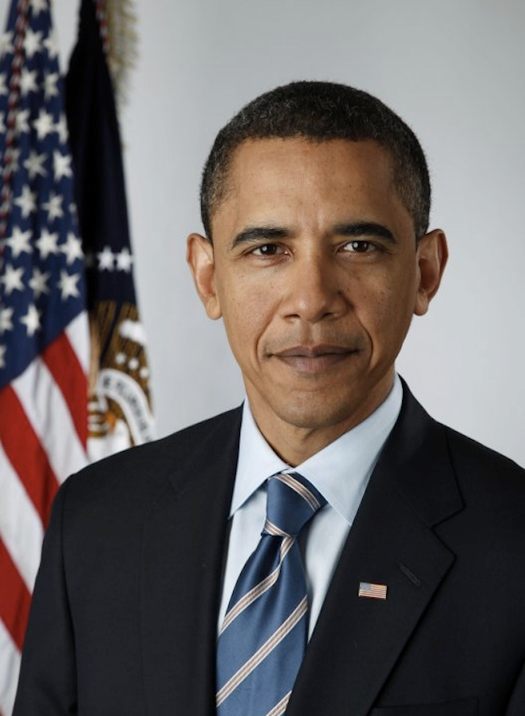
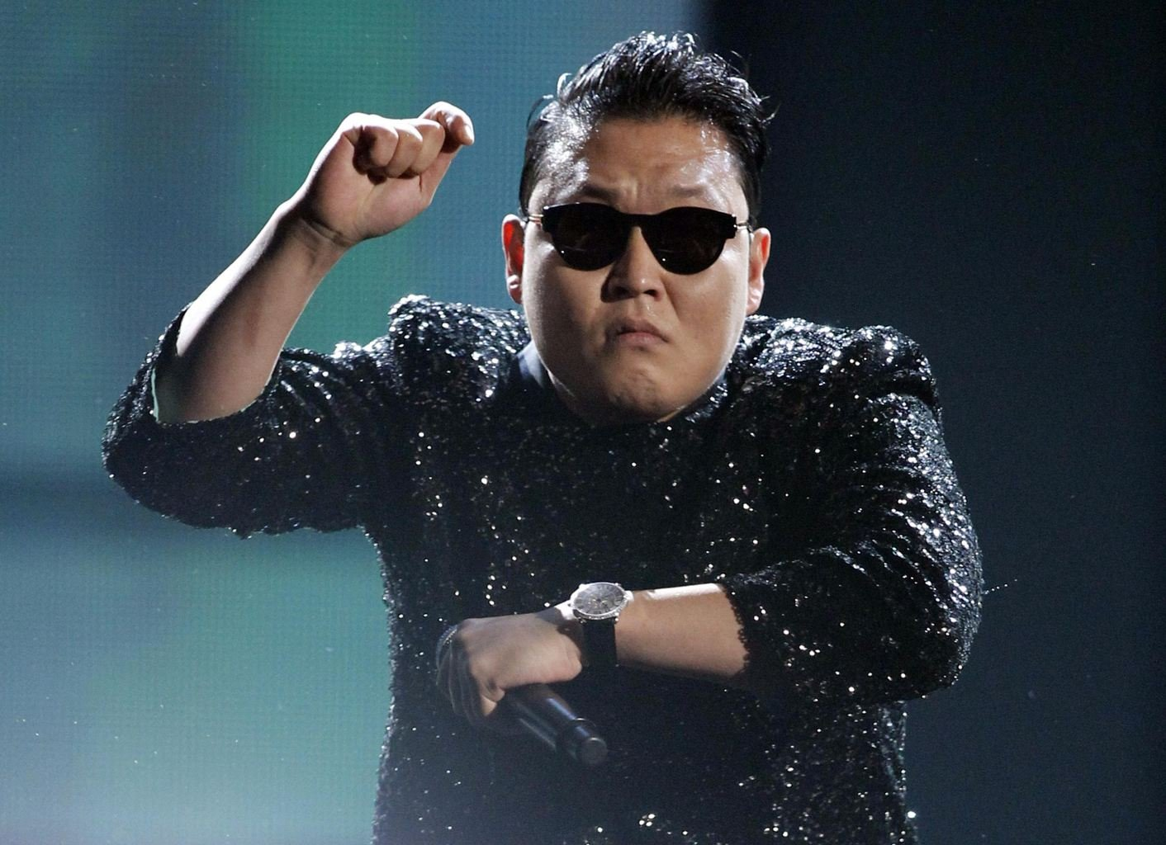
Today’s Question
Example question: who has the most friends on Facebook?
Challenges to answering this question?
It changes!
What do we need?
A snapshot of the social network graph at a particular time

Slide 5
Today’s Question
Distributed debugging
How do you debug this?
Log in to one machine and see what happens
Collect logs and see what happens
Taking a global snapshot!
P0
P1
P2
Both waiting…
Deadlock!

Slide 6
What is a Snapshot?
Single process snapshot
Just a snapshot of the local state, e.g., memory dump, stack trace, etc.
For the sake of this lecture, let’s say a log of events.
When we capture a snapshot, we want to be able to trace the causality (e.g., important for debugging).
Let’s say we’re logging all events.
The above snapshot (a dump of log messages) will include e₁⁰ and e₁¹. This allows us to trace the causality of events.
How to do this for a multiple processes?
snapshot
e₁⁰
e₁¹
e₁²
e₁³
P1

Slide 7
Ideal: Instantaneous Snapshot
Process snapshots and network messages at time t
The most general multi-process snapshot that can explain all causality
Causality across processes
Messages caused by send events
But we can’t quite do it due to imperfect clock sync.
We do it thru logical snapshots.
e₁⁰
e₁¹
e₁²
e₁³
P1
e₂¹
P2
e₂⁰
e₂²
P3
e₃⁰
e₃¹
e₃²

Slide 8
How to Do It? Definitions
A cut
e₁⁰
e₁¹
e₁²
e₁³
P1
e₂¹
P2
e₂⁰
e₂²
P3
e₃⁰
e₃¹
e₃²
For a process P_{i} , where events e_{i}⁰, e_{i}¹, … occur,
history(P_{i}) = h_{i} = <e_{i}⁰, e_{i}¹, … >
prefix history(P_{i}^{k}) = h_{i}^{k} = <e_{i}⁰, e_{i}¹, …,e_{i}^{k} >
S_{i}^{k} : P_{i} ’s state immediately after k^{th} event
For a set of processes P₁ , …,P_{i} , …. :
Global history: H = ∪_{i} (h_{i})
Global state: S = ∪_{i} (S_{i}^{k}i)
A cut C ⊆ H = h₁^{c1} ∪ h₂^{c2} ∪ … ∪ h_{n}^{cn}
The frontier of C = {e_{i}^{ci}, i = 1,2, … n}

Slide 9
Consistent States
A cut C is consistent if and only if
∀_{e ∈ C} (if f → e then f ∈ C)
A global state S is consistent if and only if
it corresponds to a consistent cut
e₁⁰
e₁¹
e₁²
e₁³
P1
e₂¹
P2
e₂⁰
e₂²
P3
e₃⁰
e₃¹
e₃²
Inconsistent cut
Consistent cut

Slide 10
CSE 486/586 Administrivia
PA2-A deadline: This Friday
PA1: some hiccups, getting delayed
Please come and ask questions during office hours.

Slide 11
The Snapshot Algorithm: Assumptions
There is a communication channel between each pair of processes (@each process: N-1 in and N-1 out)
Communication channels are unidirectional and FIFO-ordered (important point)
No failure, all messages arrive intact, exactly once
Any process may initiate the snapshot
Snapshot does not interfere with normal execution
Each process is able to record its state and the state of its incoming channels (no central collection)

Slide 12
Reminder: Clock-Sync’d Snapshot
Instantaneous snapshot
Process snapshots and network messages at time t
We can’t quite do it due to imperfect clock sync.
P1
a
b
P2

Slide 13
Chandy and Lamport’s Snapshot: Basic Idea
Goal: taking a consistent (not instantaneous) global snapshot
Any process can initiate a snapshot-taking process by taking a local snapshot and sending a message called a marker.
Upon receiving a marker, a process takes a local snapshot of its own.
How do we capture network messages?
Insight: messages in flight will eventually arrive.
P1
b
a
M
P2

Slide 14
Chandy and Lamport’s Snapshot: Basic Idea
Each process that has taken a snapshot also starts recording incoming messages
Since those messages were in the network when the snapshot was being taken.
If every process does this, we will capture all messages in flight, recording messages destined to each process.
Note: every process needs to to this for every other process.
Tricky part: the algorithm has a mechanism to stop recording incoming messages at some point.
P1
b
a
M
P2

Slide 15
Chandy and Lamport’s Snapshot: Basic Idea
Reminder: which messages do we want to record?
Messages that were in the network at the time of taking a snapshot
How do we record just those messages?
Insight: we can mark the end of relevant messages.
After taking a local snapshot, each process sends a message saying that it’s done sending all messages relevant to the snapshot.
In fact, we don’t need a different message type, we use the same marker message.
P1
M
b
a
M
P2

Slide 16
Chandy and Lamport’s Snapshot
Marker broadcast & recording
The initiator broadcasts a “marker” message to everyone else
If a process receives a marker for the first time, it takes a local snapshot, starts recording all incoming messages, and broadcasts a marker again to everyone else.
A process stops recording for each channel, when it receives a marker for that channel.
P1
M
M
M
M
a
P2
M
M
b
P3

Slide 17
The Snapshot Algorithm
1. Marker sending rule for initiator process P₀
After P₀ has recorded its own state
for each outgoing channel C, send a marker message on C
2. Marker receiving rule for a process P_{k}
on receipt of a marker over channel C
if P_{k} has not yet recorded its own state
record P_{k}’s own state
record the state of C as “empty”
for each outgoing channel C, send a marker on C
turn on recording of messages over other incoming channels
else
record the state of C as all the messages received over C since P_{k} saved its own state; stop recording state of C

Slide 18
Exercise
e₁⁰
e₁^{1,2}
e₁³
e₁⁴
e₁³
P1
M
M
a
M
e₂³
e₂⁴
M
P2
e₂⁰
e₂^{1,2,3}
M
M
b
P3
e₃⁰
e₃^{2,3,4}
e₃¹
1- P1 initiates snapshot: records its state (S1); sends Markers to P2 & P3; turns on recording for channels C21 and C31
2- P2 receives Marker over C12, records its state (S2), sets state(C12) = {} sends Marker to P1 & P3; turns on recording for channel C32
3- P1 receives Marker over C21, sets state(C21) = {a}
4- P3 receives Marker over C13, records its state (S3), sets state(C13) = {} sends Marker to P1 & P2; turns on recording for channel C23
5- P2 receives Marker over C32, sets state(C32) = {b}
6- P3 receives Marker over C23, sets state(C23) = {}
7- P1 receives Marker over C31, sets state(C31) = {}

Slide 19
One Provable Property
The snapshot algorithm gives a consistent cut
Meaning,
Suppose e_{i} is an event in P_{i}, and e_{j} is an event in P_{j}
If e_{i} → e_{j}, and e_{j} is in the cut, then e_{i} is also in the cut.
Proof sketch: proof by contradiction
Suppose e_{j} is in the cut, but e_{i} is not.
Since e_{i} → e_{j,} there must be a sequence M of messages that leads to the relation.
Since e_{i} is not in the cut (our assumption), a marker should’ve been sent before e_{i}, and also before all of M.
Then P_{j} must’ve recorded a state before e_{j}, meaning, e_{j} is not in the cut. (Contradiction)

Slide 20
Summary
Global states
A union of all process states
Consistent global state vs. inconsistent global state
The “snapshot” algorithm
Take a snapshot of the local state
Broadcast a “marker” msg to tell other processes to record
Start recording all msgs coming in for each channel until receiving a “marker”
Outcome: a consistent global state

Slide 21
Acknowledgements
These slides contain material developed and copyrighted by Indranil Gupta at UIUC.

