Slide 1
CSE 490/590 Computer Architecture Cache I
Steve Ko
Computer Sciences and Engineering
University at Buffalo

Slide 2
Last Time…
Pipelining hazards
Structural hazards
Data hazards
Control hazards
Data hazards
Stall
Bypass
Control hazards
Jump
Conditional branch

Slide 3
Branch Delay Slots (expose control hazard to software)
Change the ISA semantics so that the instruction that follows a jump or branch is always executed
gives compiler the flexibility to put in a useful instruction where normally a pipeline bubble would have resulted.
I₁ 096 ADD
I₂ 100 BEQZ r1 +200
I₃ 104 ADD
I₄ 304 ADD
Delay slot instruction executed regardless of branch outcome
Other techniques include more advanced branch prediction, which can dramatically reduce the branch penalty... to come later

Slide 4
Branch Pipeline Diagrams (branch delay slot)
time
t0 t1 t2 t3 t4 t5 t6 t7 . . . .
(I₁) 096: ADD IF₁ ID₁ EX₁ MA₁ WB₁
(I₂) 100: BEQZ +200 IF₂ ID₂ EX₂ MA₂ WB₂
(I₃) 104: ADD IF₃ ID₃ EX₃ MA₃ WB₃
(I₄) 304: ADD IF₄ ID₄ EX₄ MA₄ WB₄
time
t0 t1 t2 t3 t4 t5 t6 t7 . . . .
IF I₁ I₂ I₃ I₄
ID I₁ I₂ I₃ I₄
EX I₁ I₂ I₃ I₄
MA I₁ I₂ I₃ I₄
WB I₁ I₂ I₃ I₄
Resource
Usage

Slide 5
Why an Instruction may not be dispatched every cycle (CPI>1)
Full bypassing may be too expensive to implement
typically all frequently used paths are provided
some infrequently used bypass paths may increase cycle time and counteract the benefit of reducing CPI
Loads have two-cycle latency
Instruction after load cannot use load result
MIPS-I ISA defined load delay slots, a software-visible pipeline hazard (compiler schedules independent instruction or inserts NOP to avoid hazard). Removed in MIPS-II (pipeline interlocks added in hardware)
MIPS:“Microprocessor without Interlocked Pipeline Stages”
Conditional branches may cause bubbles
kill following instruction(s) if no delay slots

Slide 6
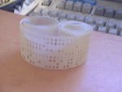
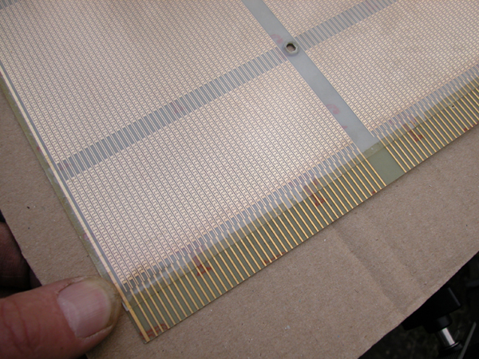
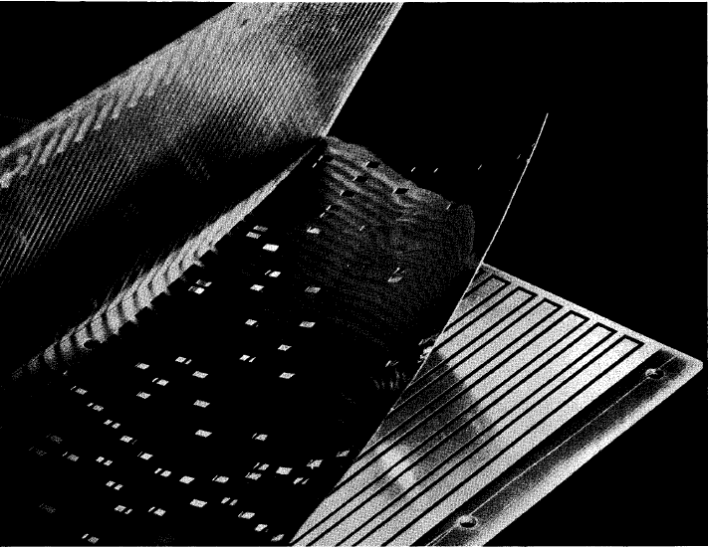
Early Read-Only Memory Technologies
Punched cards, From early 1700s through Jaquard Loom, Babbage, and then IBM
Punched paper tape, instruction stream in Harvard Mk 1
Diode Matrix, EDSAC-2 µcode store
IBM Balanced Capacitor ROS
IBM Card Capacitor ROS

Slide 7
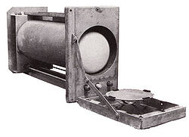
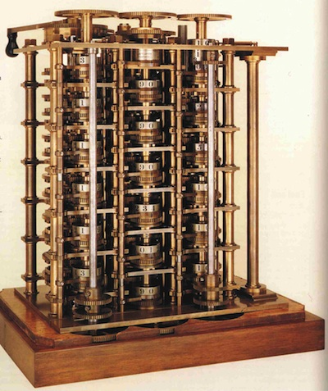
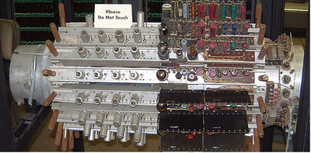
Early Read/Write Main Memory Technologies
Babbage, 1800s: Digits stored on mechanical wheels
Williams Tube, Manchester Mark 1, 1947
Mercury Delay Line, Univac 1, 1951
Also, regenerative capacitor memory on Atanasoff-Berry computer, and rotating magnetic drum memory on IBM 650

Slide 8
Semiconductor Memory
Semiconductor memory began to be competitive in early 1970s
Intel formed to exploit market for semiconductor memory
Early semiconductor memory was Static RAM (SRAM). SRAM cell internals similar to a latch (cross-coupled inverters).
First commercial Dynamic RAM (DRAM) was Intel 1103
1Kbit of storage on single chip
charge on a capacitor used to hold value
Semiconductor memory quickly replaced core in ‘70s

Slide 9
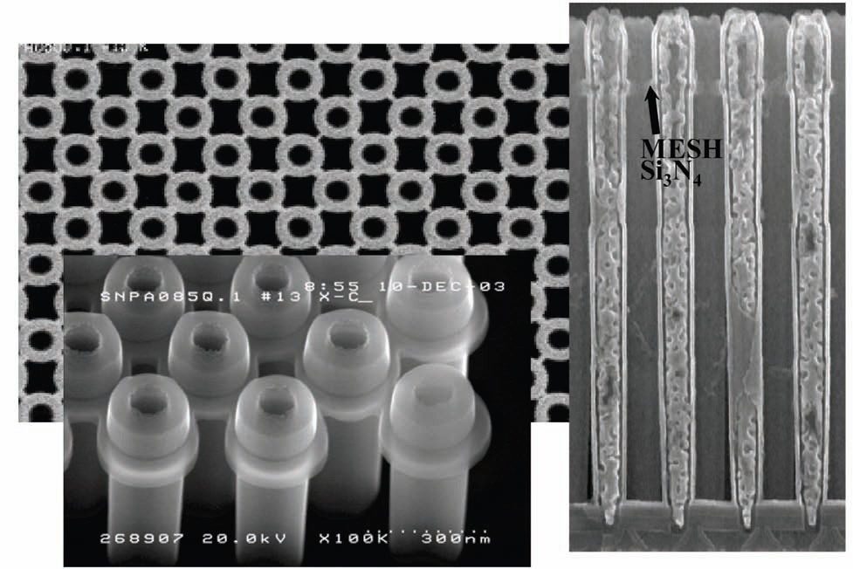
Modern DRAM Structure
[Samsung, sub-70nm DRAM, 2004]

Slide 10
DRAM Architecture
bit lines
Col.
1
Col. 2^{M}
word lines
Row 1
N
Row Address Decoder
Row 2^{N}
Memory cell (one bit)
N+M
M
Column Decoder & Sense Amplifiers
Data
D
Bits stored in 2-dimensional arrays on chip
Modern chips have around 4 logical banks on each chip
each logical bank physically implemented as many smaller arrays

Slide 11
DRAM Operation
Three steps in read/write access to a given bank
Row access (RAS)
decode row address, enable addressed row (often multiple Kb in row)
bitlines share charge with storage cell
small change in voltage detected by sense amplifiers which latch whole row of bits
sense amplifiers drive bitlines full rail to recharge storage cells
Column access (CAS)
decode column address to select small number of sense amplifier latches (4, 8, 16, or 32 bits depending on DRAM package)
on read, send latched bits out to chip pins
on write, change sense amplifier latches which then charge storage cells to required value
can perform multiple column accesses on same row without another row access (burst mode)
Precharge
charges bit lines to known value, required before next row access
Each step has a latency of around 15-20ns in modern DRAMs
Various DRAM standards (DDR, RDRAM) have different ways of encoding the signals for transmission to the DRAM, but all share same core architecture
Notes:
Use RAS/CAS to reduce average latency.

Slide 12
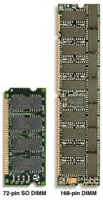
DRAM Packaging
~7
Clock and control signals
DRAM chip
Address lines multiplexed row/column address
~12
Data bus
(4b,8b,16b,32b)
DIMM (Dual Inline Memory Module) contains multiple chips with clock/control/address signals connected in parallel (sometimes need buffers to drive signals to all chips)
Data pins work together to return wide word (e.g., 64-bit data bus using 16x4-bit parts)

Slide 13
CPU-Memory Bottleneck
Memory
CPU
Performance of high-speed computers is usually
limited by memory bandwidth & latency
Latency (time for a single access)
Memory access time >> Processor cycle time
Problematic
Bandwidth (number of accesses per unit time)
Increase the bus size, etc.
Usually OK

Slide 14
Processor-DRAM Gap (latency)
µProc 60%/year
1000
CPU
Processor-Memory
Performance Gap: (grows 50% / year)
100
Performance
10
DRAM
7%/year
DRAM
1
1986
1988
1987
1989
1990
1991
1992
1993
1994
1995
1980
1996
1981
1982
1983
1984
1985
1997
1998
1999
2000
Time
Four-issue 2GHz superscalar accessing 100ns DRAM could execute 800 instructions during time for one memory access!
Notes:
Why doesn’t DRAM get faster?

Slide 15
Physical Size Affects Latency
CPU
Big Memory
CPU
Small Memory
Signals have further to travel
Fan out to more locations

Slide 16
CSE 490/590 Administrivia
Very important to attend
Recitations next week & the week after
Guest lectures
There will be a couple guest lectures late Feb/early Mar.
Quiz 1
Rescheduled
Fri, 2/11
Closed book, in-class
Includes lectures until last Monday (1/31)
Review: next Wed (2/9)

Slide 17
Memory Hierarchy
Big, Slow Memory
(DRAM)
A
Small,
Fast Memory
(RF, SRAM)
B
CPU
holds frequently used data
capacity: Register << SRAM << DRAM why?
latency: Register << SRAM << DRAM why?
bandwidth: on-chip >> off-chip why?
On a data access:
if data ∈ fast memory ⇒ low latency access (SRAM)
If data ∉ fast memory ⇒ long latency access (DRAM)
Notes:
Due to cost
Due to size of DRAM
Due to cost and wire delays (wires on-chip cost much less, and are faster)

Slide 18
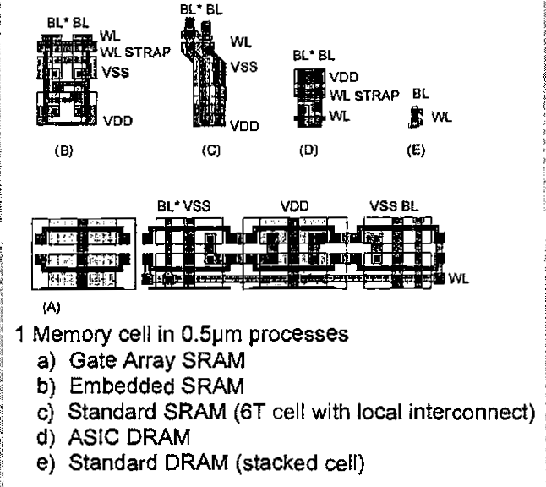
Relative Memory Cell Sizes
On-Chip SRAM in logic chip
DRAM on memory chip
[ Foss, “Implementing Application-Specific Memory”, ISSCC 1996 ]

Slide 19
Levels of the Memory Hierarchy
Capacity
Access Time
Cost
Upper Level
Staging
Xfer Unit
faster
CPU Registers
100s Bytes
<10s ns
Registers
Instr. Operands
prog./compiler
1-8 bytes
Cache
K Bytes
10-100 ns
1-0.1 cents/bit
Cache
Blocks
cache cntl
8-128 bytes
Main Memory
M Bytes
200ns- 500ns
$.0001-.00001 cents /bit
Memory
Pages
OS
512-4K bytes
Disk
G Bytes, 10 ms (10,000,000 ns)
10 - 10 cents/bit
Disk
-5
-6
Files
user/operator
Mbytes
Tape
infinite
sec-min
10
Larger
Tape
Lower Level
-8

Slide 20
Memory Hierarchy: Apple iMac G5
Managed
by compiler
Managed
by hardware
Managed by OS,
hardware,
application
07 | Reg | L1 Inst | L1 Data | L2 | DRAM | Disk
Size | 1K | 64K | 32K | 512K | 256M | 80G
Latency Cycles, Time | 1, 0.6 ns | 3, 1.9 ns | 3, 1.9 ns | 11, 6.9 ns | 88, 55 ns | 10⁷, 12 ms
iMac G5
1.6 GHz
Goal: Illusion of large, fast, cheap memory
Let programs address a memory space that scales to the disk size, at a speed that is usually as fast as register access

Slide 21
Management of Memory Hierarchy
Small/fast storage, e.g., registers
Address usually specified in instruction
Generally implemented directly as a register file
but hardware might do things behind software’s back, e.g., stack management, register renaming
Larger/slower storage, e.g., main memory
Address usually computed from values in register
Generally implemented as a hardware-managed cache hierarchy
hardware decides what is kept in fast memory
but software may provide “hints”, e.g., don’t cache or prefetch
Notes:
Secondary characteristic:
Some machines (PDP-10) have overlain the registers on memory (jse)

Slide 22
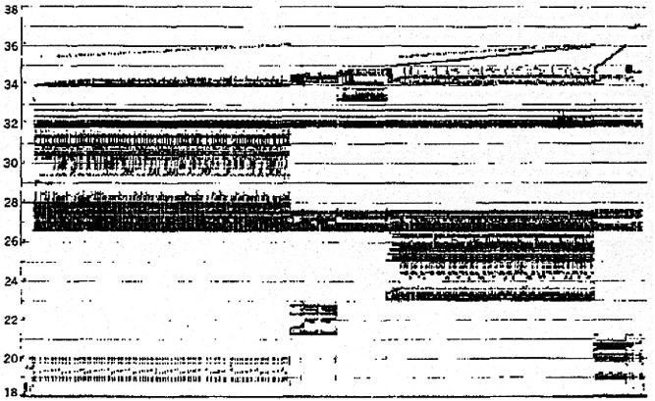
Real Memory Reference Patterns
Memory Address (one dot per access)
Donald J. Hatfield, Jeanette Gerald: Program Restructuring for Virtual Memory. IBM Systems Journal 10(3): 168-192 (1971)
Time

Slide 23
Typical Memory Reference Patterns
Address
n loop iterations
Instruction
fetches
subroutine call
subroutine return
Stack
accesses
argument access
vector access
Data
accesses
scalar accesses
Time

Slide 24
Common Predictable Patterns
Two predictable properties of memory references:
Temporal Locality: If a location is referenced it is likely to be referenced again in the near future.
Spatial Locality: If a location is referenced it is likely that locations near it will be referenced in the near future.

Slide 25
Memory Reference Patterns
Temporal
Locality
Memory Address (one dot per access)
Spatial
Locality
Time
Donald J. Hatfield, Jeanette Gerald: Program Restructuring for Virtual Memory. IBM Systems Journal 10(3): 168-192 (1971)

Slide 26
Caches
Caches exploit both types of predictability:
Exploit temporal locality by remembering the contents of recently accessed locations.
Exploit spatial locality by fetching blocks of data around recently accessed locations.

Slide 27
Inside a Cache
Address
Address
Processor
CACHE
Main
Memory
Data
Data
copy of main
memory
location 100
copy of main
memory
location 101
100
Data
Byte
Data
Byte
Line
304
Data
Byte
Address
Tag
6848
416
Data Block
Notes:
Tag only needs enough bits to uniquely identify the block (jse)

Slide 28
Cache Algorithm (Read)
Look at Processor Address, search cache tags to find match. Then either
Found in cache
a.k.a. HIT
Not in cache
a.k.a. MISS
Return copy
of data from
cache
Read block of data from
Main Memory
Wait …
Return data to processor
and update cache
Q: Which line do we replace?

Slide 29
Placement Policy
Block Number
1 1 1 1 1 1 1 1 1 1 0 1 2 3 4 5 6 7 8 9
2 2 2 2 2 2 2 2 2 2 0 1 2 3 4 5 6 7 8 9
3 3
0 1
0 1 2 3 4 5 6 7 8 9
Memory
Set Number
0 1 2 3
0 1 2 3 4 5 6 7
Cache
Fully (2-way) Set Direct
Associative Associative Mapped
anywhere anywhere in only into
set 0 block 4
(12 mod 4) (12 mod 8)
block 12
can be placed
Notes:
Simplest scheme is to extract bits from ‘block number’ to determine ‘set’ (jse)
More sophisticated schemes will hash the block number ---- why could that be good/bad?

Slide 30
Direct-Mapped Cache
Tag
Index
Block
Offset
t
k
b
V
Tag
Data Block
2^{k}
lines
t
=
HIT
Data Word or Byte

Slide 31
Direct Map Address Selection higher-order vs. lower-order address bits
Index
Tag
Block
Offset
k
t
b
V
Tag
Data Block
2^{k}
lines
t
=
HIT
Data Word or Byte
Notes:
Index and tag reversed

Slide 32
2-Way Set-Associative Cache
Tag
Index
Block
Offset
b
t
k
V
Tag
Data Block
V
Tag
Data Block
t
=
=
Data
Word
or Byte
HIT
Notes:
Compare latency to direct mapped case? (jse)

Slide 33
Fully Associative Cache
V
Tag
Data Block
t
=
Tag
t
=
HIT
Block
Offset
Data
Word
or Byte
=
b

Slide 34
Replacement Policy
In an associative cache, which block from a set should be evicted when the set becomes full?
Random
Least Recently Used (LRU)
LRU cache state must be updated on every access
true implementation only feasible for small sets (2-way)
pseudo-LRU binary tree often used for 4-8 way
First In, First Out (FIFO) a.k.a. Round-Robin
used in highly associative caches
Not Least Recently Used (NLRU)
FIFO with exception for most recently used block or blocks
This is a second-order effect. Why?
Replacement only happens on misses
Notes:
NLRU used in Alpha TLBs (jse)

Slide 35
Acknowledgements
These slides heavily contain material developed and copyright by
Krste Asanovic (MIT/UCB)
David Patterson (UCB)
And also by:
Arvind (MIT)
Joel Emer (Intel/MIT)
James Hoe (CMU)
John Kubiatowicz (UCB)
MIT material derived from course 6.823
UCB material derived from course CS252

