Slide 1
CSE 490/590 Computer Architecture Multithreading II
Steve Ko
Computer Sciences and Engineering
University at Buffalo

Slide 2
Last time…
Multithreading executes instructions from different threads
Coarse-grained multithreading switches threads on cache misses
Most of the OoO superscalar units are idle.

Slide 3
Superscalar Machine Efficiency
Issue width
Instruction issue
Completely idle cycle (vertical waste)
Time
Partially filled cycle, i.e., IPC < 4
(horizontal waste)
Notes:
Focus is switching to function unit efficiency (as a measure of throughput).

Slide 4
Vertical Multithreading
Issue width
Instruction issue
Second thread interleaved cycle-by-cycle
Time
Partially filled cycle, i.e., IPC < 4
(horizontal waste)
What is the effect of cycle-by-cycle interleaving?

Slide 5
Chip Multiprocessing (CMP)
Issue width
Time
What is the effect of splitting into multiple processors?

Slide 6
Ideal Superscalar Multithreading [Tullsen, Eggers, Levy, UW, 1995]
Issue width
Time
Interleave multiple threads to multiple issue slots with no restrictions

Slide 7
O-o-O Simultaneous Multithreading [Tullsen, Eggers, Emer, Levy, Stamm, Lo, DEC/UW, 1996]
Add multiple contexts and fetch engines and allow instructions fetched from different threads to issue simultaneously
Utilize wide out-of-order superscalar processor issue queue to find instructions to issue from multiple threads
OOO instruction window already has most of the circuitry required to schedule from multiple threads
Any single thread can utilize whole machine

Slide 8
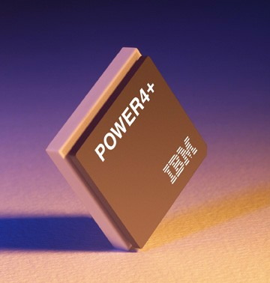
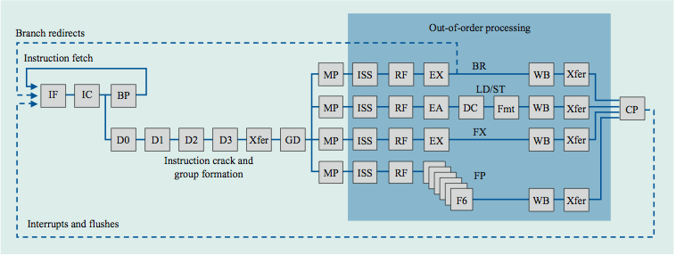
IBM Power 4
Single-threaded predecessor to Power 5. 8 execution units in
out-of-order engine, each may
issue an instruction each cycle.

Slide 9
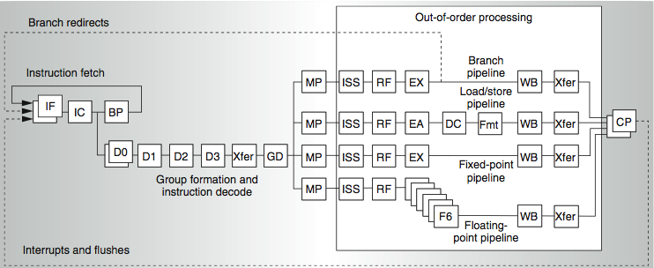
Power 4
2 commits (architected register sets)
Power 5
2 fetch (PC), 2 initial decodes

Slide 10
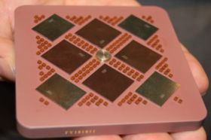
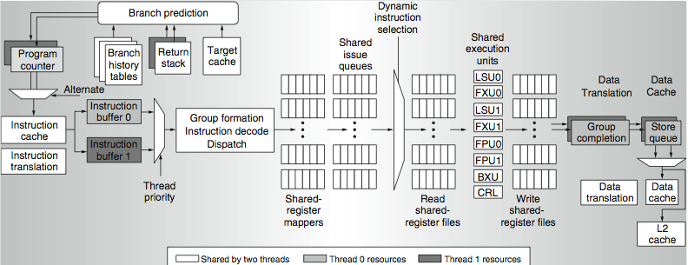
Power 5 data flow ...
Why only 2 threads? With 4, one of the shared resources (physical registers, cache, memory bandwidth) would be prone to bottleneck

Slide 11
Changes in Power 5 to support SMT
Increased associativity of L1 instruction cache and the instruction address translation buffers
Added per thread load and store queues
Increased size of the L2 (1.92 vs. 1.44 MB) and L3 caches
Added separate instruction prefetch and buffering per thread
Increased the number of virtual registers from 152 to 240
Increased the size of several issue queues
The Power5 core is about 24% larger than the Power4 core because of the addition of SMT support

Slide 12
CSE 490/590 Administrivia
Quiz 2 (next Friday 4/8): After midterm until next Monday

Slide 13
Pentium-4 Hyperthreading (2002)
First commercial SMT design (2-way SMT)
Hyperthreading == SMT
Logical processors share nearly all resources of the physical processor
Caches, execution units, branch predictors
Die area overhead of hyperthreading ~ 5%
When one logical processor is stalled, the other can make progress
No logical processor can use all entries in queues when two threads are active
Processor running only one active software thread runs at approximately same speed with or without hyperthreading
Hyperthreading dropped on OoO P6 based followons to Pentium-4 (Pentium-M, Core Duo, Core 2 Duo), until revived with Nehalem generation machines in 2008.
Intel Atom (in-order x86 core) has two-way vertical multithreading
Notes:
Load-store buffer in L1 cache doesn’t behave like that, and hence 15% slowdown.

Slide 14
Initial Performance of SMT
Pentium 4 Extreme SMT yields 1.01 speedup for SPECint_rate benchmark and 1.07 for SPECfp_rate
Pentium 4 is dual threaded SMT
SPECRate requires that each SPEC benchmark be run against a vendor-selected number of copies of the same benchmark
Running on Pentium 4 each of 26 SPEC benchmarks paired with every other (26² runs) speed-ups from 0.90 to 1.58; average was 1.20
Power 5, 8-processor server 1.23 faster for SPECint_rate with SMT, 1.16 faster for SPECfp_rate
Power 5 running 2 copies of each app speedup between 0.89 and 1.41
Most gained some
Fl.Pt. apps had most cache conflicts and least gains

Slide 15
SMT adaptation to parallelism type
For regions with high thread level parallelism (TLP) entire machine width is shared by all threads
For regions with low thread level parallelism (TLP) entire machine width is available for instruction level parallelism (ILP)
Issue width
Issue width
Time
Time
Notes:
Amdahl’s law…

Slide 16
Icount Choosing Policy
Fetch from thread with the least instructions in flight.
Why does this enhance throughput?
Notes:
Fetch unit that can keep up with the simultaneous multithreaded execution engine
have the fewest instructions waiting to be executed
making the best progress through the machine
40% increase in IPC over RR
Don’t want to clog instruction window with thread with many stalls ➔ try to fetch from thread that has fewest insts in window

Slide 17
Summary: Multithreaded Categories
Simultaneous
Multithreading
Time (processor cycle)
Superscalar
Fine-Grained
Coarse-Grained
Multiprocessing
Thread 1
Thread 3
Thread 5
Thread 2
Thread 4
Idle slot

Slide 18
Uniprocessor Performance (SPECint)
3X
From Hennessy and Patterson, Computer Architecture: A Quantitative Approach, 4th edition, 2006
VAX : 25%/year 1978 to 1986
RISC + x86: 52%/year 1986 to 2002
RISC + x86: ??%/year 2002 to present

Slide 19
Parallel Processing: Déjà vu all over again?
“… today’s processors … are nearing an impasse as technologies approach the speed of light..”
David Mitchell, The Transputer: The Time Is Now (1989)
Transputer had bad timing (Uniprocessor performance↑) ⇒ Procrastination rewarded: 2X seq. perf. / 1.5 years
“We are dedicating all of our future product development to multicore designs. … This is a sea change in computing”
Paul Otellini, President, Intel (2005)
All microprocessor companies switch to MP (2X CPUs / 2 yrs) ⇒ Procrastination penalized: 2X sequential perf. / 5 yrs
Manufacturer/Year | AMD/’09 | Intel/’09 | IBM/’09 | Sun/’09
Processors/chip | 6 | 8 | 8 | 16
Threads/Processor | 1 | 2 | 4 | 8
Threads/chip | 6 | 16 | 32 | 128

Slide 20
Symmetric Multiprocessors
Processor
Processor
CPU-Memory bus
bridge
I/O bus
Memory
I/O controller
I/O controller
I/O controller
symmetric
All memory is equally far
away from all processors
Any processor can do any I/O
(set up a DMA transfer)
Graphics
output
Networks

Slide 21
Synchronization
The need for synchronization arises whenever
there are concurrent processes in a system
(even in a uniprocessor system)
Producer-Consumer: A consumer process
must wait until the producer process has
produced data
Mutual Exclusion: Ensure that only one process uses a resource at a given time
producer
consumer
P1
P2
Shared Resource

Slide 22
A Producer-Consumer Example
Producer
tail
head
Consumer
R_{tail}
R_{tail}
R_{head}
R
Producer posting Item x:
Load R_{tail}, (tail)
Store (R_{tail}), x
R_{tail}=R_{tail}+1
Store (tail), R_{tail}
Consumer:
Load R_{head}, (head)
spin: Load R_{tail}, (tail)
if R_{head}==R_{tail} goto spin
Load R, (R_{head})
R_{head}=R_{head}+1
Store (head), R_{head}
process(R)
The program is written assuming instructions are executed in order.
Problems?

Slide 23
A Producer-Consumer Example continued
Producer posting Item x:
Load R_{tail}, (tail)
Store (R_{tail}), x
R_{tail}=R_{tail}+1
Store (tail), R_{tail}
Consumer:
Load R_{head}, (head)
spin: Load R_{tail}, (tail)
if R_{head}==R_{tail} goto spin
Load R, (R_{head})
R_{head}=R_{head}+1
Store (head), R_{head}
process(R)
1
3
2
4
Can the tail pointer get updated
before the item x is stored?
Programmer assumes that if 3 happens after 2, then 4 happens after 1.
Problem sequences are:
2, 3, 4, 1
4, 1, 2, 3

Slide 24
Sequential Consistency A Memory Model
P
P
P
P
P
P
M
“ A system is sequentially consistent if the result of
any execution is the same as if the operations of all
the processors were executed in some sequential
order, and the operations of each individual processor
appear in the order specified by the program”
Leslie Lamport
Sequential Consistency =
arbitrary order-preserving interleaving
of memory references of sequential programs

Slide 25
Acknowledgements
These slides heavily contain material developed and copyright by
Krste Asanovic (MIT/UCB)
David Patterson (UCB)
And also by:
Arvind (MIT)
Joel Emer (Intel/MIT)
James Hoe (CMU)
John Kubiatowicz (UCB)
MIT material derived from course 6.823
UCB material derived from course CS252

