Slide 1
CSE 490/590 Computer Architecture Putting it all together: Intel Nehalem
Steve Ko
Computer Sciences and Engineering
University at Buffalo

Slide 2
Intel Nehalem
Review entire semester by looking at most recent microprocessor from Intel
Nehalem is code name for microarchitecture at heart of Core i7 and Xeon 5500 series server chips
First released at end of 2008
Figures/Info from Intel, David Kanter at Real World Technologies.

Slide 3
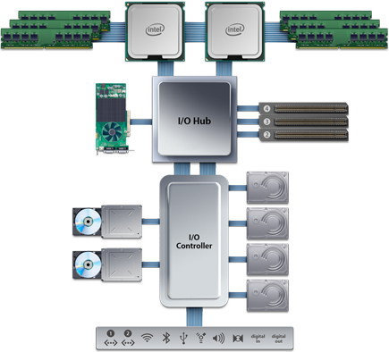
Nehalem System Example: Apple Mac Pro Desktop 2009
Two Nehalem Chips (“Sockets”), each containing four processors (“cores”) running at up to 2.93GHz
Each chip has three DRAM channels attached, each 8 bytes wide at 1.066Gb/s (3*8.5GB/s).
Can have up to two DIMMs on each channel (up to 4GB/DIMM)
“QuickPath” point-point system interconnect between CPUs and I/O.
Up to 25.6 GB/s per link.
PCI Express connections for Graphics cards and other extension boards. Up to 8 GB/s per slot.
Disk drives attached with 3Gb/s serial ATA link
Slower peripherals (Ethernet, USB, Firewire, WiFi, Bluetooth, Audio)

Slide 4
Building Blocks to support “Family” of processors

Slide 5
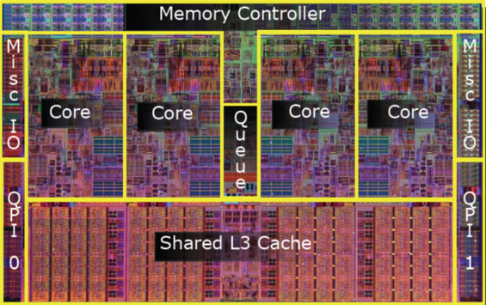
Nehalem Die Photo

Slide 6
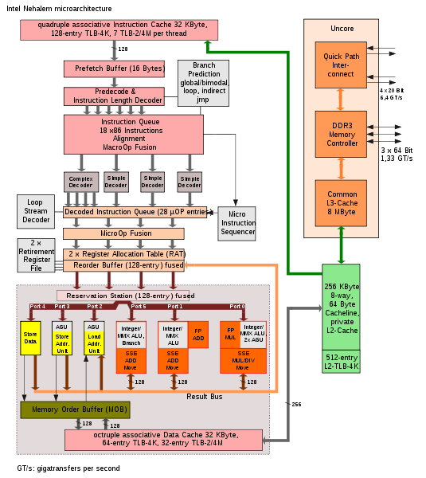
In-Order Fetch
In-Order Decode and Register Renaming
In-Order Commit
Out-of-Order Execution
2 SMT Threads per Core
Out-of-Order Completion

Slide 7
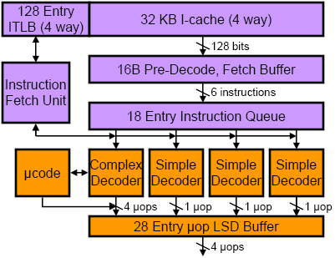
Front-End Instruction Fetch & Decode
x86 instruction bits
internal µOP bits
µOP is Intel name for internal RISC-like instruction, into which x86 instructions are translated
Loop Stream Detector (can run short loops out of the buffer)

Slide 8
Branch Prediction
Part of instruction fetch unit
Several different types of branch predictor
Details not public
Two-level BTB
Loop count predictor
How many backwards taken branches before loop exit
(Also predictor for length of microcode loops, e.g., string move)
Return Stack Buffer
Holds subroutine targets
Renames the stack buffer so that it is repaired after mispredicted returns
Separate return stack buffer for each SMT thread

Slide 9
x86 Decoding
Translate up to 4 x86 instructions into uOPS each cycle
Only first x86 instruction in group can be complex (maps to 1-4 uOPS), rest must be simple (map to one uOP)
Even more complex instructions, jump into microcode engine which spits out stream of uOPS

Slide 10
Split x86 in small uOPs, then fuse back into bigger units

Slide 11
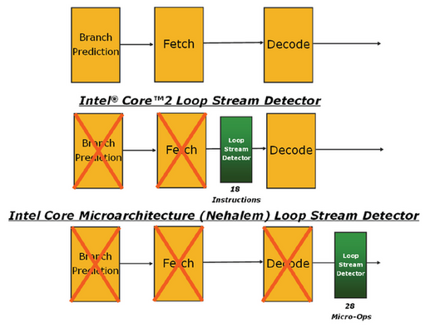
Loop Stream Detectors save Power

Slide 12
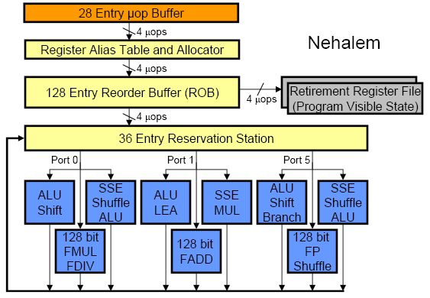
Out-of-Order Execution Engine
Renaming happens at uOP level (not original macro-x86 instructions)

Slide 13
SMT effects in OoO Execution Core
Reorder buffer (remembers program order and exception status for in-order commit) has 128 entries divided statically and equally between both SMT threads
Reservation stations (instructions waiting for operands for execution) have 36 entries competitively shared by threads

Slide 14
Nehalem Memory Hierarchy Overview
32KB L1 I$
32KB L1 I$
CPU Core
4-8 Cores
CPU Core
Private L1/L2 per core
32KB L1 D$
32KB L1 D$
L3 fully inclusive of higher levels (but L2 not inclusive of L1)
256KB L2$
256KB L2$
Local memory access latency ~60ns
8MB Shared L3$
DDR3 DRAM Memory Controllers
QuickPath System Interconnect
Other sockets’ caches kept coherent using QuickPath messages
Each DRAM Channel is 64/72b wide at up to 1.33Gb/s
Each direction is 20b@6.4Gb/s

Slide 15
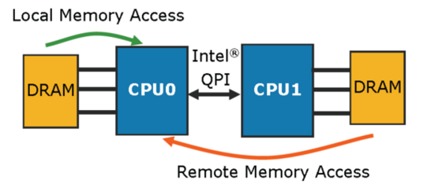
All Sockets can Access all Data
~60ns
~100ns

Slide 16
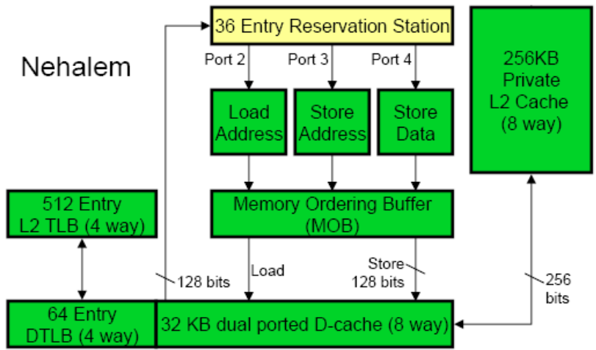
Core’s Private Memory System
Load queue 48 entries
Store queue 32 entries
Divided statically between SMT threads
Up to 16 outstanding misses in flight per core

Slide 17
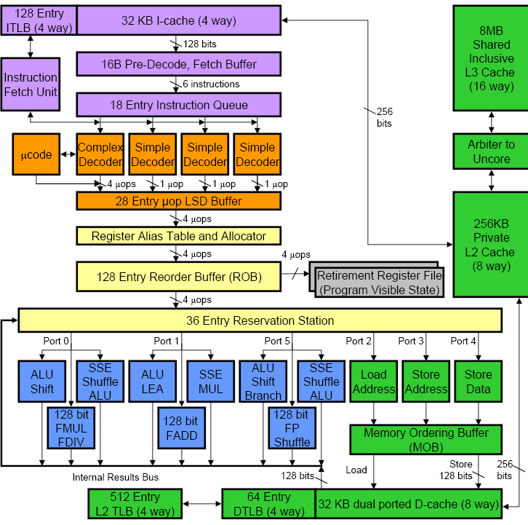

Slide 18
Cache Hierarchy Latencies
L1 32KB 8-way, latency 4 cycles
L2 256KB 8-way, latency <12 cycles
L3 8MB, 16-way, latency 30-40 cycles
DRAM, latency ~180-200 cycles

Slide 19
Nehalem Virtual Memory Details
Implements 48-bit virtual address space, 40-bit physical address space
Two-level TLB
I-TLB (L1) has shared 128 entries 4-way associative for 4KB pages, plus 7 dedicated fully-associative entries per SMT thread for large page (2/4MB) entries
D-TLB (L1) has 64 entries for 4KB pages and 32 entries for 2/4MB pages, both 4-way associative, dynamically shared between SMT threads
Unified L2 TLB has 512 entries for 4KB pages only, also 4-way associative
Additional support for system-level virtual machines

Slide 20
Virtualization Support
TLB entries tagged with virtual machine and address space ID
No need to flush on context switches between VMs
Hardware page table walker can walk guest-physical to host-physical mapping tables
Fewer traps to hypervisor

Slide 21
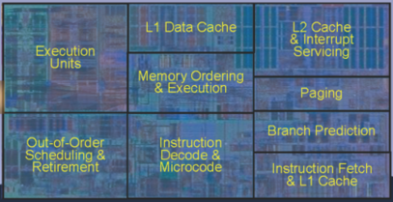
Core Area Breakdown

Slide 22
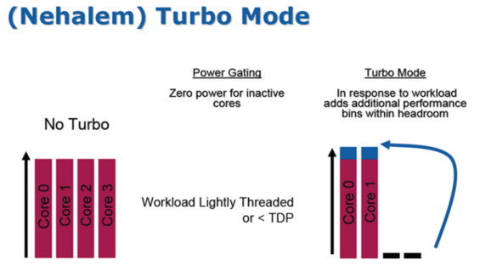

Slide 23
CSE 490/590 Administrivia
Keyboards available for pickup at my office
Project 2: less than 2 weeks left (Deadline 5/2)
Will have demo sessions
No class on 5/2 (finish the project!)
Final exam: Thursday 5/5, 11:45pm – 2:45pm
Project 2 + Final = 55%

Slide 24
Acknowledgements
These slides heavily contain material developed and copyright by
Krste Asanovic (MIT/UCB)
David Patterson (UCB)
And also by:
Arvind (MIT)
Joel Emer (Intel/MIT)
James Hoe (CMU)
John Kubiatowicz (UCB)
MIT material derived from course 6.823
UCB material derived from course CS252

