Slide 1
My Perspectives on Graduate Research
Panya Chanawangsa
Ubiquitous Multimedia Lab
Advisor: Dr. Chang Wen Chen
10/14/2014

Slide 2



About Myself
SUNY Buffalo, Ubiquitous Multimedia Lab 5th year PhD student
Xerox Corporation Rochester, New York August 2012 – May 2013
AFT Computer Vision Seattle, Washington June 2013 – August 2013
AFT Computer Vision: Surveillance Camera Applications Group Seattle, Washington May 2014 – August 2014

Slide 3
Ubiquitous Multimedia Lab

Slide 4
Ubiquitous Multimedia Lab

Slide 5
Ubiquitous Multimedia Lab

Slide 6
Agenda
Overview of my group’s research area
Overview of my research area
My PhD research
Exciting (and not so exciting) aspects of doing research
What I wish I had known when I joined the program
Q&A

Slide 7
Ubiquitous Multimedia Lab
HTTP live streaming
Video transmission over various networks
Mobile video adaptation
Quality of experience for multimedia consumers
Multimedia in social media context
Computer vision and image processing

Slide 8
Ubiquitous Multimedia Lab
HTTP live streaming
Video transmission over various networks
Mobile video adaptation
Quality of experience for multimedia consumers
Multimedia in social media context
Computer vision and image processing

Slide 9
My Research Overview
Computer Vision for
Intelligent Transportation Systems

Slide 10
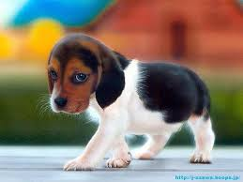
Puppy, 0.94
Computer
Vision System
Input image
Useful information

Slide 11
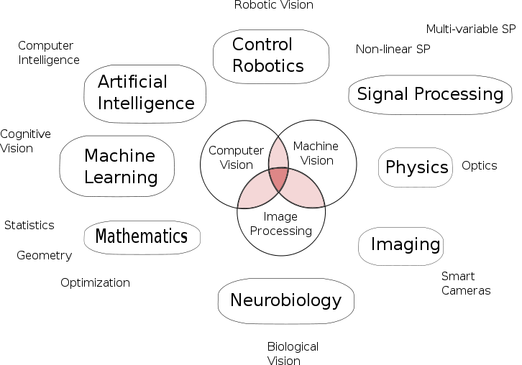
Wikipedia

Slide 12
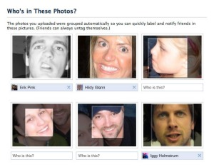
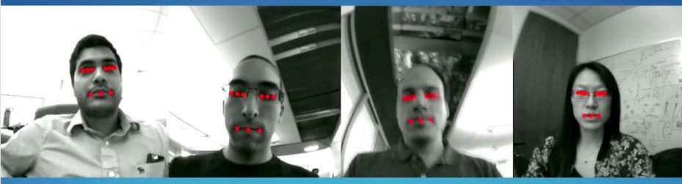
Computer Vision and its Applications
Facebook facial detection/recognition
Amazon Fire Phone face tracking
Face recognition

Slide 13
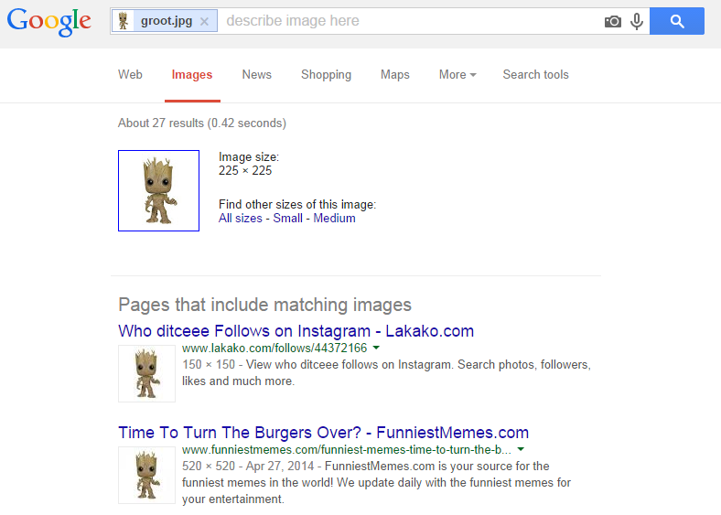
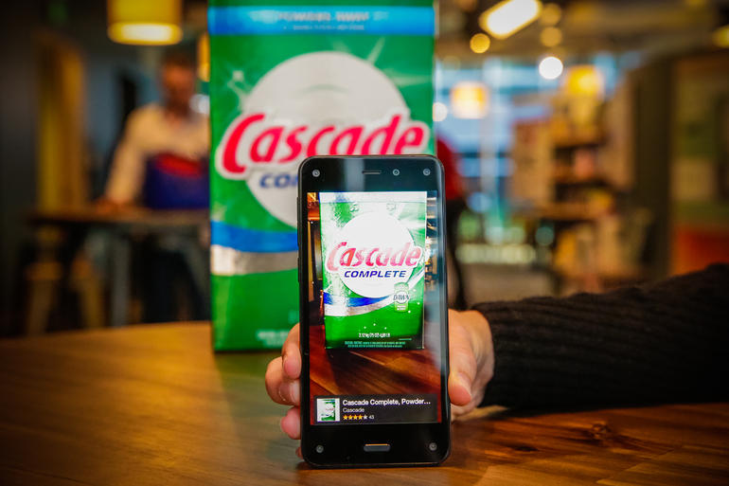
Computer Vision and its Applications
Google Image
Amazon Firefly
Image search, Image retrieval

Slide 14
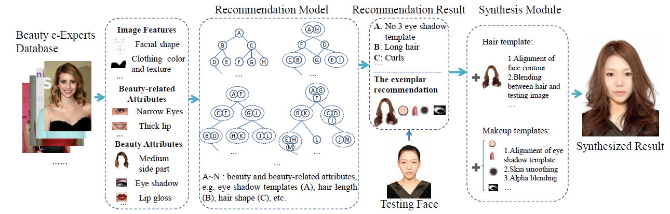
Computer Vision and its Applications
Carl Vondrick, Aditya Khosla, Tomasz Malisiewicz, Antonio Torralba, Wow! You are so beautiful today!, ACM International Conference on Multimedia, pp. .
Beauty recommendation systems

Slide 15
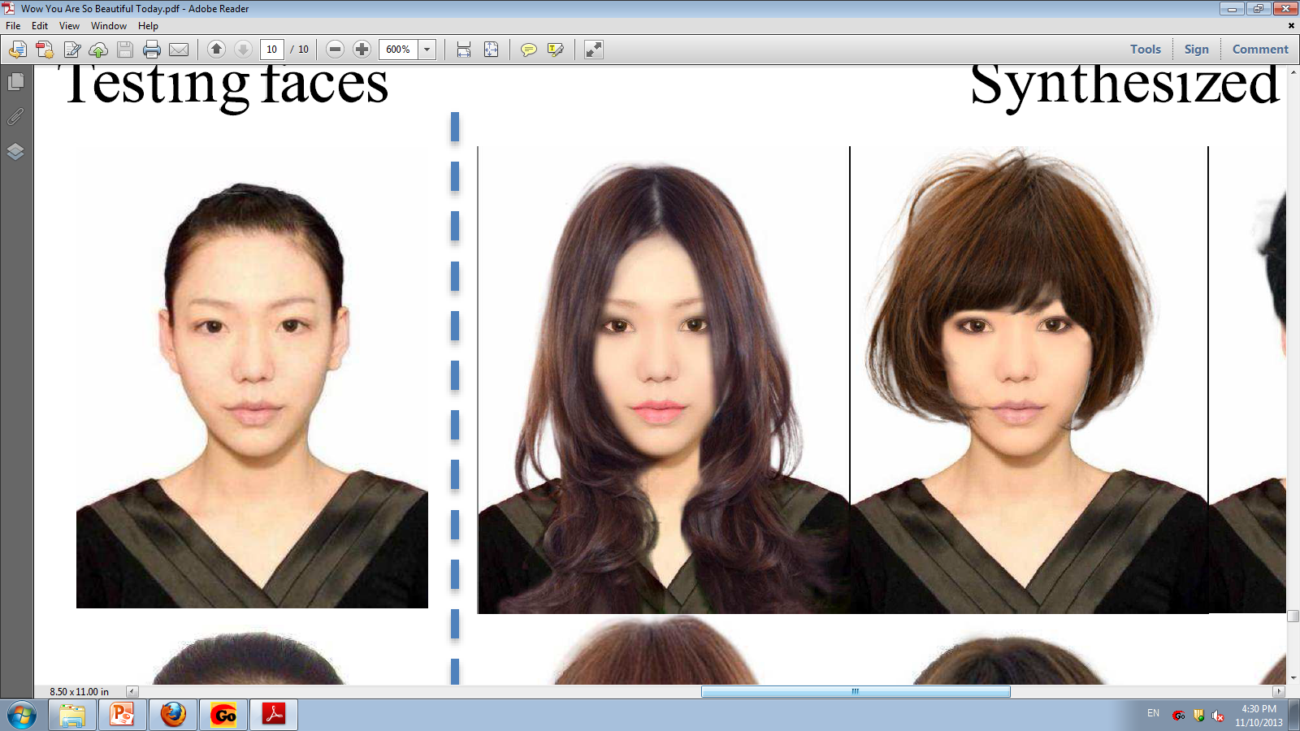
“You should do the following:
Have long hair with curls.
Use black eye shadow.
Use number 3 foundation.”
Recommendation results
Recommendation System
Input image
Beauty recommendation systems
Synthesized result

Slide 16
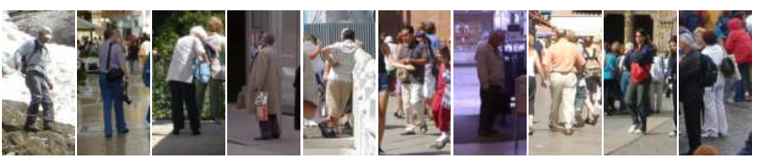
Why Computer Vision is Hard
Is there a human in the image?

Slide 17
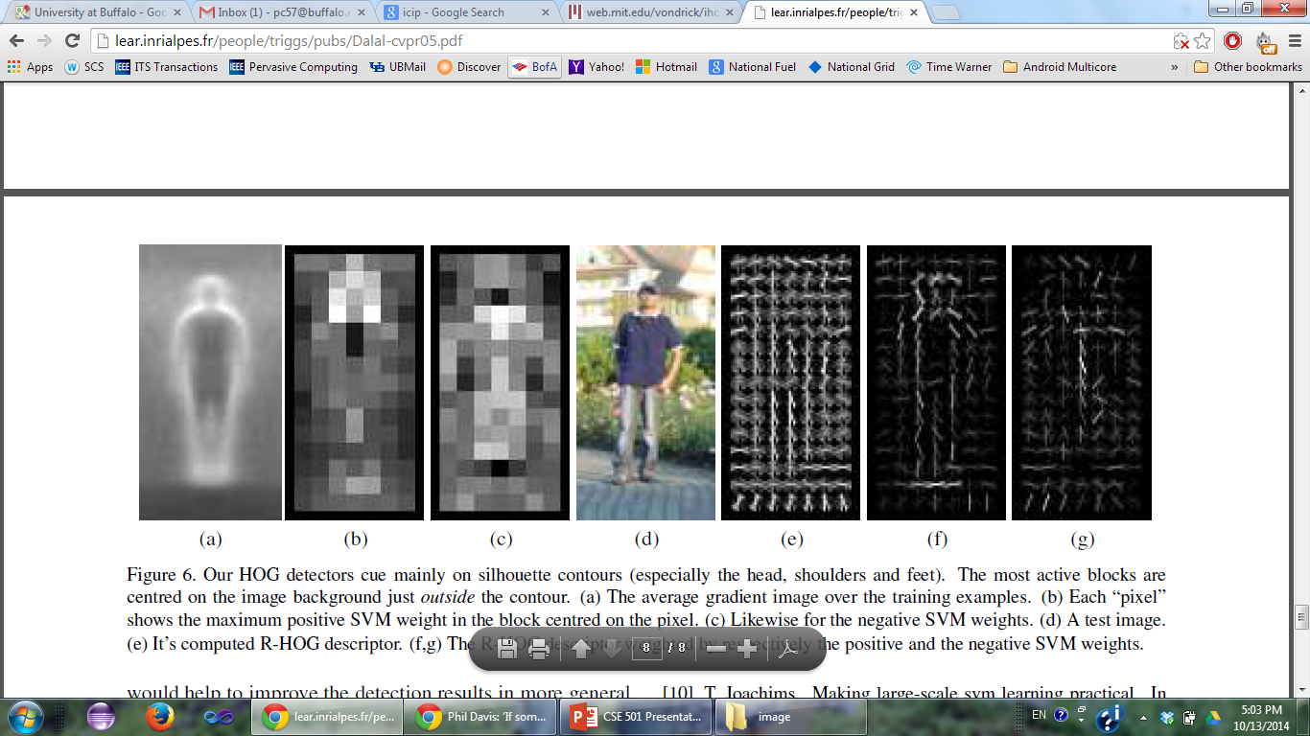
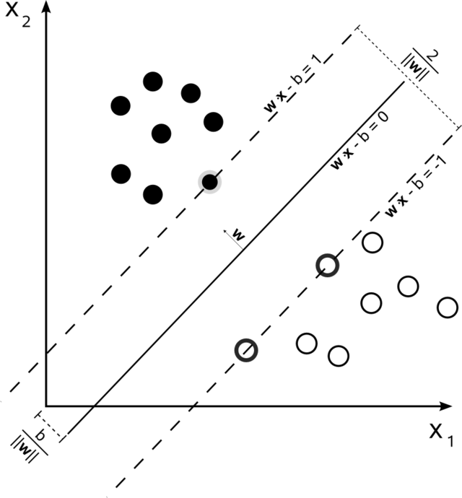
Why Computer Vision is Hard
Input image
Features
Classifier
Notes:
Mention that HOG is the state-of-the-art object descriptor

Slide 18
“The new approach gives near-perfect separation on the original MIT pedestrian database, so we introduce a more challenging dataset containing over 1800 annotated human images with a large range of pose variations and backgrounds.”
Naveet Dalal and Bill Triggs, Histogram of Oriented Gradients for Human Detection, CVPR 2005.

Slide 19
Why Computer Vision is Hard
Notes:
Object detection has come a long way. Computer vision researchers are often unable to explain the failures of object detection. Place blame on features,

Slide 20
Why Computer Vision is Hard
Carl Vondrick, Aditya Khosla, Tomasz Malisiewicz, Antonio Torralba, HOGgles: Visualizing Object Detection Features, IEEE International Conference on Computer Vision. 2013.

Slide 21
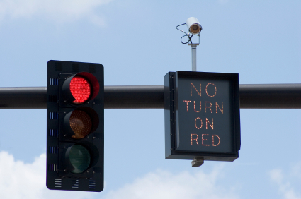
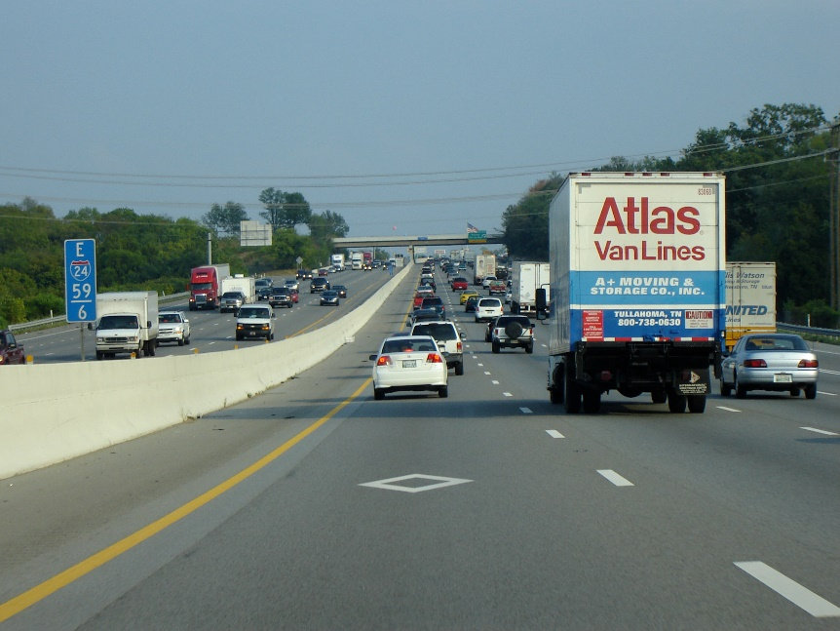
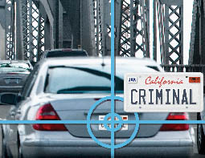
Intelligent Transportation Systems
Red light cameras
High-occupancy vehicle lane
License plate number recognition

Slide 22
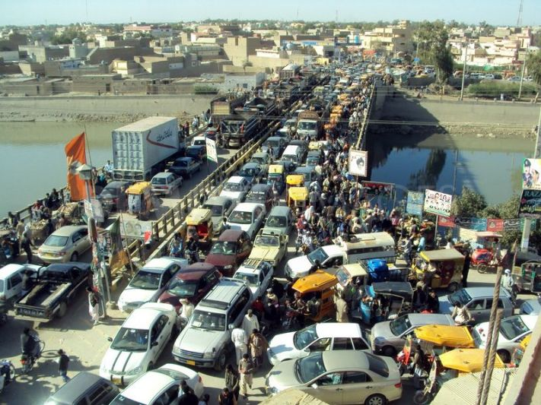
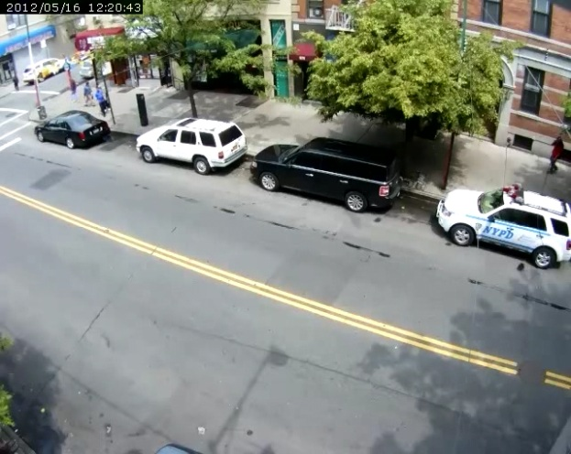
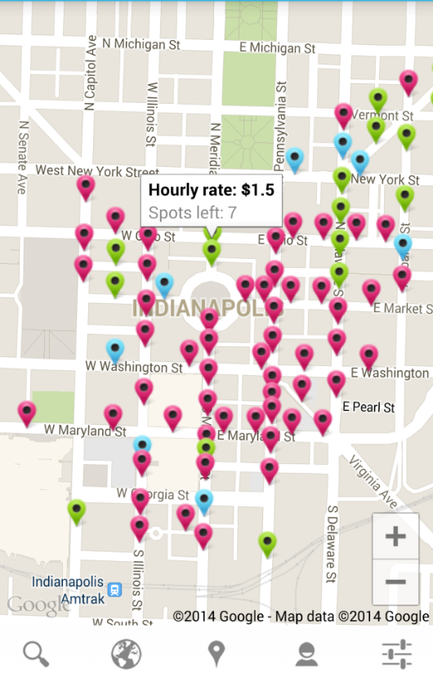
Intelligent Transportation Systems
Real-time traffic monitoring
Smart parking

Slide 23
My Research Overview
Lane departure warning system
Overtaking vehicle detection
Smart parking
Drunk-driving detection
Notes:
-
- wasn’t long ago when I was a first year student. Struggle in 596

Slide 24
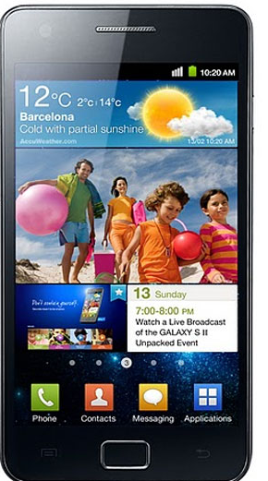
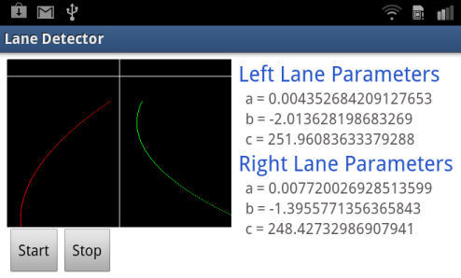
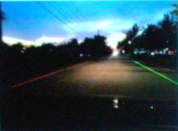
Lane Departure Warning System

Slide 25
Research and Implementation Challenges
Feature selection: color? edge?
Feature detection:
Resource constraint: energy, processing power
Efficiency: can we meet the real-time requirement?
Implementation: Android? iOS?
Result validation: ground-truth generation
Notes:
-
- wasn’t long ago when I was a first year student. Struggle in 596

Slide 26
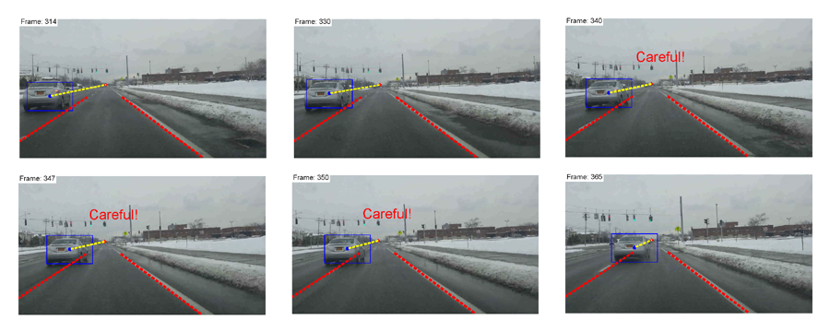
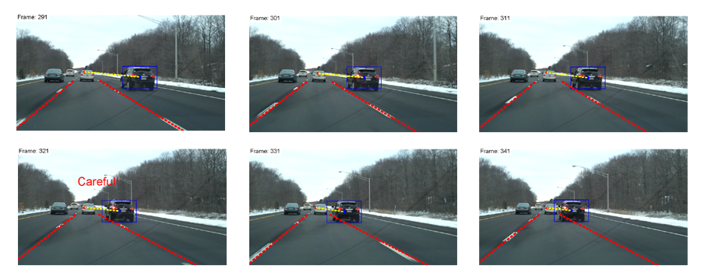
Overtaking Vehicle Detection System

Slide 27
Research and Implementation Challenges
Feature selection: HOG? Symmetry?
Feature detection: highly dynamic scene
Efficiency: can we meet the real-time requirement?
Accuracy: how do we make an accurate prediction
Notes:
-
- wasn’t long ago when I was a first year student. Struggle in 596

Slide 28
Drunk Driving Detection
Is this driver drunk?

Slide 29
Basic Idea
1. Use NHTSA’s visual cues for police officers.
Notes:
NHTSA: National Highway Traffic Safety Administration

Slide 30
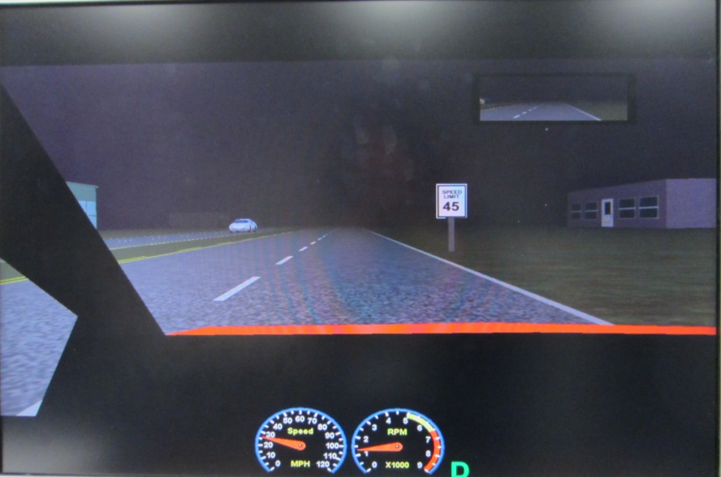
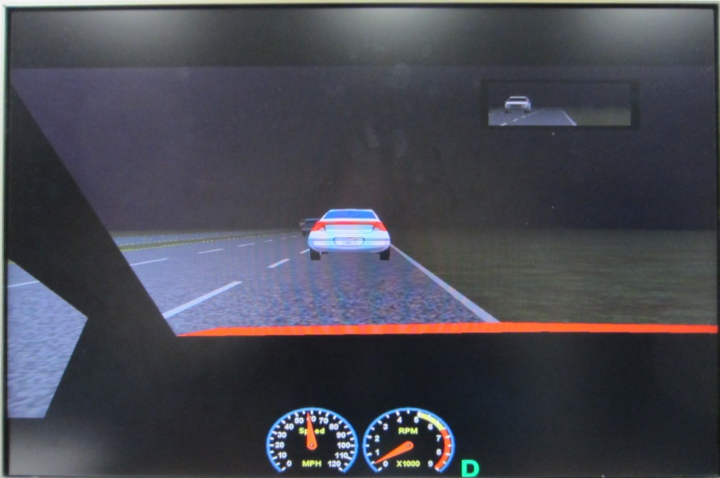

Basic Idea
2. What are some of the effects of alcohol on driving performances?
User studies: in collaboration with Dr. Sean Wu from the IE department

Slide 31
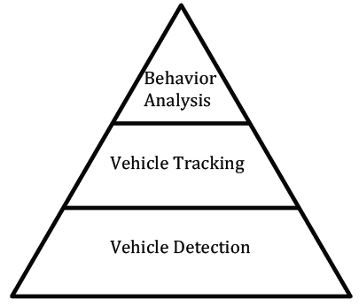
Basic Idea
3. Approach the problem from ground up.

Slide 32
Driving Parameters
Ability to maintain lateral positions
Speed variability
Stopping distance from the stop signs and traffic lights
Turning radius

Slide 33
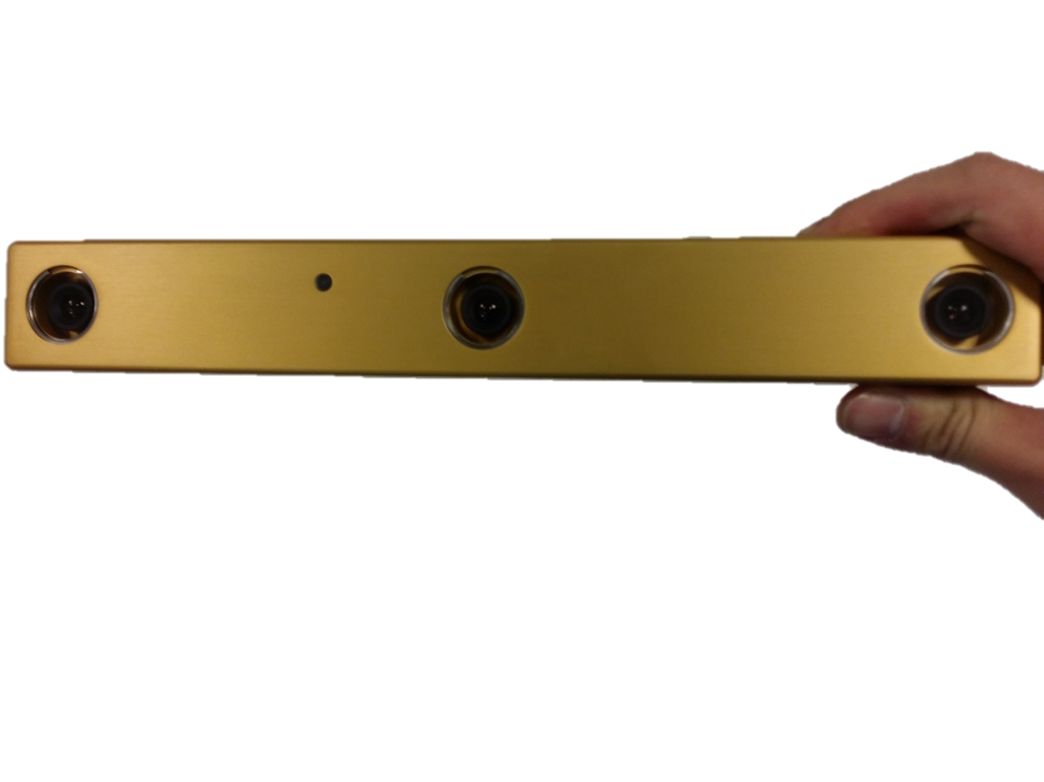
Data Acquisition
BumblebeeXB 3

Slide 34
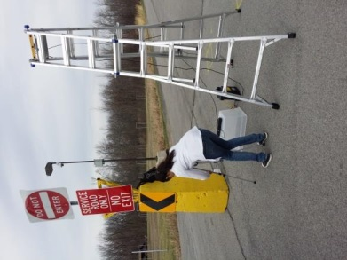
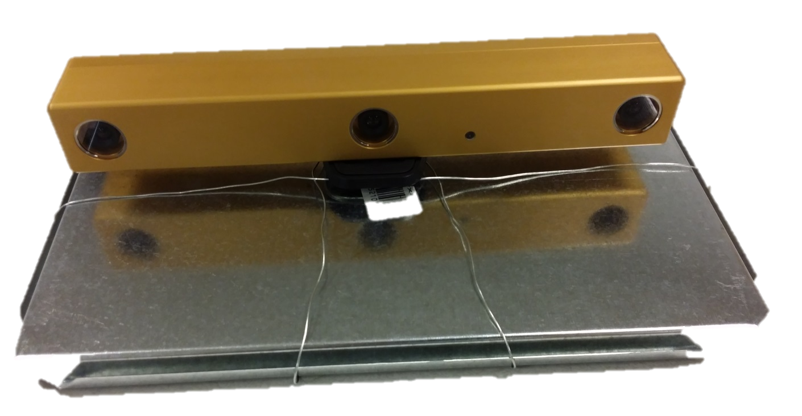
Initial System Setup

Slide 35
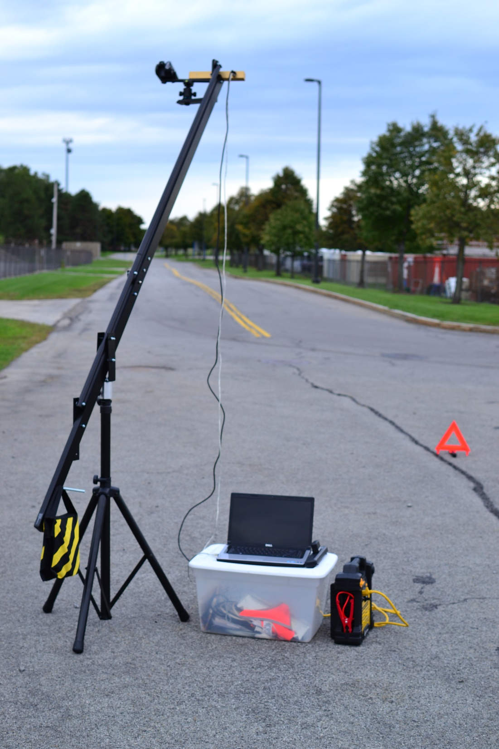
3D camera
IEEE 1394 cables
Jib
Safety triangle
Laptop
Weights
Portable battery

Slide 36
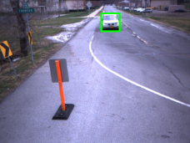
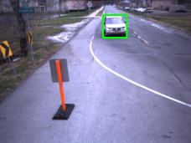
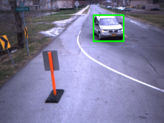
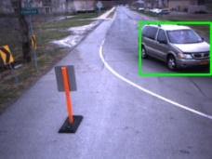
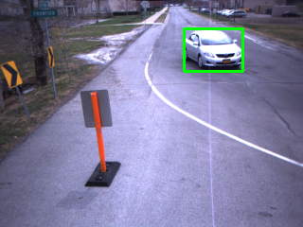
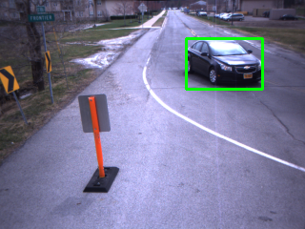
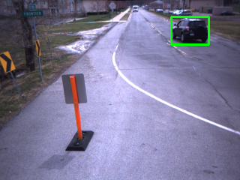
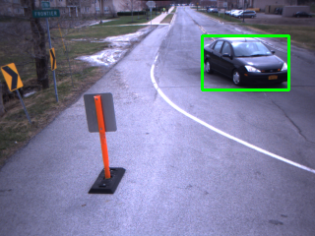
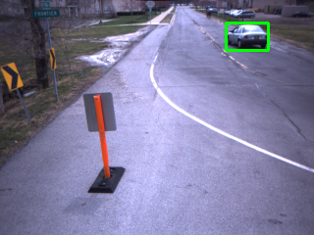
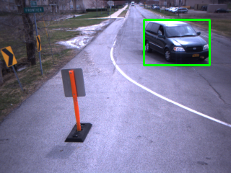
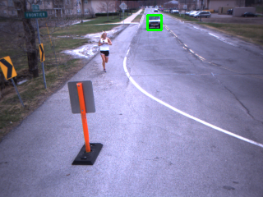
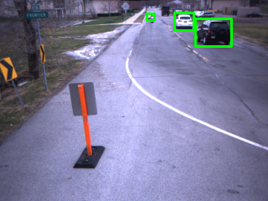
Dataset
Tracking of instrument vehicle
Multiple vehicle tracking

Slide 37
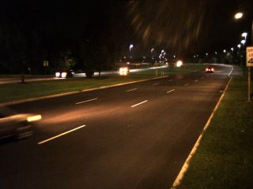
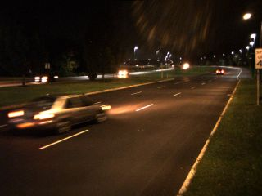
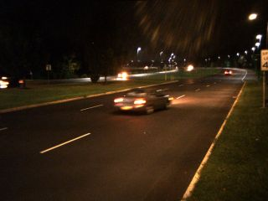
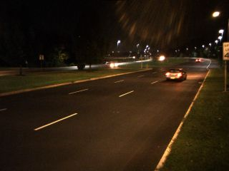
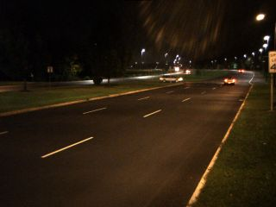
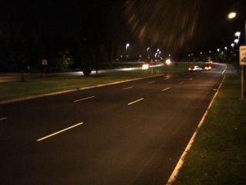
Dataset
Lane keeping

Slide 38
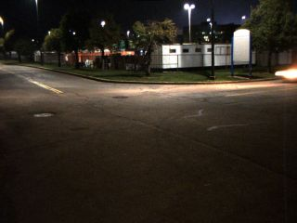
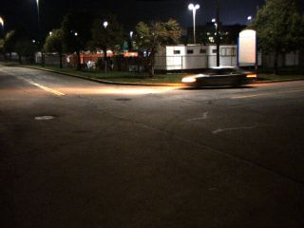
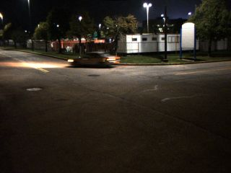



Dataset
Turning radius

Slide 39






Dataset
Stopping distance

Slide 40



3D Processing
front view
top view
Vehicle mask
Vehicle point cloud

Slide 41
Extracted 2D/3D Trajectories
Trajectories of all the vehicles in data set 1

Slide 42
What I wish I had known way back
Have many interests; focus on one.
Four years is a short period of time.
Treat your PhD like a full-time job.
Prioritize your tasks.
Make sure you are truly passionate about your research topic.
Ask yourself what you really want to do in life.
Do internships.
Notes:
-
- wasn’t long ago when I was a first year student. Struggle in 596

Slide 43
What gets me excited
Freedom to pursue my academic curiosity
Collaboration with top-notch researchers on funded projects
High-impact and practical research
Computer vision applications are everywhere.
Lots of research challenges and extremely difficult problems:
Object recognition
Action recognition
Robotics

Slide 44
Academic vs. Industry Research
Access to large datasets
Shared codebase vs. implementing everything yourself
Freedom to pursue your research interests
Funding

Slide 45
Questions? pc57@buffalo.edu

