Slide 1
LaTeX (+ BibTeX) Tutorial
Steve Ko

Slide 2
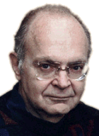
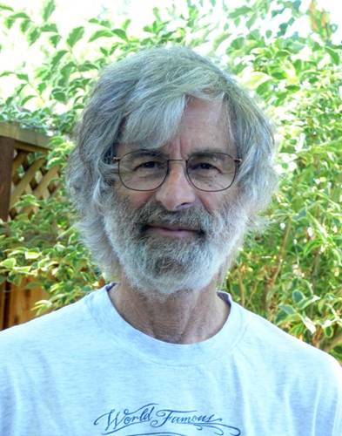
LaTeX: Brief History
Don Knuth (TAOCP)
  Developed TeX for math typesetting
Leslie Lamport (Lamport clock & Paxos)
  Developed LaTeX from TeX

Slide 3


Word vs. LaTeX
Word
  WISIWYG
  Convenient
  Cumbersome
  Can be ugly
LaTeX
  Use markup language (tags as in HTML)
  Convenient
  Cumbersome
  Mostly pretty

Slide 4
Word vs. LaTeX - Workflow
Word
  Heavily mouse-oriented
  Type
  Use mouse to change
  See
LaTeX
  Heavily keyboard-oriented
  Type
  Compile
  See

Slide 5
Word vs. LaTeX
Word
  Promotes backward thinking
LaTeX
  Promotes forwarding thinking

Slide 6
CSE Support
https://wiki.cse.buffalo.edu/services/content/tex

Slide 7
Word vs. LaTeX
Simple text
Putting some structure (sections, subsections, etc.)
Tables & figures
Math
References

Slide 8
Demo

Slide 9
Simple Text
Space and carriage returns
Quotation marks & italic fonts
  ``’’
  \emph{}
Text sizes
  \bf{}
  \footnotesize{}, \small{}, \large{}, \Large{}
Accents
Notes:
Start from showing how to write in latex from scratch
Mention you can use any of your favorite text editor,
even word (the case of my advisor for grammar & spell check)
Show what to start with, How to compile, Focus on writing (the workflow)

Slide 10
Putting Some Structure
Sections
  \section, \subsection, \paragraph, etc.
Bullet points & numbering
  \begin{itemize} \end{itemize}
  \begin{enumerate} \end{enumerate}
Reference
  \label

Slide 11
Tables & Figures
\begin{table}…\end{table} & \begin{tabular}…\end{tabular}
\begin{figure} \includegraphics[]{} \end{figure}
  Requires \usepackage{epsfig}
\caption{}
\centering

Slide 12
Math
$$
Math symbols
  \over, \times, ^, _, \bigcap, \bigcup, \eq, \le, …
  \sin, \cos, \inf, …
  \frac{numerator}{denominator}
Greek letters
  \alpha, \beta, \gamma, …

Slide 13

Reference management system
Can’t live without this when writing papers
In LaTeX,
  \bibliographystyle{}
  \bibliography{}

Slide 14
Questions?

