Slide 1
Enabling Effective Crowdsourcing Using Interest Graph
Yavuz Selim Yilmaz
Computer Science and Engineering,
SUNY University at Buffalo

Slide 2
Crowdsourcing: Definition
Crowd-based outsourcing -> Crowdsourcing (2005 - Wired Magazine)
The process of obtaining needed services, ideas, or content by soliciting contributions from a large group of people
Wisdom of the crowd
Aristotle first mentions in his work ‘Politics’
the superiority of crowd averages over individual judgments (the elimination of individual noise)
Crowdvoting, Crowdfunding, Crowdsearching, Crowdsensing…

Slide 3
Crowdsourcing: How?
People are online
People are connected on the internet
Facebook
Twitter
Instant messages
Games
…
People contribute to the internet (Web 2.0)

Slide 4
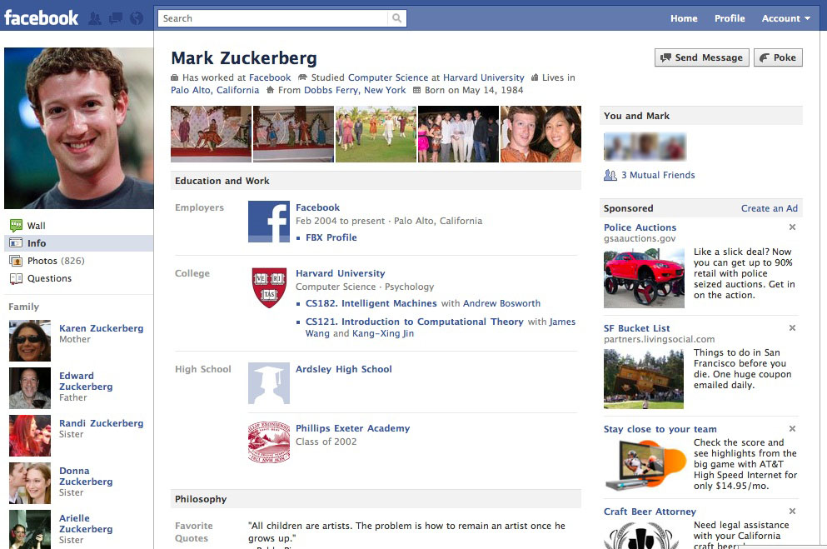
Crowdsourcing around us

Slide 5
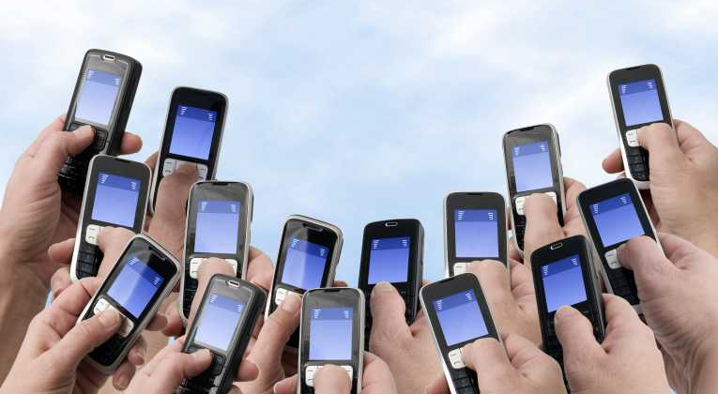

Crowdsourcing: Reaching the Crowd
6.8 Billion mobile phones Worldwide
1.4 Billion of them are Smartphones
7 Billion
World’s Population
Global smartphone penetration grows fast:
It exploded from 5% (end of 2009) to 22% (end of 2013) in 4 years

Slide 6

Smartphone Era
The way we communicate is changing.
58% of the smartphone users check their smartphones at least once in an hour

Slide 7
Crowdsourcing Multiple Choice Questions
Why multiple choice questions?
Easy to present
Easy to answer
Easy to aggregate the responses
Any open-domain question can be formed as multiple choice questions^{[1]}
[1] C. H. Lin, Mausam, and D. S. Weld, “Crowdsourcing control: Moving beyond multiple choice” in UAI, 2012, pp. 491–500.

Slide 8
Why Crowdsourcing the Questions?
Our analysis reveals that search engines fail on non-factual (subjective) questions
Search engines can only answer 30%
Crowd is able to answer with around 90% accuracy

Slide 9
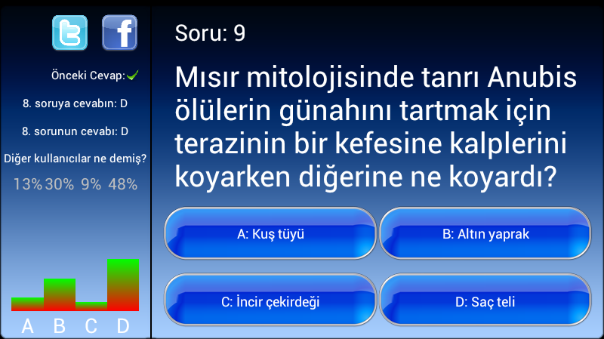
CrowdReply: A Crowdsourced “Who wants to be a millionaire?” App

Slide 10
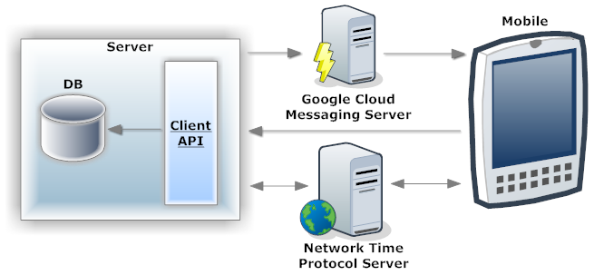
CrowdReply: The Smartphone App
300+ thousands of downloads

Slide 11
Building a Crowdsourced WWTBAM Player
The Naïve Approach: Majority Voting

Slide 12
Smarter Crowd
How should we categorize people?
Our categorization should:
reduce the number of votes at the group level
increase the homogeneity of the votes inside the groups
Result:
Be able to identify the appropriate minority voice and design effective MCQA algorithms

Slide 13
Smarter Crowd
Interest based user groups!

Slide 14



Smartphone App Boom
1+ Million Apps
50 Billion Downloads
220k Apps
3 Billion Downloads
1+ Million Apps
50 Billion Downloads
245k Apps
4 Billion Downloads

Slide 15
Application Categories on Google Play Store
There are 34 app categories
Applications are categorized based on their content/use
Some categories are:
Books and Reference
Health and Fitness
Photography
Shopping
Travel and Local

Slide 16
Apps in Our User Base
Top 10 Apps
1. Android Services
2. CrowdReply
3. Google Services
4. Facebook
5. Chrome
6. WhatsApp
7. Dropbox
8. Subway Surfers
9. Candy Crush Saga
10. Twitter
1397 Users
16651 Apps

Slide 17
Our Superplayer Algorithm: Selective User Groups
Books & Reference
Sports & Lifestyle
Libraries & Demo
Libraries & Demo
Music and Audio
Entertainment
Entertainment
Shopping
Shopping
Shopping
Shopping

Slide 18
Conclusions
Crowdsourcing for Question Answering (QA):
efficient
users are willing to play QA games (300+ thousands of downloads without any campaign/ads)
fast
in our experiments, question arrival time is less than 6 seconds, and users answer the questions in less than 10 seconds (total ≈16 seconds)
accurate
overall >90% accuracy on QA

Slide 19
Questions?
?

