Slide 1

Introduction to Cryptocurrency:
Getting Ready for the Crypto Economy
B. RAMAMURTHY
©2023, ALL RIGHTS RESERVED
Manning author: Blockchain in action
PROGRAM DIRECTOR, DATA-INTENSIVE COMPUTING PROGRAM
COURSERA INSTRUCTOR
DIRECTOR, BLOCKCHAIN THINKLAB
HTTP://WW.CSE.BUFFALO.EDU/FACULTY/BINA
COMPUTER SCIENCE AND ENGINEERING
https://www.linkedin.com/in/bina-ramamurthy/

Slide 2





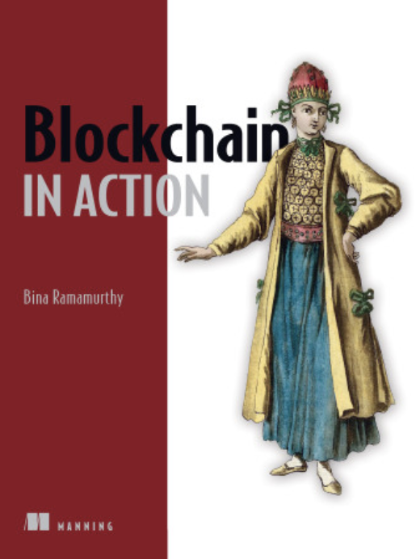
Introducing myself
  Been in Buffalo for more than 40 years!
  Ph.D. in Computer Engineering: Fault tolerance in distributed systems
  Faculty at CSE and University at Buffalo (UB) for the past 3 decades
  Launched a 4-courses certification on blockchain on Coursera MOOC
    --More than 300,000 learners and 1,000,000 visitors from all over the world
  NSF-supported Data-intensive computing since 2009 and recently in blockchain
  SUNY chancellor’s award for excellence in teaching 2019
  IEEE Region 1 Outstanding Teacher Award (2022)
  Author of a technical book: Blockchain in Action (Manning.com)
  Been in crypto since 2016.. Working a Decentralized Finance (DeFi) production

Slide 3
Presentation plan
Part I : What? What is cryptocurrency?
Part II: Why? Why should you care about it?
Part III:
  How? How can you prepare yourself for crypto-economy when it becomes mainstream?
  What? What can you do now with cryptocurrency?
Part IV: Looking ahead: Impact and outlook (if time permits)
  What are some of the major impacts of cryptocurrency technology besides the newer currency system

Slide 4
Disclaimer
This presentation is for educational purposes only.
This presentation does not endorse any of the applications or products discussed.
This presentation relies on facts and research experiences of the presenter; the audience is requested to explore the concepts and applications on their own before investing in cryptocurrencies.
The investment products used as examples are only for your information (FYI).

Slide 5
PART I : What is Cryptocurrency?
An intuitive understanding

Slide 6
On completion of this Part I, you’ll be able to
Understand what a cryptocurrency is.
Explore how create a crypto-currency wallet, to store, send and receive crypto to a peer participant in the same network.

Slide 7


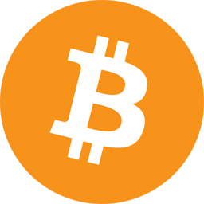
Origins of cryptocurrency
Wonder where did it come from?
2. Bitcoin 0.1.0 was released on 9 January 2009
Released to the world by a mysterious person(s) named Satoshi Nakamoto
2
1
3
3. A little bit of technical detail:
Bitcoin cracked the trust and
integrity puzzle with its
Mathematics, algorithms and hardware network
1. 2007-2008 financial meltdown
4
4. Many other cryptocurrencies followed: Prominent one is Ethereum (or Eth)

Slide 8
Cryptocurrency
It is a digital currency, transacted online.
It holds value;
  For example, One US dollar is $1, 1 bitcoin is ~$26,000, 1 Eth is ~$1800
It can be transferred peer to peer without an intermediary such as a bank.
It is generated by software with its rules, running on a network of safe and secure hardware.
  It is not issued by any country. It is not controlled by any geographic or political boundaries.
Initially its goal was to address manipulation financial system by middleman; empower participants in a democratic process to govern the financial system.
Cryptocurrency infrastructure provides a “trust layer” for a trustless world.

Slide 9
Imagine this scenario:
I give someone in this room a dollar bill?
Can you replicate this action to someone right now located outside this room? Outside Buffalo, in Jamestown, say? Someone in Florida? Somebody in Croatia? …I can go on.
For what do you want to send this dollar/currency/funds?
For a onetime purchase or service? Somebody cooking food for your parents who are inaccessible to you due to Covid, for example?
Cryptocurrency can do that.

Slide 10
Peer to Peer transfer of value
What do you need? When you have an intermediary such as bank, you’ll need sender and receiver’s account details. Imagine creating your account: they need many details.
In the case of cryptocurrency, you will minimally need your identity and balance funds kept in a wallet and receiver’s identity and wallet.
What is a wallet? A piece of software, a plugin to your browser or an app on your phone.
Your identity is a 256-bit number; you can self-generate it; one of my identities is: 0xF6117c946a33Cc0A105Ac131fDED8f17fbD9F4e6
Send from my wallet to any identity anywhere within the Ethereum network.
Let's look at 1 minute video to look at a wallet and to send a value in cryptocurrency to an address.

Slide 11
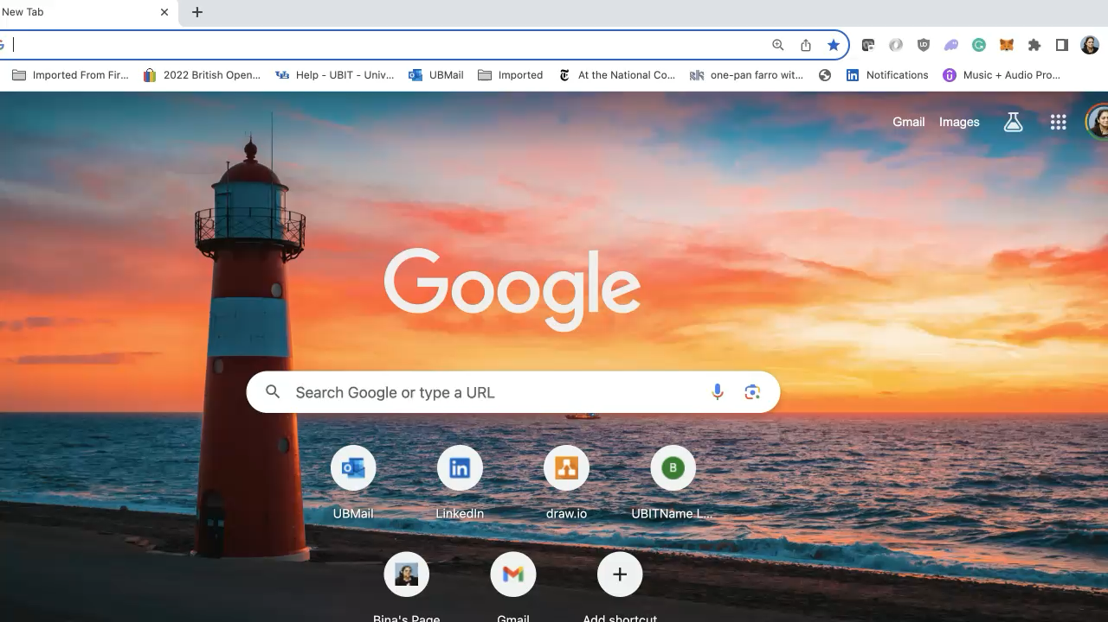
Video demo of wallet and peer to peer transfer of funds

Slide 12
Summarizing Part I
Now you know, cryptocurrency is digital currency that you transact over the internet.
You can create a wallet plugin to your browser or an app on your phone that will generate a unique identity for you on a cryptocurrency network.
Using this setup, you can send and receive cryptocurrency, store cryptocurrency, and manage your assets without an intermediary.

Slide 13
PART II : WHY should you care about it?
Evolution of Financial Systems

Slide 14
On completion of the Part II, you’ll be able to
Understand the important role cryptocurrency plays/will play in your future: Let’s look 4 (of many) reasons to consider at cryptocurrencies.
Understand tokenization enabled by cryptocurrency.

Slide 15
1. Market value
How big is this crypto that we should care about it?
Bitcoin market value: $508,762,137,306 USD ~ 508Billion Dollars
Ethereum market value: $202,237,354,608 USD ~202 Billion Dollars
New Zealand GDP: ~249 Billion Dollars

Slide 16
2. Evolution of financial systems
Consider how our financial systems have evolved over the last century.
Let's go all the way back to the times of precious metals.
1. Gold and silver coins were the value holders. → Still, they hold value but not a legal tender anymore
2. Paper currency and notes. → Initially based on gold store/gold standard now printed by central governments; Banks came into existence as intermediaries.
3. Internet banking.
4. Mobile-phone banking.
5. Venmo, apple pay, G-pay and similar
6. Cryptocurrency
Consider this: Did the Internet banking make paper currency disappear?! No
All these will coexist, serving their roles. Do you envision this co-existence?

Slide 17
3. Innovative Social Functions
What are some common social functions?
Common functions for living: grocery shopping,
gift giving.. etc.
Consider the social functions you perform everyday. Now expand it to global level. Conversely, revert global level operations to local level. These global focused and local community focused functions can be organically enabled by crypto.
  Example: You can pay somebody during a disaster/epidemic to take care of your family and friends wherever they are.
Never imagined use cases are possible with cryptocurrency: Global level peace missions, disaster relief, scientific experiments, and (global) garbage cleaning efforts, just to mention a few.

Slide 18
4. Tokenization
Emerging area : Tokenization; decentralized applications (Dapps)
Tokenization is expected to affect a broad range of businesses from healthcare, global emergency management to space.
By now you must have heard of the euphoria around NFT or non-fungible token.
There is also fungible token – FT.
Let's examine FT and NFT with examples -- no technical details.

Slide 19
From Coins to tokens
The coin is a general-purpose value holder.
Bitcoin or BTC does not depend on based on any business, political, geographical, or cultural domain.
The token concept is an evolution of the coin concept for a specific purpose or domain. It has narrower scope and application focusing on a particular environment.
Let's examine tokens we use in real-life before exploring their evolution in the cryptocurrency domain/world.

Slide 20
Cryptocurrency tokens
Take a minute to think about why amusement parks and trains use tokens (either physical or digital versions.). Here are some reasons:
  Uniformity in processing
  Standardized use – standardization
  Automation – machines can easily read and process
  Customizable and manageable for a specific business (for example casino chips or train tokens)
  Faster identification and transaction times
  Ease of accountability
Let’s explore some of these tokens. Here they are:
All these can be digitally replicated by cryptocurrency tokens resulting in a world of “Digital Assets”

Slide 21
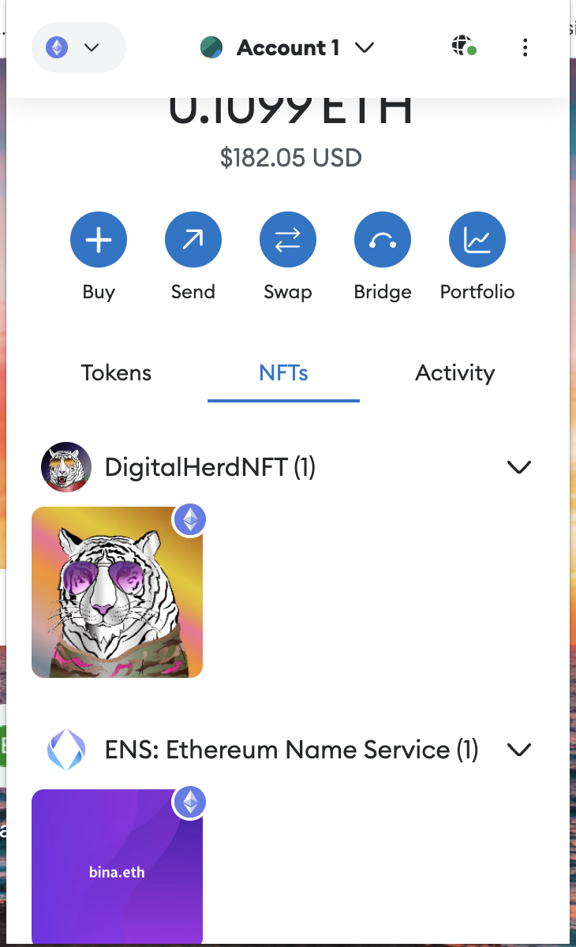
NFT : Non-fungible token
To represent assets that exhibit broad range properties and values.
Started off with arts and crafts, but can represent anything from a service, utility, person, real-estate.
Popular is arts and sports world.
You can buy, sell, trade, make profit (or loose) NFT with cryptocurrencies.
NFT is evolving and this area is something that you get involved if you are experienced in trading, art and other digital assets.
You can store, view your NFTs in your crypto wallet.
Here are two of my NFTs.
My wallet
My NFTs on
Ethereum network

Slide 22
Summarizing
Cryptocurrency technology offers innovative and unique opportunities in broad range of application areas besides finance.
Tokens and digital assets have added excitement to cryptocurrencies.
Tokenization has enabled a lot of opportunities for commerce and trade.

Slide 23
PART III : How to prepare yourself?
The Essentials: What do you need?
Apps, Tools and Techniques

Slide 24
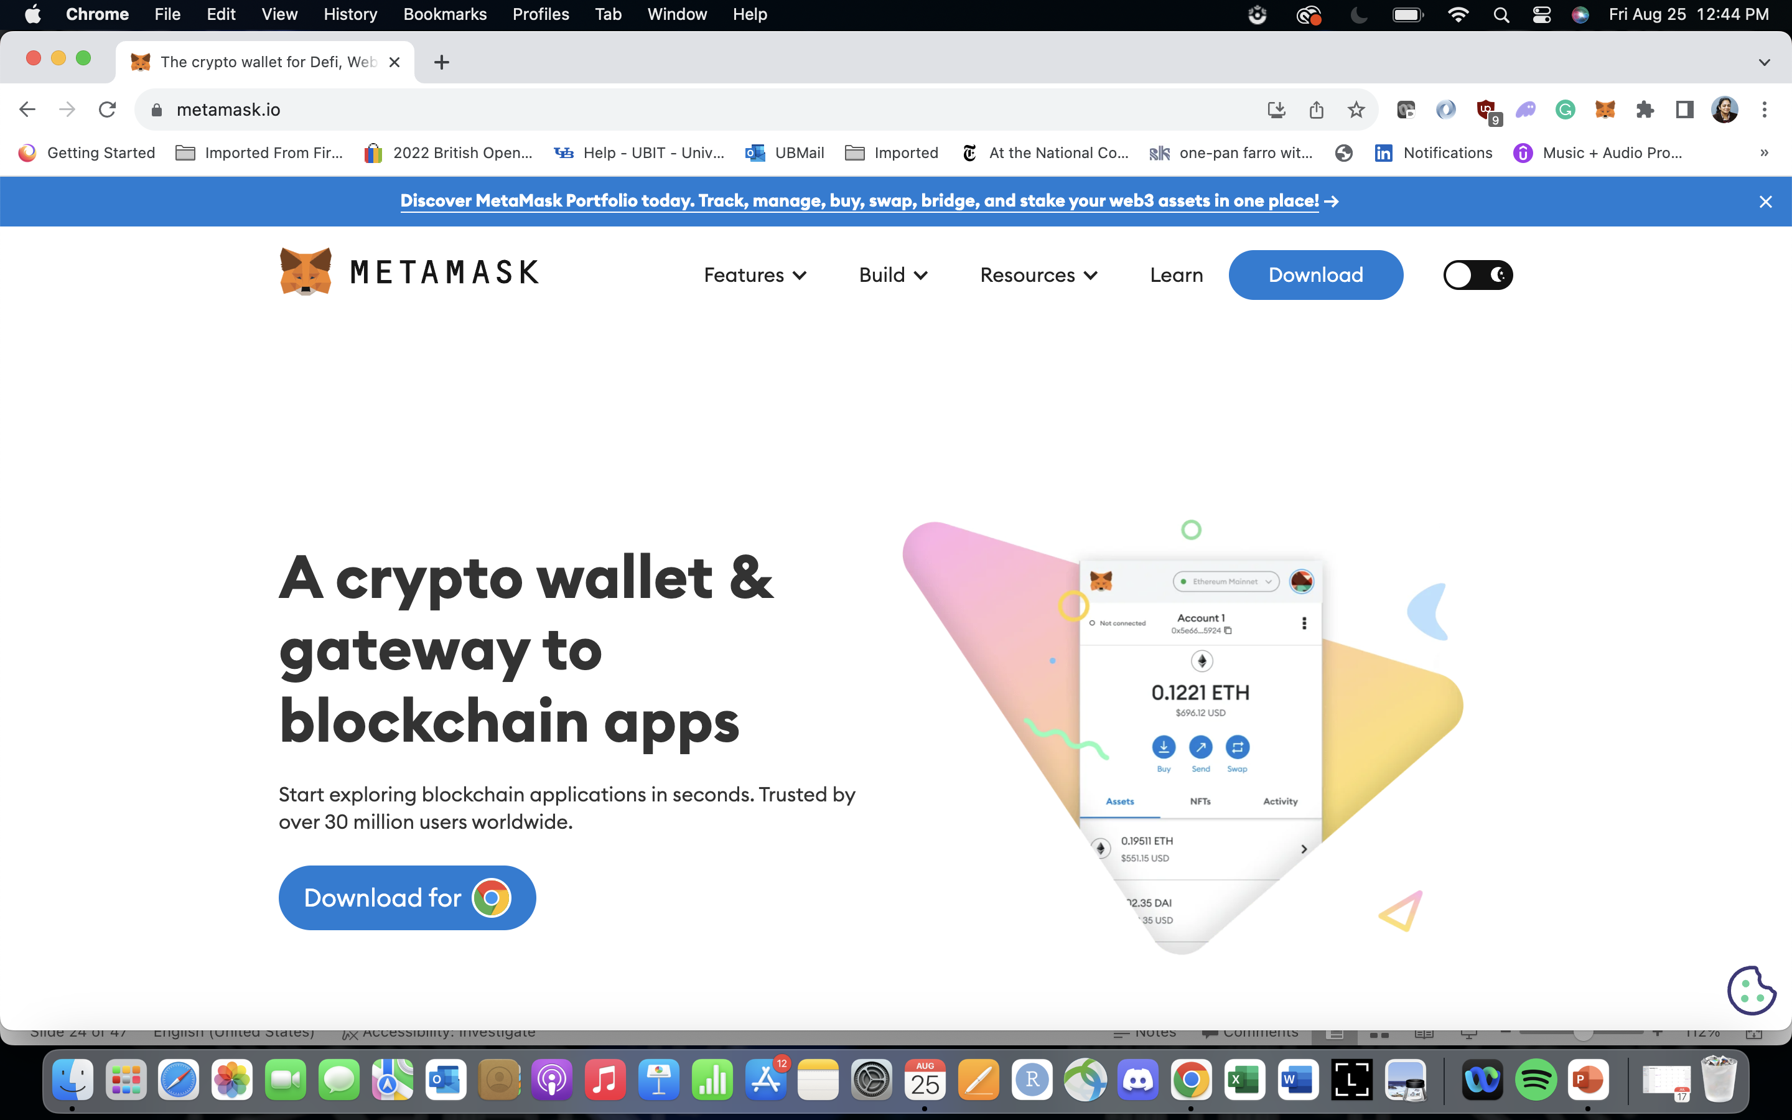
1. Get yourself an identity and a wallet
You can install a software wallet as a plugin to your browser if you are regular computer user.
Alternatively, you can install the same wallet as an app on your cell phone.
The installed wallet comes with set of unique identities that you can readily use.
I use Metamask wallet and is available here for download and install at metamask.io
You can also use a hardware wallet if you want complete control of your assets.
You can do most crypto transactions using a wallet.

Slide 25
2. Centralized exchange Coinbase
If you are not sure about your wallet, your alternative is to get an account on a “crypto bank”.
These crypto banks offer user interfaces like your regular bank functions and are known as a centralized exchanges.
The crypto exchange is linked to your traditional bank account or other traditional funding source for buying and cashing in cryptocurrency and digital assets.
Web site address: Coinbase.com
Coinbase has its own wallet: coinbase wallet that you install as a plugin or as an app on your cell phone.

Slide 26
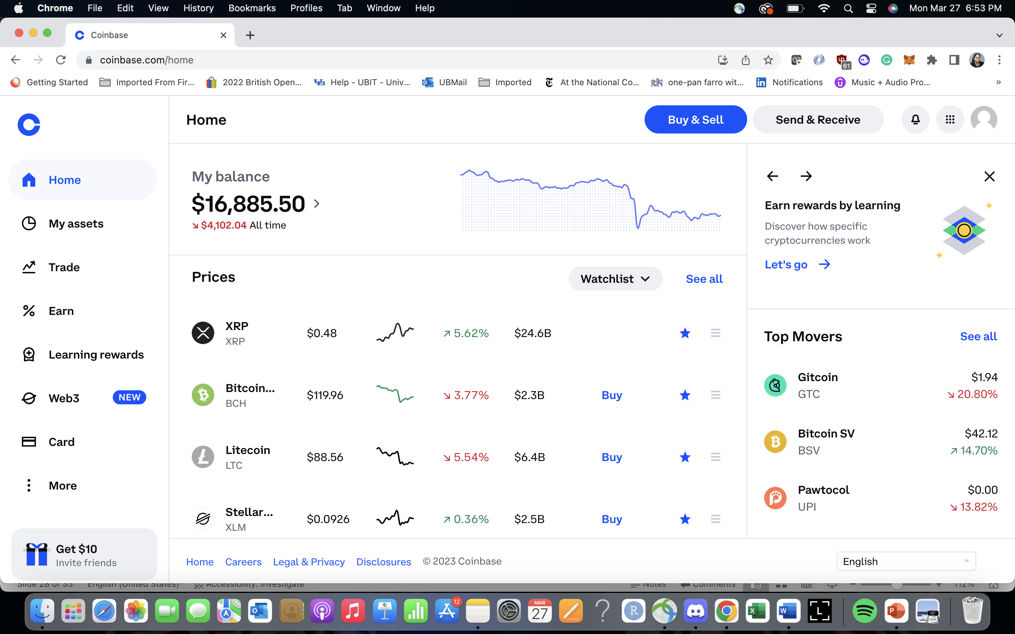
Opening page: coinbase

Slide 27
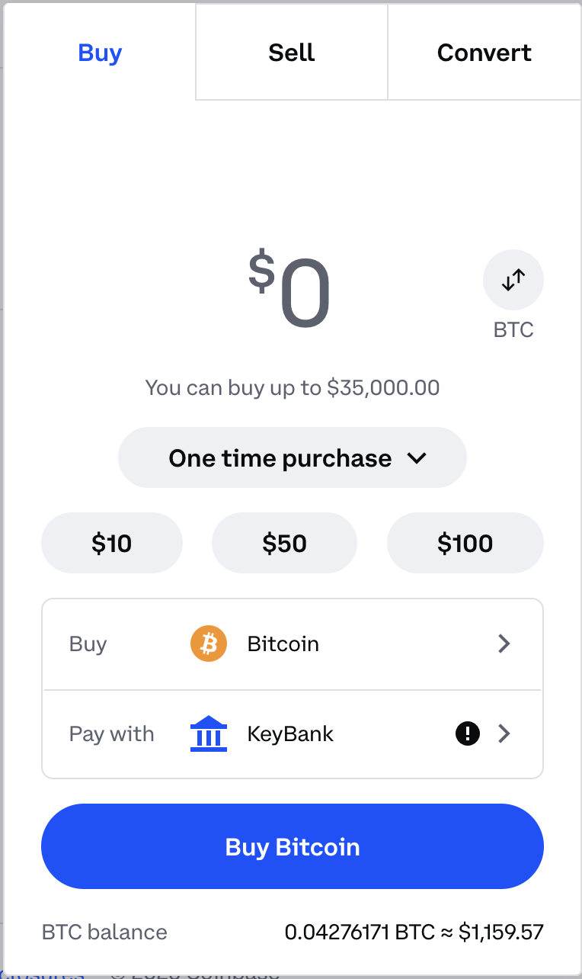
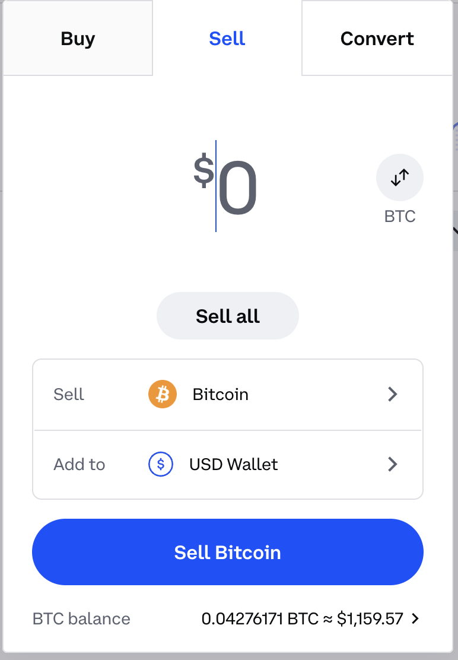
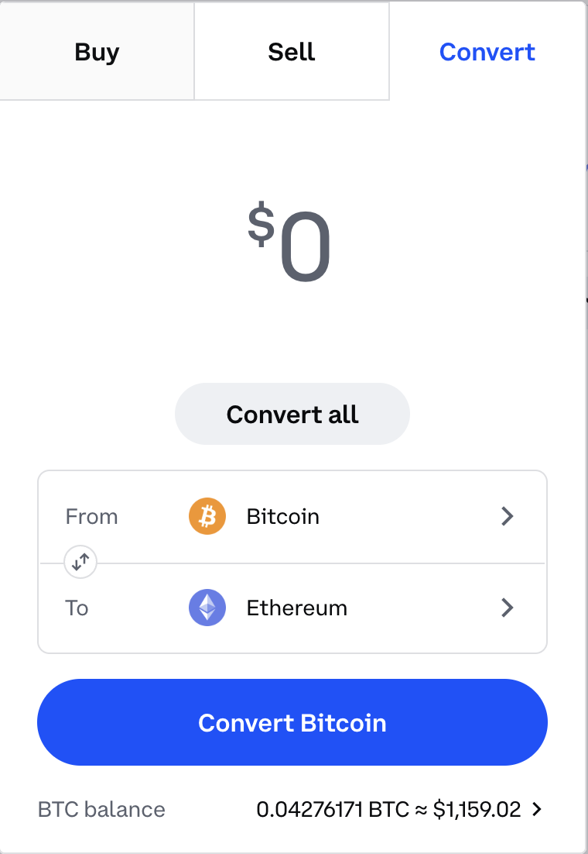
Buy, sell, convert interface

Slide 28
Summarizing,
We explored two different ways (Wallet and centralized exchanges) to acquire and manage cryptocurrency and digital assets.
There are many other ways you can get involved in cryptocurrencies: investments, trading, etc. Lookout for my DeFi online course.
One of the exciting areas that I am working on now is called decentralized finance (DeFi) and it features “decentralized exchange” or Dex and several new ways of investing crypto.

Slide 29
PART IV : Looking ahead
Major impact of cryptocurrency technology

Slide 30
Impact 1: Blockchain
Bitcoin 0.1.0 was released on 9 January 2009
Bitcoin and blockchain
Bitcoin cracked the trust and
integrity puzzle with its
Mathematics and algorithms
Innovation: blockchain technology
Idea: What worked for cryptocurrency should work for other business transactions
2007-2008 financial meltdown

Slide 31
Impact 2: Smart Contracts
Smart contracts are like your regular contracts. What role do real world contracts fulfill? For example, a rental contract? “Trust”
Smart contracts are code /programs that execute on the blockchain.
First cryptocurrencies and now smart contracts run on blockchain trust infrastructure.
Ethereum (another cryptocurrency) introduced the concept of smart contracts on blockchain.
This concept has taken a life of its own (besides crypto) and create a new world of decentralized applications. (Dapps)

Slide 32

Blockchain: A Trust Layer over the Internet
Trust is a critical component for trade and any type of business transaction.
Take a look at the evolution of our Internet as shown here.
Trust layer:
Let us motivate trust layer with an example.
Year 2009,
Blockchain-based trust
No standards yet
Year 1991, RFC 7230
Year 2000, RFC 2818 Standard
Web application
Secure web application
Secure & Trusted web application
HTTP
HTTPS Security
HTTPS Security
Blockchain Trust
The Internet

Slide 33

Blockchain infrastructure
3: Now many different types of
cryptocurrencies and
decentralized applications
can ”run” on the blockchain.
2: At first, bitcoin ran on it, and
is still running strong.
Dapps
1: Blockchain is like the train tracks or railroads.
4: We must realize that the real value
is in the decentralized applications or Dapps
Blockchain

Slide 34




Blockchain is people centered
A major difference is that blockchain is meant for “trusted” peer-peer transactions.
It is people/participant centered.
It is not all about programming and application development.
There is a role for every one of us to play.
The decentralized applications are for planetary level participants.
The technology encompasses all business domains not just FinTech and DeFi!
It is like the Internet, but with a trust layer.
It will allow enterprise and people to transact across the geographical borders.

Slide 35
Relating blockchain to artificial intelligence (AI)
Upstream AI processes can inform what Txs can you initiate.
Blockchain Txs.
Downstream analysis on the blockchain Txs to gather intelligence.
To do or not to do?
What’s happening here?
Txs
Blockchain transactions
Txs
Ongoing project of ThinkLab
Blockchain Txs provide gold mine of data for intelligence gathering.

Slide 36
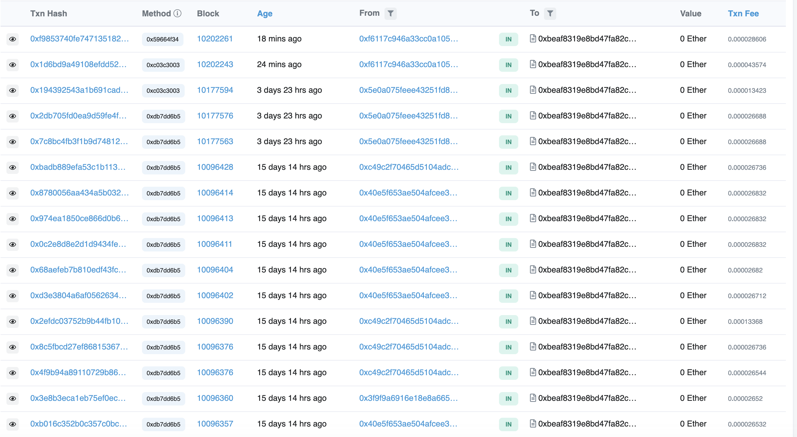
A peek into blockchain Txs.
We can also break down
the parameters of the Txs.

Slide 37
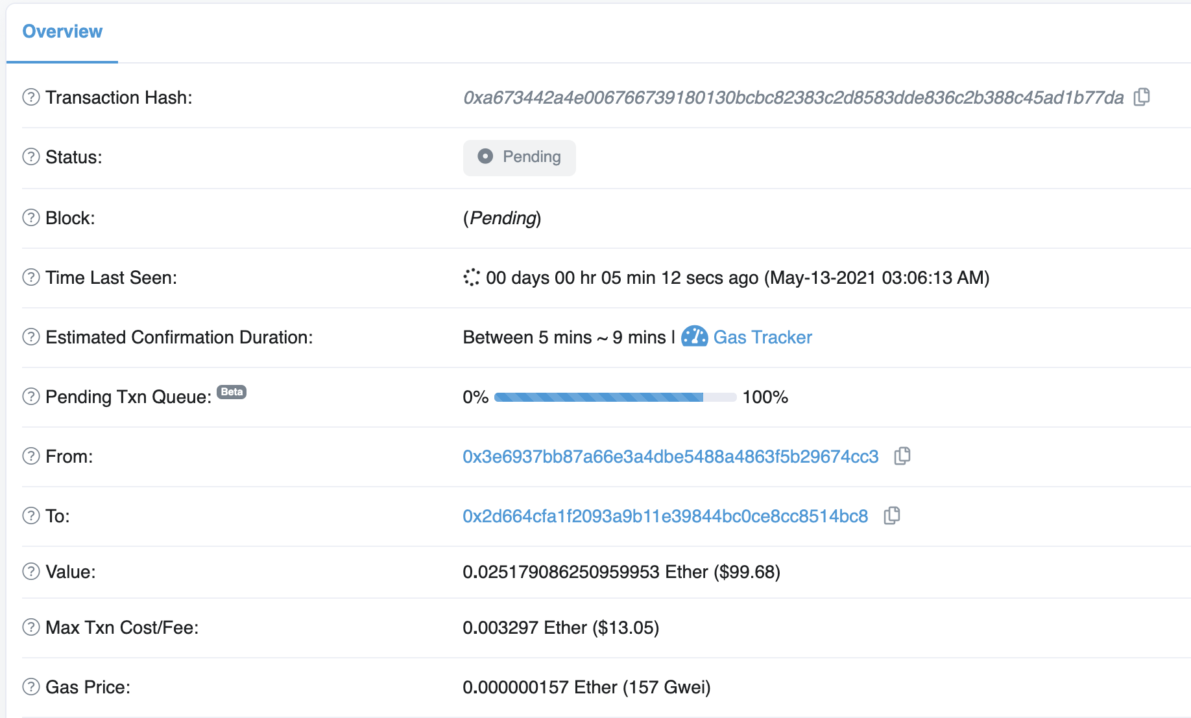

Slide 38
More information: Blockchain in action
I have written a book on Dapps or decentralized application development.
It features six Dapps: Not only for developers but also for other though leaders:
  Digital democracy
  Blind auction (decentralized auction platform)
  Airline consortium (Marketplace for seats)
  Micropayment channel (for planetary level operations)
  Tokenization of assets (for global trade)
  Educational credentialing (counting education from various sources)
More 150 figures explaining the various concepts

Slide 39
Summary
We learned about: (i) cryptocurrencies, (ii) wallet technology (iii) why cryptocurrencies (tokens, NFT, Dapps) and (iv) blockchain and smart contracts.
Two prominent cryptocurrencies are Bitcoin and Ethereum.
Bitcoin contributed “blockchain” and cryptocurrency.
Ethereum contributed “smart contracts”.
Blockchain technology is not about cryptocurrency anymore.
  It is used for broad range of applications across many industries: finance, healthcare, government, manufacturing, and distribution.
  Blockchain can enable an inclusive economy.
Blockchain has created exciting new opportunities and innovative application models:
Global collaboration systems, self-governing systems, open government
It is here to stay, in one form or another.

Slide 40
cynical view
To make a railroad round the world available to all mankind …-- Henry David Thoreau
In his famous book Walden
Blockchain cryptocurrency can be that railroad that Thoreau never got to see.

