Slide 1
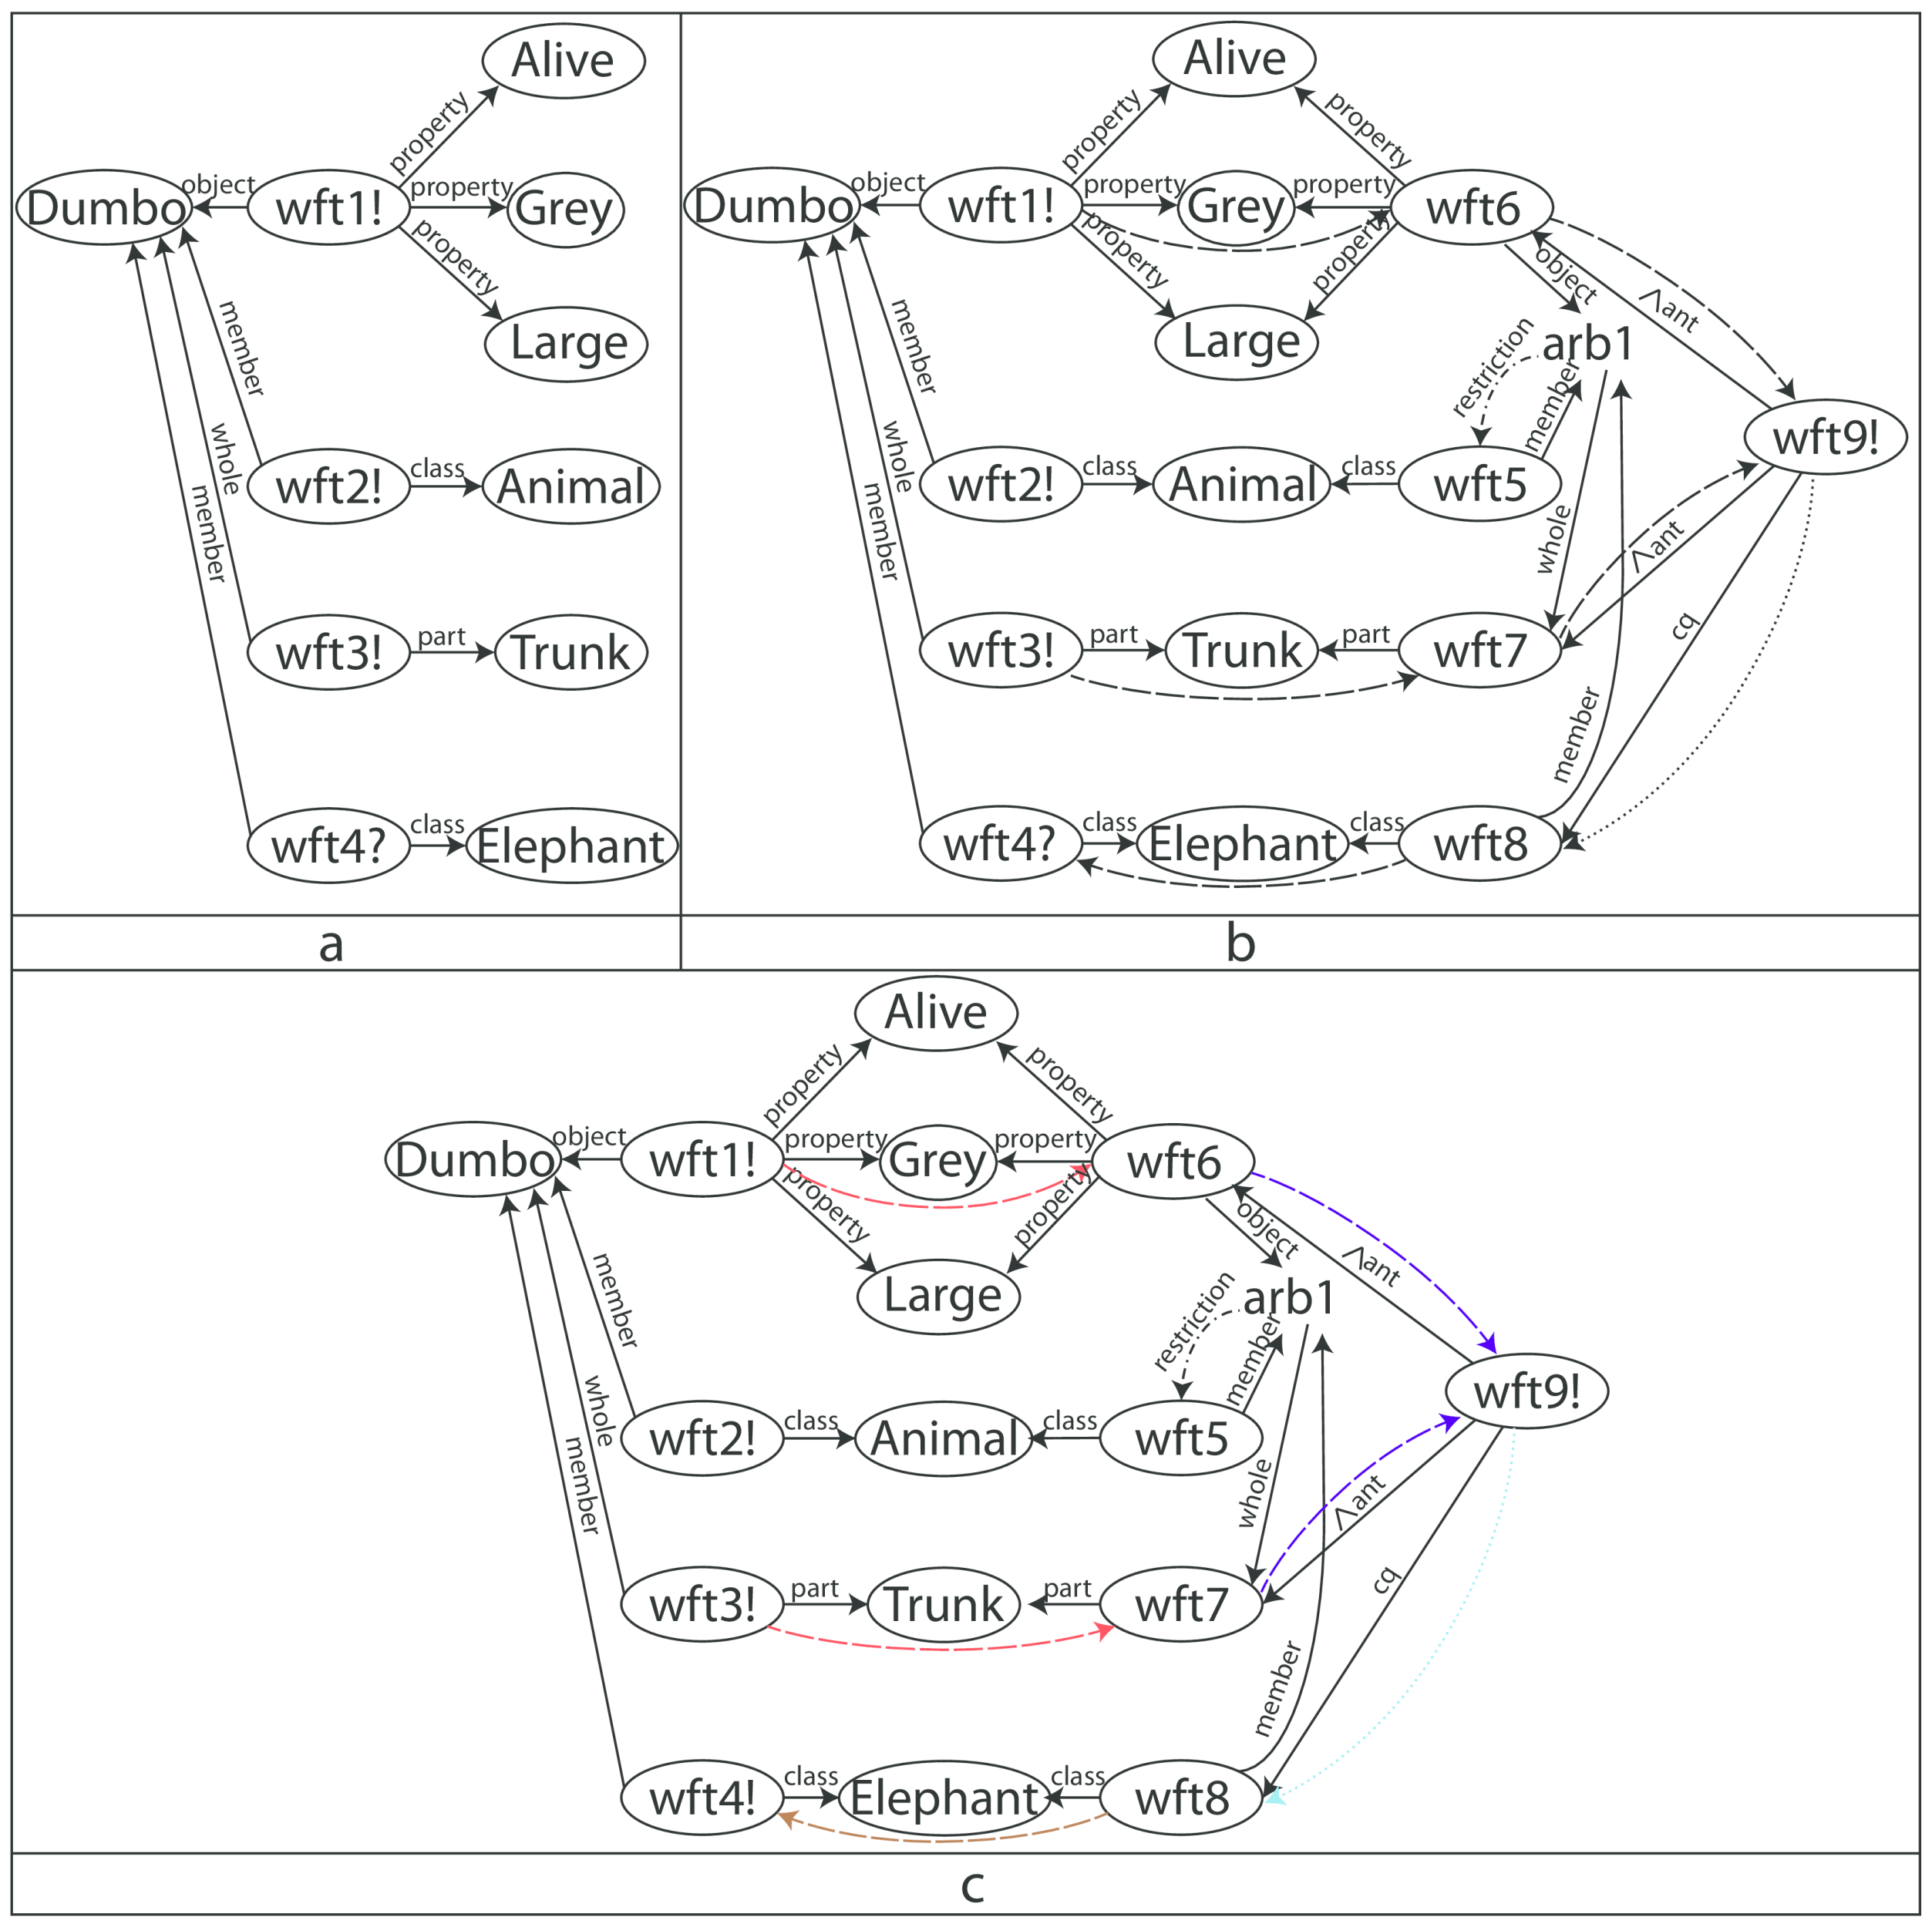
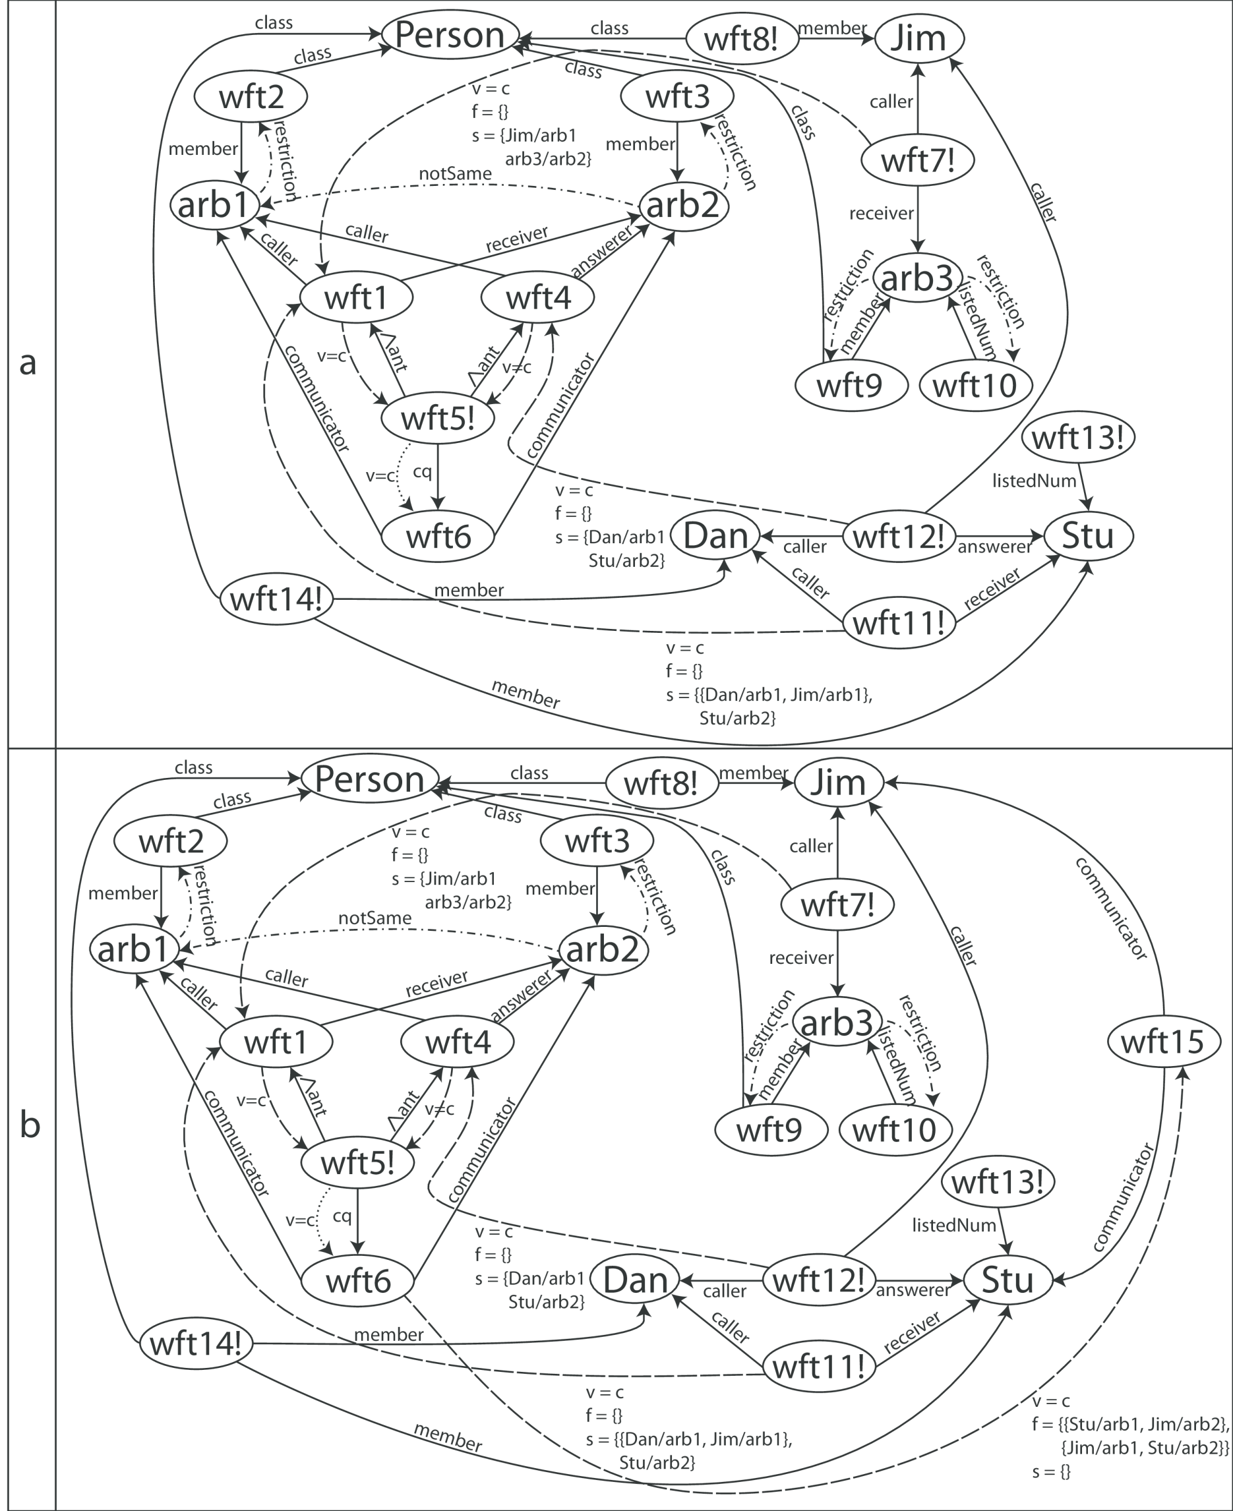
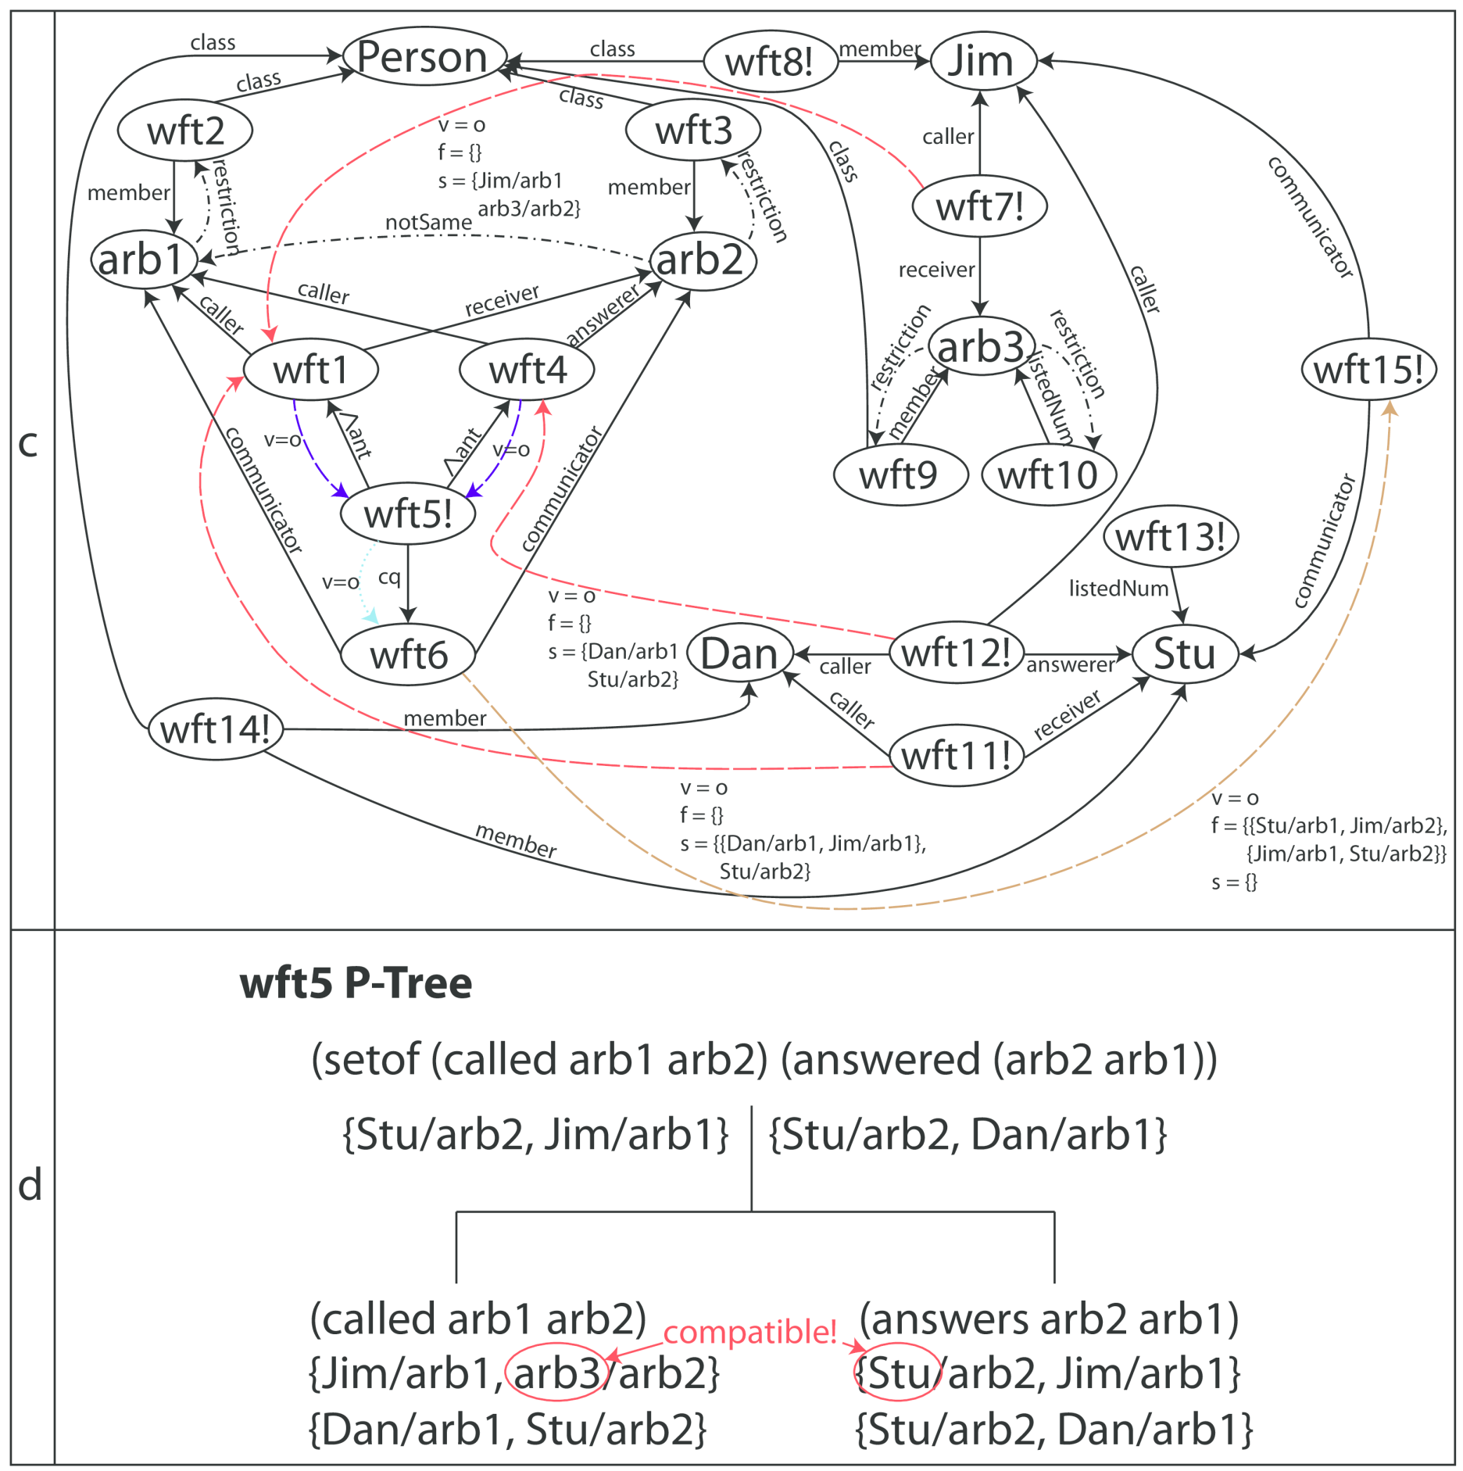
Inference Graphs: A Roadmap
Daniel R. Schlegel and Stuart C. Shapiro
<drschleg,shapiro>@buffalo.edu
Department of Computer Science and Engineering
Logic in Cognitive Systems
L_{A} – Logic of Arbitrary and Indefinite Objects²
Focused Reasoning
Logical inference can be used to implement the reasoning component of a cognitive system
Logic needs to be at least as expressive as FOPL
Proof-theoretic approach most useful
Designed for use as the logic of a KR system for natural language understanding, and for commonsense reasoning. Maintains locality of natural language phrases, uses a uniform syntax for differently quantified statements, and supports subsumption inference.
Would like to answer currently unanswerable questions as soon as they are answerable.
Like pushing a problem to the “back of your mind”
Mainly different from FOPL in use of structured quantified terms:
Arbitrary – Reason about a single arbitrary member of a class, instead of universals.
Indefinite – Essentially Skolem functions, replacing existential quantifiers.
Match terms with each other (unify, and perform check of structural subsumption³), build i-channels between matching terms, and use factorization of mgu to enhance channels:
Filter: stop messages with irrelevant substitutions
Switch: change the substitution’s context to that of the destination term
Transfer substitutions using messages along i-channels – “I have a new substitution you might be interested in”
Combine substitutions in rule nodes using various structures.
Eg. P-Tree: Binary tree combining conjuncts in conjunctive rules. Tests compatibility by ensuring equivalence or subsumption/instantiation of quantified terms.
Example: Agent observes Dumbo, who has the properties of being Alive, Grey, and Large, and has a Trunk. The agent wonders “Is Dumbo an Elephant?” (a), but doesn’t know how to tell. It later learns what characteristics an Elephant has (b), and immediately answers that Dumbo is an Elephant (c).
Inference Graphs
Built upon Propositional Graphs
KR Formalism
Every well formed expression is a node
Rules and other non-atomic terms are represented with:
A node for the term itself (a wft node)
Nodes for argument formulas
Arcs from the term to the arguments, labeled with role the argument plays
Performs inference using a message passing architecture.
Channels connect nodes
i-channels – “I have a new assertional status”
u-channels – “You have a new assertional status”
Have valves, allowing or preventing flow of messages
Messages pass through channels
Communicate inference progress
Control inference (open/close valves)
Rule nodes track messages received, and send messages about new derivations when the rule’s conditions are met, and sends other messages to cancel redundant or unnecessary inference.
Forward, backward, and bi-directional inference
Use concurrency for near linear speedup.¹
Example: If a person calls another person, and the second person answers the call from the first person, then those two people can communicate . Jim, Dan, and Stu are a persons. Jim calls everyone who has a listed number. Stu has a listed number. Dan calls Stu. Stu answers both Dan and Jim (a). The system is asked “Do Stu and Jim communicate?” (wft15, b), causing backward inference to commence. Valves in channels are opened, messages flow forward, and substitutions are combined (c,d), and the system concludes that yes, Stu and Jim do communicate.
“Wh- Question” Answering
“Who are the dogs you know about?” rather than “Is Lassie a dog?”
Questions added to the KB, using a new quantified term type: WhQuestion
Similar to Arbitrary in structure
Terms containing WhQuestions cannot be believed.
Answer can be one or more quantified terms.
Problem Summary
Inference graphs use only propositional logic.
Want to answer “wh- questions” using quantified terms .
We’d like to be able to answer previously unanswerable questions automatically, without asking and performing backward inference again (focused reasoning).
Solutions are the three not-yet-implemented extensions shown here.
References
Schlegel, D. R. & Shapiro, S. C. Concurrent Reasoning with Inference Graphs. In M. Croitoru, et al., Eds. LNAI 8323, Springer-Verlag, Berlin, 2013, pp. 138-164, in press.
Shapiro, S. C. A Logic of Arbitrary and Indefinite Objects. In D. Dubois, C. Welty, & M. Williams, Proc. of KR2004, AAAI Press, Menlo Park, CA, 2004, 565-575.
Woods, W. A. Understanding subsumption and taxonomy. In Sowa, J., ed., Principles of Semantic Networks. Los Altos, CA: Morgan Kaufmann. 45–94, 1991.
This work has been supported by a Multidisciplinary University Research Initiative (MURI) grant (Number W911NF-09- 1-0392) for Unified Research on Network-based Hard/Soft Information Fusion, issued by the US Army Research Office (ARO) under the program management of Dr. John Lavery.

