Slide 1
Problem solving using Blockchain
B. Ramamurthy
©2018, all rights reserved
bina@buffalo.edu
http://ww.cse.buffalo.edu/faculty/bina
Research Associate Professor
Computer Science and Engineering
Director, Blockchain THinklab
University at Buffalo
April 12, 2018

Slide 2
Overview and GOALS
1. Blockchain Concepts (slides 3-17)
A brief history of blockchain
What is a blockchain?
2. Introduction to smart contracts (slides 18-43)
Designing and Developing SC
Solidity and Remix IDE
3. Problem Solving using Blockchain (slides 44-47)
Blockchain Buildathon: How to?
Summary (slides 48-49)
References (slide 50)
Q & A

Slide 3
Blockchain Concepts

Slide 4
A Brief History of Bitcoin Blockchain
E-Commerce
Communication
mobile apps …
Cryptocurrency: Bitcoin: 2008/2009
Peer-to-peer autonomous digital currency system among unknown peers with no intermediaries
Validation, Verification, Immutable recording
The Blockchain
The Internet
Notes:
Need better graphics for all figures
Where is the innovation? Bitcoin is a live proof of a robust

Slide 5

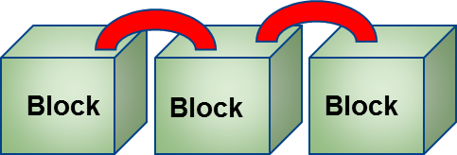
A Brief History of the Blockchain
Two major contributions of the famous cryptocurrency Bitcoin are
(i) A working digital currency system and
(ii) An autonomous decentralized technology called the blockchain.
Notes:
This software system that supports Bitcoin has been sustained completely by the crowd of developers, volunteers and miners.

Slide 6
What is a Blockchain?
The Blockchain is
An enabler for decentralization, without intermediaries.
A model for trust management in a network where peers operate beyond boundaries of trust.
An immutable ledger of records.
Enabled automation, accountabilty, auditability, efficiency, accuracy, fidelity, fairness, and inclusivenes.

Slide 7
IT is not all about Cryptocurrency!
Peer to peer transactions with no intermediaries (no middleperson)
Among unknown peers (not necessarily known to each other)
Peers thus operate outside boundaries of trust
Decentralized, peers hold their assets themselves (bearer assets)
Transactions are not necessarily about currency (e.g. reports, complaints, warning signals, grades)
Notes:
Now extend the scenario to 10000 entities, robots and all, all over the planet, unknown to each other; decentralized; holding something to transact; how will you trust them; where will you record them?

Slide 8
BLOCKCHAIN to the Rescue
Blockchain protocol (software, hardware) takes care of validation, immutable recording and verification of transactions.
The protocol is robust; it has a strong foundation established on the outcomes from more than 30 years of scientific research in
Public key cryptography,
Secure hashing (SHA),
Peer-to-peer networks,
Consensus/agreement protocols

Slide 9
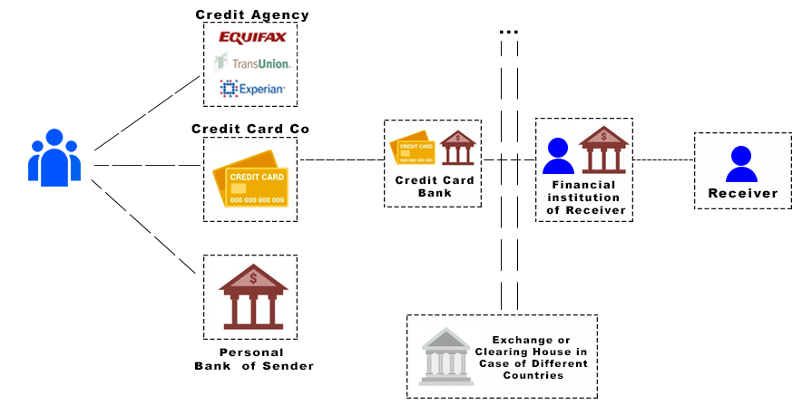
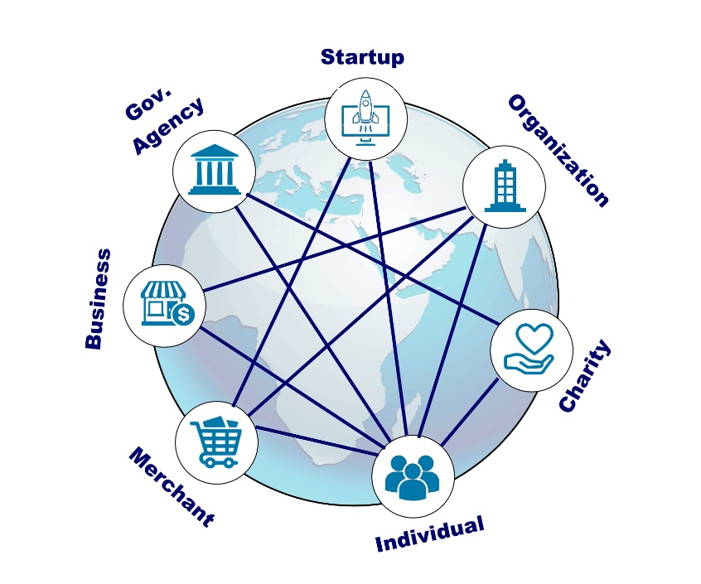
Blockchain: THE DECENTRALIZATION INFRASTRUCTURE - 1
Traditional Centralized System
Decentralized System
Functions of the intermediaries are shifted
to the peer participants and the blockchain nodes:
Disintermediation.

Slide 10
Blockchain: The DISINTERMEDIATION - 2
The Blockchain infrastructure supports methods to:
-- validate, verify and confirm transactions
-- record the transactions in a distributed ledger of blocks
-- implement a consensus protocol for agreement on the validity of blocks
-- create a tamper-proof record of blocks (chain of blocks)
Validation, Verification, Consensus, Immutable Recording ➔ Trust, Security
All defined by protocols, implemented by software and realized autonomously.

Slide 11


Blockchain: THE DISTRIBUTED Immutable Ledger - 3
Transactions
Eve
Block
Chain
invalid
Modify
Validate &
Gather
Transactions
Consensus &
Verify &
Confirm
Block
Block
Block
Chain link is the hash of elements of the previous block

Slide 12
Summarizing, BC is about
Decentralization
Disintermediation
Distributed Immutable ledger

Slide 13
Evolution of the Blockchain into Computing
E-Commerce
Communication
mobile apps …
Cryptocurrency: Bitcoin: 2008/2009
Autonomous, Decentralized, applications: 2013
Validation, Verification,
Immutable recording
Computing infrastructure:
Smart contracts
The Blockchain
The Internet

Slide 14
Smart Contracts
Typically currency transfer is for buying a service, product and utility from a person or a business. There may be other conditions besides availability of funds for executing a transaction.
A business transaction may involve rules, policies, laws, regulations and governing contexts.
Smart contract allows for these real-world scenarios to be realized on a blockchain.
Thus a smart contract enables a wide variety of decentralized applications of arbitrary complexity to be implemented on the Blockchain:
from supply chains to disaster recovery.
Probably many of the applications for the Blockchain technology have not been conceived of yet.

Slide 15
Smart Contracts using Solidity and REMIX IDE

Slide 16
Learning Objectives
Define the concept of a smart contract.
Discuss the syntax and the semantics of a smart contract programming language, Solidity.
Solve a problem and design a smart contract solution.
Learn Remix development environment for building and testing smart contracts.
Deploy the smart contract using Remix and invoke it from the web interface provided by Remix IDE.

Slide 17
Pedagody
It is imperative that you try the various concepts related to smart contracts on a test environment in order to understand and apply these concepts.
We will use Remix Integrated Development Environment (IDE) that is a web interface for these hands-on exploration. At this time please check you are able to access this interface at remix.ethereum.org
Be warned that remix is only a development environment and it keeps changing as new features are being added almost every week.
Notes:
Remix.ethereum.org

Slide 18
What is a smart contract?

Slide 19
What is a Smart Contract?
A smart contract facilitates transactions for transfer of assets other than cryptocurrency.
A smart contract allows specification of rules for an operation on the blockchain.
It facilitates implementation of policies for transfer of assets in a decentralized network.
The smart contract represents a business logic layer with the actual logic coded in a special high-level language.
A smart contract embeds functions that can be invoked by “messages” that are like function calls. These messages and the input parameters for a message are specified in a transaction.

Slide 20
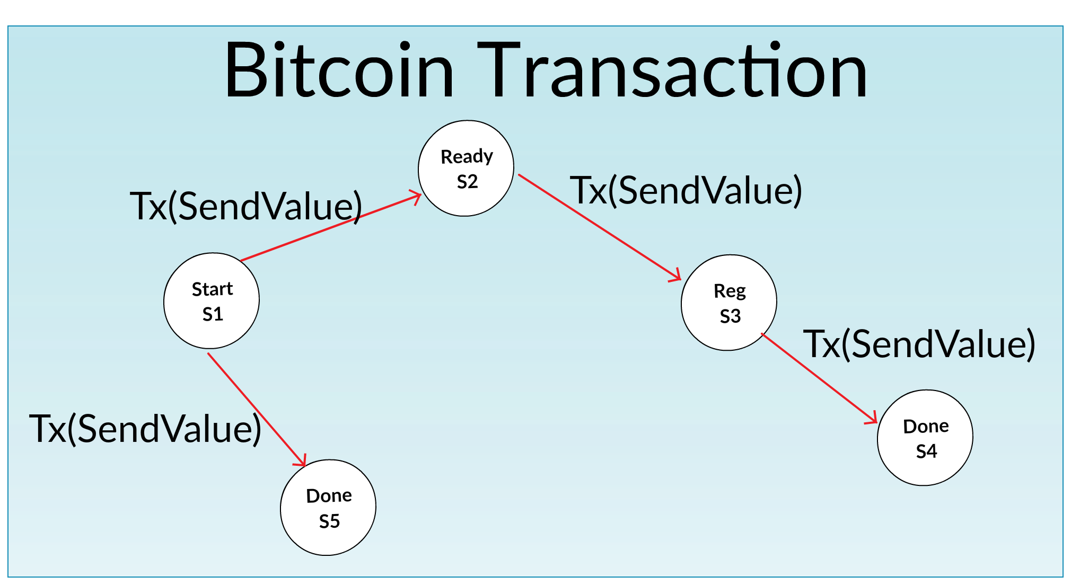
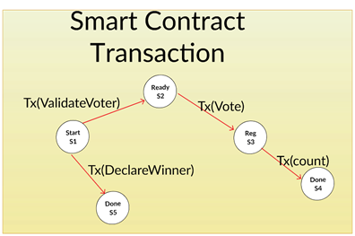
Transfer of currency vs. Smart contract Transaction (BY Sean Sanders)
Notes:
Let us compare Bitcoin transaction and a smart contract transaction.
As you can see in Bitcoin, all the transactions are about “SendValue”.
In the case of a blockchain that supports smart contract, a transaction could embed a function implemented by a smart contract.
In this case, we have a Voting Smart contract. The functions are validateVoter(..), vote (..), count (..), declareWinner(..)

Slide 21
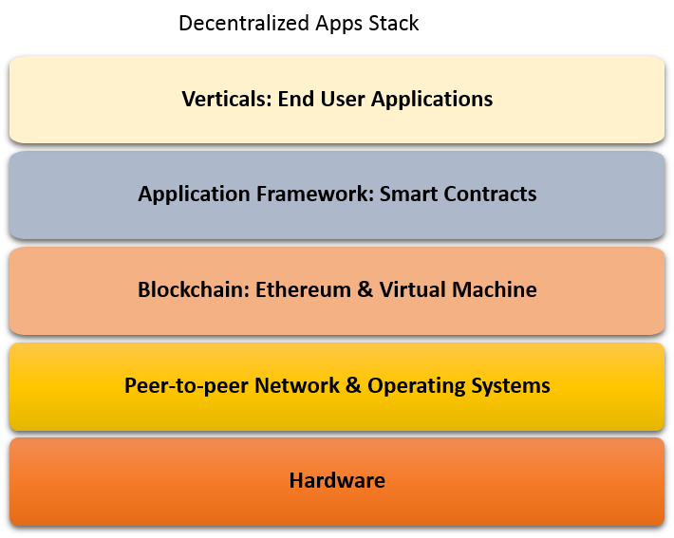
Dapp Stack (Decentralized APPLICATION STACK)on ETHEREUM Blockchain
Notes:
Smart contract provides a layer of computational logic that can be executed on the blockchain thus availing the features enabled by the blockchain framework.
Recall the layers of a decentralized application that we discussed in the Course 1, module 2. Observe the smart contract providing the application framework for a domain application. For example, consider home mortgage applications. Smart contract could embed all the business logic and intelligence for the rules and regulations to allow for automatic computations and initiation of operations. How might this be different from the existing systems you may ask? Here all the operations are transparent and are recorded on the blockchain. Customers can directly access the tools without an intermediary like a bank. It is like ATM for mortgage initiation! You are holding the assets instead of an intermediary.

Slide 22
What problem does a smart contract solve?
Typically currency transfer is for buying a service, product and utility from a person or a business. There may be other conditions besides availability of funds for executing a transaction.
A business transaction may involve rules, policies, laws, regulations and governing contexts.
SC allows for these real-world scenarios to be realized on a blockchain.
Smart Contract solves the problem of conditional transition from one state of the blockchain network to another.
Thus a smart contract enables a wide variety of decentralized applications of arbitrary complexity to be implemented on the Blockchain: from supply chains to disaster recovery.
Probably many of the applications for the Blockchain technology have not been conceived of yet. It is predicted that online shopping will takeover retails shopping for the first time this holiday season (2017-2018). Could you have imagined the dominance online shopping, mobile apps and uber 20 years ago?

Slide 23
Basic Structure of a SOLIDITy Smart contract
Contract in the Ethereum Blockchain has:
Pragma directive
Name of the contract
Data or the state variables that define the state of the contract
Collection of functions to carry out out the intent of an application
Other items we will discuss in the next lessons.
Identifiers representing these elements are restricted to ASCII character set. Make sure you select meaningful identifiers and follow Camel Case convention in naming them.
We will learn these concepts using simple contracts written in a high level language called Solidity.
We will use a web Integrated Development Environment (IDE) called Remix to create, deploy, execute and explore the working of a few representative smart contracts.
Notes:
https://en.wikipedia.org/wiki/Camel_case

Slide 24
Smart Contracts in Soldity by Example
We will examine two a simple smart contracts:
Greeter
Coin
These two examples are modified versions of the examples given in Solidity documentation.
Our goal is to get an overview of the structure of a smart contract without getting into the details of the Solidity language.
However we will explain every item in the smart contract we plan to explore.

Slide 25
pragma solidity ^0.4.0;
contract Greeter {
/* Define variable greeting of the type string */
string public yourName;
/* This runs when the contract is executed */
function Greeter() public {
yourName = "World";
}
function set(string name)public {
yourName = name;
}
function hello() constant returns (string) {
return yourName;
}
}
Notes:
Here we see code for the Greeter contract.
It begins with the pragma that provides the version number so that compiler knows which version of Solidity
This was developed in.
You also see the name of the contract Greeter, state variable yourName. Note that it is in camel notation.
This is followed by functions: The constructor Greeter, that initializes yourName variable,
Set function that sets the variable to a name supplied by the user’s message as a parameter.
And a hello function that retrieves the name for use by the invoking application.

Slide 26
Remix Environment
File Explorer
Editor
Commands: Compile, Run, Debug, with Details
Account Addresses
Create Button
Details: ABI, Byte code, etc.
Smart Contract web interface Panel
Console/terminal Output area
Notes:
REMIX IDE: remix.ethereum.org
Here we show a block diagram of the Remix IDE. It has a File explorer on the left panel, an editor for entering code in the upper middle, and a console output area at the bottom middle. On the right panel are commands for compile, run, create etc. And at the bottom right panel is the web interface area. With all these features Remix is indeed a one stop environment to develop, deploy and test a smart contract.

Slide 27
Smart Contract Creation & Execution
Let us now explore the creation and execution of smart contracts.
We will begin with Remix environment. remix.ethreum.org
Then we will compile and execute the two simple contracts” Greeter and Coin and understand the structure of a contract.
We will also learn the features of the Remix IDE for supporting development and testing of contracts for your applications.

Slide 28
Here are some basic elements of a smart contract
Data or state variables
Functions : There are several types of functions allowed,
Constructor ( default or user specified; only one, meaning it cannot be overloaded)
Fallback function (This is a powerful feature of an anonymous function that we will discuss in the best practices module later in this course.)
Pure functions (no state change allowed, it computes and returns a value; example: math functions)
Public functions (accessible from outside thru transactions, state changes recorded on the bc).
Private functions (accessible only with the current contract)
Internal functions (accessible inside current contract and inherited contract)
External functions (can be accessed only from outside the smart contract, for viewing data, for example)
User defined types in struct and enums
Modifiers
Events

Slide 29
Function definition
Now we will step into the smart contract and look at the function definition: function definitons are similar to functions in any other high level language;
Function header followed by the code within curly brackets.
function header { function code }
Function code contains the local data and statements to process the data and return the results of the processing.
Notes:
https://github.com/fivedogit/solidity-baby-steps/tree/master/contracts/
https://remix.ethereum.org

Slide 30
Solidity Data Types By Example
Solidity supports many of the basic data types of a high-level language, we have given here just a few:
uint : unsigned int of 256 bits
int : integer, positive and negative value of 256 bits
string: string of characters
bool : that supports logic true and false value
Default modifier for data is private, you explicitly state the “public” modifier if that is what is intended. For every data declared public, accessor (getter) function is automatically provided.

Slide 31
Basic Statements
The common statements available in any high level language are available in Solidity with very little variation: assignment statement, if..else, while, for, etc.
We will learn them as we add code elements to the examples.
We will develop Bidder smart contract in incremental steps starting with the basic design representation shown here. Always design before you code.
Let us move to the Remix environment to work on this example.

Slide 32
Address data structure
Address is a special Solidity defined complex data type; It can hold a 20 byte Ethereum address, recall that it is the reference address to access a smart contract.
Address data structure also contains the balance in Wei of the account represented by the address; it also supports a function “transfer” to transfer value to a specific address. This is shown in the figure here.
<address>.balance (uint256):
balance of the Address in Wei
<address>.transfer(uint256 amount):
transfer given amount of Wei to Address

Slide 33
Mapping data structure
“Mapping” is a versatile data structure that is similar to a <key, value> store. It can also be thought of a hash table.
The key is typically a secure hash of simple Solidity data such as the address, and the value in <key,value>pair can be any arbitrary type.
mapping (uint => string) phoneToName;
struct customer { unit idNum;
string name;
uint bidAmount;}
mapping (address => customer) custData;
Notes:
Here we illustrate the idea of mapping with two examples.
We can use phone number to name mapping, that is a common utility function on our phone system.
As a second example, You can have “struct” of all the customer data, and can use mapping to map an account address to customer data as shown.

Slide 34
Msg is special data structure
msg is a complex data type specific to smart contract.
It represents the call that is used to invoke a function of a smart contract.
It supports many attributes, of which, we are interested in two of them now. You can always look up other msg details in the Solidity documentation.
msg.sender that holds the address of the sender, msg.value that has the value in Wei sent by the sender:
address adr = msg.sender
uint amt = msg.value
Usage: now you can write statements that verify and validate adr and amt to make sure the application specifics are met.

Slide 35
Use these data structures: address, mapping and msg
Let us now use these data structures and mint some money.
Let us look at a smart contract for “Coin” as specified in the Solidity documentation.
Recall we always start with a design (say, a class diagram) whether we are analyzing a program or coding an application.
Also make a note of the statements for if..else and assignment statement.

Slide 36
contract Coin {
// The keyword "public" makes those variables readable from outside.
address public minter;
mapping (address => uint) public balances;
// Events allow light clients to react on changes efficiently.
event Sent(address from, address to, uint amount);
function Coin() public{
minter = msg.sender;
}
function mint(address receiver, uint amount) public {
if (msg.sender != minter) return;
balances[receiver] += amount;
}
function send(address receiver, uint amount) public {
if (balances[msg.sender] < amount) return;
balances[msg.sender] -= amount;
balances[receiver] += amount;
Sent(msg.sender, receiver, amount);
}
}
Notes:
Lets review this code in REmix IDE.

Slide 37
Modifiers
Modifiers can change the behavior of a function: that is why this feature is referred to as a “modifier”
It is also known as a function modifier since it is specified at the entry to a function and executed before the execution of a function begins.
You can think of a modifier as a screen/filter protecting a function.
A modifier is typically checks a condition using a “require” and if the condition failed, the transaction that called function can be reverted using revert function. This will completely reject the transaction and revert all its state changes. There will no recording on the blockchain.

Slide 38
Modifier and Require
Let us understand modifier and require using the Coin smart contract functions:
We will add a modifier “onlyOwner” to the mint function. We will do this by these steps:
Define a modifier for the clause “onlyOwner”
Adding the special notation ( _; ) to the modifier definition that includes the function
Using the modifier clause in the function header

Slide 39
Modifier for COIN.sol
modifier onlyOwner()
{
require(msg.sender == minter);
_;
}
// This is the constructor whose code is
// run only when the contract is created.
function Coin() public{
minter = msg.sender;
}
function mint(address receiver, uint amount) onlyOwner public {
// if (msg.sender != minter) return;
balances[receiver] += amount;
}

Slide 40
Importance of Modifiers
Function modifiers along with the state-reverting functions of revert(), require() collectively support a robust error handling approach for a smart contract.
These declarative features can be be used to perform formal verification and static analysis of a smart contract to make sure it implements the intent of a smart contract.

Slide 41
Summary
We learned the purpose of smart contract and its critical role in transforming blockchain technology from enabling decentralized systems.
We explored the structure and basic concepts of a smart contract through examples.
We illustrated Remix (remix.ethereum.org) web IDE for deploying and interacting with a smart contract.
We learned basics of Solidity language.

Slide 42
How to solve a problem with Blockchain? There is a Dapp for that.
Blockchain is NOT solution for all your problems. It is NOT a data repository.
You save only the “sliver” of info that is needed for business logic, provenance and governance on the blockchain.
Write the use cases
Choose your blockchain. Lets say we chose Ethereum. And Ethereum is not the only blockchain technology. There are many others.
Design and Implement a smart contract solution in Solidity Language
Test it using Remix IDE (Integrated Development Environment)
Develop end-to-end Dapp using Truffle IDE with a graphical user interface
Deploy it on a blockchain for the whole decentralized world to use.

Slide 43
ProblEM Solving using blockchain

Slide 44



Decentralized Application Development
Problem statement
Analysis and design of smart contract solution
Implement and test the smart contract using Remix IDE
Deploy the smart contract on the blockchain and test it
Design and implement the front end and connect it to blockchain backend

Slide 45
Dapp Design Process & Demo
Problem Statement
Smart Contract –-
Solidity Remix
Code Dapp, test—
Truffle

Slide 46
A Method for Developing a DApp
Code Dapp, test—
Truffle
Clearly state the problem and all its constraints.
Design the prototype smart contract(s) for the solution and do basic testing: Solidity, Remix
Now move onto Truffle IDE. (This is pre-loaded in the VM given to you)
Create a directory; initialize for various components of the Dapp using
“truffle init”
Generate the test blockchain accounts using “truffle develop” framework.
Deploy the compiled contracts to test blockchain:
“truffle migrate”
Test the Dapp using the interface and transact using a Metamask chrome extension.
Create the contracts .sol files in the contracts directory. Compile using
‘truffle compile”,
debug
Add the test files for testing the functions of the contracts. Use
“truffle test”

Slide 47
Blockchain Opportunities
Blockchain users, reporters
Contributing Peer participants in blockchain application platforms
Blockchain application development and education
Disciplinary /vertical domain research in investigating application of blockchains (legal, healthcare, government, fintech…)
Blockchain Dapp development tools and frameworks
Blockchain protocol improvement research and decision makers
Blockchain alternatives for decentralized systems
Fundamental research in blockchain algorithms

Slide 48
UB Initiatives: How can we help?
UB SEAS is at the leading edge of educating people about this technology.
We are in the process of cresting a Coursera Blockchain “Specialization” that has 4 courses of 4 weeks of online instruction each with practical hands-on components.
UB Blockchain Thinklab has been created with the support from President’s Circle Club funding
Premier event: UB Blockchain Buildathon April 13-15, 2018 See ethBuffalo.org
Educating UB students across the campus
Locating resources for your research and answering your blockchain questions
Consulting with regional and international businesses
Promoting Buffalo as a world renowned blockchain hub

Slide 49
Summary
Blockchain technology is not about cryptocurrency anymore.
It is used for broad range of applications across many industries: finance, healthcare, government, manufacturing, and distribution.
Blockchain can enable an inclusive economy.
Blockchain has created exciting new opportunities and innovative application models:
Global colloboration systems, self-governing systems, open government.
Private, public and permissioned (consortium) models to meet diverse business needs.
There is a role to play for each and everyone of you.

Slide 50
References
S. Nakamoto. Bitcoin: A Peer-to-Peer Electronic Cash System. http://www.bitcoin.org, 2008.
Ethereum Project: Homestead and Platform. https://www.ethereum.org/, last view 2017.
Introduction to Smart Contract. https://solidity.readthedocs.io/en/develop/introduction-to-smart-contracts.html#. Last viewed 2017.
The Hyperlegder Project. https://www.hyperledger.org/, last viewed 2017.
Remix IDE: remix.ethereum.org, last viewed 2018.
Truffle IDE : http://truffleframework.com/docs/, last viewed 2018.

