Slide 1
CSE321: Realtime and Embedded Systems
B. Ramamurthy
University at Buffalo
bina@buffalo.edu

Slide 2
Outline
What is a realtime system?
What is an embedded system?
What is a realtime embedded system?
Embedded system but not a realtime system
Realtime system but not an embedded system
Why realtime&/embedded system?
How do realtime embedded systems differ from regular computational systems?
Lets define and identify some examples of realtime embedded systems in your school/work/home environment.
We will attempt a simple design process.

Slide 3
Defining RTOS

Slide 4
Lets define realtime systems
Timing: RT systems (RTOS) are required to compute and deliver correct results within a specified period of time. Ex: traffic light controller
Interrupt driven: event-driven preemption; RTOS are often involved with handling events.
Events manifest themselves in terms of interrupt signals arising from the arrival data at an input port or ticking of a hardware clock, or an error status alarm.

Slide 5
RTOS Definition (contd.)
Low-level programming: RTOS often deal with devices; C language is still a favorite for writing device drivers for new hardware.
Specialized hardware: Most RTOS work within, or at least close beside, specialized electronic and mechanical devices. Often closed loop systems.
Volatile data IO: Variables that change their value from moment to moment. RTOS software must be structured to check for changes at the correct rate, so as not to miss a data update.

Slide 6
RTOS Definition (contd.)
Multi-tasking: RTOS are often multitasking. Several processes cooperate to carry out the overall job. Divide RTOS problem into tasks as a design strategy.
Run-time scheduling: Separation of activities into tasks leads to question of task sequencing or scheduling. Moreover the external events and required response to these lead to run-time scheduling or dynamic scheduling.
Unpredictability in inputs/stimulus: Being event-driven, RTOS are at the mercy of unpredictable changes in their environment.
Predictability response requirement!
Life-critical code: failure to run correctly may result in death or at least injury to the user and/or others. Life-critical systems requires extra testing, documentation and acceptance trials.

Slide 7
Types of RTOS
Hard RTOS: tight limits on response time, so that a delayed result is a wrong result.
Ex: jet fuel controller and camera shutter unit
Soft RTOS: need to meet only time-average performance target. As long as most results are available before deadline the system will run successfully.
Ex: audio and video transmission, single frame skip is fine, but repeated loss is unacceptable
Firm RTOS: somewhere between the two.
Ex: Space station solar panel unit

Slide 8
Microprocessor
Examples: vending machines, mobiles phones, alarm systems, washing machines, motor car engine controllers, heart monitors, microwave ovens all operate using embedded microcontrollers running dedicated software.
“Microprocessor” is one of the critical enabling hardware for realtime systems.

Slide 9
Embedded Systems
Dedicated functionally
Special purpose
Optimized for a certain operations
Small (typically)
Lower power consumption
Embedded within other large systems

Slide 10
Embedded Systems
Embedded systems are computing systems with tightly coupled hardware and software integration.
Designed to perform dedicated function
Embedded means that the system is a integral part of a larger system
Multiple embedded systems can co-exist in a single system.
General purpose processor are typically not aware of the applications.
An embedded processor is application-aware.

Slide 11
Embedded Systems (contd.)
Hardware and software co-design: hardware and software for the embedded system are developed in parallel.
Cross-platform development: Both embedded system and its application use the cross-platform development method.
Software is developed on one platform but runs on another.
Software storage will have to be chosen to allow for upgradeability.
Of course, the SoC (system on a chip), PoE (Power on Ethernet), etc.

Slide 12
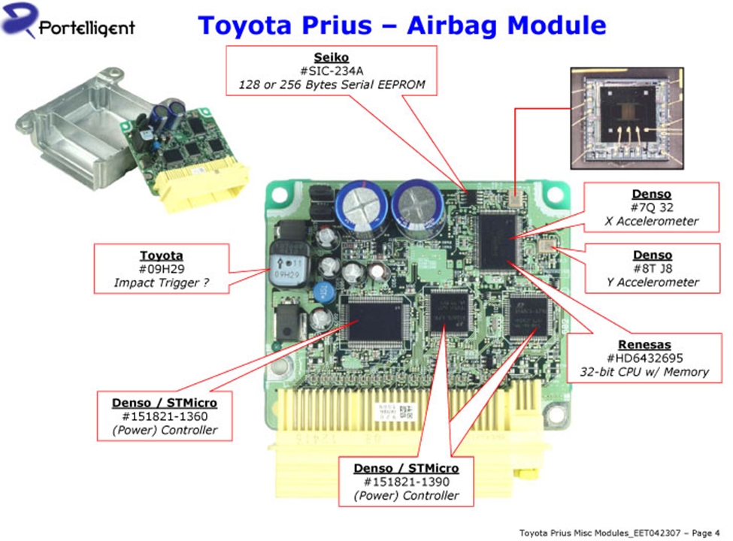
Examples
From everyday applications
From automotive domain: Electronic Control Unit (ECU)
Any examples?

Slide 13
Realtime Embedded Systems
RTOS
EMB
RTEMB
Railway monitoring and scheduling : RTOS
Cell phone: EMB
Heart pacemaker: RTSEMB

Slide 14
Class work #1
Lets identify 10 embedded systems, realtime systems and realtime/embedded system
I will begin with Arduino Uno
Example | Type; justification

Slide 15
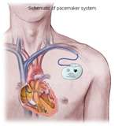
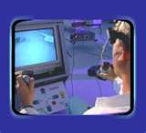
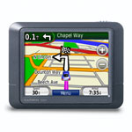
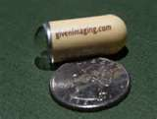
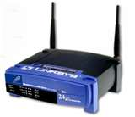
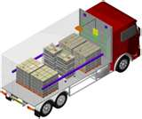
Embedded Systems

Slide 16
Designing RTOS
Where do you begin?
ANS: Requirements

Slide 17
Functional and non-functional requirements
Functional: Describes the explicit operations to be performed by the RTOS.
If you consider the climate control system in an automobile:
Sense temperature: T1
Compare with user set temperature: Tset
If T1 > Tset, start cold air fan
Else if T1 < Tset, start hot air fan
Non-functional: describes the quality of the operations
Example: Need to control temperature within 0.5 degree error
Accuracy
Precision
Reliability
Safety
Response time
Responsiveness
Predictability
Deadlines

Slide 18
Hardware Requirements
Hardware support for functional requirements
Hardware support for non-functional requirements
Size of the device
Power of the processor
Power consumption
Speed of the device
Support for devices, interrupts
Electronic Control Units (ECU): typical modern automobile has 100’s of ECUs [Takada]

Slide 19
Software requirements
Software functions to implement the operations
Driver that dispatches calls to these operations
Interrupt handlers
Device drivers
Operating system
Typical modern automobile has millions of lines of software [Takada]
Reference [Takada]:
http://estc.dsr-company.com/images/b/b5/Automotive-embedded-systems.pdf

Slide 20
Software Quality Assurance
QA is especially important to RTS since many of these are deployed in life critical environments / situations.
Consider a heart pace maker
Consider a rail signaling system

Slide 21
Design Representation
Today we will look at a finite state machine (FSM) for representing the design of a RTOS.
On to the design…

Slide 22
Design Considerations
Requirements → Design representation
Design representation → prototype
Prototype testing
Production system

Slide 23
Class work #2
Automatic vending machine money counter
Embedded system (25Cent counter)
Coins: 5, 10, 25 cent coins
S5
10
S15
5
5
25
5
25
10
S10
10
S20
5
5
10,25
S0
5
10
S25+
25
S25

Slide 24
Finite State Machine (FSM)
An FSM M = five tuple ➔ { S, i, T, Σ, δ }
S = set of states
i = initial state
T = terminal state (s)
Σ = events that bring about transitions
δ = transitions
Lets do this exercise for the avionics for a fighter aircraft/a drone

Slide 25
Design methods: Finite state machines
Finite state automaton (FSA), finite state machine (FSM) or state transition diagram (STD) is a formal method used in the specification and design of wide range of embedded and realtime systems.
The system in this case would be represented by a finite number of states.
Lets design the avionics for a drone aircraft.

Slide 26
Drone aircraft avionics (simplified)
else
MA: Mission Assigned
TD: Target Detected
LO: Locked On
EE: enemy Evaded
ED: Enemy Destroyed
MC: Mission Complete
MA
else
TAK
NAV
TD
else
NAE
MC
TAK: Take off
NAV: Navigate
NAE: Navigate & Evade
NAA: Navigate & Attack
LAN: Land
else
LO
NAA
EE
LAN
ED

Slide 27
State Transition table
 | MA | LO | TD | MC | EE | ED
TAK | NAV
NAV |  |  | NAE | LAN
NAE |  | NAA
NAA |  |  |  |  | NAE | NAV
LAN

Slide 28
Lets design a simple embedded/ realtime system
Use the table-cell to code a function / use with switch statement
Or write a table-driven code
Which is better and why?

Slide 29
Summary
We studied the basic definitions of realtime and embedded system.
We studied key issues which make development of realtime software more challenging than desktop or traditional data processing applications.
Timing is very critical for RTOS input, output, computing and response.
UML state diagram is a useful tool for design representation.
We will study the design and implementation of RTOS system in detail later on.

Slide 30
Recitations & Course work
Meet at 340 Bell: Please attend recitation: any one of them (only for next week)
Meet and greet your TA
Topic: C Basics, memory alloc/dealloc, makefile
Work for this course:
2 C lang-based –labs : individual: on xinu: kernel programming
6 Codecon C-programming homework on codecon env. : individual
1 term project { RTEM problem solved using Arduino, Raspberry Pi or CrazyFlie2.0}: groups of two or less
Two exams: one midterm in class; one final exam

