Slide 1
UART and UART Driver
B. Ramamurthy

Slide 2
UART
UART: Universal Asynchronous Receiver/Transmitter device
Device connected to the system bus; it takes parallel data converts into RS232C serial format and transmits it; and receives data in serial format and converts it to parallel format for CPU bus
-- parallel byte is converted into start bit, 8 bits, parity bit and stop bit serial form and vice versa
Asynchronous transmission allows data to be transmitted without the sender having to send a clock signal to the receiver. Instead, the sender and receiver must agree on timing parameters in advance and special bits are added to each word which are used to synchronize the sending and receiving units.
-- That’s why you set the baud rate in your xinu environment

Slide 3
16550 UART Chip
Lets study the layout and operation of 16550 UART chip.
Page 1: The features
Page 2: Basic chip configuration
Page 6 …: RD and WR cycle timing
Page 11: Pin descriptions
Page 15: Register summary
Page 16…: Register explanation

Slide 4
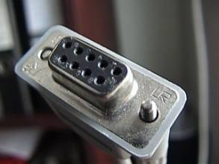
RS 232C Standard
Serial communication standard.
See the DE-9 pin configuration: G (5), TxD (3), RxD(2), DTR(4), DSR(6), RTS(7), CTS(8), DCD(1), RI (9)

Slide 5
XINU UART Driver
xinu_mips-1.0.2/include/uart.h
xinu_mips-1.0.2/uart/*
Map all that you learned in the last few slides to the code in uart.h and the driver implementation in uart directory

Slide 6
References
http://www.freebsd.org/doc/en/articles/serial-uart/
http://xinu.mscs.mu.edu/National_Semiconductor_16550_UART#Physical_UART
http://en.wikipedia.org/wiki/RS-232
Linux device-driver:
http://www.networkcomputing.com/unixworld/tutorial/010/010.txt.html

Slide 7
Device driver context
User process
Operating System: dev/xyz
Device driver
Physical Device
hardware

Slide 8
UART Driver in EXINU
General device driver related files: device.h, devtable.c
Uart files: uart.h defining the physical features of the uart
All the files in the uart directory that implement the operations related to the uart.
uartControl.c uartInit.c uartIntr.c
uartPutChar.c uartWrite.c uartGetChar.c uartRead.c

Slide 9
Device Drivers
On board devices are called internal peripherals and one outside are called external peripherals
UART Chip (internal)
TTY (external)
UART→ transceiver→RS232→D-9 connector → laptop serial socket
WRT54GL board and modifications

Slide 10
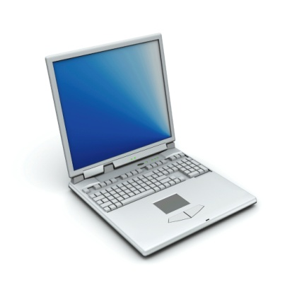
Serial Port Block Diagram (general)
Processor
UART
Peripheral
RS-232
Transceiver
COM1
DB-9
connector

Slide 11
Our Setup
WRT54GL
Processor:
BCM5353
UART
Peripheral
TI 16552
RS-232
Transceiver
AMD202
COM1
DB-9
connector

Slide 12
Device drivers
Embedded processor interacts with a peripheral device through a set of control and status registers.
Registers are part of the peripheral device.
Registers within a serial controller are different from those in a timer.
These devices are located in the memory space of the processor or I/O space of the processor-- two types: memory-mapped or I/O mapped respectively.

Slide 13
Device driver (contd.)
The keyword volatile should be used when declaring pointers to device drivers.
Our text goes on to discuss bit manipulation: please read it)
Bit patterns for testing, setting, clearing, toggling, shifting bits, bitmasks, and bitfields.
Struct overlays:
In embedded systems featuring memory mapped IO devices, it is common to overlay a C struct on to each peripheral’s control and status registers.
This will provide the offsets for the various registers from the base address of the device.

Slide 14
Device Driver Philosophy
Hide the hardware completely: hardware abstraction
If the device generates any interrupts include interrupt controllers.
Device driver presents a generic interface for applications at higher level to access the devices: device.h
Device drivers in embedded systems are different from general purpose operating systems: See diagram in slide #7
Applications in general purpose systems accesses OS (Operating Systems) which in turn accesses device drivers.
Applications in embedded systems can directly access device drivers.

Slide 15
General Purpose OS vs. Embedded System
Application
process
Application
process
Operating System: dev/xyz
Device driver
Device driver
Physical Device
hardware
Physical Device
hardware

Slide 16
Device Driver development steps
An interface to the control and status registers.
Variables to track the current state of the physical and logical devices
-- Major and minor device number, device name
A routine to initialize the hardware to known state
An API for users of the device driver
-- Read, write, seek
Interrupts service routines

Slide 17
Example: A serial device driver
Now lets look at the UARTdriver of the embedded xinu and WRT54GL.
Study the tty driver that is a logical device that is layered on top of the UART driver.
Framebuffer is an example of logical device driver.

Slide 18
DD: How to in Xinu?
Obtain the data sheet for the device. Study the hardware regsiters.
Define uart.h for all the registers, data such as buffer, semaphores, and symbolic constants for ease of programming and readability
Create a directory uart and define the functions
Update the Makefile
Compile and test.

Slide 19
Summary
We studied the design and development of device drivers.
We analyzed the code for a sample UART driver.
Read the UART device driver exinu and wrt54gl.

Slide 20
Introduction
In the last module, we learned about the use of hashing and public-key cryptography for validation of transactions and blocks.
In this module, we will
1.Define elements of trust in a Blockchain
2. Consensus protocol: an algorithmic approach to add a new block and to secure the chain
3. Trust in the robustness of the main chain
4. Trust in managing exceptional situations

