Slide 1
Introduction to Xinu and Kernel Programming
Bina Ramamurthy
bina@buffalo.edu

Slide 2
Embedded XINU and WRT54GL

Slide 3
WRT54GL
History of WRT54G Open source firmware
Common features
Processor architecture (BCM5352)
WRT54GL Block diagram

Slide 4
History
Introduced in 2002
The GNU General Public License (GNU GPL or GPL) is a widely used free software license, which guarantees end users (individuals, organizations, companies) the freedoms to run, study, share (copy), and modify the software.
The GNU General Public License does not permit incorporating your program into proprietary programs.
Read about Open Source movement.
In 2003 Andrew Miklas posted to Linux Kernel Mailing List about Linksys using GPL code in its firmware
Linksys executives gave into the pressure from the community, Linksys released the code to the community under GPL.

Slide 5
Topics
WRT54GL architecture and internals
What is Xinu? And Embedded Xinu?
What is CFE?
Modifying WRT54GL to host Xinu: or port Xinu to MIPS platform
Connecting, compiling and deploying
Embedded Xinu Code reverse engineering

Slide 6
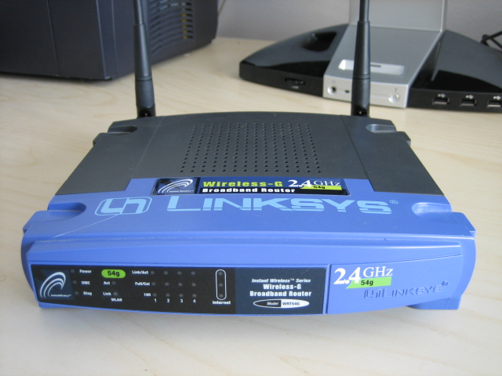
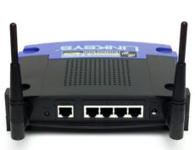

Slide 7
Common Features
Power: 12VDC 1.0amp
  This power requirement is standard for embedded devices and wireless access points
  This makes them compatible with Power over Ethernet (PoE)
  This especially significant in mobile environment.
The Reset button: to reset the configuration

Slide 8
Common Features (Contd.)
LED lights to indicate various conditions
Power : indicates presence of power
DMZ: use differs; ex: can show boot progress
WLAN LED
Ethernet
Internet
You can manipulate the LED thru’ your code by changing contents of system files.

Slide 9
Linksys WRT54GL (contd.)
Linux kernel 2.4
Based on Broadcom BCM535E SoC (System on Chip)
All-in-one Internet-sharing router,
  4-port switch
  54Mbps wireless-G (802.11g) access point
  Shares a single internet connection with Ethernet wired and wireless-G –B devices
  Push button setup
  High security: TKIP and AES encryption providing a powerful firewall

Slide 10
Processor Architecture
WRT54Gl uses Broadcom MIPS (Microprocessor without Interlocked Pipelines Stages) processor, common to embedded devices and game consoles.
Model: BCM5352
Based on Reduced Instruction Set Architecture (RISC)
The BCM5532 family of processors is a next generation SoC architecture that combines the CPU, Wireless MAC (media access controller), Ethernet MAC onto one chip RISC (reduced instruction set computer)
MIPS is used Sony playstation for example.

Slide 11
BCM5352
Next generation SoC (System on a Chip)
SoC: combines CPU + Wireless MAC + Ethernet MAC onto one chip
Flash memory
SDRAM
Wireless access (802.11)
Ethernet switch

Slide 12
WRT54GL Block diagram
See next slide:
Also follow this model:
CPU
Input
Storage
Output

Slide 13
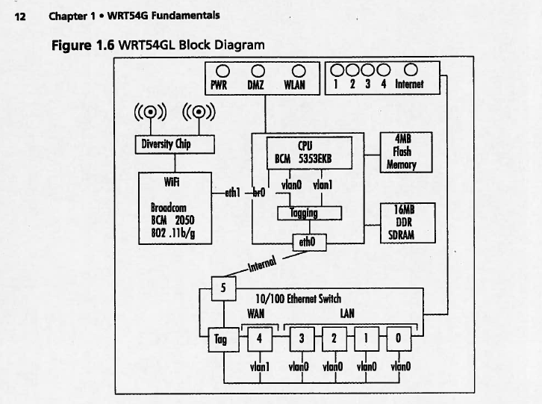

Slide 14
Storage
On board storage is indeed a limitation when using WRT54GL in situation other than for which it is meant for.
WRT54GL has a flash memory (4 MB), a form of non-volatile storage commonly used in small devices, such as digital camera.
It also use SDRAM (Synchronous Dynamic Random Access Memory) soldered directly into the printed board. DIMM (Dual In-line Memory Module)

Slide 15
Wireless and Ethernet networking
WRT54GL has a powerful networking architecture
It provides 5 port Ethernet switch that is broken down into two virtual LANs VLAN0 and VLAN1 (default)
Wireless interface is bridged by default to the Ethernet switch.
WiFi component is BCM2050, a 802.11b/g radio chipset.
It uses a diversity chip to balance signals between two built-in antenna.
WiFi radio connects to the CPU Wireless MAC on eth1 which is bridged to VLAN0 via br0 interface.
Ethernet switch controls EthernetLAN and Internet lights, whereas Power, DMZ, WLAN are controlled by GPIO port on the CPU
WAN port: plug in cable modem into this port,
  it will pull a DHCP (Dynamic Host Configuration Protocol) address from your ISP (Internet Service Provider).
  Since it belongs to VLAN1 it is separate from VLAN0 and the two are linked by WRT54Gl’s routing capabilities.
  Firewall prevents traffic from flowing from WAN to LAN network, traffic initiated by LAN to exit via WAN.

Slide 16
What does WRT54GL do?
Creates a network between the wireless interface and the LAN ports known as br0.
Router address is 192.168.1.1 by default.
WLAN port (port 4).
Typically you will plug your cable modem into this port; this will pull the DHCP address from your ISP.
WAN and LAN are separate network linked by WRT54GL

Slide 17
Embedded XINU
http://xinu.mscs.mu.edu/Main_Page
XINU ("XINU Is Not Unix", a recursive acronym) is a Unix-like operating system originally developed by Douglas Comer for instructional purposes at Purdue University in the 1980s.
Embedded XINU is a reimplementation of the original XINU operating system on the MIPS processor which is able to run on inexpensive wireless routers and is suitable for courses and research in the areas of Operating Systems, Hardware Systems, Embedded Systems, and Compilers.

Slide 18
Embedded Xinu
To port Xinu to embedded MIPS/other platforms
ANSI-compliant C
Meant for educational purposes
This particular project is a collaboration between University at Buffalo and Marquette university.
Our Xinu port ar UB is built with the help of federal grant from National Science Foundation (NSF) grant.

Slide 19
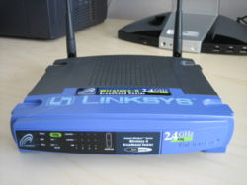
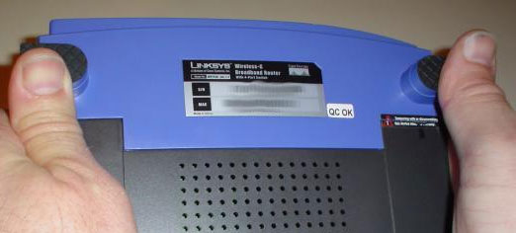
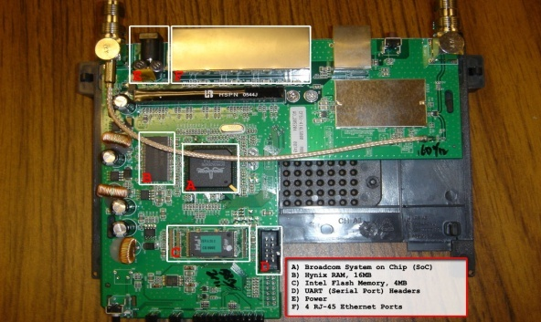
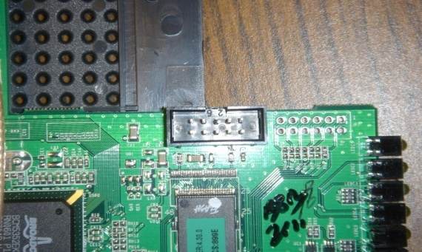
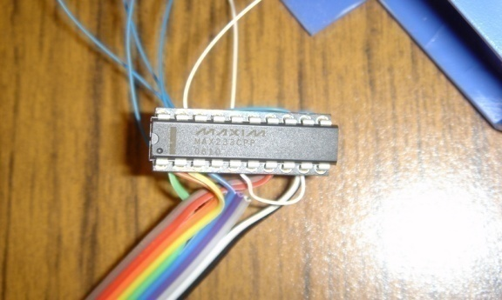
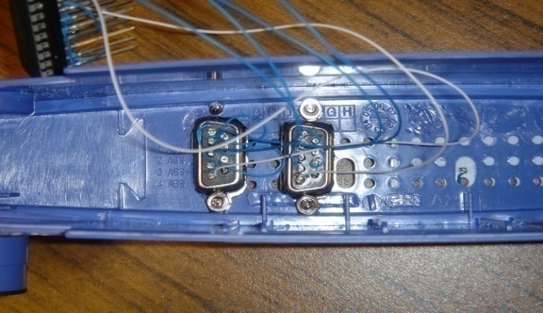
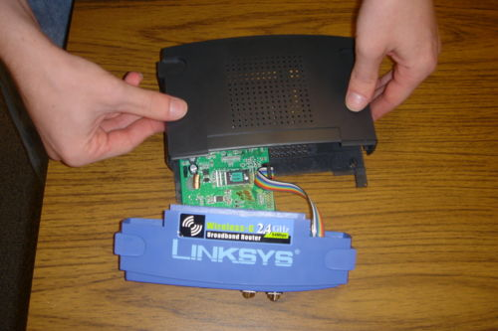
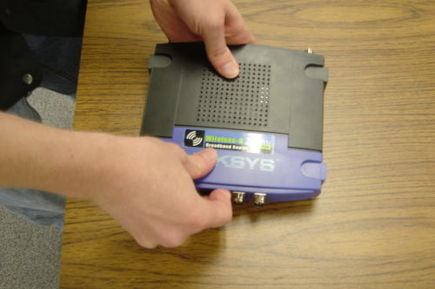
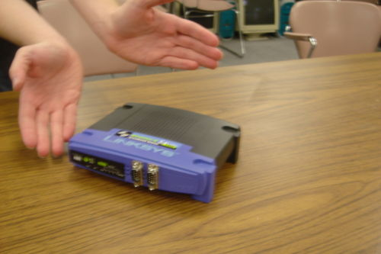
The Basic Hardware modifications

Slide 20
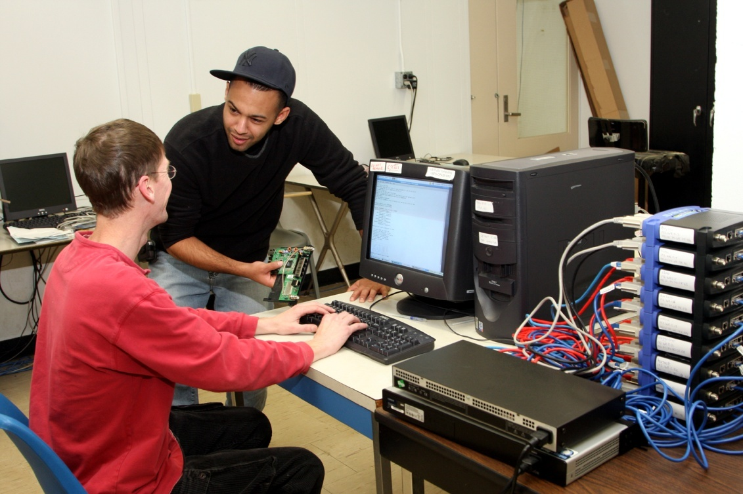
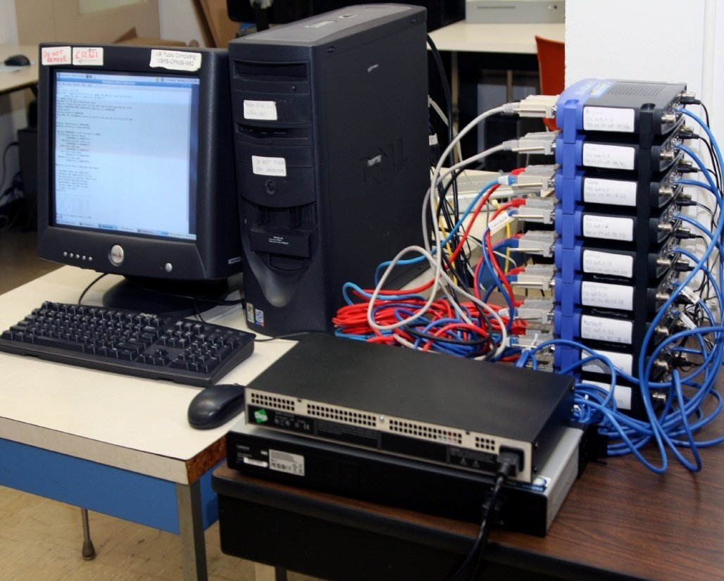
The NSF-Supported Facility at UB

Slide 21
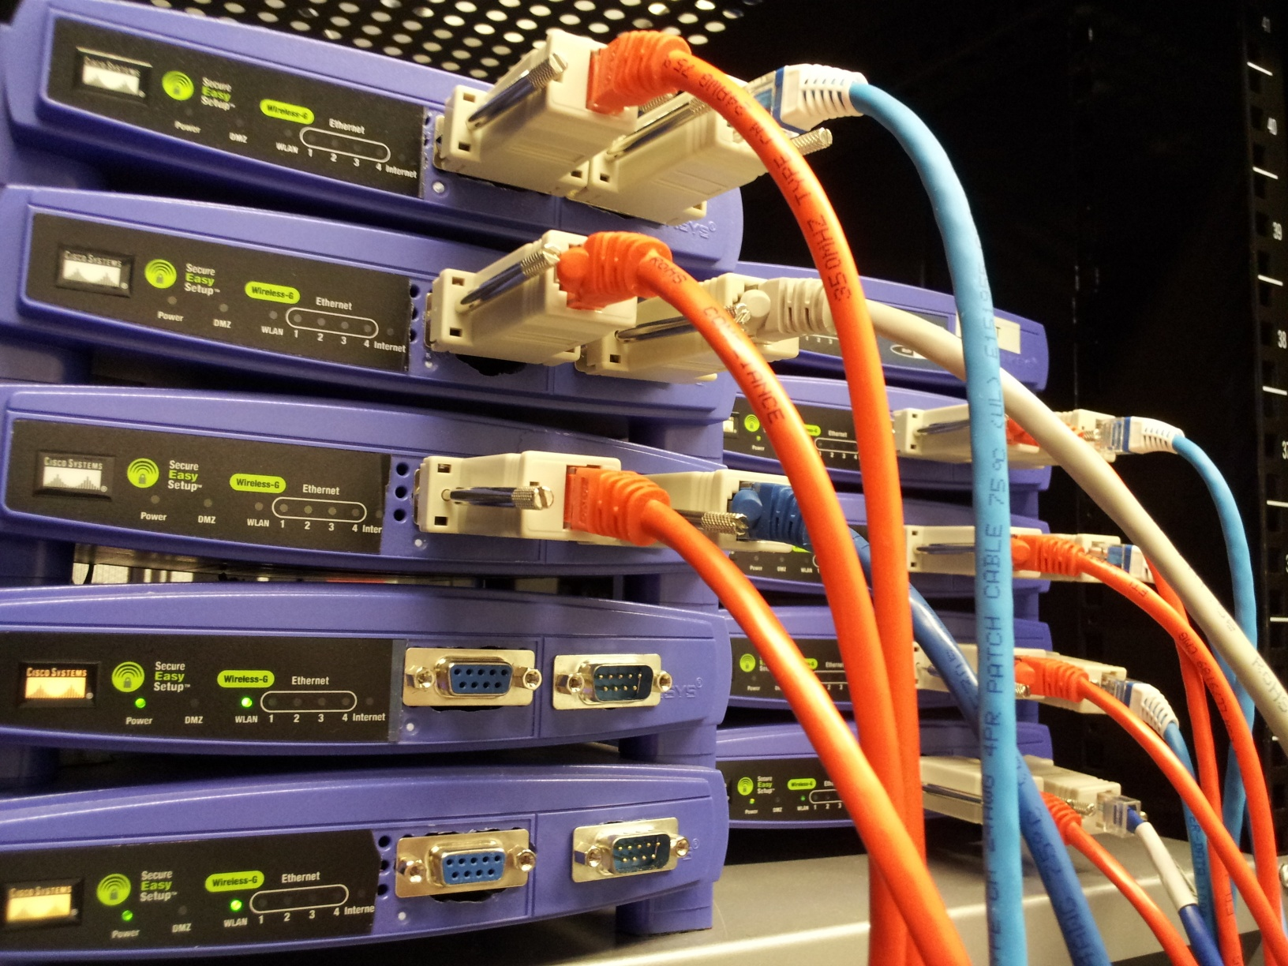

Slide 22
Embedded XINU Code
http://xinu.mscs.mu.edu/
ls xinu_mips-1.0
AUTHORS README include loader system tty
LICENSE compile lib shell test uart
Above is the xinu kernel directory organization
See attached XINU directory structure and class diagram
We will develop programs into XINU kernel on linux server called nexos.cse.buffalo.edu
We will cross compile this kernel and load the firmware into WRT54GL (“upload”) and test it

Slide 23
Common Firmware Environment (CFE)
The Common Firmware Environment (CFE) is the firmware developed by Broadcom for the BCM947xx SoC platform (among others). It is the first code that runs when the router boots and performs functions similar to Apple's Open Firmware:
Initializes the system
Sets up a basic environment in which code can run
Optionally provides a command line interface non-standard usage
Loads and executes a kernel image
So, in normal operation, a user will not see CFE working at all; it will load the Linksys kernel and send it on its merry way without hesitation. For us, however, CFE is crucial, because it provides us with the ability to load an image over the network using TFTP.

Slide 24
CFE: http://melbourne.wireless.org.au/files/wrt54/cfe.pdf
On startup, CFE performs the following low-level initialization:
  Reset and ROM trap handler vectors
  CPU and FPU initialization
  L1 and L2 Cache initialization
  Multiprocessor initialization
  Memory controller initialization
  PCI and LDT bus configuration
  Environment variables
  Console device initialization
  Bootstrap device initialization
Certain information, such as the physical memory layout and other critical information, are stored by CFE and are made available to boot loaders and operating systems via CFE’s external API.
Once initialization has completed, CFE is ready to load programs from the bootstrap device (UART, Flash, ports etc.)

Slide 27
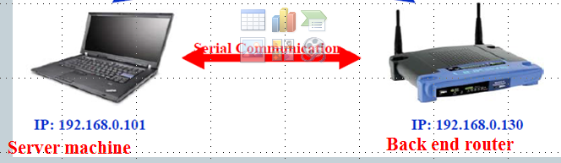
Connecting WRT54GL
You have modified the connections, connected the server to wrt54gl
using serial cable. How will you make bacn end recognize the server machine?

Slide 28
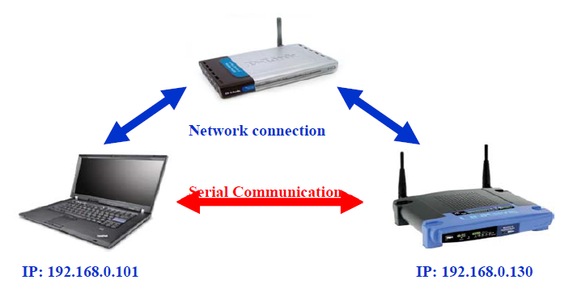
Basic Xinu Environment
Front end router
Server machine
Back end router

Slide 29
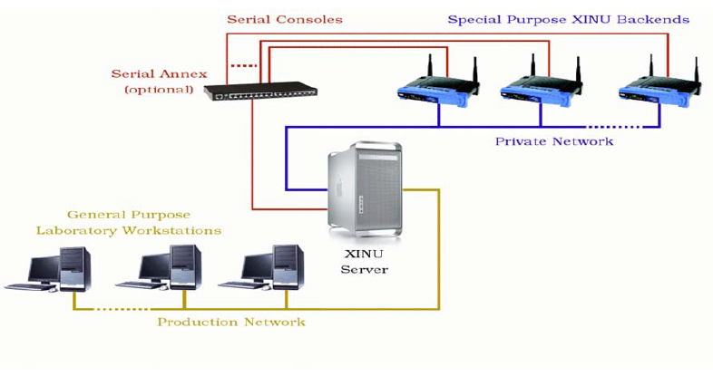
Extended Xinu Environment

Slide 30
WRT54GL
Detailed instruction: http://xinu.mscs.mu.edu/HOWTO:Modify_the_Linksys_hardware
You DO NOT have to do this. We already did it for you.
Our goal is to get you familiar with working in the Embedded Xinu environment
Some of the following slides are by a long-time teaching assistant Panya Chanawangsu

Slide 31
Introduction to NEXOS Lab
Log on to timberlake
Connect to the NEXOS server:
ssh nexos.cse.buffalo.edu
Change your password:
passwd

Slide 32
Some Technical Terms
Cross Compiler
Shell
Kernel

Slide 33
Cross Compiler
General idea:
  Compile a program on machine A
  Run it on machine B where an OS is not supported
In our case, we build the XINU system on a local machine and upload the executable to the routers.

Slide 34
Shell
User interface for the operating system
Access to the kernel
Other programs are called through shell
CLI (Command Line Interface)
GUI (Graphical User Interface) – not available in our system

Slide 35
Kernel
Lowest level but the most important part of an operating system
Resource management
Bridge between software and hardware

Slide 36
xinu_mips-1.0.2.tar.gz
Obtain the tarball from home directory
cd /home
Copy the tarball to your directory
cp xinu_mips-1.0.2.tar.gz ~
Go to your directory and untar the package
cd ~
tar zxf xinu_mips-1.0.2.tar.gz

Slide 37
Compiling
Go to xinu_mips-1.0.2
cd xinu_mips-1.0.2
View all the files and folders
ls
Go to the compile folder
cd compile
Compile all the source files
make

Slide 38
Connecting to a router
View available routers
xinu-status
You need the file xinu.boot so stay in the compile folder
mips-console router_name
For example,
mips-console moiz

Slide 39
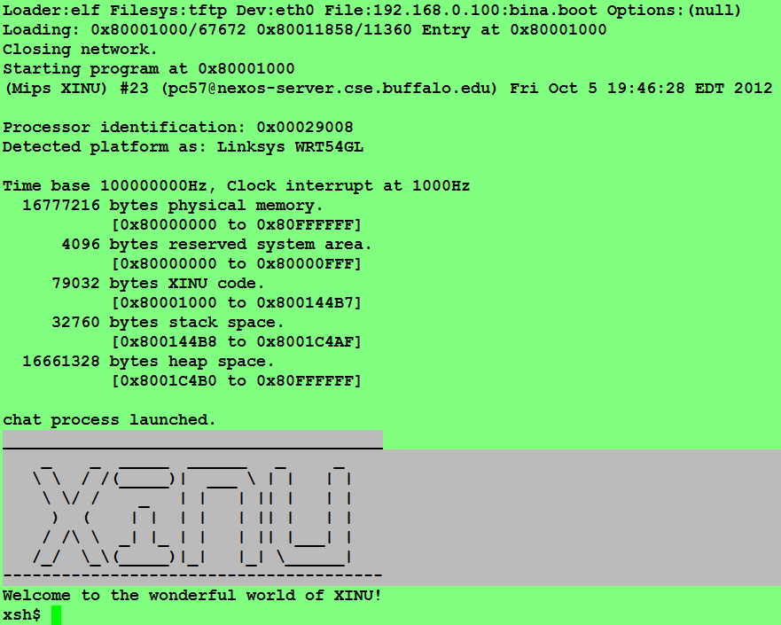

Slide 40
Disconnecting from a router
You have to release the router once you are done using it.
Press ctrl + spacebar
And then q
Other students have the right to ask me to kill your connection if you are logged on to the same router for more than 15 minutes.

Slide 41
Working with Xinu/Nexos
Lets look at the code and update the shell functions to get started with Xinu
Lets reverse engineer and understand the current xinu code.

Slide 42
Using in XINU
To view all available commands
help
To call a function
function_name arg1 arg2 …

Slide 43
Adding your own commands
See http://xinu.mscs.mu.edu/Shell
Write and save your source file in the shell directory
Follow the naming convention:
xsh_commandName.c
For example,
xsh_myTest.c
Hint: use xsh_test.c in the shell directory as a template.

Slide 44
Parameters explained
ushort = unsigned short (0 to 65,535)
nargs holds the number of arguments
arg[0] is the command itself
arg[1] is the first argument, arg[2] is the second argument, etc.

Slide 45
Adding your own commands
(cont’d)
Update the command table in shell/shell.c
{ “myTest”, FALSE, xsh_myTest }
Update include/shell.h
command xsh_myTest(ushort, ushort, ushort, ushort, char *[]);
Update compile/Makefile. Look for ”SHL =” and add your source file to the list
xsh_myTest.c

Slide 46
Some basic C commands
To print something in standard output,
fprintf(stdout, “CSE524\n”);
fprintf(stdout, “%s”, args[1]);
To convert a string to its integer equivalent,
int x = atoi(args[1]);

Slide 47
Adding your own commands
(cont’d)
Now you are ready to compile your command. Change your directory to compile and type
make
Connect to a router and try running your command.
mips-console router_name
Now when you type help, you should see your command added to the list.

Slide 48
Resources
XINU reference page:
http://www.cse.buffalo.edu/~bina/cse321/fall2017/xinu
XINU main page: how to deploy XINU
http://xinu.mscs.mu.edu/Main_Page

