Slide 1
Blockchain: An innovation to empower All
B. RAMAMURTHY
©2020, ALL RIGHTS RESERVED
Manning author: Blockchain in action
PROGRAM DIRECTOR, DATA-INTENSIVE COMPUTING PROGRAM
COURSERA INSTRUCTOR
DIRECTOR, BLOCKCHAIN THINKLAB
HTTP://WW.CSE.BUFFALO.EDU/FACULTY/BINA
COMPUTER SCIENCE AND ENGINEERING
https://www.linkedin.com/in/bina-ramamurthy/

Slide 2
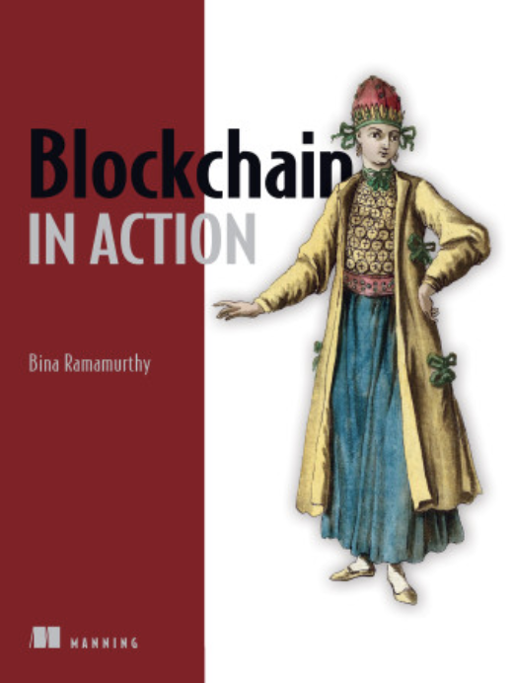
Introducing myself..
Ph.D. in Computer Engineering: Fault tolerance in distributed systems
Faculty at CSE and University at Buffalo (UB) for the past 3 decades
Launched a 4-courses certification on blockchain on Coursera MOOC
--More than 160000 learners and 500,000 visitors from all over the world
NSF-supported Data-intensive computing since 2009 and recently in blockchain
SUNY chancellor’s award for excellence in teaching
My latest:
Author of a technical book: Blockchain in Action (Manning.com)

Slide 3
Goals for this presentation
Part I: What is blockchain? The innovation
Part II: Why is it important? Its potential impact, applications and careers
Part III: Application development environment and exploration.
Hands-on workshop

Slide 4
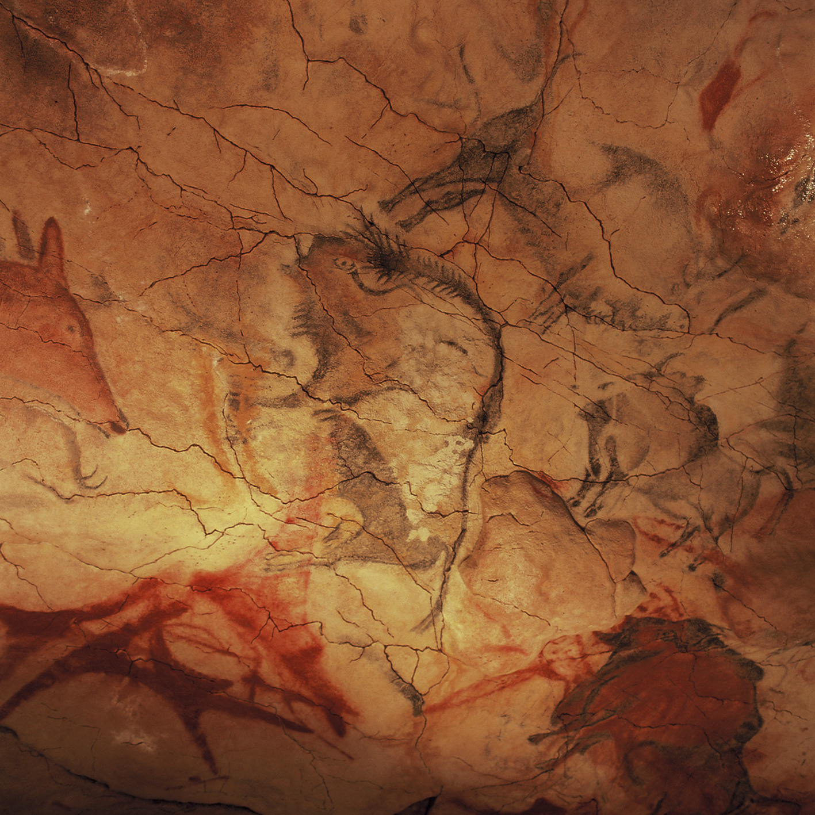
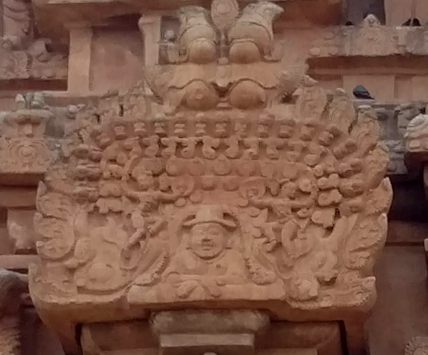
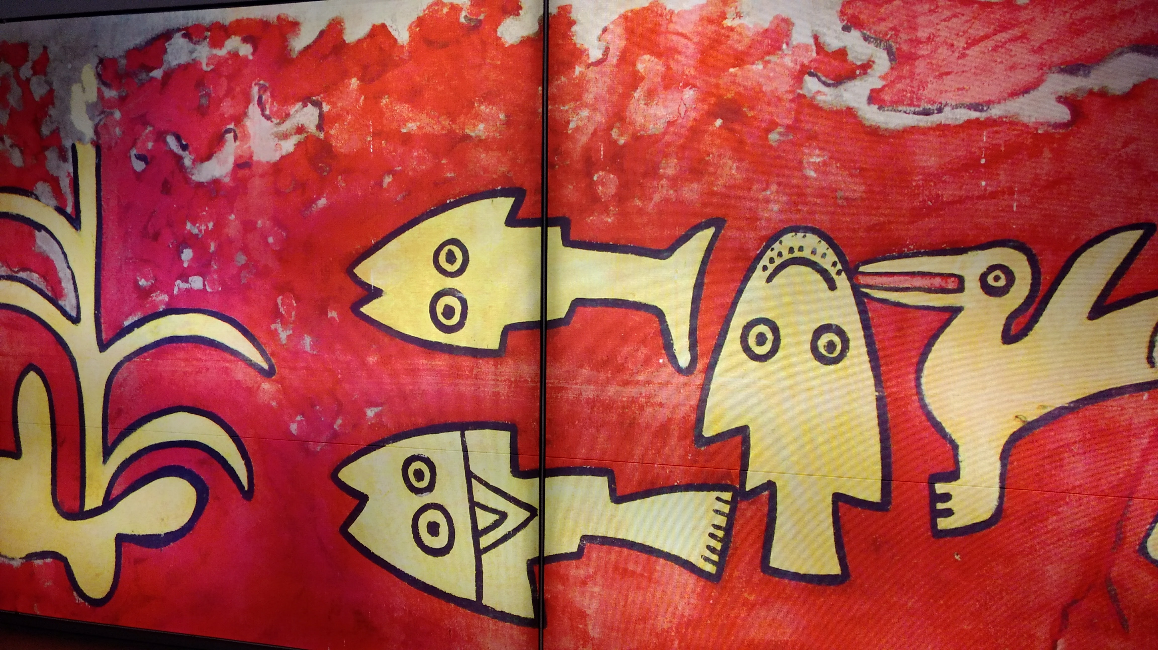
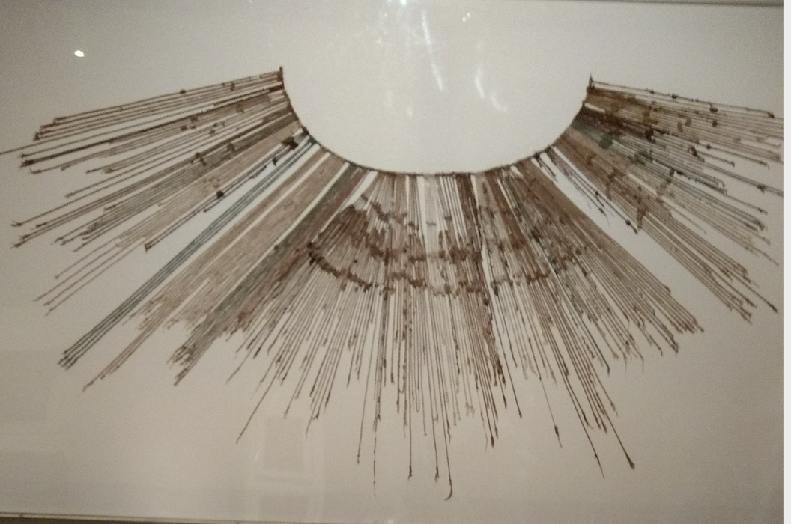
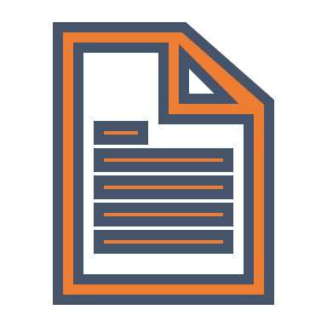
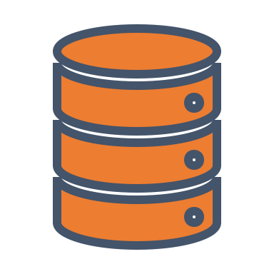
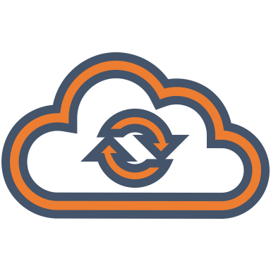
Quest for recording…
Bison: 36,000 years ago
Cave of Altamira, UNESCO, Wikipedia
Foreigner’s head: Thanjavur temple, 1010 AD
Photo © Bina Ramamurthy
Fish and birds: Pachacamac, Lime, Peru, 1400 AD
Photo © Bina Ramamurthy
Tally marks: 35,000 and 25,000 years ago
to current day!
Current recording system
Quipus: Andean recording device 3000 BC – 1700 AD
Photo ©Bina Ramamurthy
But blockchain recording
is different

Slide 5
Part I : what is Blockchain?
The innovation and the basic concepts

Slide 6
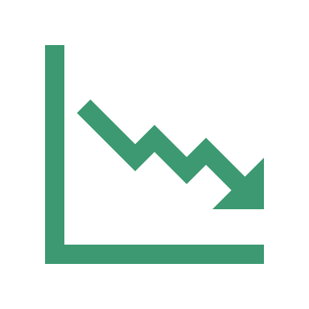
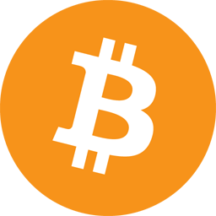
Bitcoin & Blockchain
Bitcoin 0.1.0 was released on 9 January 2009
Bitcoin cracked the trust and
integrity puzzle with its
Mathematics and algorithms
Bitcoin showed that -- a fact recorded on a blockchain
can be automatically verified by anybody thus establishing
trust and transactions among unknown peers
Innovation: blockchain technology
Idea: What worked for cryptocurrency should work for other
business transactions
2007-2008 financial meltdown

Slide 7
Bitcoin
Bitcoin : peer-peer cryptocurrency that does not require a middle entity such as a bank to complete a transaction between the sender and receiver.
Created by a secretive person(s) known as Satoshi Nakamoto.
Runs on the Internet
To keep track of the transactions, an ingenious ledger technology has been devised.
This ledger is distributed and is a collection of blocks of transactions.
How do you trust the ledger? The trust model out of this distributed ledger is an important contribution of Bitcoin.
The distributed ledger and associated concepts are called the “blockchain”
Bitcoin technology is the genesis for the blockchain revolution.

Slide 8
BLOCKCHAIN IS NOT JUST ABOUT CRYPTOCURRENCY ANYMORE!
E-Commerce
Communication
mobile apps …
Cryptocurrency: Bitcoin: 2008/2009
Autonomous, Decentralized, applications: 2013
We need code to
verify and validate
application-specific
rules and criteria
Validation, Verification,
Immutable recording
Computing infrastructure:
Smart contracts
The Blockchain
The Internet

Slide 9
Blockchain: A Trust Layer over the Internet
Trust is a critical component for trade and any type of business transaction.
We develop and model our trust based on ad hoc means: Recommendation systems, our own knowledge, business experts on the news, etc.
Blockchain is about “trust automation”.
Take a look at the evolution of our Internet as shown here.
Trust layer:
Let us motivate blockchain
with an example I used on
Coursera blockchain course 1.
Year 2009,
Blockchain-based trust
No standards yet
Year 1991, RFC 7230
Year 2000, RFC 2818 Standard
Web application
Secure web application
Secure & Trusted web application
HTTP
HTTPS Security
HTTPS Security
Blockchain Trust
The Internet

Slide 10
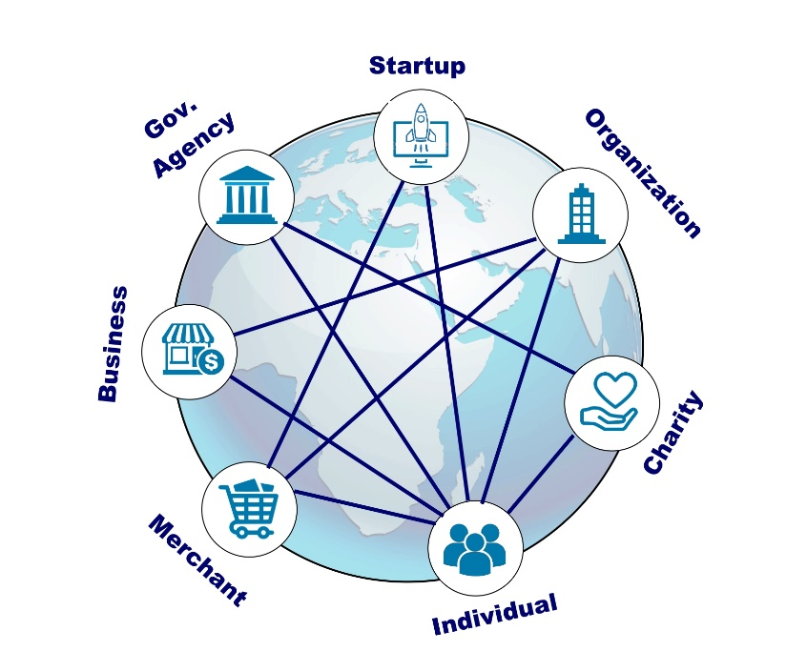
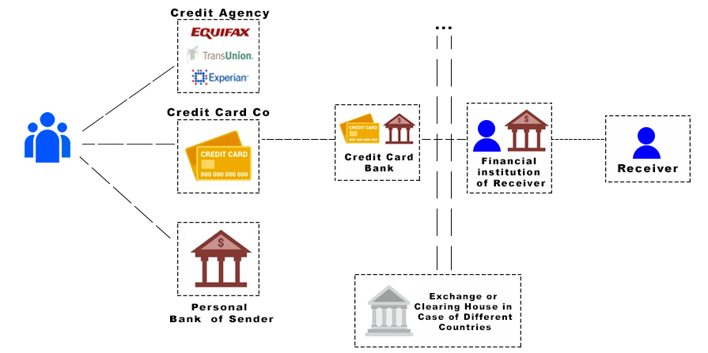
Blockchain: The Decentralization Infrastructure (1)
1:Decentralization
Decentralized System
Traditional Centralized System
Functions of the intermediaries are shifted
to the peer participants and the blockchain nodes:
Disintermediation: validation, recording, verification using blockchain software

Slide 11
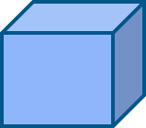
BLOCKCHAIN: THE DISTRIBUTED IMMUTABLE LEDGER (2)
2:DLT
Transactions
Eve
Validate
Gather
Block
Chain
invalid
Modify
Consensus
Verify Confirm
Transactions
New
Block
Transactions
Block
Blockchain

Slide 12
Blockchain: The trust (Dis)-intermediator (3)
Verification
Validation
Recording
Consensus
3: Disintermediation
Trust &
integrity
Defined by the blockchain protocol, and implemented.
For example, consider checking in for your flight at the airport.

Slide 13
SUMMARIZING, BLOCKCHAIN IS ABOUT
Decentralization
Disintermediation
Distributed Immutable Ledger
Blockchain is a trust layer on the internet.
On a strong foundation of more than 40 years of scientific research (cryptography, hashing, p2p, consensus protocols)
Enabling automation, accountability, auditability, efficiency, accuracy, fidelity, fairness, and inclusiveness.
Blockchain is a technology
that provides the hardware
and software infrastructure
and protocols for realizing trust.

Slide 14
Part II : Why is Important for all?
Potential impact, applications and careers, education and curriculum.

Slide 15
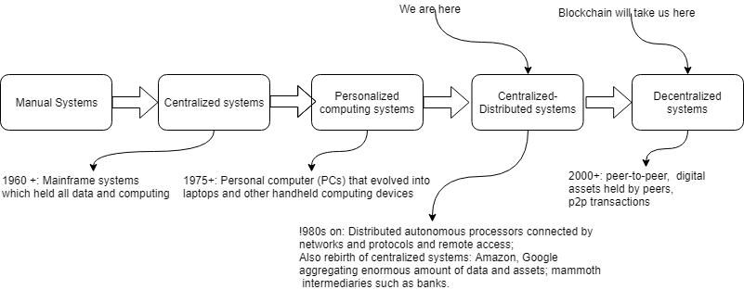
Evolution of computing systems -- 1

Slide 16
Blockchain is people centered -- 2
We discussed hardware, software, infrastructure and other technology related things about blockchain.
A major difference is that blockchain is meant for “trusted” peer-peer transactions.
It is people/participant centered.
It is not all about programming and application development.
There is a role for every one of us to play.
The decentralized applications are for planetary level participants.
The technology encompasses all business domains not just FinTech!
It is like the Internet, but with a trust layer.
It will allow enterprise and people to transact across the geographical borders.

Slide 17
Positioning blockchain education
Imperative: Educating all is the first step in empowering all.
Education will enable people to understand the impact and benefits.
It is about letting them know: for example about identity, management of identity, different genre of applications, how to participate, how to innovate with blockchain and contribute.
It is about finding decentralized planetary level solutions for planetary level problems.
Blockchain education is NOT limited to Computer Science, Engineering or FinTech.
Any discipline from political science to arts can find a use case in blockchain.
Blockchain is discipline-agnostic … meaning it can be introduced in any discipline. The applications, work, careers are NOT restricted to science and engineering.

Slide 18
How can my experiences help?
Coursera MOOC specialization on blockchain: 4 –courses of broad introduction -- 2018
Blockchain application designers and developers should consider all 4 courses whereas business-oriented audience should look at course 1 and 4.
Blockchain basics
Smart contract
Decentralized applications
Blockchain platforms
The book: Blockchain in action
Comprehensive treatment of blockchain technology
Let’s discuss the book further and explore how it help with blockchain education, and career development

Slide 19
The book: Blockchain in Action
This book covers end-to-end development of blockchain-based Dapp.
I chose to use the Ethereum blockchain platform because its code is open source.
Solidity language, Remix and Truffle IDEs, test chains Ganache and Ropsten, MetaMask browser-plugin wallet.
Six end-to-end Dapps: Not only for developers but also for other thinkers:
Digital democracy
Blind auction (decentralized auction platform)
Airline consortium (Marketplace for seats)
Micropayment channel (for planetary level operations)
Tokenization of assets (for global trade)
Educational credentialing (counting education from various sources)
More 150 figures explaining the various concepts

Slide 20
Developing blockchain careers
#BIA Blockchain in Action can help.
The broad range of decentralized applications discussed in the book provides excellent case-study material for any classroom, board room, or training room.
A freelancer can pick up the book, go through the examples, work on the code, read the material, and become a blockchain programmer and Dapp developer.
Educators can create a curriculum based on the book for one or two courses (6 chapters each) and prepare their students. All the necessary figures and code are readily available in the book.
We need thought leaders and visionaries to come up with innovations based on blockchain technology. A high-level reading of the book can provide the necessary background for the people to get started.
This book can provide summer reading for high school students to prepare ahead for this emerging technology.

Slide 21
Where do you begin?

Slide 22
Part III : Blockchain Ecosystem
Decentralized application development and hands-on exploration with Dapps

Slide 23
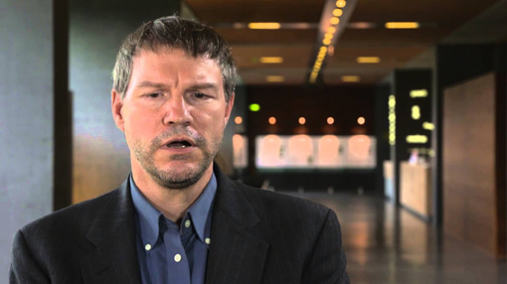
What is a smart contract?
Smart contract is executable code on the blockchain that uses the features of the blockchain.
-- introduced by a Georgetown law school graduate Nick Szabo in 1999
--adopted by Ethereum blockchain in 2013
-- it provides automatics verification, validation and immutable recording of transactions
I discuss more about him in my Coursera
courses

Slide 24
Ethereum stack

Slide 25
How to develop a Dapp?
You must understand Dapp programming is not your traditional programming. There are many new concepts that you must understand before you start coding.

Slide 26
Counter smart contract in Solidity : Counter.sol
pragma solidity ^0.5.8;
// Imagine a big integer counter that the whole world could share
contract Counter {
int value;
address organizer;
modifier onlyOrganizer() {
require(msg.sender == organizer,'onlyOrganizer’);
_; }
constructor() public {
organizer = msg.sender;
}
function initialize (int x) public onlyOrganizer(){
value = x;
}
function get() public view returns (int){
return value; }
function increment (int n) public {
value = value + n;}
function decrement (int n) public {
value = value - n; }
}
Activity 1:
Let’s copy and past this in Remix IDE,
deploy and transact with it.

Slide 27
Activity 2: I have deployed a Counter-Dapp on cloud (Infura). You are all going to play the role
of decentralized participants to interact with my Counter-Dapp.
We are going to work on Kovan Ethereum test network. You need Kovan test ethers to interact.

Slide 28
Your identity in a decentralized system
Here are some ways you identity yourself to the business system you are in : Driver’s license, social security number, person number in an education institution, employee number.
Think about these, these are all your affiliations to a centralized institutions.
In a decentralized system, where participants are unknown, and can join and leave as they wish, how can we identify them?
We need a self-generated secure identity for you. Let’s do that.
Derived from a private-public key pair of 256 bits each, your identity is derived from this pair, 160 bits account number on Ethereum “blockchains”.

Slide 29
Self-generate your identity-- 1
Hope you are all prepared with the document I sent earlier. If you are not please install the software I requested you to install NOW. Otherwise, you’ll have to do the hands-on activity yourself.
We’ll use a web tool : Ian Coleman’s BIP39 web tool.
Follow along the handout provided.
0xF6117c946a33Cc0A105Ac131fDED8f17fbD9F4e6

Slide 30
Add a account manager and wallet -- 2
Do you have Chrome browser installed?
Make sure you’ve added MetaMask plugin to your Chrome browser.
MetaMask will serve as your account manager and a wallet.
Next step is to get some Ethers to your wallet. Follow along in the handout.

Slide 31
Collect some test ethers for your account -- 3
We are using Kovan test network.
Pre-requisite is that you have a github account.
From your chrome browser, link to faucet.kovan.network
Copy and paste your address.
Get 1 ether transferred to your account. You can get 1 Ether (test ether) every 24 hours.
Now you’re ready to run a decentralized app (Dapp) I have deployed.

Slide 32
Interact with the Dapp -- 4
Pre-requisite: All the software I has provided in the handout should have been installed.
Unzip the code counter-app.zip
Open a terminal window by typing cmd on Windows, opening a terminal on Mac.
Navigate to the directory /folder where you unzipped the counter-app
Issue the command
npm start
You should see several information lines followed by this message:
Counter Dapp listening on port 3010!
Now open the chrome bowser, and link to localhost:3010
You should see an interface to interact. Wait for my instructions at this time before you interact.

Slide 33
Summary
Blockchain technology is not about cryptocurrency anymore.
It is used for broad range of applications across many industries: finance, healthcare, government, manufacturing, and distribution.
Blockchain can enable an inclusive economy.
Blockchain has created exciting new opportunities and innovative application models:
Global collaboration systems, self-governing systems, open government.
Private, public and permissioned models to meet diverse business needs.
It is here to stay, in one form or another.

