Slide 1
Selecting k representative skyline items
Representative Skylines using Threshold-based Preference Distributions
Atish Das Sarma, Ashwin Lall, Danupon Nanongkai,
Richard J. Lipton, Jim Xu
College of Computing, Georgia Institute of Technology

Slide 2
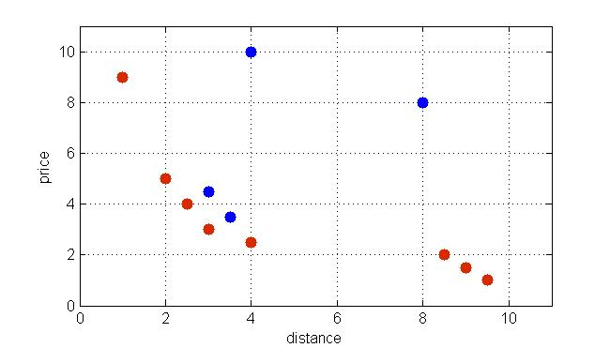
Skyline Queries [BKK01]

Slide 3
Skyline Queries [BKK01]
Dominance relation
  A dominates B iff it is no worse than it in every dimension and strictly better in at least one dimension
Goal: finding all the undominated tuples
Properties:
  It contains the best result for any linear monotonic scoring function
  It is stable w.r.t. shifting and scaling
  It is not a weak order

Slide 4

Top-k Representative Skyline
Goal:
  approximating the skyline with only k points
Motivation
  The skyline can be huge
  [BUCHTA89] If we sample from a uniform distribution the expected size is
Notes:
99.9%

Slide 5
Outline
Three approaches:
  Max-dominance [LYZ+07]
  Threshold-preference driven [AAD+11]
  Distance-based [TDL+09]
Complexity
  Two dimensions
  Several dimensions
Preference distributions
Critique
Notes:
We want to maximize a given objective function

Slide 6
Max-dominance [LYZ+07]
Goal: pick k skyline points such that the total number of data points dominated by at least one of them is maximized
We try to minimize the number of points that are left undominated
Intuition: the user will find interesting those items that dominates many other items
Notes:
99.9%

Slide 7
Max-dominance [LYZ+07]
Notes:
99.9%

Slide 8
Outline
Three approaches:
  Max-dominance [LYZ+07]
  Threshold-preference driven [AAD+11]
  Distance-based [TDL+09]
Complexity
  Two dimensions
  Several dimensions
Semantics
Notes:
We want to maximize a given objective function

Slide 9
Threshold Preferences [AAD+11]
Every user explicitly express her preferences in terms of 0-1 thresholds
Goal: maximizing the number of users that will click on at least one of the representative points
Note: a skyline point p satisfy a threshold t iff t is dominated by p
Notes:
99.9%

Slide 10
Threshold Preferences [AAD+11]
Notes:
99.9%

Slide 11
Outline
Three approaches:
  Max-dominance [LYZ+07]
  Threshold-preference driven [AAD+11]
  Distance-based [TDL+09]
Complexity
  Two dimensions
  Several dimensions
Semantics
Notes:
We want to maximize a given objective function

Slide 12

Distance-based [TDL+09]
Key idea: the Euclidean distance between two points can be used as a similarity metric
In order to find k representative we run a clustering algorithm over the skyline set
Intuition: closer skyline points are similar and can be grouped together
Goal: minimizing the maximum representation error
Notes:
99.9%

Slide 13
Distance-based [TDL+09]
Notes:
99.9%

Slide 14



Complexity results: overview
 | Max-dominance [LYZ+07] | Threshold preferences [AAD+11] | Distance-based [TDL+09]
d=2 | polynomial | polynomial | Polynomial
d>2 | NP-HARD (max coverage) | NP-HARD (max coverage) | NP-HARD (k-center)
approx | 1-1/e | 1-1/e | 2
Notes:
Notation!

Slide 15
How to compute the Skyline in 2D?

Slide 16
Notation

Slide 17



[LYZ+07, AAD+11] in 2D
Let be the number of dominated points in the optimal
solution to the problem when we restrict the skyline to and

Slide 18
[TDL+09] in 2D

Slide 19
[TDL+09] in n dimensions
NP-HARD
Approximate solution: greedy algorithm for k-center
  Pick the first representative randomly
  At each step select the most distant point
Notes:
99.9%

Slide 20
[LYZ+07, AAD+11] in n dimensions
NP-HARD
Approximate solution: greedy algorithm for max coverage
  At each step pick the point that minimize the number of tuples left uncovered
Notes:
99.9%

Slide 21
Preference distributions (F)
Notes:
99.9%

Slide 22
Preference distributions
Notes:
99.9%

Slide 23
Greedy on distributions
Notes:
99.9%

Slide 24
Critiques
Notes:
99.9%

Slide 25
References
[AAD+11] Atish Das Sarma, Ashwin Lall, Danupon Nanongkai, Richard J. Lipton, Jim Xu, Representative Skylines using Threshold-based Preference Distributions, in ICDE, 2011 IEEE 27th International Conference on. IEEE, 2011
[LYZ+07] X. Lin, Y. Yuan, Q. Zhang, and Y. Zhang, Selecting stars: The k most representative skyline operator, in ICDE, 2007, pp. 86–95
[TDL+09] Y. Tao, L. Ding, X. Lin, and J. Pei. Distance-based representative skyline. In ICDE, 2009.
[BKK01] Stephan Börzsönyi, Donald Kossmann, Konrad Stocker: The Skyline Operator. ICDE 2001:421-430
[BUCHTA89] Buchta, Christian, On the average number of maxima in a set of vectors, Information Processing Letters 33.2 (1989): 63-65.
[PTF+03] Dimitris Papadias, Yufei Tao, Greg Fu, Bernhard Seeger: An Optimal and Progressive Algorithm for Skyline Queries. SIGMOD Conference 2003: 467-478

