Slide 1
Efficient Computation of Trade-Off Skylines
In: 13th International Conference on Extending Database Technology (EDBT). 2010.
Christoph Lofi, lofi@ifis.cs.tu-bs.de
Ulrich Güntzer, ulrich.guentzer@informatik.uni-tuebingen.de
Wolf-Tilo Balke , balke@ifis.cs.tu-bs.de
Presented by Sarath
25/03/2013

Slide 2
Outline
Introduction
Basic Concepts
Trade-off Skylines
Algorithms
Experimental Evaluation
Conclusion

Slide 3
Introduction
Selecting alternatives from large amounts of data is primarily reflected by the top-k retrieval paradigm.
Providing meaningful scoring functions is almost impossible for complex data.
Subsequently skyline paradigm was adopted.
Do not allow compensation(trade-off), weighting or ranking between domains.
Skyline result sets tend to be very large.
Proposed an efficient method for computing skylines that allows trade-offs.
Proposed algorithms to speed up retrieval by indexing and pruning the trees.

Slide 4
Basic Concepts
Top-K Retrieval
Recalling Skylines from previous lecture
Full product order
Pareto Skylines

Slide 5
Top-K Query Processing
Example scenario:-
Consider a user interested in ﬁnding a location (e.g., city) where the combined cost of buying a house and paying school tuition for 10 years at that location is minimum.
The user is interested in the ﬁve least expensive places.
Assume that there are two external sources (databases), Houses and Schools, that can provide information on houses and schools, respectively
How this works:
For the join results in this example, the scoring function obtains the total cost of each house-school pair by adding the house price and the school tuition for 10 years.
The ﬁve cheapest pairs constitute the ﬁnal answer to this query.

Slide 6
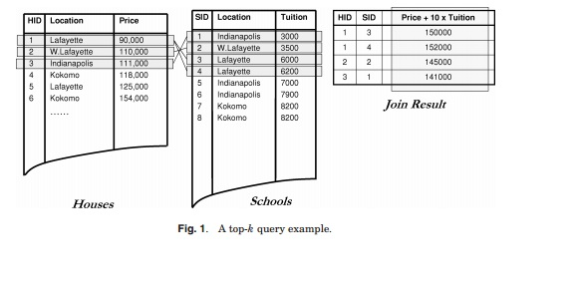
Top-K Query Processing

Slide 7
Skylines

Slide 8
Skyline in Eucledian Space
In two dimensional Eucledian space,
Skyline consists of maximal vectors

Slide 9
Full Product Order
Definition: full product order P
For 𝑃⊆(𝐷1×…×𝐷𝑛)×(𝐷1×…×𝐷𝑛) and for any 𝑜1,𝑜2∈(𝐷1×…×𝐷𝑛), 𝑜1,𝑜2 ∈𝑃 denoted by 𝑜1>𝑃𝑜2 is defined by
∀ 𝑖 ∈ {1,…,𝑛} : o1,i ≳𝑖 o2,i ∧ ∃ 𝑖 ∈ {1,…𝑛}: o1,i >𝑖 o2,i.

Slide 10
Pareto Skyline
Definition:
Assume a database relation 𝑅 ⊆ 𝐷1×…×𝐷𝑛 on 𝑛 attributes. Then the Skyline of R is defined as.,
We test whether 𝑜1 >𝑃 𝑜2 holds, by comparing only necessary objects component wise using the individual attribute preferences.

Slide 11
Trade-off Skylines
Consider a sample Trade-off,
” I would prefer a car for $18000 with a metallic blue paint job over a car for $16000 with a plain blue paint job ”.
𝑡1:= $18000, 𝑏𝑙𝑢𝑒 𝑚𝑒𝑡𝑎𝑙𝑙𝑖𝑐 ⊳ $16000, 𝑏𝑙𝑢𝑒
The car o1:($17000, 𝑏𝑙𝑢𝑒 𝑚𝑒𝑡𝑎𝑙𝑙𝑖𝑐, 100 ℎ𝑝, 𝑎/𝑐) previously incomparable with o2:($16000, 𝑤ℎ𝑖𝑡𝑒, 100 ℎ𝑝, 𝑛𝑜 𝑎/𝑐)
After introducing t1 , Car o1 with above characteristics will dominate the car o2.

Slide 12
Trade-off Skylines
Definition:
Assuming a set of trade-offs 𝑇, the resulting skyline with respect to the new domination relationships induced by all the given trade-offs is given by.,
This new criterion respects all trade-offs in 𝑇, and also all original Pareto preferences.

Slide 13
Trade-Off Dominance Relationships
For a set 𝑇 ≔ {𝑡1:= (𝑥1 ⊳ 𝑦2)} containing only a single trade-off and given two objects 𝑜1 and 𝑜2, 𝑜1 may either dominate 𝑜2 according to the original Pareto semantics or by actually applying the trade-off using both ceteris paribus and Pareto semantics.
Proposition 1: constructing 𝒐𝟏 >𝐓 𝒐𝟐 with 𝑻 = 𝟏

Slide 14
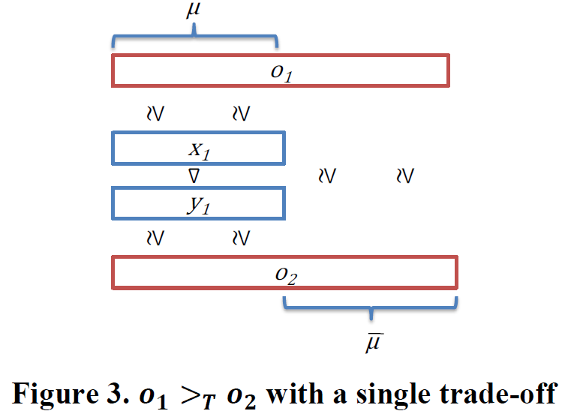
Trade-Off Dominance Relationships

Slide 15
Trade-Off Dominance Relationships
Consider trade-off t1 as
o1: (($18000, blue metallic, a/c, 80hp))
o2: (($16000, white, non a/c, 80hp))
Apply the rules! will o1 dominate o2?

Slide 16
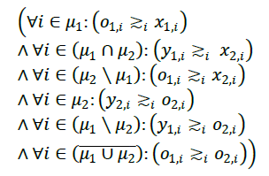
Trade-Off Dominance Relationships
Proposition 2: constructing 𝒐𝟏 >𝐓 𝒐𝟐 with 𝑻 = 𝟐:
Given 𝑡1 = 𝑥1 ⊳ 𝑦1 with 𝜇1 and 𝑡2 = 𝑥2 ⊳ 𝑦2 with 𝜇2.
Assume 𝑡1 and 𝑡2 can be applied in sequence 𝑡1 ∘ 𝑡2, i.e. ∀𝑖 ∈ 𝜇1 ∩ 𝜇2 : 𝑦1,𝑖 ≳𝑖 𝑥2,𝑖 . Then, for any 𝑜1, 𝑜2 ∈ 𝐷 1,…,𝑛 a domination relationship 𝑜1 >T 𝑜2 via a sequence 𝑡1 ∘ 𝑡2 holds, if .,

Slide 17
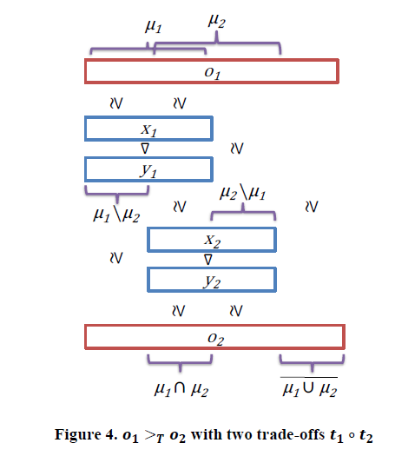
Trade-Off Dominance Relationships

Slide 18
Trade-Off Dominance Relationships
Consider two trade-offs,
𝑡1 = $18000, 𝑏𝑙𝑢𝑒 𝑚𝑒𝑡𝑎𝑙𝑙𝑖𝑐 ⊳ $16000, 𝑏𝑙𝑢𝑒
𝑡2 = 𝑏𝑙𝑢𝑒, 𝑎/𝑐 ⊳ 𝑏𝑙𝑢𝑒 𝑚𝑒𝑡𝑎𝑙𝑙𝑖𝑐, 𝑛𝑜 𝑎/𝑐
o1= (($18000, blue metallic , a/c, 80hp))
o2=(($16000,blue metallic , no a/c, 80hp))
o1 >T o2 ! Check it out !

Slide 19
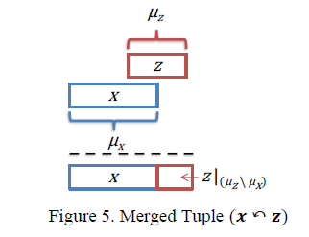
Merging Trade-Off Tuples
Definition: The Merge Operator ↶ :
Let 𝜇x , 𝜇z ⊆ {1, … , 𝑛}. For 𝑥 ∈ 𝐷𝜇 𝑥 and 𝑧 ∈ 𝐷𝜇 𝑧 , the tuple 𝑥 ↶ 𝑧 is defined component-wise as: (𝑥 ↶ 𝑧) ≔ 𝑢 𝑤𝑖𝑡ℎ 𝑢𝑖 = 𝑥𝑖 : 𝑖 ∈ 𝜇x 𝑧𝑖 : 𝑖 ∈ (𝜇z ∖ 𝜇𝑥 )

Slide 20
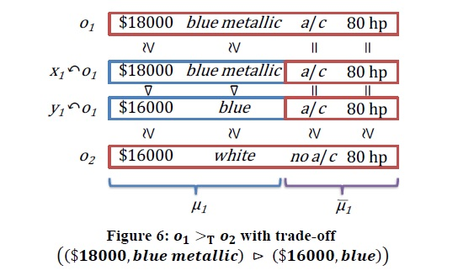
Merging Trade-Off Tuples
Proposition 1 (cont.): constructing 𝒐𝟏 >𝐓 𝒐𝟐 with the merge operator for 𝑻 = 𝟏
Consider trade-off t1 as

Slide 21
Merging Trade-Off Tuples
Proposition 2 (cont.): constructing 𝒐𝟏 >𝐓 𝒐𝟐 with the merge-operator for 𝑻 = 𝟐
Consider again our example for two trade-offs 𝑡1 and 𝑡2 as follows:
𝑡1 = $18000, 𝑏𝑙𝑢𝑒 𝑚𝑒𝑡𝑎𝑙𝑙𝑖𝑐 ⊳ $16000, 𝑏𝑙𝑢𝑒
𝑡2 = 𝑏𝑙𝑢𝑒, 𝑎/𝑐 ⊳ 𝑏𝑙𝑢𝑒 𝑚𝑒𝑡𝑎𝑙𝑙𝑖𝑐, 𝑛𝑜 𝑎/𝑐

Slide 22
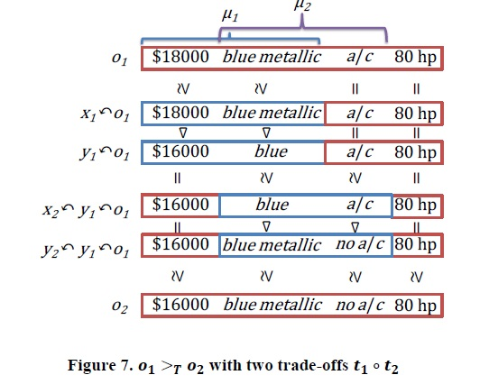
Merging Trade-Off Tuples

Slide 23
Integrating Trade-Off Chains into Single Trade-offs
Definition: trade-off integration
Assume that 𝑡1≔(𝑥1⊳y1) on 𝜇1, and 𝑡2≔(𝑥2⊳y2) on 𝜇2,
and 𝑡1 and 𝑡2 can be applied in sequence, i.e. ,
∀𝑖∈ 𝜇1∩𝜇2 : 𝑦 1,𝑖≳𝑖 𝑥2,𝑖 .
This integrated trade-off is given by:
If ∀𝑖∈ 𝜇1∩𝜇2 holds 𝑦1,𝑖≳𝑖 𝑥2,𝑖 then
𝑡1∘2≔( 𝑥1↶𝑥2 ⊳ y2↶𝑦1 )
Integrating trade-off sequences into a single trade-off does not affect subsequent skyline computation.

Slide 24
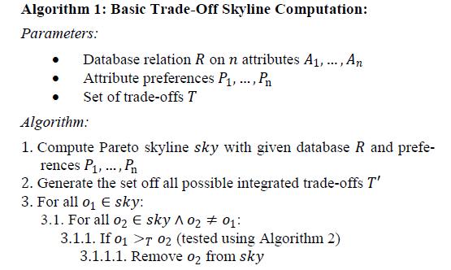
A Basic Trade-Off Skyline Algorithm

Slide 25
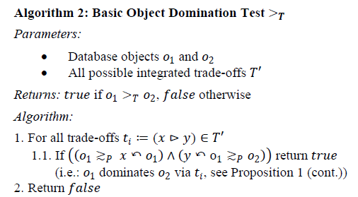
A Basic Trade-Off Skyline Algorithm

Slide 26
Representing Trade-Off Sequences
Algorithm 3: Basic Algorithm for computing integrated trade-offs
Step 1:
For each trade-off (𝑥1⊳y1), test with already included trade-offs (𝑥2⊳y2) iff..,
∀𝑖∈ 𝜇1∩𝜇2 : 𝑦1 ≳𝑖 𝑥2 .
Step 2:
If yes ,
Create integrated trade-off for the two trade-offs.
For this newly constructed trade-offs, repeat from step 1 to check
for further valid sequences.

Slide 27
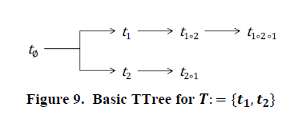
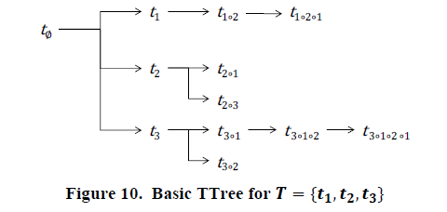
Representing Trade-Off Sequences

Slide 28
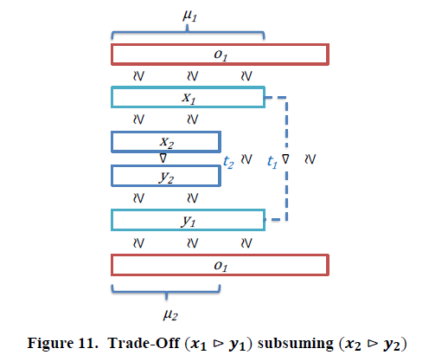
Removing Redundancy from the Tree
Subsumption criterion for 𝒕𝟏 ⊆ 𝒕𝟐:
For two trade-offs 𝑡1 ≔ (𝑥1 ⊳ 𝑦1) and 𝑡2 ≔ (𝑥2 ⊳ 𝑦2),
𝑡1 ⊆ 𝑡2, iff 𝑥1 ≥𝑃 𝑥2 ↶ 𝑥1 ∧ 𝑦2 ↶ 𝑦1 ≥𝑃 𝑦1 ∧ 𝜇2 ⊆ 𝜇1

Slide 29
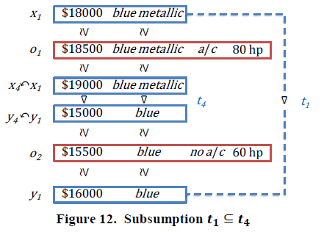
Removing Redundancy from the Tree
As an example, consider following trade-offs.,
Consider a blue-metallic car o1 for $18500 and a blue car for $15500 .
Clearly o1 more desirable than o2.However o1 >T o2 via t4 not via t1.

Slide 30
Indexing for Improved Match-Making
Algorithm 5: Indexing for improved match making
Idea is to check only those trade-off sequences which potentially could establish a domination relationship.
Trade-offs that satisfy..,
𝑡≔(𝑥⊳𝑦)∈𝑇 ∀𝑖∈𝜇: 𝑦𝑖 ≳𝑖 𝑜2,𝑖
𝑡≔(𝑥⊳𝑦)∈𝑇 ∀𝑖∈𝜇𝑖∶𝑜1,𝑖 >𝑖 𝑥𝑖

Slide 31
Experimental Evaluations
Randomly generated sets of consistent trade-offs to be integrated.
The underlying database relation has 6 attributes with domains of about 20 distinct values each (based on values often occurring in e-commerce settings).
Trade-offs are chosen randomly on two to four of those attributes.
Up to 10 trade-offs are used per set

Slide 32
Trading Tree Size
Measured the tree sizes (i.e. number of tree nodes) and analyzed them according to different percentage quantiles (e.g. “2%-quantile = 139” means 2% of all trees are smaller than 139 nodes).
Below table shows the observed results

Slide 33
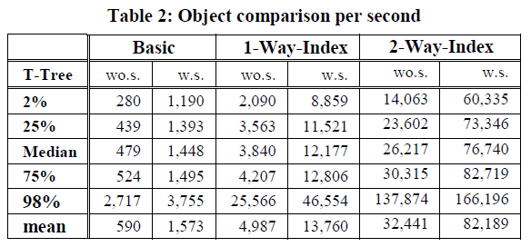
Comparison Speed-Up Using Indexes
For each trade-off set 10,000 pairs of skyline objects were generated and checked for dominance with respect to the trade-off set.
For each object pair, we used the basic algorithm (Algorithm 2), an algorithm with 1-way-indexing, and the algorithm for 2-way-indexing (Algorithm 5), each with trading trees with and without subsumption respectively. Below table shows the observed results.

Slide 34
Computing Trade-off Skylines
Computed some trade-off skylines using two typical real world E-commerce datasets with 998 notebook offers and 1,350 real estate offers.
For notebook dataset, the Pareto skyline still contains 205 items.
Assuming the user prefers to buy a 15’’ screen size laptop and larger or smaller screens are less desirable.
Two new trade-offs can be generated i.e.,
(15’’,cluster avg. values) > (13.3’’,cluster avg. values)
(15’’,cluster avg. values) > (13.3’’,cluster avg. values)

Slide 35
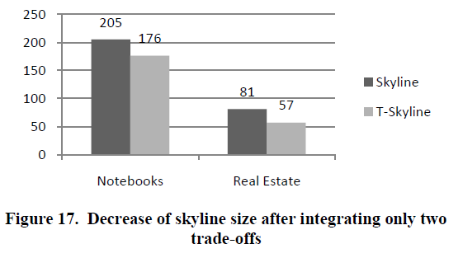
Computing Trade-off Skylines
Incorporating these two trade-offs decreased the skyline size on avg. by 15% to 176 items.
For real estate dataset of 1,350 offers ,initial skyline set has 81 items.
Incorporating two trade-offs with respect to space and price reduced skyline set by 30% to 57 items.

Slide 36
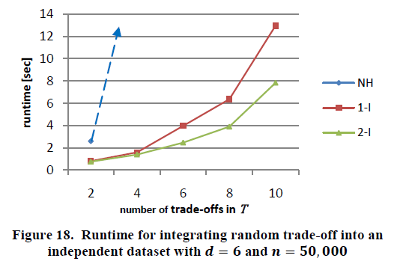
EXPERIMENTAL EVALUATIONS
Computing Trade-off Skylines
The run time results of all the three algorithms ( naïve baseline, 1-way indexing,
and 2-way indexing ) with subsumption are given in the below figure.

Slide 37
Questions..?
Conclusion and future work .
Thank you!

