Slide 1
CrowdER -
Crowdsourcing Entity Resolution

Slide 2
Agenda
Our agenda for today is to answer these questions:
WHY CrowdER??
WHAT is CrowdER??
HOW is CrowdER implemented??

Slide 4
What is Entity Resolution?
Entity reconciliation or duplicate detection.
Central to data integration and data cleaning where you get data from multiple sources.
Problem: Two records that are not exactly identical may refer to same real word entity.
Solution: Entity Resolution - It is the task of finding different records that refer to the same entity.

Slide 5
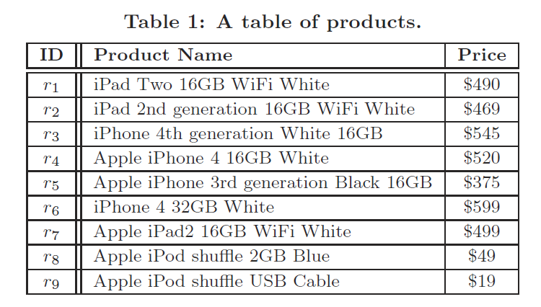
Product Data set:
Similar!!!!

Slide 6
Entity Resolution Techniques
Machine based techniques:
Similarity Based
Learning Based

Slide 7
Similarity Based Techniques
These require a similarity function and a threshold.
Similarity function takes a pair of records as input, and outputs a similarity value.
If similarity value > threshold then they refer to the same entity.

Slide 8
Example: Jaccard similarity
Apply Jaccard similarity between product names and consider threshold value to be 0.5
Jaccard similarity over two sets is defined as the size of the set intersection divided by the size of the set union.
Jaccard similarity between r₁ and r₂:
As J(r₁,r₂) > 0.5, r₁ and r₂ are referring to the same entity.

Slide 9
Disadvantages:
Expensive to compute the similarity for every pair of records and also might not result in accurate results.

Slide 10
Learning Based Techniques:
These model the entity resolution as classification problem.
Here we can choose Jaccard similarity on product name.
Each pair of records will be represented as feature vector that contains only single dimension.
Train the classifier - Training set consists of positive and negative feature vectors indicating matching and non-matching pairs.

Slide 11
Disadvantages:
Need a good training set to train the classifier.
But these state of art techniques have difficulty in identifying duplicate products based on textual descriptions in many domains.

Slide 13
Crowdsourcing?
It is the practice of obtaining needed services, ideas, or content by soliciting contributions from a large group of people, and especially from an online community, rather than from traditional employees.
Popular crowdsourcing platforms:
Amazon Mechanical Turk (AMT)
Crowdflower
They support crowd sourced execution of “microtasks” or “Human Intelligence Tasks” (HITS), where people do simple jobs requiring little or no domain expertise.

Slide 14
Entity Resolution using Crowdsourcing:
ER is expressed as a query in a crowd-enabled query processing system such as Crowd DB.
Simple CrowdSQL query:
SELECT p.id, q.id FROM product p, product q
WHERE p.product_name ~= q.product_name
~= is an operator that can ask crowd to decide whether or not p.product_name and q.product_name refer to same product.

Slide 15
Naïve Approach:
Create a HIT for each pair of records, and for each HIT, to ask people in the crowd to decide whether or not the two records both refer to same entity.
If table has ‘n’ records
Number of HITs = O(n²)

Slide 16
Batching Strategies:
First Approach: Place multiple record pairs into a single HIT.
Worker must check each pair in the HIT individually.
Suppose a pair based HIT consists of ‘k’ pairs of records
Number of HITs = O(n²/k)

Slide 17
Batching Strategies:
Second Approach: Place multiple record pairs into a single HIT but asked workers to find all matches among all of the records.
Suppose a pair based HIT consists of ‘k’ records
Number of HITs = O(n²/k²)

Slide 18
Disadvantages of Batching:
Though batching provide significant benefits in cost with only minimal negative impact on accuracy, it suffers from scalability problem.
Example: size of records = 10000, k = 20, cost = $0.01 per HIT
Approach | Number of HITs | Cost
First | 5,000,000 | $50,000
Second | 250,000 | $2500

Slide 19
Can we do better???????

Slide 20
HOW ??

Slide 21
Hybrid Human Machine Approach
Machine Based
Techniques
Only Crowd Based
Techniques
Hybrid Human Machine Approach

Slide 22
Contributions:
Propose a hybrid human-machine system for entity resolution.
Formulate cluster-based HIT generation problem using two-tiered heuristics-based solution.
Compare Pair-based and cluster-based HIT generation.
Compare this approach with other techniques by experimenting on some sample data.

Slide 23
CrowdER – Hybrid Human Machine Approach
CrowdER uses machine-based techniques to discard those pair of records that look very dissimilar and only asks the crowd to verify the remaining pairs which need human insight.
Combined the efficiency of the machine-based approaches with the answer quality that can be obtained from people.

Slide 24
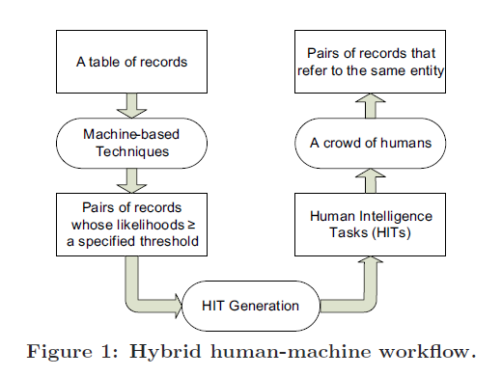
Hybrid Human-Machine Workflow
HIT generation is the key component of this workflow

Slide 25
HIT Generation
Given set of pair of records, they must be combined into HITs for crowdsourcing.
Two types:
Pair-Based HITs
Cluster-Based HITS

Slide 26
Pair-based HIT Generation:
Each HIT consists of multiple pairs of records to be compared, batched into a singe HIT.
Worker just have to verify they refer to the same entity or not.
Suppose pair-based HIT can contain at most k pairs. Given set of pairs, P, we need to generate (|P|/k) pair-based HITs.

Slide 27
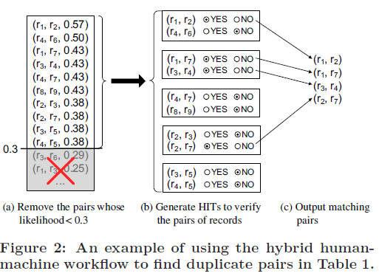
Example
Total records = 9, Total pairs = 36
Pairs to be verified = 10, k=2
Number of HITs = 5

Slide 28
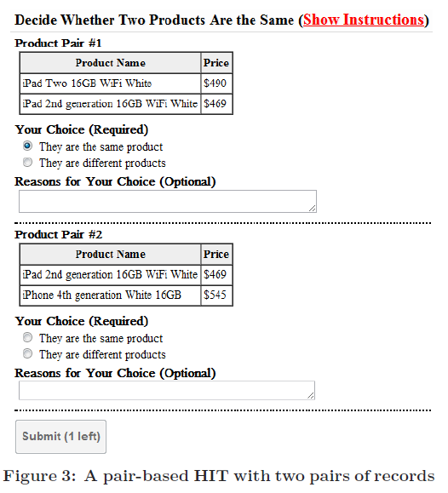
Amazon Mechanical Turk Example:

Slide 29
Cluster-based HIT Generation:
A HIT consists of group of individual records rather than pairs and workers are asked to find all duplicate records in the group.
It allows pair of records to be matched if and only if both records are in the HIT.
As payment is made per HIT, we must reduce the number of HITs
A bound should be placed to number of records to be placed in a HIT to avoid higher latencies and lower quality answers.

Slide 30
Example

Slide 31
Goal
Goal: Given a set of pairs of records, P, and a cluster-size threshold, k, the cluster-based HIT generation problem is to generate the minimum number of cluster-based HITs, H₁,H₂, · · · ,H_{h}, that satisfy two requirements:
1. |H_{ℓ}| ≤ k for any ℓ ∈ [1, h], where |H_{ℓ}| denotes the number of records in Hℓ
2. for any (r_{i}, r_{j}) ∈ P, there exists H_{ℓ} (ℓ ∈ [1, h]) such that r_{i} ∈ H_{ℓ} and r_{j} ∈ H_{ℓ}

Slide 32
Example
Consider the ten pairs of records in Figure 2(a). Given the cluster-size threshold k = 4.
Suppose we generate three cluster-based HITs,
H1 = {r₁, r₂, r₃, r₇}, H2 = {r₃, r₄, r₅, r₆} and
H3 = {r₄, r₇, r₈, r₉}
Both the conditions mentioned satisfies.
Number of HITs = 3

Slide 33
Problem
Cluster-based HIT generation problem is
NP-Hard

Slide 34
Two-Tiered Approach
First build a graph on set of pairs. The graph formed will consists of many connected components.
We classify the connected components into 2 types based on cluster-size threshold ‘k’.
1. Large Connected Components (LCCs) (more than k vertices)
2. Small Connected Components (SCCs) (no more than k vertices)

Slide 35
Two-Tiered Approach
Since LCCs have vertices greater than ‘k’, they have to be partitioned into SCCs.
While partitioning, create SCCs that are highly connected so as to increase the number of edges covered by a component.
By using a packing method, we can add multiple SCCs to a single HIT to reduce the number of HITs.

Slide 36
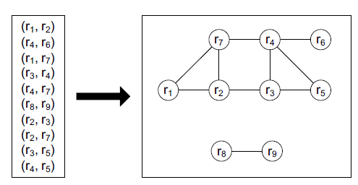
Example
It consists of two connected components. Suppose k = 4.
The top one is an LCC and the bottom one is an SCC. Consider the top component containing seven vertices {r₁, r₂, r₃, r₄, r₅, r₆, r₇}.
Since it is an LCC, it must be partitioned. Assume it is partitioned into three SCCs{r₁, r₂, r₃, r₇}, {r₃, r₄, r₅, r₆}, {r₄, r₇}, which can cover all of its edges. Then the graph becomes
{r₁, r₂, r₃, r₇}, {r₃, r₄, r₅, r₆}, {r₄, r₇}, {r₈, r₉}.

Slide 37
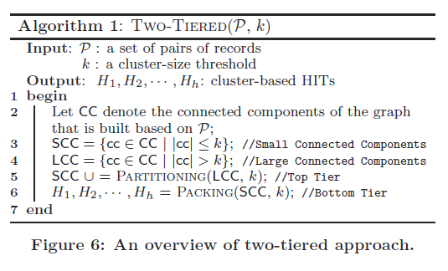
Algorithm

Slide 38
LCC Partitioning (Top Tier)
Input: LCC
Output: SCCs formed by partitioning LCC
Approach: Greedy Algorithm
Process: The algorithm iteratively generates SCC with highest connectivity and iterates until the generated SCCs cover all edges in larger one.
Indegree: Number of edges between vertex ‘r’ (not in scc) and vertices in scc
Outdegree: Number of edges between ‘r’ (not in scc) and vertices not in scc

Slide 39
Procedure
Initialize a ‘scc’ with vertex having maximum degree in LCC.
The algorithm repeats to add new vertex to scc that maximizes connectivity of scc.
If there is a tie in case of maximum indegree, the algorithm selects a vertex with minimum outdegree.
Add this vertex to scc and update indegree and outdegree of all vertices w.r.t new scc.
Algorithm stops when size of scc is equal to ‘k’ or when no remaining vertex connects with scc.

Slide 40
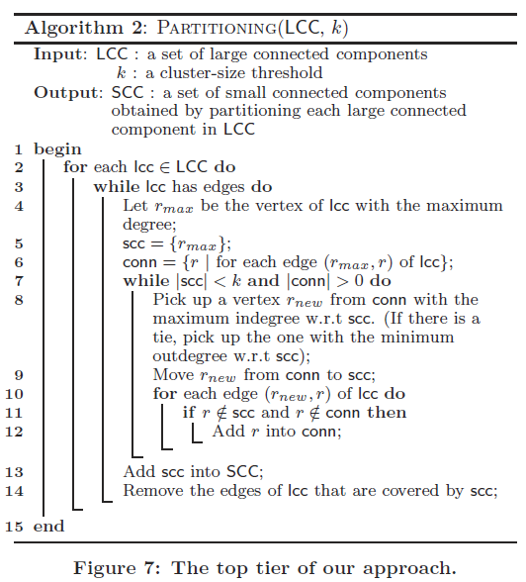
Algorithm

Slide 41
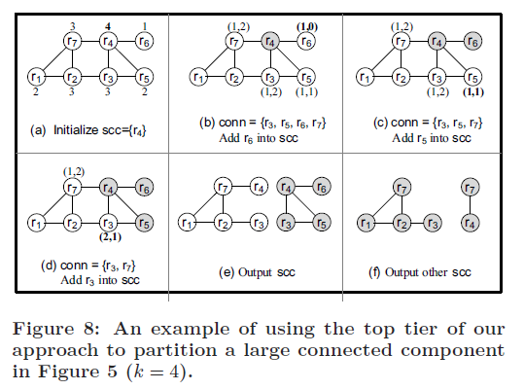
Example

Slide 42
SCC Packing (Bottom Tier)
Input: SCCs
Output: Pack them into minimum number of HITs such that such that size of each HIT is no larger than ‘k’.
As this is NP-hard problem we formulate it as an integer linear problem.
The integer linear problem can be solved by using efficient column generation and branch-and-bound

Slide 43
Procedure
Let p = [a₁, a₂, · · · , a_{k}] denote a pattern of a CB HIT, where a_{j} (j ∈ [1, k]) is the number of SCCs in the HIT that contain j vertices.
Since a cluster-based HIT can contain at most k vertices, we say that p is a feasible pattern only if ∑ _{j=1}^{k} (j * a_{j}) ≤ k holds.
For example, suppose k = 4, p₁ = [0, 0, 0, 1] is a feasible pattern since 1 · 0 + 2 · 0 + 3 ·0 + 4 · 1 = 4 ≤ k holds. We collect all feasible patterns into
a set A = {p₁, p₂, · · · , p_{m}},
where pi = [a_{i1}, a_{i2}, · · · , a_{ik}](i ∈ [1,m]).

Slide 44
Continued…
When packing a set of SCCs into cluster-based HITs, each HIT must correspond to a pattern in A.
Let x_{i} denote number of cluster-based HITs whose pattern is p_{i} (i ->[1,m]).
Now problem is to minimize the total number of patterns. We can formulate our packing problem as following integer linear program:
min ∑_{i=1}^{m} (x_{i})
such that ∑_{i=1}^{m} (a_{ij}x_{i}) >= c_{j} ∀j ∈[1,k]
x_{i} >= 0, integer

Slide 45
Example
Given a set of SCCs, {r₃, r₄, r₅, r₆},
{r₁, r₂, r₃, r₇}, {r₄, r₇} and {r₈, r₉}.
We have c₁ = 0, c₂ = 2, c₃ = 0 and c₄ = 2. To pack them into cluster-based HITs (k = 4)
We first generate all feasible patterns,
i.e. A = {p₁ =[0, 0, 0, 1], p₂ = [0, 2, 0, 0],
p₃=[0, 1, 0, 0]}.

Slide 46
Continued…
Now decide on number of CB-HITs corresponding to each feasible pattern (x₁,x₂,x₃).
One possible solution: x₁=2, x₂=0, x₃=2
It needs ∑_{i=1}³ (x_{i}) = 4 CB-HITs
Check if this satisfies constraint condition.
∑_{i=1}³ (a_{ij}x_{i}) >= c_{j} ∀j ∈[1,4] (j=2)
But the solution is not optimal, since there is another solution x₁=2, x₂=1, x₃=0 which results in 3 CB-HITs.

Slide 47
PB-HITs Vs CB-HITs
In PB-HITs, the number of comparisons is the number of pairs which are batched into the HIT.
For CB-HIT with n-records:
Lets say CB HIT has “m” distinct entities e₁,e₂,….e_{m} where e_{i} represents set of records that refer to i^{th} entity.
Total comparisons = ∑_{i=1}^{m} (n-1- ∑_{j=1}^{i-1} |e_{j}|)
So the CB HIT requires fewer comparisons if it contains more matches.

Slide 48
Example
Consider the CB HIT with 4 records {r₁,r₂,r₃,r₇}
e1 = {r₁,r₂,r₇} e2 = {r₃}
Number of comparisons = 3

Slide 49
Experimental Results
Datasets:
1. Restaurant: 858 records
Total pairs = 367,653 (106 refer to same entity)
2. Product: 1081 records from abt, 1092 from buy.
Total pairs = 1,180,452 pairs (1097 pairs refer to same entity).

Slide 50
Terms
Precision: Percentage of correctly identified matching pairs out of all pairs identified as matches.
Recall : Percentage of correctly identified matching pairs out of all matching pairs in dataset.

Slide 51
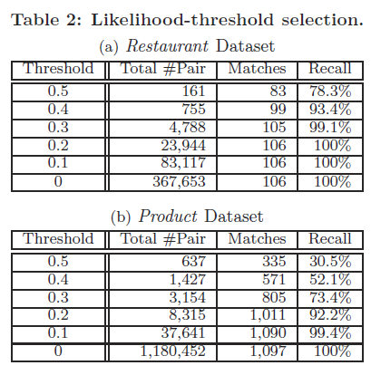
Results - Machine Based (Simjoin)

Slide 52
Amazon Mechanical Turk
We use AMT to evaluate our hybrid human –machine workflow.
Cost per HIT: $0.02 to worker and $0.005 to AMT for publishing.
Techniques to improve result quality:
Replication: Each HIT is replicated into 3 different assignments and is assigned to different worker.
Qualification Test: for workers to be eligible to do our HITs

Slide 53
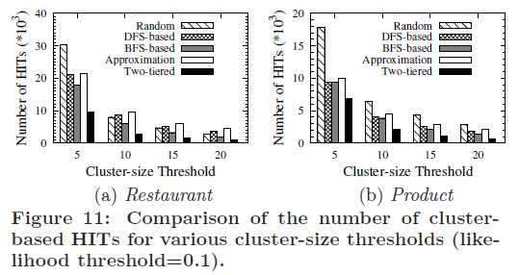
Results – Cluster Based HIT

Slide 54
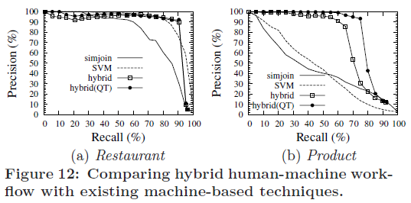
Results – Entity Resolution Techniques

Slide 55
Conclusion
Proposed a hybrid human-machine approach for crowdsourcing entity resolution.
Proposed a two-tier approach for generation of cluster-based HITs
Still lot of work to be done to address various issues like scaling to much larger datasets, techniques to take privacy into consideration (confidential data).

Slide 56
QUESTIONS???

