Slide 1
(Self) Balanced Search Trees
AVL
Red-black
2-4 (no time to discuss)
Splay

Slide 2
BSTs are Potentially Good
In O(h)-time, where h is the height of the tree, we can perform
  Search
  Minimum, maximum
  Predecessor, successor
  Insert, Delete
An n-node binary tree must have height
h = Ω(log n)
  The best we can hope for is h = O(log n)

Slide 3
Intuitively, How to Keep a Tree’s Height Small?
For every internal node v
  |left branch of v| ≈ |right branch of v|
  Exactly the same reason quick sort needs balanced partition
AVL trees maintain this property by
  Keeping the heights of left and the right subtrees roughly equal
Red Black trees maintains this property by
  Loosely keeping all leaves at the same (asymptotic) depth
AVL is more rigid, faster search
Red-Black has faster insert/delete

Slide 4
AVL Trees
Named after
- Геóргий Макси́мович Адельсóн-Вéльский
and
Евгéний Михáйлович Лáндис
1962
Idea: rebalance the tree after an insert/delete

Slide 5
AVL Trees
Balanced node:
  A node v is “balanced” if its left subtree and right subtree have heights differ by at most 1
An AVL tree is
  a BST in which every internal node is balanced.
Theorem: an AVL tree on n nodes has
O(log n)-height

Slide 6
Proof of Theorem
Let h(n) be the max height of an AVL-tree with n nodes
Want to show (roughly) h(n) ≤ 10 log(n)
  Where 10 could be some other constant
The following two statements are equivalent
  An AVL-tree can’t have large height h (relative to n)
  An AVL-tree can’t have two few nodes n (relative to h)
Let n(h) be the minimum # of nodes of an AVL-tree with height h
Want to show (roughly) n(h) ≥ 2^{h/10}

Slide 7
Recurrence for n(h)
For convenience, heights measured to the NULLs

Slide 8
Solving for n(h)

Slide 9
Old Friend: Fibonacci

Slide 10
But how do we maintain AVL property?
After an insert
  One subtree might be taller than the other by 2
  Potentially affect the balance of all nodes up to the root
  Rebalance
After a delete
  One subtree might be shorter than the other by 2
  Potentially affect the balance of all nodes up to the root
  Rebalance

Slide 11
Insert
50
90
unbalanced
30
110
10
70
100
150
8
40
80
105
130
160
35
60
120
140

Slide 12
Balance
Let’s define the “balanceness” of a node
  Balance(v) = height(v->left) – height(v->right)
We want v’s balance to be in {-1, 0, 1}
  balance = -1 means v is “right heavy”
  balance = 1 means v is “left heavy”
After inserting a new node
  Let a be the first node on the path back to the root that’s not balanced, then a’s new balance is -2 or 2

Slide 13
Example: RR case
0
-2
a
b
b
-1
Single Rotation
0
a
T₁
T₃
T₁
T₂
T₂
T₃
New node
Done!

Slide 14
Example: RL case
0
b
-2
a
0
+1
c
Double Rotation
a
c
T₁
b
T₂
T₄
T₄
T₁
T₃
T₂
T₃
New node
Done!

Slide 15
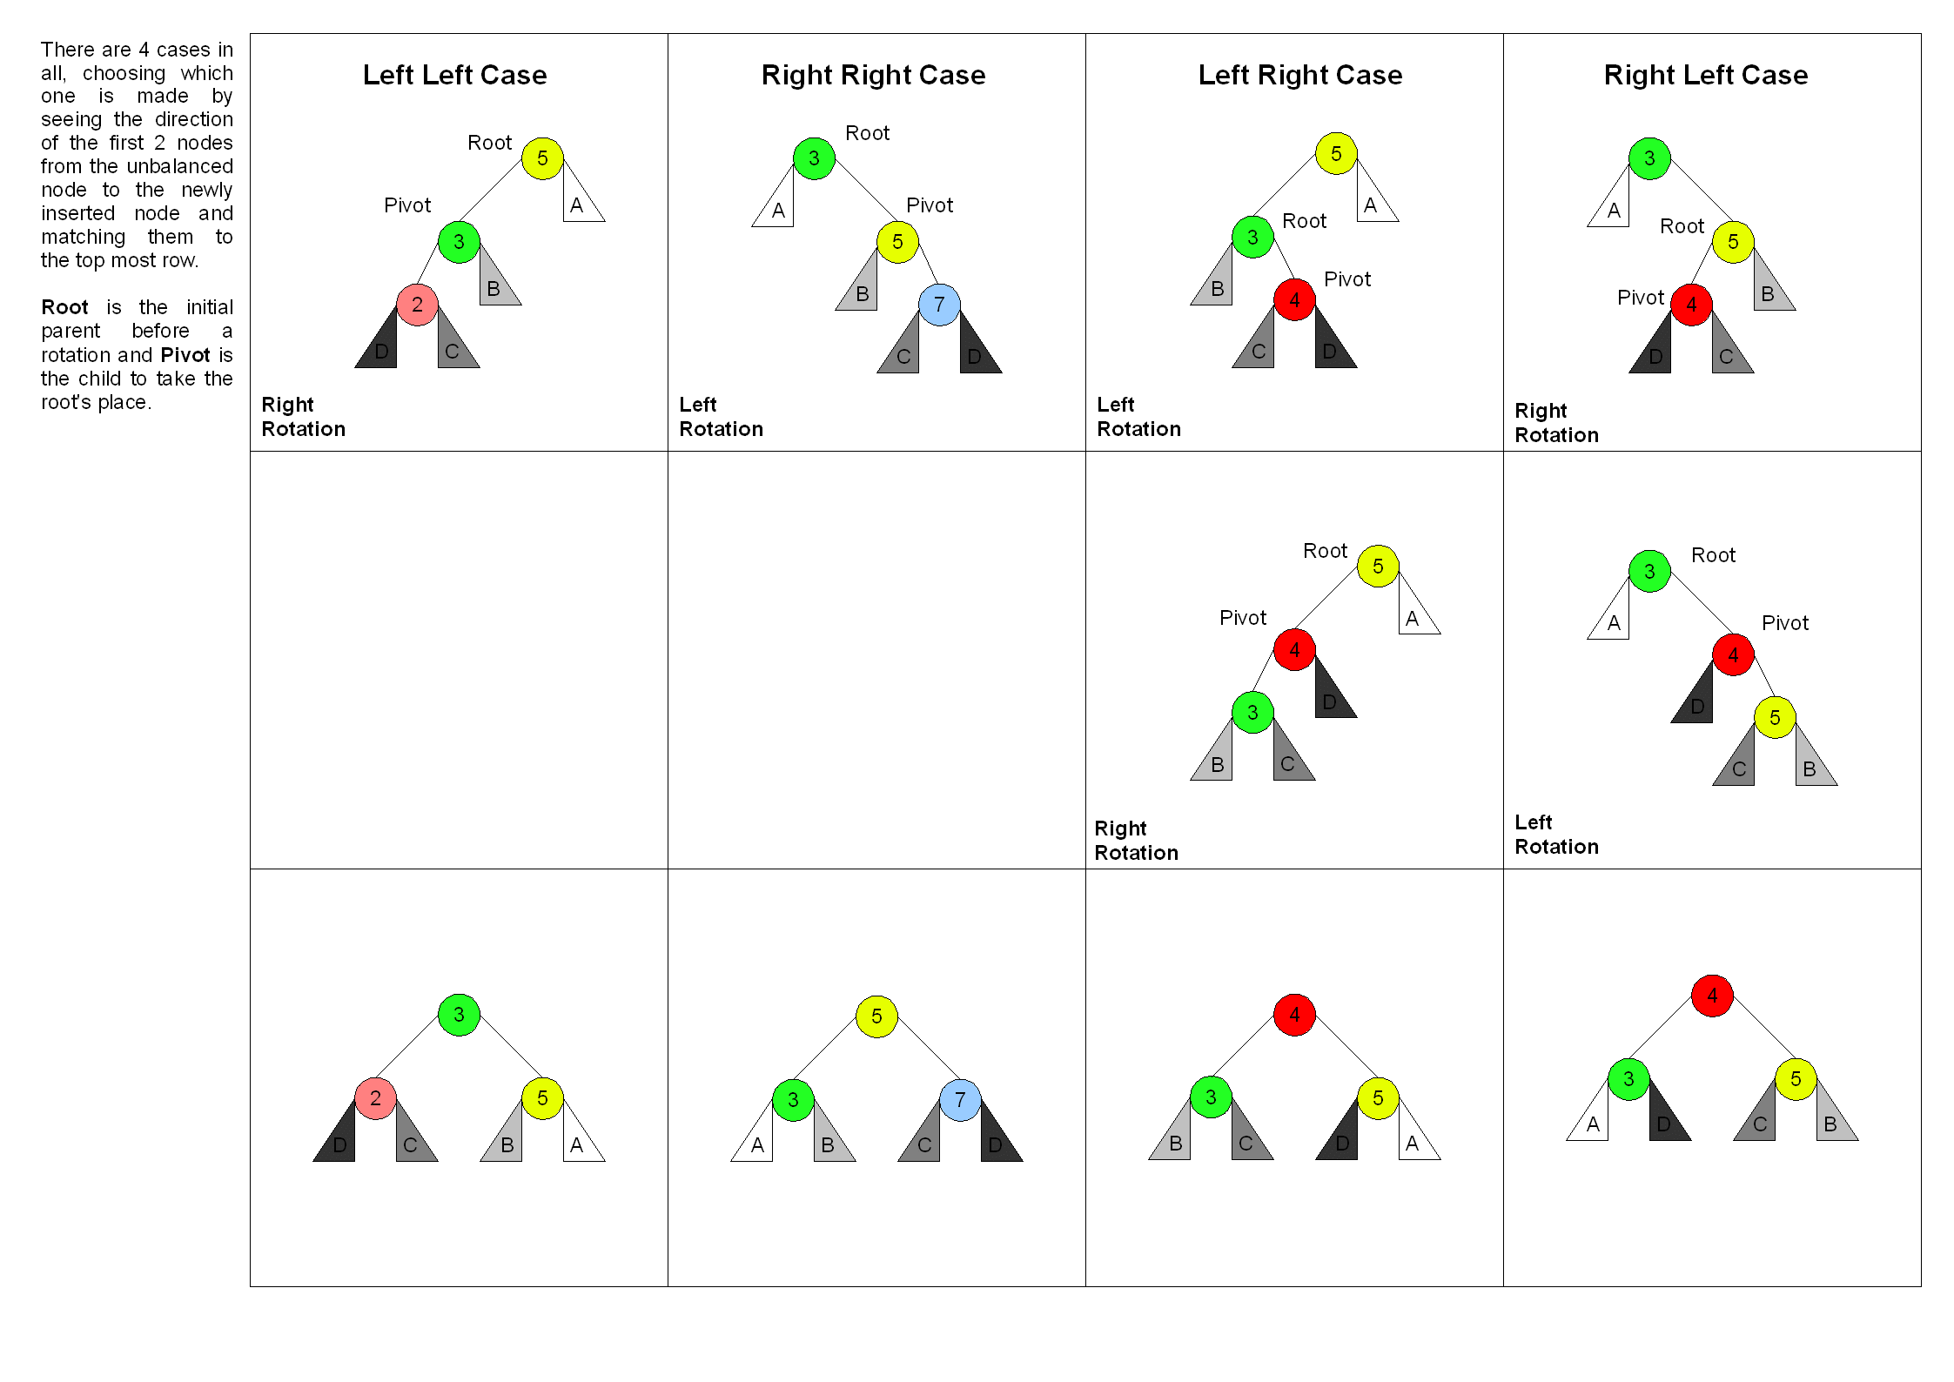
Picture from Wikipedia
14

Slide 16
Delete
First, delete as in normal BST
  But nodes on path to root might become unbalanced
Second, fix unbalanced nodes one by one using exactly the same strategy
  Might require up to O(log n) rotations
Insert & delete run in time O(log n)

Slide 17
Theorems
Insertion:
  After fixing one node (with a single/double rotation) the tree becomes balanced (i.e. AVL again) – why?
Deletion:
  Fixing one node does not necessarily balance the tree
  Need more fixing up to the root
Think of an example AVL-tree for which
Ω(log n) fixes are necessary after a deletion!

Slide 18
Red-Black Trees
Rudolf Bayer (1972)
Leonidas J. Guibas and Robert Sedgewick (1978)
Now we understand the banner on the course’ blog
std::map and std::set are based on red-black trees

Slide 19
Idea
In a perfectly balanced tree
  Every path from the root to the leaves have the same length
  In fact, every path from any given node to its descendent leaves have the same length
This property is way too strong to be feasible
We will relax it
  Color nodes black or red
  Black nodes form the “skeleton” of a perfectly balanced tree
  Red nodes provide some slack
  Can’t cut the tree too much slack or else it will become unbalanced

Slide 20
Red-Black Trees
Are BSTs with the following properties
  Leaves are the NULL nodes (for convenience)
  Every node is either RED or BLACK
  Root and leaves are black
  Black parent property:
  Both children of a RED node are BLACK
  Equivalently, every RED node has a BLACK parent
  Black height property:
  Every path from an internal node to any descendent leaf has the same number of black nodes
  Number of black nodes from v down to a leaf (not counting v) is called black-height(v)

Slide 21
30
Black height = 3
Black height = 2
15
40
10
24
35
50
3
12
17
26
32
37
45
55
14
36
39

Slide 22
Key Results
In a Red Black Tree with n nodes
Its height is O(log n)
Insertion and deletion
  take O(log n)-time
  require only O(1) rotations

Slide 23
Height of an RB-tree, Connection to 2-4
Move each red node next to its black parent
Get a 2-4 tree with height h’
  2-4 tree: every internal node has 2, 3, or 4 children
  h’ is exactly the black height of the root
We will show that
  h = height(RB-tree) ≤ 2 log₂(n+1)

Slide 24
30
15
40
10
24
35
50
3
12
17
26
32
37
45
55
14
36
39

Slide 25
2-3-4 Tree from a Red-Black Tree
h’ = black-height(root)
30
40
10
15
24
35
37
50
3
12
14
17
26
32
36
39
45
55

Slide 26
Insertion
Insert as in normal BST
Call new node z
Color it red
Fix the potential “double red” problem

Slide 27
Lucky case: New Node’s Parent is Black
30
15
40
10
24
35
50
3
12
17
26
32
37
45
55
z
14
36
39
Great, nothing to do!

Slide 28
Unlucky case: z’s Parent is Red
10
3
12
Double red problem!
z
14

Slide 29
Case 1: z’s Uncle is Red
New z
b
b
Recolor & move
a
c
a
c
the double red
problem up toward
the root
z
T₁
T₂
T₁
T₂
d
d
T₃
T₃
T₄
T₅
T₄
T₅

Slide 30
Case 2a: z’s Uncle is Black
b
c
Single rotation
a
c
b
d
z
a
T₃
T₄
T₅
T₁
T₂
d
T₃
T₁
T₂
T₄
T₅

Slide 31
Case 2b: z’s Uncle is Black
b
c
Double rotation
a
d
b
d
z
a
T₃
T₄
T₅
T₁
T₂
c
T₅
T₁
T₂
T₃
T₄

Slide 32
Deletion
Delete as in normal BST
Let z be the lone child of the spliced out node
If we spliced out a red node, lucky! Nothing else to do
Else, fix the potential “double black” problem

Slide 33
Lucky Case 0a: splice out a red node
30
15
40
10
24
35
50
3
12
17
26
32
37
45
55
14
36
39
Great, nothing to do!

Slide 34
Lucky Case 0b: splice out a red node
30
16
15
40
10
24
35
50
3
12
17
26
32
37
45
55
16
36
39
Great, nothing
else to do!

Slide 35
Unlucky → Double Black Problem
30
15
40
10
24
35
50
3
12
17
26
32
37
45
55
z
14
36
39

Slide 36
Solving the double black problem
  z’s sibling can’t be a leaf. Why?
Case 1: z’s sibling is black with a red child
Case 2: z’s sibling is black with no red child
Case 3: z’s sibling is red

Slide 37
Case 1a: z’s sibling is black with a red child
c
b
z
Single rotation
b
d
a
c
d
a
T₃
T₁
T₂
d
T₄
T₅
T₃
T₁
T₂
T₄
T₅

Slide 38
Case 1b: z’s sibling is black with a red child
c
b
z
Double rotation
a
d
a
c
d
T₁
b
T₁
T₂
d
T₄
T₅
T₃
T₂
T₃
T₄
T₅

Slide 39
Case 2a: z’s sibling is black with 2 black children
b
b
z
Recolor
a
c
a
c
d
T₂
T₁
T₂
T₁
T₃
T₄
T₃
T₄

Slide 40
Case 2b: z’s sibling is black with 2 black children
New z
b
b
d
z
Recolor & move up
a
a
c
c
d
T₂
T₁
T₂
T₁
T₃
T₄
T₃
T₄

Slide 41
Case 3: z’s sibling is red
b
a
z
Rotate
a
c
b
d
T₁
New z with a
black sibling
T₁
T₂
T₂
c
T₃
T₄
T₃
T₄

Slide 42
(2,4)-Trees
(please read blog post)
Also called 2-3-4-trees
A type of B-Trees
A type of Multi-way search trees
Invented by rudolf bayer (1972)
Red-black trees can be viewed as an implementation of (2,4)-trees and vice versa, they are “isomorphic”

Slide 43
Multi-Way Search Trees
d-node
K₁ ≤ K₂ ≤ … ≤ K_{d-1}
v₁
v₂
v_{d-1}
v_{d}
Keys ≤ K₁
K1 ≤ Keys ≤ K₂
K_{d-2} ≤ Keys ≤ K_{d-1}
K_{d-1} ≤ Keys

Slide 44
Multi-Way Search Trees
4-node
30 | 60 | 81
3-node
2-node
3 | 10
32 | 45 | 55
95
1 | 2
8
31
38
57
88
97 | 99

Slide 45
Searching in a Multiway Search Tree
47
57
30 | 60 | 81
3 | 10
32 | 45 | 55
95
1 | 2
8
31
38
57
88
97 | 99
Minimum, maximum, predecessor, successor?

Slide 46
(2, 4)-Trees
A multi-way search tree which maintain
Size Property
  Each internal node has 2, 3, or 4 children
Depth property
  All leaves (NULL nodes) have the same depth

Slide 47
(2,4)-Trees
30 | 60 | 81
3 | 10
32 | 45 | 55
70 | 78
95
1 | 2
8
11 | 15
31
38
47 | 50
57
65
72 | 77
80
88
97 | 99

Slide 48
Properties of (2, 4)-trees
On n keys
Number of leaves (NULL) is n+1
If the height of the tree is h, then
2^{h} ≤ n+1 ≤ 4^{h} ➔ h ≤ log (n+1)
Search, min, max, predecessor, successor all take logarithmic time
How about updates?

Slide 49
Insertion, the Nice Case
48
30 | 60 | 81
3 | 10
32 | 45
70 | 78
95
8
31
38
47 | 48 | 50
1 | 2
11 | 15
47 | 50
65
72 | 77
80
88
97 | 99

Slide 50
Insertion, Overflow Case → Split
25 | 101
Propagate further up if still overflow
30 | 45 | 60 | 81
25 | 45 | 101
5 children: overflow
30
60 | 81

Slide 51
Insertion, Overflow at the Root
This is the new root
45
root
30 | 45 | 60 | 81
30
60 | 81

Slide 52
Deletion, Nice Case #1
30 | 60 | 81
3 | 10
32 | 45
70 | 78
95
47 | 50
1 | 2
8
11 | 15
31
38
47 | 48 | 50
65
72 | 77
80
88
97 | 99
Delete parent of a leaf and no underflow

Slide 53
Deletion, Nice Case #2
30 | 60 | 81
3 | 10
32 | 45
70 | 78
95
8
31
38
47 | 50
62
1 | 2
11 | 15
62 | 65
72 | 77
80
88
97 | 99
Successor has no underflow

Slide 54
Deletion ➔ Underflow ➔ Transfer
25 | 101
60 | 101
transfer
15
60 | 81
25
81
Adjacent sibling is a
3-node or a 4-node
25 | 101
14 | 101
transfer
10 | 14
52
10
25

Slide 55
Deletion ➔ Underflow ➔ Fusion
25 | 101
25 | 90
15
81
15
81
95
One 2-node sibling
Two 2-node siblings
fusion
101
90
25
81
15
25
95

Slide 56
Fusion Propagation Might be Necessary
25
25
To be deleted
15
81
25
81

Slide 57
Splay Trees
Invented by
Daniel Dominic Sleator, Robert Endre Tarjan 1985
- Self balanced
- Does not require additional data fields (color, balance)
- Any operation takes O(log n) amortized time

Slide 58
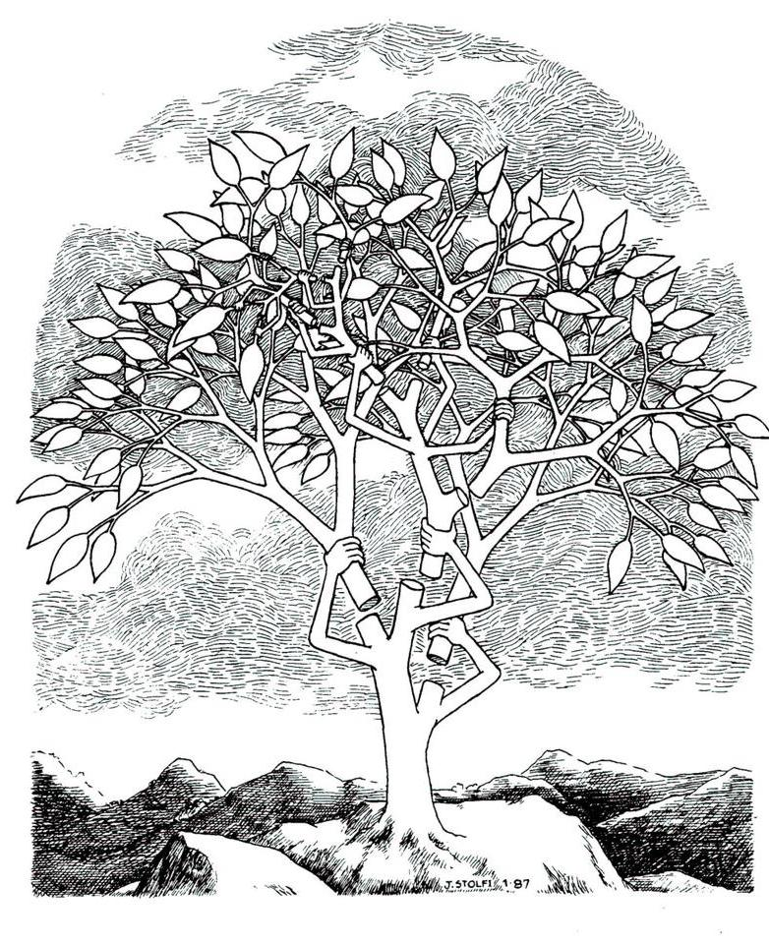

Slide 59
Differences with Blanced Trees
In Red-Black, AVL:
  Extra space per node (color, height)
    Well, for RB there’s a way to avoid the color, but tricky
  Logic is slightly complicated to implement
In a splay tree
  No extra space per node
  Insert/delete are done exactly like it BST + one “splaying” step
  Basic operations: O(log n)-time, in amortized term.
  One additional property: frequently accessed nodes are close to the root!

Slide 60
Splay operation
After each operation (insert, delete, search) a node c is splayed
Result of splay(c) is that c ends up in the root!
  Splay(c) consists of O(height) # of steps
  Each step is one of: zig-zig, zig-zag, or zig
We’ll talk about which node is splayed later

Slide 61
Zig-zig (depth(c) -= 2)
y
c
x
x
T₁
Zig-Zig
T₄
c
C has a grandparent
y
T₂
T₃
T₃
T₄
T₁
T₂
There’s also the symmetric case when y is on the left
and c is the left child of y

Slide 62
Zig-zag (depth(c) -= 2)
y
c
x
Zig-Zag
y
x
T₁
c
C has a grandparent
T₂
T₄
T₄
T₁
T₃
T₂
T₃
There’s also the symmetric case when y is on the left
and c is the right child of y

Slide 63
Zig (depth(c) -= 1)
y
c
c
y
x
T₁
Zig
x
C has no grandparent
T₂
T₃
T₄
T₂
T₁
T₃
T₄
There’s also the symmetric case when c & y are on the left
note that y could be NULL

Slide 64
Which node to splay?
Search:
  Successful: splay the found node
  Unsuccessful: splay the node just before falling off to NULL
Insert:
  Splay the newly inserted node
Delete:
  Splay the child of the spliced-out node
After splaying c, it ends up in the root!
  http://webdiis.unizar.es/asignaturas/EDA/AVLTree/avltree.html

Slide 65
44
Splay(78)
50
17
88
32
65
97
zig-zag
28
54
82
z
29
76
y
80
x
78

Slide 66
44
Splay(78)
50
17
88
32
65
97
zig-zag
28
54
82
x
29
78
z
80
y
76

Slide 67
44
Splay(78)
50
17
88
32
z
65
97
zig-zag
y
28
54
82
29
78
x
76
80

Slide 68
44
Splay(78)
50
17
88
32
x
78
97
zig-zag
28
z
65
y
82
29
54
76
80

Slide 69
44
z
Splay(78)
50
17
88
y
32
x
78
97
zig-zag
28
65
82
29
54
76
80

Slide 70
44
x
Splay(78)
78
17
z
88
y
50
82
32
97
zig-zag
65
28
80
54
76
29

Slide 71
y
44
x
Splay(78)
78
17
88
w
50
82
32
97
zig
65
28
80
54
76
29

Slide 72
78
x
y
44
Splay(78)
17
88
w
50
82
32
97
zig
65
28
80
54
76
29

Slide 73
Main Theorem
The amortized cost of each operation is O(log n)
In particular, for a sequence of m searches, inserts, deletes on a splay tree, the total time it takes is
O(m + Σ_{i=1..m} log n_{i})
Where n_{i} = # of nodes in the tree at i’th operation

Slide 74
So Many Data Structures
What to adopt?
Need experiments

Slide 75
Here’s one set of experiments
Ben Pfaff, SIGMETRICS 2004
  http://www.stanford.edu/~blp/papers/libavl.pdf

Slide 76
Among many other conclusions, here are some
RB trees are preferred when
  When input is expected to be randomly ordered with occasional runs of sorted order
AVL trees are preferred when
  Insertions often occur in sorted order
  Later random access
Splay trees are preferred when
  Insertions often occur in sorted order
  Later sequential or clustered access

