Slide 1
Much ado about Fibonacci numbers
Ah hah! Algorithms
Recursion and iteration
Asymptotic analysis
The repeated squaring trick

Slide 2
Agenda
The worst algorithm in the history of humanity
Asymptotic notations: Big-O, Big-Omega, Theta
An iterative solution
A better iterative solution
The repeated squaring trick

Slide 3
Fibonacci sequence
And the worst algorithm in the history of humanity

Slide 4
Fibonacci sequence
0, 1, 1, 2, 3, 5, 8, 13, 21, 34, …
F[0] = 0
F[1] = 1
F[2] = F[1] + F[0] = 1
F[3] = F[2] + F[1] = 2
F[4] = F[3] + F[2] = 3
F[n] = F[n-1] + F[n-2]

Slide 5
Recursion – fib1()
/**
*----------------------------------------------------------
* the most straightforward algorithm to compute F[n]
*----------------------------------------------------------
*/
unsigned long long fib1(unsigned long n) {
if (n <= 1) return n;
return fib1(n-1) + fib1(n-2);
}

Slide 6
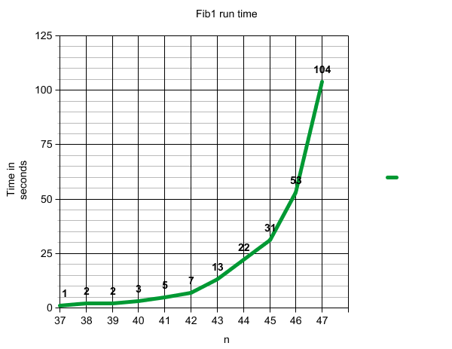
Run time on my laptop
2.53GHz Intel Core 2 Duo, 4 GB DDR3

Slide 7
On large numbers
Looks like the run time is doubled for each n++
We won’t be able to compute F[120] if the trend continues
The age of the universe is 15 billion years < 2⁶⁰ sec
The function looks … exponential
Is there a theoretical justification for this?

Slide 8
A Note on “Functions”
Sometimes we mean a C++ function
Sometimes we mean a mathematical function like F[n]
A C++ function can be used to compute a mathematical function
But not always! There are un-computable functions
Google for “busy Beaver numbers” and the “halting problem”, for typical examples.
What we mean should be clear from context

Slide 9
Analysis of fib1()
Guess and induct strategy
Thinking about the main body

Slide 10
Guess and induct
For n > 1, suppose it takes c mili-sec in fib1(n) not counting the recursive calls
For n=0, 1, suppose it takes d mili-sec
Let T[n] be the time fib1(n) takes
T[0] = T[1] = d
T[n] = c + T[n-1] + T[n-2] when n > 1
To estimate T[n], we can
Guess a formula for it
Prove by induction that it works

Slide 11
The guess
Bottom-up iteration
T[0] = T[1] = d
T[2] = c + 2d
T[3] = 2c + 3d
T[4] = 4c + 5d
T[5] = 7c + 8d
T[6] = 12c + 13d
Can you guess a formula for T[n]?
T[n] = (F[n+1] – 1)c + F[n+1]d

Slide 12
The Proof
The base cases: n=0,1
The hypothesis: suppose
T[m] = (F[m+1] – 1)*c + F[m+1]*d for all m < n
The induction step:
T[n] = c + T[n-1] + T[n-2] = c + (F[n] – 1)*c + F[n]*d + (F[n-1] – 1)*c + F[n-1]*d = (F[n+1] – 1)*c + F[n]*d

Slide 13
How does this help?
The golden ratio

Slide 14
So, there are constants C, D such that
This explains the exponential-curve we saw

Slide 15
Asymptotic analysis
Back of the envelope time/space estimation
Independent of whether our computer is fast
Big-o, big-omega, theta

Slide 16
From intuition to formality
Suppose fib1() runs on a computer with C = 10⁻⁹:
We need a formal way to state that (1.6)^{n} is the “correct” measure of fib1()’s runtime
How fast the target computer runs shouldn’t concern us

Slide 17
Big-O

Slide 18
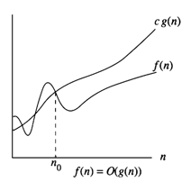
Intuition

Slide 19
In English
f(n) = O(g(n)) means: for n sufficiently large, f(n) is bounded above by a constant scaling of g(n)
Does the “English translation” make things worse?
An algorithm with runtime f(n) is at least as good as an algorithm with runtime g(n), asymptotically

Slide 20
Examples

Slide 21
Big-Omega

Slide 22
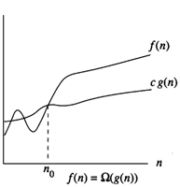
In picture

Slide 23
Examples

Slide 24
Equivalence

Slide 25
Theta
We say they “have the same growth rate”

Slide 26
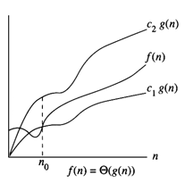
In picture

Slide 27
Better algorithms for computing F[n]
A Linear time algorithm using vectors
A linear time algorithm using arrays
A linear time algorithm with constant space

Slide 28
An algorithm using vector
unsigned long long fib2(unsigned long n) {
// this is one implementation option
if (n <= 1) return n;
vector<unsigned long long> A;
A.push_back(0); A.push_back(1);
for (unsigned long i=2; i<=n; i++) {
A.push_back(A[i-1]+A[i-2]);
}
return A[n];
}
Guess how large an n we can handle this time?

Slide 29
Data
n | 10⁶ | 10⁷ | 10⁸ | 10⁹
# seconds | 1 | 1 | 9 | Eats up all my CPU/RAM

Slide 30
How about an array?
unsigned long long fib2(unsigned long n) {
if (n <= 1) return n;
unsigned long long* A = new unsigned long long[n];
A[0] = 0; A[1] = 1;
for (unsigned long i=2; i<=n; i++) {
A[i] = A[i-1]+A[i-2];
}
unsigned long long ret = A[n];
delete[] A;
return ret;
}
Guess how large an n we can handle this time?

Slide 31
Data
n | 10⁶ | 10⁷ | 10⁸ | 10⁹
# seconds | 1 | 1 | 1 | Segmentation fault
Data structure matters a great deal!
Some assumptions we made are false if too
much space is involved: computer has to use
hard-drive as memory

Slide 32
Dynamic programming!
unsigned long long fib3(unsigned long n) {
if (n <= 1) return n;
unsigned long long a=0, b=1, temp;
unsigned long i;
for (unsigned long i=2; i<= n; i++) {
temp = a + b; // F[i] = F[i-2] + F[i-1]
a = b; // a = F[i-1]
b = temp; // b = F[i]
}
return temp;
}
Guess how large an n we can handle this time?

Slide 33
Data
n | 10⁸ | 10⁹ | 10¹⁰ | 10¹¹
# seconds | 1 | 3 | 35 | 359
The answers are incorrect because F[10⁸] is
greater than the largest integer representable
by unsigned long long But that’s ok. We want to know the runtime

Slide 34
An even faster algorithm
The repeated squaring trick

Slide 35
Math helps!
We can re-formulate the problem a little:

Slide 36
How to we compute A^{n} quickly?
Want
But can we even compute 3^{n} quickly?

Slide 37
First algorithm
unsigned long long power1(unsigned long n) {
unsigned long i;
unsigned long long ret=1;
for (unsigned long i=0; i<n; i++)
ret *= base;
return ret;
}
When n = 10¹⁰ it took 44 seconds

Slide 38
Second algorithm
unsigned long long power2(unsigned long n) {
unsigned long long ret;
if (n == 0) return 1;
if (n % 2 == 0) {
ret = power2(n/2);
return ret * ret;
} else {
ret = power2((n-1)/2);
return base * ret * ret;
}
}
When n = 10¹⁹ it took < 1 second Couldn’t test n = 10²⁰ because that’s > sizeof(unsigned long)

Slide 39
Runtime analysis
First algorithm O(n)
Second algorithm O(log n)
We can apply the second algorithm to the Fibonacci problem: fib4() has the following data
n | 10⁸ | 10⁹ | 10¹⁰ | 10¹⁹
# seconds | 1 | 1 | 1 | 1

