Slide 1
Getting started in C++
The procedural parts of c++
C-style strings
Pointers and references

Slide 2
Agenda
The main body and cout
Fundamental data types
Declarations and definitions
Control structures
References, pass-by-value vs pass-by-reference

Slide 3
The main body and cout
C++ is an OO extension of C
C++ has both procedural and object-oriented features
We will use C++ as a procedural language with objects

Slide 4
Every C++ program must have a main()
// hw.cpp
#include <iostream>
using namespace std;
int main() {
cout << "Hello world\n";
return 0;
}
Somewhat similar to Java’s import
Similar to Java’s namespace
iostream is a C++ abstraction to perform input/output operations on media using “streams”
  Media as character streams: keyboard, files, console, network sockets
  cout is an output stream object associated with the console
  “writing to cout” using << will print to the console

Slide 5
cout is pretty easy to use
#include <iostream>
using namespace std;
int main() {
string my_name = "David Blaine";
string my_text_editor = "Emacs";
string my_home_os = "Windows";
cout << "My name is " << my_name << endl
<< "I was able to install and test g++ and "
<< "the text editor " << my_text_editor << '\n'
<< "in my home computer/laptop, which runs "
<< my_home_os << endl;
return 0;
}

Slide 6
Fundamental data types
They are what you expect them to be, similar to those in Java

Slide 7
The fundamental data types
bool : true or false
char : a character
int : an integer
float : a floating-point real number
And cout will output a variable with the appropriate format for the above types

Slide 8
Cout is easy to use on basic types
#include <iostream>
using namespace std;
int main() {
string name = "David Blaine";
char c = 'H';
int i = 12345;
bool smart = true;
double avg = 3.5;
cout << "I am " << name << endl
<< "smart = " << smart << endl
<< "c = " << c << endl
<< "i = " << i << endl
<< "avg = " << avg << endl;
return 0;
}

Slide 9
Declarations and Definitions
Every name must be declared before used
There must always be at most one definition for each named entity
There can be many declarations
Many declarations are also definitions

Slide 10
Declarations
// variable declarations
string name; char c; int i;
bool smart; double avg;
// a type declaration (the type is a struct)
struct Date;
// a const bool declaration
const bool i_am_smart = true;
// a function declaration
int foo(int);

Slide 11
Definitions
// definition of function foo()
int foo(int x) {
return x*x;
}
// definition of struct Date
struct Date {
int d;
int m;
int y;
};

Slide 12
Many declarations are also definitions
// these declarations are *also* definitions
string name;
char c;
int i;
bool smart;
double avg;
// these declarations are *not* definitions
int foo(int);
struct Date;
extern int age;
typedef vector<int> Int_Vector;

Slide 13
Again
Every name (identifier) must be declared before use
A name can be declared multiples times
There is at most 1 definition per name
Some declarations are also definitions

Slide 14
Control structures
Similar to java
The ones we’ll often use are
if else
while loop
for loop
switch statement
continue and break
exit(.) function

Slide 15
Let’s Write a Program That Does The Following
For each line the user types
  Prints a copy of the line with all characters in reversed order
  Prints a copy of the line with all words in reversed order
Illustrates
  Modularization
  Functions and control structures

Slide 16
References
- A reference is an alias for an existing object

Slide 17
References
A reference is an alternative name for an object
Once referring to an object, a reference can’t be reassigned to refer to another object
Why would one wants to do this?
  Pass-by-reference semantic
  Return a reference (later)
int i = 1;
int& r = i; // a reference must always be initialized
int x = r; // x = i, which is 1
r = 2; // now both r and i are 2, but x is still 1

Slide 18
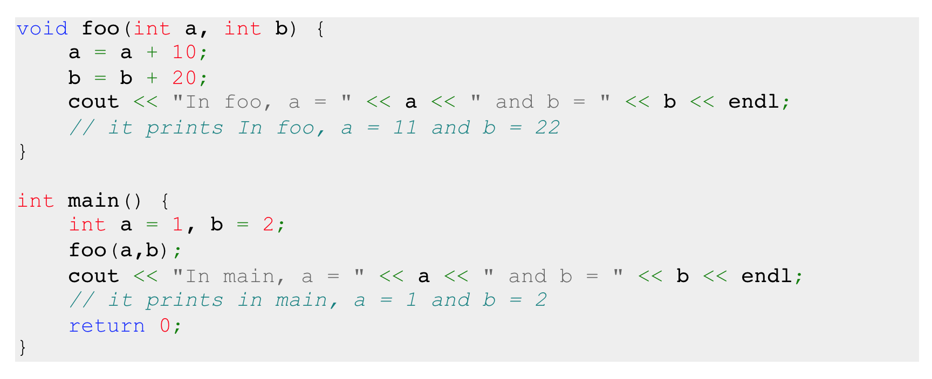
Default argument passing semantic: pass by value

Slide 19
swap() like this does not work

Slide 20
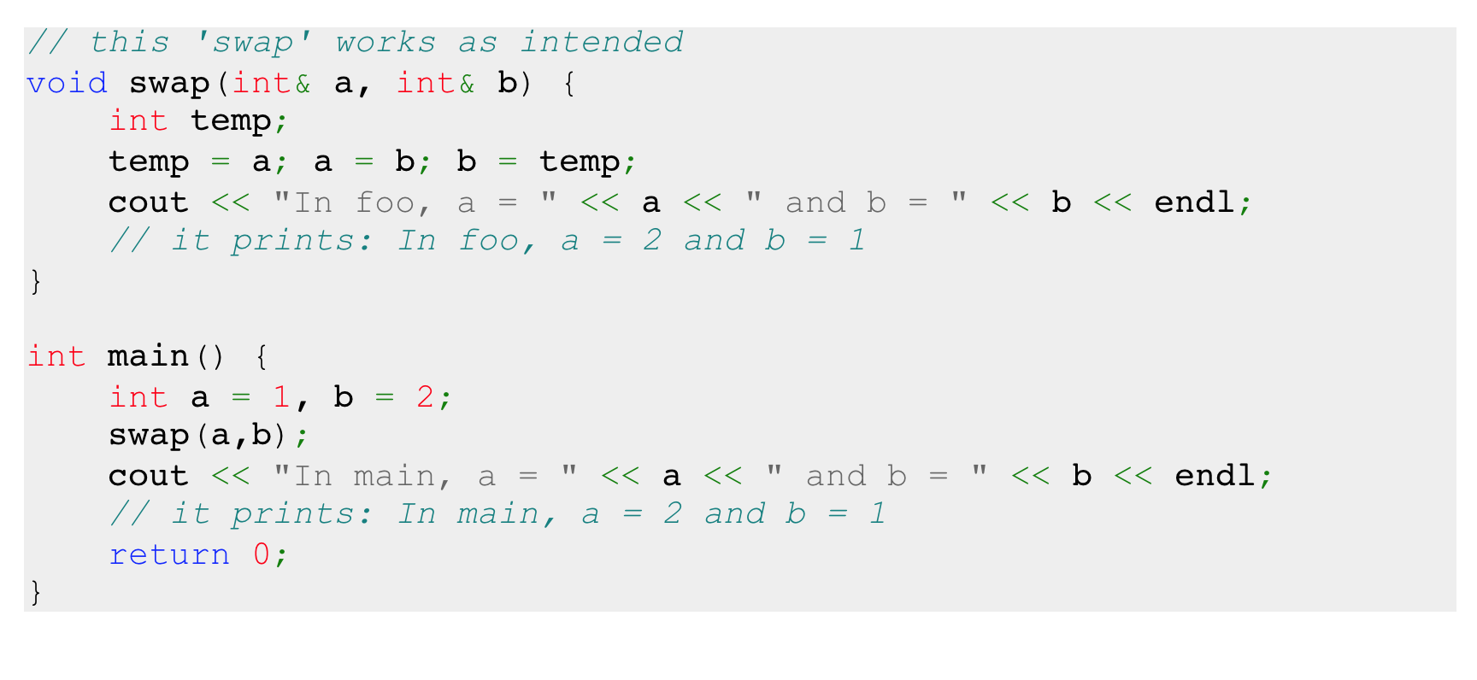
swap() with pass-by-reference works!

Slide 21
When to use references?
When we want the function to modify the arguments
  However, the name of the function has to give a very strong hint that this is the intention! (swap is a good name, foo is not)
When the arguments are large objects
  Save space and time
  But if no modification is intended, put a const in front

