Slide 1
CSE 250 – Data structures in C++
FALL 2012
MWF 11:00-11:50am
Davis 101 (yeah!)

Slide 2
Agenda
Administrative aspects
Brief overview of the course
“Hello world” in C++

Slide 3
Administrative Aspects
Chapter 1

Slide 4
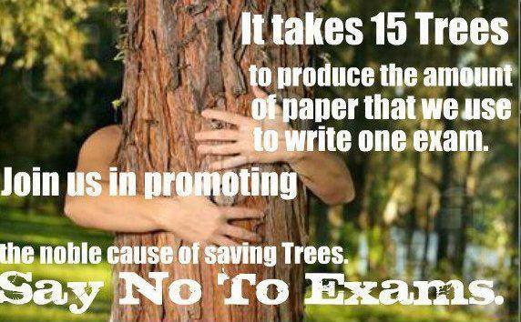

Slide 5
We’re Going Paperless, Not Examless
http://cse250.wordpress.com
The blog has a link to the course’s homepage
http://www.cse.buffalo.edu/~hungngo/classes/2012/Fall/250/
Those pages contain everything we talk about today and much more!

Slide 6
What you will learn from this course
Data structures
  Design
  Analyze
  How to use them (with algorithms)
  When to use them, and which one(s)
  How to implement (some of) them in C++
It is not a C++ course
  Some C++ covered, sufficient for our above purposes

Slide 7
What you will not learn from this course
A lot!
Why?
  There are a lot of things I don’t know
  Both data structures and C++ are huge subjects

Slide 8
Why Data Structures in C++
Data structures are everywhere
  Numerous examples
C++ is powerful, fast, and widely used
  http://www.theregister.co.uk/2011/06/03/google_paper_on_cplusplus_java_scala_go/
The combination is great for your future job search!
  http://steve-yegge.blogspot.com/2008/03/get-that-job-at-google.html
  http://www.cforcoding.com/2010/07/my-google-interview.html
Both are extremely interesting topics!

Slide 9
Prerequisites
CSE 115/116
  Object Oriented design/programming concepts
  You must have done some programming before!
CSE 119
  Mathematical maturity
  Recursion, trees, graphs

Slide 10
Teaching Staff
Mr. Jangyoung (Chris) Kim
  jangyoun@buffalo.edu
Mr. Suchismit Mahapatra
  suchismi@buffalo.edu
Hung Q. Ngo (i.e. me)
  hungngo@buffalo.edu

Slide 11
When/where/how to talk to me
Algorithm 1:
1: post on course blog (http://cse250.wordpress.com)
2: else
email me at hungngo@buffalo.edu
3: else
office hours
4: else
sneak in whenever the door is open
5: goto 1

Slide 12

Course Materials
Textbook:
  Elliot B. Koffman & Paul A.T. Wolfgang. 2006. Objects, Abstraction, Data Structures and Design: Using C++ , Wiley. (ISBN: 0471467553)
Online materials (including lecture notes)
  http://www.cse.buffalo.edu/~hungngo/classes/2012/Fall/250/
  http://cse250.wordpress.com

Slide 13
Work Load
Heavy!
Approximately 50 pages of reading per week
8-9 written and programming assignments
2 midterm exams
1 final exam

Slide 14
Grading Policy
Exam component
  2 midterm exams (20%, lower-scored one worth 5%)
  1 final exam (30%)
Written and programming assignment component
  9 assignments (50%, two lowest-scored ones worth 5%)
Late submission:
  24 hours late: 20% deduction
  48 hours late: 50% deduction
  > 48 hours late: not accepted
Incompletes & Make-up exams
  Not given except in provably extraordinary cases! (see syllabus)

Slide 15
Letter Grades
Percentage score | Letter grade
90-100 | A
85-89 | A-
80-84 | B+
75-79 | B
70-74 | B-
65-69 | C+
60-64 | C
55-59 | C-
50-54 | D
0-49 | F

Slide 16

Academic Honesty

Slide 17
Academic Honesty
On plagiarism:
  Zero on the particular assignment/exam/project
  ‘F’ for the course on the second violation!
  Apply to both parties!
Group study/discussion is encouraged, but the submission must be your own work!
Programming:
  Discussions of ideas are welcomed, but no exchange of codes
  If you use a piece of code from Mr. Google, say so!

Slide 18
No Lame Excuses, Please
I want to go home early, can I take the final on Dec 01?
I had a fight with my girlfriend
I’ve studied very hard, I understood the stuff very well, but I got a C-, please consider giving an A-

Slide 19
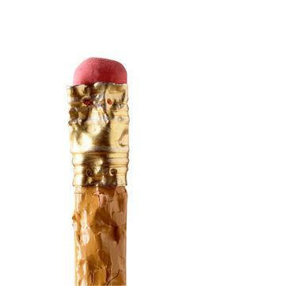
How to do well in the course?

Slide 20

How to do well in the course?

Slide 21

How to do well in the course?

Slide 22
How to do well in the course?
Participate: discuss, answer, ask questions
“the only stupid question is the question you don’t ask”
Give suggestions, please! I’ll take them seriously
Start early!
Make use of the Tas
  And occasionally me too

Slide 23
Brief Overview of the Course
Chapter 2

Slide 24
Outline
3 weeks: the procedural parts of C++, programming environment, some algorithms
2 weeks: asymptotic notations & analysis
2 weeks: array, vector, priority queues
1 week: lists, stack, queue
3 weeks: trees
2 weeks: hash tables
1 week: graphs

Slide 25
Hello World in C++
Chapter 3

Slide 26
int main() {
cout << "Hello world\n";
return 0;
}

Slide 27
What You Must Do This Week!
Settle on a “development pipeline”
  Compiler
  Editor
    Vi/vim
    Emacs
    Eclipse
    Notepad++, nano
Submit Assignment 0
  See course’s webpage

Slide 28
Last Words for Today
You’ll learn as much from me as I will learn from you
Welcome, again!

