Slide 1
Basic Searching and Sorting
Operations on the array/vector data structures
Linear and binary search
Recursive and Iterative Algorithms
Five sorting algorithms
Heap data structure
Function template
Callback functions

Slide 2
Agenda
Linear and binary search
Recursive and iterative algorithms
Sorting
Insertion sort
Selection sort
Merge sort
Quick sort and randomized quick sort
The heap data structure
Heap Sort
Priority queues
Experimenting with the 5 sorting algorithms

Slide 3
Linear and binary search
Search for a key in a given vector/array

Slide 4
The Problem
3 | 10 | 1 | 34 | 12 | 3 | 5 | 8 | 9 | 17
5
in the array?
14
in the array?

Slide 5
Linear search
/**
* ------------------------------------------------------------------------
* scan a vector, search for the key
* ------------------------------------------------------------------------
*/
bool linear_search(const vector<int>& vec, int key) {
for (size_t i=0; i<vec.size(); i++) {
if (key == vec[i]) return true;
}
return false;
}

Slide 6
Recursive Linear Search
bool recursive_linear_search( const vector<int>& vec, int key, size_t start) {
if (start >= vec.size())
return false;
else
return (key == vec[start] ||
recursive_linear_search(vec, key, start+1));
}

Slide 7
Linear Search: Recursion vs. Iteration
The iterative solution is much more
Natural
Efficient
The recursive solution is
Clumsy
Ugly
Iteration >> Recursion, Round 1

Slide 8
Binary Search
Assume the array is already sorted
Check key vs. middle element
If key found, output YES
If key < middle element, search the left half
If key > middle element, search the right half
1 | 3 | 3 | 5 | 10 | 13 | 14 | 17 | 19 | 34 | 41 | 42 | 51 | 53 | 66 | 98
34

Slide 9
Recursive Binary Search
bool recursive_binary_search(const vector<int>& sorted_vec, int key,
size_t left, size_t right)
{
if (left >= right || right > sorted_vec.size()) {
return false;
} else {
size_t mid = left + (right - left)/2;
if (key > sorted_vec[mid])
return recursive_binary_search(sorted_vec, key, mid+1, right);
else if (key < sorted_vec[mid])
return recursive_binary_search(sorted_vec, key, left, mid);
else
return true;
}
}
// could we have done this? size_t mid = (left+right)/2

Slide 10
Iterative Binary search
bool binary_search(const vector<int>& sorted_vec, int key) {
size_t mid, left = 0, right = sorted_vec.size();
while (left < right) {
// mid = (left+right)/2 is problematic
// due to potential integer overflow
mid = left + (right - left)/2;
if (key > sorted_vec[mid])
left = mid+1;
else if (key < sorted_vec[mid])
right = mid;
else
return true;
}
return false;
}

Slide 11
Iterative Binary Search 2
bool binary_search(const vector<int>& sorted_vec, int key) {
size_t mid, left = 0, right = sorted_vec.size()-1;
while (left <= right) {
mid = left + (right - left)/2;
if (key > sorted_vec[mid])
left = mid+1;
else if (key < sorted_vec[mid])
right = mid-1;
else
return true;
}
return false;
}
The above is problematic, why?

Slide 12
Binary Search: Recursion vs. Iteration
The recursive version is
More natural
Less efficient
The iterative version is slightly uglier (?)
Recursion ~ Iteration: Round 2

Slide 13
Linear search vs. binary search
Binary search
is much faster
but takes time to sort
Pre-sort + binary search if lots of searches are expected
m searches, T(n) sort time
O(mn) vs O(T(n) + m log n)

Slide 14
Sorting algorithms
Insertion sort
Selection sort
Merge sort
Quick sort
Randomized quick sort
http://www.sorting-algorithms.com/

Slide 15
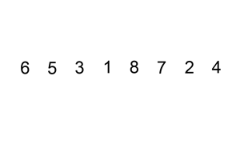

Insertion sort

Slide 16
Insertion sort
void insertion_sort(vector<int> &vec) {
int temp, j;
for (int i=1; i<vec.size(); i++) {
temp = vec[i];
j = i-1;
while (j >= 0 && vec[j] > temp) {
vec[j+1] = vec[j];
j--;
}
vec[j+1] = temp;
}
}

Slide 17
Properties
Worst case run time is O(n²)
Worst case input: inversely sorted vector
Sorting is in-place, i.e. O(1)-extra storage
Number of comparisons Ω(n²) at worst
Number of item moves is also Ω(n²) at worst
Adaptive: O(n) time for nearly sorted input
It is a stable sort algorithm

Slide 18
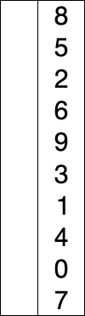
Selection sort
void selection_sort(vector<int> &vec) {
int i, j, k;
for (i=0; i<vec.size()-1; i++) {
j=i;
for (k=i+1; k<vec.size(); k++)
if (vec[k] < vec[j]) j=k;
if (j!=i) swap(vec[i], vec[j]);
}
}

Slide 19
Properties
Number of comparisons & run-time Ω(n²)
Even when the input is already sorted, thus not adaptive
Sorting is in-place, i.e. O(1)-extra storage
Number of data movements is always O(n): nice!
Important for some applications (relational database) where we want to move memory/disk blocks
We do not always have to move data!
Sort pointers to data
Not stable (why?)
Can be made stable at the cost of O(n²) moves

Slide 20
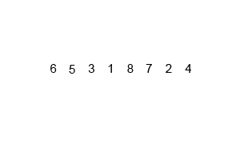

Merge sort
A classic divide-and-conquer algorithm

Slide 21
Merge sort
void merge_sort(vector<int> &vec) {
size_t n = vec.size();
if (n <= 1) return;
vector<int> left(vec.begin(), vec.begin()+n/2);
vector<int> right(vec.begin()+n/2, vec.end());
merge_sort(left);
merge_sort(right);
merge(vec, left, right);
}
An important idea, used elsewhere!

Slide 22
The merge procedure
void merge(vector<int> &target,
const vector<int> &left,
const vector<int> &right)
{
size_t i=0, j=0, k=0;
while (i < left.size() && j < right.size()) {
if (left[i] < right[j])
target[k++] = left[i++];
else
target[k++] = right[j++];
}
while (i < left.size()) target[k++] = left[i++];
while (j < right.size()) target[k++] = right[j++];
}

Slide 23
Recurrence tree

Slide 24
Properties of Merge Sort
Worst case run time O(n log n) is optimal among comparison-based sorting algorithms
O(n log n) comparisons and item moves
Space complexity S(n) = S(n/2) + cn = Θ(n)
Big problem!
Can be made in-place, but too complex
Only O(log n) space (for recursion) when sorting linked list
Is stable, not adaptive
Question: write an iterative version of merge sort
Recursion > Iteration (slightly), round 3

Slide 25
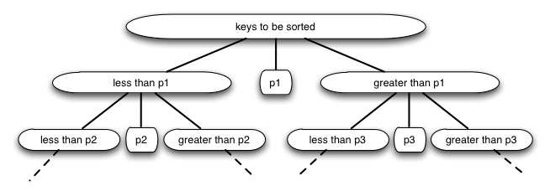
Quick sort

Slide 26
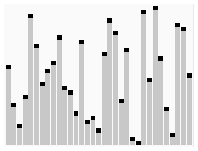

Quick sort

Slide 27
Basic Quicksort
static void recursive_qs(vector<int> &vec, int left, int right)
{
if (right <= left) return;
// partition,
int i=left-1, j=right;
while (true) {
while (vec[++i] <= vec[right])
if (i == right) break;
while (vec[--j] >= vec[right])
if (j == left || j == i) break;
if (j <= i) break;
swap(vec[i], vec[j]);
}
if (i < right) swap(vec[i], vec[right]);
// recursively sort the left & the right parts
recursive_qs(vec, left, i-1);
recursive_qs(vec, i+1, right);
}

Slide 28
Properties
Worst-case run time Ω(n²)
Which sequence of pivots lead to this?
Not stable
Ω(log n) extra space
Not adaptive
Why is it called “quick” sort then?
Work well on “average”, O(n log n)

Slide 29
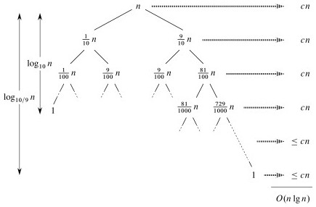
Why O(n log n) can be expected?

Slide 30
Making Quicksort Quick
We can make it more likely to work well by randomizing the pivot!!!
Las Vegas algorithm
Randomization is an extremely important idea!
It is very slow on almost-equal inputs
Randomization can fix that too!

Slide 31
Randomized Quick sort
void recursive_rqs(vector<int> &vec, int left, int right) {
if (right <= left) return;
// pick a random pivot
int m = rand() % (right-left+1);
swap(vec[right], vec[left+m]);
// partition,
int i=left-1, j=right;
while (true) {
while (vec[++i] <= vec[right])
if (i == right) break;
while (vec[--j] >= vec[right])
if (j == left || j == i) break;
if (j <= i) break;
swap(vec[i], vec[j]);
}
if (i < right) swap(vec[i], vec[right]);
recursive_rqs(vec, left, i-1);
recursive_rqs(vec, i+1, right);
}

Slide 32
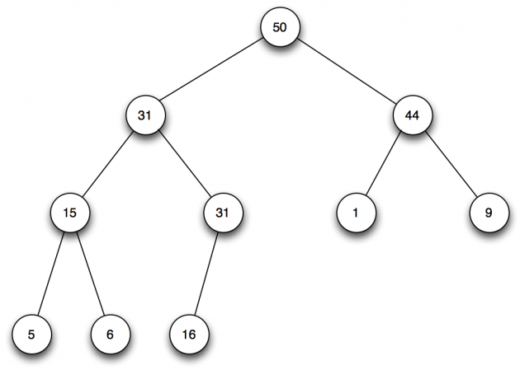
Max Heap

Slide 33
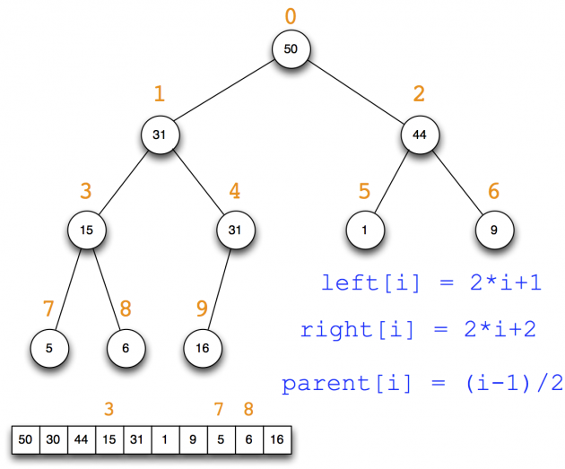
Max Heap as an Array

Slide 34
Heap sort
heapify: turn a vector/array into a heap
sink(i, n, array): make sub-tree rooted at i a heap
Assumes left & right sub-trees are already max heap
Sinks node i down to the correct level
heap_sort(array):
heapify(array)
swap root to array[n]
sink(0, n-1, array)

Slide 35
Heapify and heap_sort
void heapify(vector<int> &vec) {
for (int i=vec.size()/2; i>=0; i--)
sink(vec, i, vec.size());
}
void heap_sort(vector<int> &vec) {
heapify(vec);
for (int j=vec.size()-1; j>=1; j--) {
swap(vec[0], vec[j]);
sink(vec, 0, j);
}
}

Slide 36
Sinking, Recursively
void recursive_sink(vector<int> &vec, size_t i, size_t n) {
size_t left = 2*i + 1;
if (n > vec.size() || left >= n) return;
size_t right = left + 1; // possibly >= n
size_t my_pick = (right >= n) ? left : (vec[right] > vec[left]) ? right : left;
if (vec[i] < vec[my_pick]) {
swap(vec[i], vec[my_pick]);
recursive_sink(vec, my_pick, n);
}
}

Slide 37
Time and Space
sinking a node at height h takes O(h) time
heapify sinks nodes at various heights, O(n) time
heap_sort()
runs in time O(n log n)
space complexity O(log n) due to recursion

Slide 38
Sinking Iteratively
void iterative_sink(vector<int> &vec, size_t i, size_t n) {
if (n > vec.size()) return;
size_t left, right, my_pick;
while ((left = 2*i+1) < n) {
right = left + 1; // possibly >= n
my_pick = right >= n ? left :
vec[right] > vec[left] ? right : left;
if (vec[i] >= vec[my_pick]) break;
swap(vec[i], vec[my_pick]);
i = my_pick;
}
}

Slide 39
Binary Heap as Priority Queue
Insert new key takes O(log n)
Delete key takes O(log n)
Drawback: search takes a long time
Used in Dijkstra’s algorithm
Link state routing protocol!

Slide 40
Experiments with sorting
Random input
Sorted input
Inversedly sorted input

Slide 42
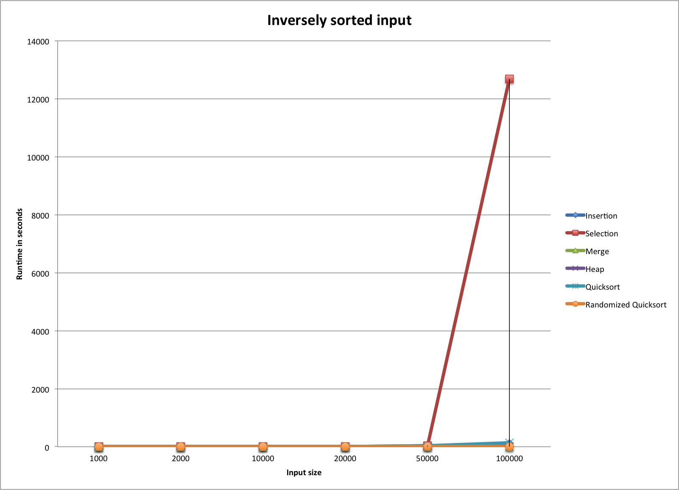

Slide 46
Generic sorting routines
Function templates
Call back functions

Slide 47
Function templates
template <typename Item_Type>
void insertion_sort(std::vector<Item_Type> &vec) {
Item_Type temp, j;
for (int i=1; i<vec.size(); i++) {
temp = vec[i];
j = i-1;
// assumes '>' with Item_Type is meaningful
while (j >= 0 && vec[j] > temp) {
vec[j+1] = vec[j];
j--;
}
vec[j+1] = temp;
}
}

Slide 48
Problems
With the above templates
Sorting doubles, long, etc. are OK
Since <, >, == are built-in with them
Can’t sort strings (say, sort by last name)
Can’t sort in some other order (say, reverse order)

Slide 49
Callback functions
template <typename Item_Type>
void insertion_sort(std::vector<Item_Type> &vec,
int (*cmp)(Item_Type, Item_Type))
{
Item_Type temp;
int j;
for (int i=1; i<vec.size(); i++) {
temp = vec[i];
j = i-1;
while (j >= 0 && cmp(vec[j],temp) > 0) {
vec[j+1] = vec[j];
j--;
}
vec[j+1] = temp;
}
}

Slide 50
Problems, Still
Users always have to specify a callback function, even for primitive types

Slide 51
Solution: default function
template <typename Item_Type>
void insertion_sort(
std::vector<Item_Type> &vec,
int (*cmp)(Item_Type, Item_Type) = default_cmp)
{
Item_Type temp;
int j;
for (int i=1; i<vec.size(); i++) {
temp = vec[i];
j = i-1;
// uses 'cmp' to compare instead of '>'
while (j >= 0 && cmp(vec[j],temp) > 0) {
vec[j+1] = vec[j];
j--;
}
vec[j+1] = temp;
}
}

