Slide 1
Stacks and Applications
New lexer
vector
stacks
Well-formed expression
Infix and postfix expressions

Slide 2
Agenda
Lexer with richer vocabulary
Vectors
Stacks
Well-ballanced expressions
Infix and postfix expressions

Slide 3
An Improved Lexer
More types of tokens
Programming with a (Deterministic) Finite Automata (DFA)
New member function returning a token vector

Slide 4
More Types of Tokens
INTEGER
a consecutive sequence of digits
OPERATOR
one of five operators +-*/=
DELIM
bracket delimiters such as {}[]()
COMMENT
all characters that follow a # character to the end of the source file/string or until the end of line '\n'character is reached
IDENT (defined differently from before)
Alphanumeric characters [a-z, A-Z, 0-9, and _], starting with [a-z,A-Z]
STRING
All characters enclosed in a pair of “…”, no escape
Unrecognized tokens are considered to be syntax error
DFA for more complex language

Slide 5
New Member Function
vector<Token> Lexer::tokenize()
Returns a vector of remaining tokens

Slide 6
Vector in C++
vector<int> myvec;
myvec.pushback(123);
myvec.pushback(456);
Access using myvec[0], myvec[1], myvec.at(0), myvec.at(1)
myvec.front() // first element
myvec.back() // last element
myvec.insert(position)
myvec.size()
myvec.pop_back()
…

Slide 7
Stacks and Applications
Well-formed expressions
stacks
Infix, postfix

Slide 8
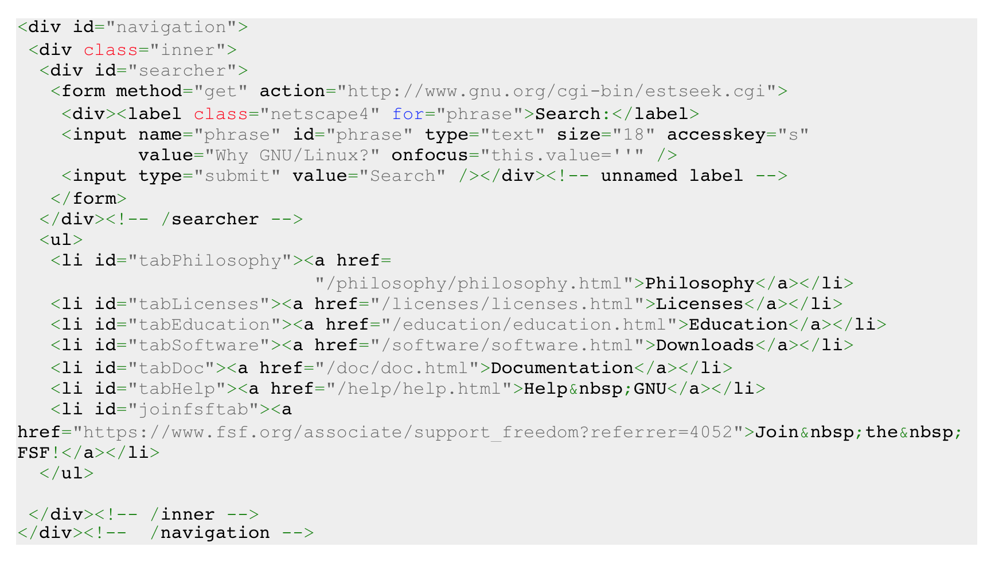
HTML File

Slide 9
Well-Formed Expressions
Or “balanced expressions”:
([this is] { a number } 12345) # well-formed
([this is] { a number ) 12345} # not wf
{[(34+4)/5] + 7}/4 # wf
{[(34+4)/5} + 7]/4 # not wf

Slide 10
(Recursive) Definition of WFE
The empty sequence is well-formed.
If A and B are well-formed, then the concatenation AB is well-formed
If A is well-formed, then [A], {A}, and (A) are well-formed.
How to we check if an expression is WF?
Use a stack!

Slide 11
Stack: push(obj), pop(), and top()
B
A
C
push
push
top
pop
push
B
A
B
B
B
A
A

Slide 12
Algorithm for Recognizing WFE
Read the next delimiter token.
If it is an open delimeter (i.e. [({)
push it into the stack.
If it is a close delimiter (i.e. ])})
match it with a corresponding open delimiter in the stack ([ with ] and so on).
If there is no match → not WF
If there is a match, stack.pop() and discard both
When there is no more token left
If the stack is empty → WF
If the stack is not empty → not WF

Slide 13
Infix vs Postfix Expressions
Infix: 5 + 4*5/2 - 3
Postfix: 5 4 5 * 2 / + 3 -
Infix: (5+4)*5/2 - 3
Postfix: 5 4 + 5 * 2 / 3 –

Slide 14
Postfix Expression Evaluation Algorithm
Initialize an empty stack
While (there is still a token to read)
read the token t
if t is an operand, push it onto the stack
if t is an operator,
pop two operands from the stack, compute the result (using t) // if there is division by zero, scream foul
push the result back onto the stack // if there is less than two operands, scream foul
In the end, if there is one number in the stack, output it.
// If there is more than one number in the stack, scream foul.

Slide 15
How about Infix Expression?
Shunting yard algorithm
Convert infix to postfix
Or, evaluate infix expressions directly

Slide 16
Rough Idea
Use 2 stacks: an operand stack, an operator stack
If tok is an operand, push it on operand stack
Else if tok is one of + - * /
while (precedence(tok) ≤ precedence(stack.top())
Evaluate stack.top()
Push tok on top of operator stack
Else if tok is one of ( [ {
Push tok on top of operator stack
Else if tok is one of ) ] }
Evaluate operators on top until ( [ { seen, match up

