Slide 1
Towards Best Effort Information Extraction: iFlex
Warren Shen, Pedro DeRose,
Robert McCann, AnHai Doan,
Raghu Ramakrishnan
By
Akanksha Dayal

Slide 2
Topics
Introduction
Approximate IE programs
Representing Approximate Data
Approximate Query Processing
The Next Effort Assistant
Empirical Evaluation
Conclusion
Future Work

Slide 3
        1 . Introduction

Slide 4
The Idea
User ‘U’ uses a declarative language and writes and initial approximate IE program ‘P’ using an approximate Query Processor that may fetch an approximate result. ‘U’ then examines that result and figures out if further refinement is required.

Slide 5
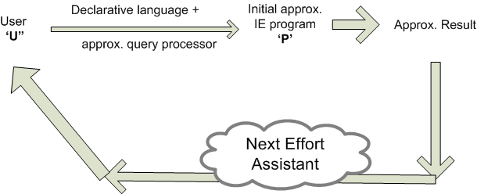
iFlex Approach

Slide 6
Traditional Approaches
Precise IE (Information Extraction) programs
Precise IE results

Slide 7
Traditional Approaches (Drawbacks)
Difficult to execute partially specified IE programs and obtain meaningful results, which produces a long debug loop.
Long time before first meaningful results are obtained. (impractical for time sensitive operation)
May be waste of effort as in most cases approximate results suffice and can be produced quickly.

Slide 8
How iFlex Addresses the drawbacks?
Relaxes precise IE requirement in an effort to have a best effort Information extraction.
User writes a quick initial approximate IE program P with possible real world semantics and evaluates it using approximate query processor to quickly arrive at approximate results.

Slide 9
Example
Problem: For a given 500 web pages with 1 house per page, user U wants to find out all house with price exceeding $500,000 and whose high school is Lincoln.
Using iFlex:
The user ‘U’ writes ‘P’ (initial approximate IE program) specifying constraints like price should be numeric and maybe just one number greater than $500,000 with high school as Lincoln.
9 search results. ‘U’ stops!
200 result pages. ‘U’ redefines ‘P’ for further refinement.

Slide 10
The Flexible Approach
User knows when the program is
  under-defined or
  over-defined
by looking at the result set.
U asks Next effort Assistant to suggest what to focus on. For example, look for the prices in bold.
More time spent writing program/iterating → high precision results.

Slide 11
Challenge: Language for writing approximate IE programs??
For approximate IE programs we can extend a precise IE language like UIMA, GATE, Lixto or Xlog.
Xlog – Extension of Datalog (Datalog variant for declarative IE programs)
Alog – To write approximate IE rules & specify types of approximation in values.

Slide 12
        2
        Approximate IE
        Programs

Slide 13
Topics (Program writing languages):
Xlog
  Brief overview
  Usage and Limitations
Alog

Slide 14
Xlog
Xlog Program P consists of multiple rules.
Rules are of form:
p :- q₁, q₂, …, q_{n}
where p, q_{i} are predicates (head & body resp.)
Each predicate atom in a rule is associated with a relational table.
Extentional Predicate: when table is provided to P
Intensional Predicate: when table needs to be computed using the rules in P

Slide 15
Example
Xlog program that extracts houses with price over $500000 and area above 4500 ft² & top high school.
R1: houses(x,p,a,h) :- housePages(x), extractHouses(x,p,a,h)
R2: schools(s) :- schoolPages(y), extractSchools(y,s)
R3: q(x,p,a,h) :- houses(a,p,a,h), schools(s), p>500000,
a>4500, approxMatch(h,s)
where x: documents, p: price, a: area, h: top high school
2 predicates: extractHouses(x,p,a,h) & extractSchools(y,s)
1 p-function: approxMatch(h,s) (true iff 2 text spans are similar ..tf/idf)

Slide 16
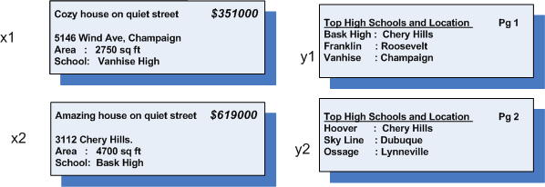
Example (cont’d)
Assuming housePages consists of 2 documents, x1 & x2, and schoolPages of 2 documents, y1 & y2
R1: tuple extracted from x1: (x1, 351000, 2750, “vanhise High”)
R1: tuple extracted from x2: (x2, 619000, 4700, “ Bask High”)
R2: 3 tuples: (y1, “Bask High”); (y1, “Franklin”); (y1, “Vanhise”)
…
R3: (x2, 619000, 4700, “Bask High”)

Slide 17
Xlog: Usage & Limitations
Decompose task into subtasks making up p-predicates and p-functions
Then implement these made up predicates & functions using a procedural language
Significant amount of time spent in writing procedures. Refinement aggravates the whole scene.

Slide 18
Best effort IE with Alog
Start off by initial Xlog program called Skeleton (list of IE predicates, no procedures associated with them)
U implements them only partially. So for a predicate q, U partially writes one or more description rules.
U executes the so called partial IE programs.

Slide 19
Example
  S1: houses(x,p,a,h) :- housePages(x), extractHouses(x,p,a,h)
  S2: schools(s) :- schoolPages(y), extractSchools(y,s)
  S3: Q(x,p,a,h) :- houses(x,p,a,h), schools(s), p>500000, a>4500, approxMatch(h,s)
  S4: extractHouses(x,p,a,h) :- from(x,p), from(x,a), from(x,h), numeric(p)=yes, numeric(a)=yes
  S5: extractSchools(y,s) :- from(y,s), bold-font(s)=yes

Slide 20
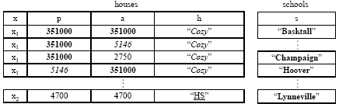
Example (cont’d)

Slide 21
Vocabulary
Description rules (r): Declare a set of domain constraints about the textual features of the attributes extracted.
q:- q1 , …. , qn (similiarity to Xlog rule)
q is an IE predicate and defines a relation
Domain Constraints: A domain constraint f(a) = v : feature f of any text span that is a value for attribute a must take value v.

Slide 22
Writing Safe Description Rules
A description rule is safe if each non-input variable in the head also appears in the body (either in intentional or extensional predicate or as in output variable in an IE predicate)
For example:
S1: extractHouses(x,p,a,h) :- numeric(p) = yes, numeric(a) = yes
                p, a: no indication where they are extracted from
iFlex provides a built in from(x,y)

Slide 23
Safe Description Rule
from(x,y) : extract all subspans of y from doc x.
e.g.
S2 : extractHouses(x,p,a,h) :- from(x,p), from(x,h), from(x,a), numeric(p) = yes, numeric(a)= yes

Slide 24
Providing Ways to Declare the Approximation Types
Two common types of approximation supported:
  Existence of a tuple (Existence annotation – this indicates that each tuple in the relation R produced by a rule r may or may not exist.)
  Value of an attribute of a tuple (Attribute annotation – this indicates that an attribute takes a value from a given set, but we do not know which value.)
  U annotates an Alog rule to indicate these approx. types.

Slide 25
Example
  S1: houses(x,p,a,h) :- housePages(x), extractHouses(x,p,a,h)
  S2: schools(s) :- schoolPages(y), extractSchools(y,s)
  S3: Q(x,p,a,h) :- houses(x,p,a,h), schools(s), p>500000, a>4500, approxMatch(h,s)
  S4: extractHouses(x,p,a,h) :- from(x,p), from(x,a), from(x,h), numeric(p)=yes, numeric(a)=yes
  S5: extractSchools(y,s) :- from(y,s), bold-font(s)=yes
  S’1: houses(x,<p>,<a>,<h>) :- housePages(x), extractHouses(x,p,a,h)
  S’2: schools(s)? :- schoolPages(y), extractSchools(y,s)
  S’3: Q(x,p,a,h) :- houses(x,p,a,h), schools(s), p>500000,a>4500, approxMatch(h,s)

Slide 26
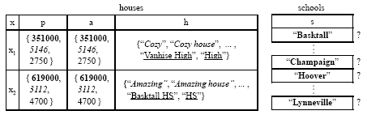
Example (cont’d)

Slide 27
Formal Definitions
Definition 1 (Existence Annotation). Let p be the head of a rule r that produces relation R under the normal Xlog semantics. Then adding an existence annotation to r means replacing p with “p?”. This produces a rule r′ that defines a set of possible relations R, which is the powerset of the tuples in R.
Definition 2 (Attribute Annotation). Suppose the head of rule r is p(a1, . . . , ai, . . . , an). Then annotating attribute ai means replacing the head with p(a1, . . . , <ai>, . . . , an) to produce rule r′. Suppose that r defines relation R under the normal Xlog semantics. Then r′ defines the set R of all possible relations that can be constructed by grouping R by a1, . . . , ai−1, ai+1, . . . , an and selecting one value for ai in each group.

Slide 28
Example illustrating the 2 annotations:
Example. Evaluating rule S1 together with rule S4 would produce the houses table , which contains all
tuples (x, p, a, h) .
This is a rough slide. Will be altered or removed!
Use: For explanation
Now suppose we know that each document x in housePages contains information about exactly one
house (i.e., x forms a key in the true houses relation). Then we can annotate attributes p, a, and h to
produce rule S′1 in Figure (down). Evaluating rule S′1 would produce the set of possible houses relations
as represented in Figure 2.e, where each possible relation is constructed by selecting just one value
(from the corresponding set of values) for each table cell . This way, each possible houses relation contains exactly one tuple for each document x, thus accurately reflecting our knowledge of the domain.Similarly, evaluating rules S2 in Figure 2.a together with rule S5 in Figure 2.b would produce the schools table in Figure 2.d, which contains all tuples (s) where s is a bold span coming from
a document y in schoolPages.
Clearly, not all bold spans in each document y are schools.Thus, we can add an existence annotation to rule S2 to produce rule S′2 in Figure 2.c. Evaluating S′ 2 would produce the set of
possible schools relations represented in Figure 2.e, where each
possible relation consists of a subset of the extracted tuples.
Notes:
Example. Evaluating rule S1 together with rule S4 would produce the houses table , which contains all
tuples (x, p, a, h) .
Now suppose we know that each document x in housePages contains information about exactly one
house (i.e., x forms a key in the true houses relation). Then we can annotate attributes p, a, and h to
produce rule S′1 in Figure (down). Evaluating rule S′1 would produce the set of possible houses relations
as represented in Figure 2.e, where each possible relation is constructed by selecting just one value
(from the corresponding set of values) for each table cell . This way, each possible houses relation contains exactly one tuple for each document x, thus accurately reflecting our knowledge of the domain.
Similarly, evaluating rules S2 in Figure 2.a together with rule S5 in Figure 2.b would produce the schools table in Figure 2.d, which contains all tuples (s) where s is a bold span coming from
a document y in schoolPages.
Clearly, not all bold spans in each document y are schools.Thus, we can add an existence annotation to rule S2 to produce rule S′
2 in Figure 2.c. Evaluating S′ 2 would produce the set of
possible schools relations represented in Figure 2.e, where each
possible relation consists of a subset of the extracted tuples.

Slide 29
Executing Revising and Cleanup
Once U has written an initial Alog program P, he can execute P to obtain an approximate extraction results.
Then, U can revise P - add more domain constraints to the rules.
  Eventually, either P has been revised to the point where it produces precise IE results - U stops.
  OR to the point where U feels that adding more domain constraints will not help improve the extraction result.
In this latter scenario, U can write a “cleanup procedure (g) “ in a procedural language (e.g., Perl) rather than continue to revise P declaratively.
U declares a new p-predicate p and associate ‘g’ with it.

Slide 30
3
Representing Approximate Data

Slide 31
Representing 2 types of approximation using tables:
          a-tables
          compact Tables

Slide 32
a-tables
Extend relational model - approximate tables or a-tables.
An a-table is a multiset of a-tuples that represents set of all poss. relations
An a-tuple is a tuple (V1, . . . , Vn),
    where each Vi is a multiset of possible values.
maybe a-tuple.
An a-table can be constructed by
  1. selecting a subset of the maybe & all non maybe a-tuples in T, then
  2. selecting 1 possible value ∀ attribute in each a-tuple selected in 1.

Slide 33
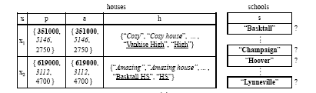
example
a-tables for the houses & schools relations
(set notation for the x attribute ommited for clarity)

Slide 34
The iFlex approach: Compact Tables
Compact version of a-tables specifically designed for approximate extracted text. The sequential nature of text is exploited to “pack” the set of values of each cell into a much smaller set of so-called assignments, when possible.
2 types of assignment :
  exact(s) encodes a value that is exactly span s (modulo an optional cast from string to numeric). For e.g, exact(“92”) encodes value 92.
  contain(s) encodes all values that are s itself or sub-spans of s. For e.g., the assignment contain(“Cherry Hills”) encodes all values that are spans inside “Cherry Hills” (e.g., “Ch”, “Cherry”, etc.).

Slide 35
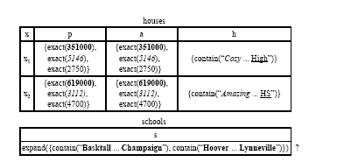
each cell c contains a multiset of assignments: c = {m1(s1), . . . ,mn(sn)} where each mi is either exact or contain and each si is a span

Slide 36
Pros & Cons: Compact Tables
Disadvantages:
compact tables cannot represent mutual exclusion among tuples (e.g., a relation contains either tuple t1 or tuple t2, but not both).
Advantages:
they can express two common types of extraction approximation (the existence of a tuple and the value of an attribute), and thus can accommodate a broad variety of IE scenarios.
they exploit text properties, and hence enable efficient IE processing

Slide 37
4.
Approximate Query Processing

Slide 38
To generate and execute and execution plan for P (Alog pgm)
Step 1: Unfold the non-description rules in P to produce a P′.
1. If the body of a r1 in P has an IE predicate q, & q appears in the head of r2. Then we unfold r1 by replacing q in r1 with its body in r2.
2. Repeat 1 till only IE predicates with associated procedures remain in P.
for e.g.,
S1: houses(x,<p>,<a>,<h>) :- housePages(x), extractHouses(x,p,a,h)
S2: schools(s)? :- schoolPages(y), extractSchools(y,s)
S3: Q(x,p,a,h) :- houses(x,p,a,h), schools(s), p>500000,a>4500, approxMatch(h,s)
S4: extractHouses(x,p,a,h) :- from(x,p), from(x,a), from(x,h)
numeric(p)=yes, numeric(a)=yes
S5: extractSchools(y,s) :- from(y,s), bold-font(s)=yes

Slide 39
Example contd.
After unfolding rules S′1, S′2, and S′3 (using the description rules
S4 and S5):
S’1: houses(x,<p>,<a>,<h>) :- housePages(x), from(x,p),
from(x,a), from(x,h), numeric(p)=yes, numeric(a)=yes
S’2: schools(s)? :- schoolPages(y), from(y,s), bold-font(s)=yes
S’3: Q(x,p,a,h) :- houses(x,p,a,h), schools(s), p>500000, a>4500, approxMatch(h,s)

Slide 40
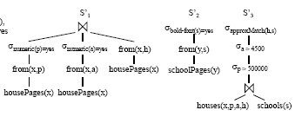
Step 2: Construct logical plan fragment h for each r in P’
[annotations ignored for simplicity] plan fragments we compile for the rules

Slide 41
Step 3: Change each plan fragment h to work over compact tables instead of ordinary relations (in three steps.)
  Convert each extensional relation into a compact table by changing the contents of each cell that has a document or span value v to instead have the value {exact(v)}.
  modify each operator in h to take compact tables as input and produce a compact table as output.
  append an annotation operator to the root of h, where converts the set of relations O/P by h into another set of possible relations, taking into account the annotations of the rule r that h corresponds to.
Finally, form a final execution plan g by “stitching” together the plan fragments, unifying variables if necessary.

Slide 42
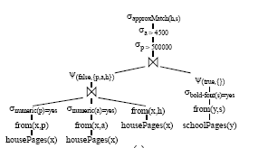
The result of stitching together the plan fragments

Slide 43
Challenges during compilation
Compact tables are not closed under relational operators (not complete model)
=> we develop operators such that the execution plan produces an approximate approximation for a program P. Specifically, we adopt
a superset semantics for query execution,

Slide 44
Modifying Relational Operators and
P-Predicates
Relational operators (i.e., select, join, project) & p-predicates in execution plans to work over compact tables.
Projection is straightforward since we ignore duplicate detection. Thus, we focus on selections and -joins.
for e.g. Consider evaluating a selection on a compact table. To ensure superset semantics we want the results to contain all compact tuples that may satisfy the selection condition.
we evaluate a selection f with selection condition f over a compact table T as follows. For each compact tuple t ∈ T with cells (c1, . . . , cn), we evaluate the selection condition f over every possible tuple (v1, . . . , vn),
where vi ∈ V(ci) for 1 ≤ i ≤ n.
If f is satisfied for any possible tuple, then we add t to T′. Also, if f is satisfied for some but not all of the possible tuples, we set t to be a maybe compact tuple.

Slide 45
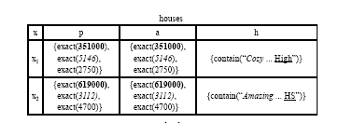
Example contd:
To illustrate, consider applying a selection condition p > 500000 to the first compact tuple in the houses table
Since x1 contains no possible price > 500000, we can safely drop this tuple.

Slide 46
We adapt -joins over compact tables T1, . . . , Tn in a
similar fashion except that we evaluate the condition on
all compact tuples in the Cartesian product
T1×. . .×Tn.
approximate string joins over compact tables is
significantly more involved.

Slide 47
Evaluating a p-predicate over compact table:
take the union of the results of evaluating p over each compact tuple t ∈ T.
To evaluate p over a compact tuple t, we first convert t into an equivalent set of compact tuples U that have no expansion cells by repeatedly replacing each expansion cell c in t with T.
Then for each compact tuple u ∈ U, we enumerate the possible tuples V that u represents, and invoke p for each v ∈ V .
If p[v] be the tuples produced by p with input tuple v. We convert p[v] into a set of compact tuples by making each cell a set of assignments (i.e., by changing any cell with span value s to be {exact(s)}).
Finally, set each tuple in p[v] to be a maybe compact tuple if u represents more than one possible tuple (i.e., if |V | > 1).

Slide 48
5.
The Next Effort Assistant

Slide 49
Overview:
Task is to suggest ways to refine the current IE program
by asking the developer U questions such as “is price in
bold font?”.
  If U chooses to answer the question, iFlex forms a new
  constraint from the answer and incorporates the
  constraint into the IE program.
  Ease of Answering Questions: iFlex so far focuses on appearance(bold, etc), location & semantics.

Slide 50
Question Selection Strategies
The Space of Questions: questions of the form
“what is the value of (text span) feature f for attribute a?”
E.g. features: bold, italic, hyperlinked, preceded-by, followed-by, min-value, and max-value.
If U answers v for the above Question. Then iFlex adds
the predicate
f(a) = v to the description rule.

Slide 51

Strategies to select the next best question from the question Space:
Sequential Strategy: Questions selected based on a predefined order over the question space.
  Rank the attributes in decreasing “importance”, in a domain-independent fashion. Ranked list a1, . . . , an.
Simulation Strategy: selects the question that is expected to reduce by the largest amount the size of the current result. Expected number of results after asking d is
Pr[X answers v|asks d] ・ |exec(g(P, (a, f, v)))|
where,
V : set of possible values for f,
P : current Alog program being developed.
g(P, (a, f, v)) : new Alog program after adding f(a) = v to the rule in P
exec(g(P, (a, f, v)))| :- result size [if iFlex executes the modified P’]
costly for every f/val pair Optimised by subset evaluation & reuse

Slide 52
Convergence:
The Next effort assistant(A) also keeps a check on the
  The number of tuples generated after each iteration &
  The number of assignments produced by extraction process.
  If the 2 remain constant for say k iterations, A informs user that the convergence has reached.

Slide 53
Multi-Iteration Optimization
Optimizing program execution across iterations is
critical to reduce development time as well as to
maximize the utility of the assistant.
Two Complementary solutions:
reuse &
subset evaluation.

Slide 54
Reuse:
Reusing the intermediate results generated in the previous iteration to avoid the re-computation saving time and efforts.
e.g. Let Cn be the set of the intermediate results generated while executing plan p in iteration n. So when executing p in iteration (n + 1), we reuse Cn. To do so, we
  examine the developer’s feedback in iteration (n+1) to find new attributes that this feedback “touches”,
  re-extract values for these attributes using Cn,
  re-execute the parts of plan p that may possibly
  have changed, again using Cn.

Slide 55
Subset Evaluation:
Execute plan p over only a subset of the input documents, thus dra matically reducing execution time.
The subset is created via random sampling with size set to 30% of the original set, depending on how large this original set is.
iFlex employs reuse as discussed above for both subset evaluation and full execution.

Slide 56
6.
Empirical Evaluation

Slide 57
Evaluating effectiveness of iFlex:
To establish the effectiveness of iFlex, we consider three real-
world domains for the experiments:
            Movies
            DBLP, &
            Books.
For each domain we :
a) downloaded a set of Web pages (3-749).
b) partitioned the pages into groups based on the related content.
c) for each group we divided each page into a set of records & stored the records as tuples in a table.
(e.g., a fragment of an Amazon page describing info about 1 book)
Such a generated table is as shown in the next slide:

Slide 58
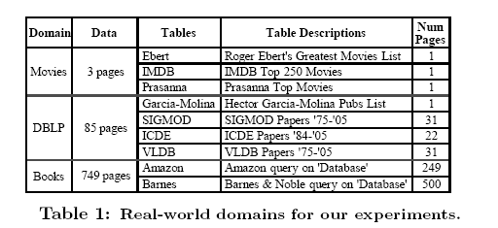
Depiction below describes characteristics of these tables:

Slide 59
We perform 9 IE tasks over
    the tables &
    their initial Xlog program (before adding predicate description rules, annotations, and cleanup procedures).
These tasks require extracting a variety of attributes, for
e.g. the title and year of movies from IMBD, etc

Slide 60
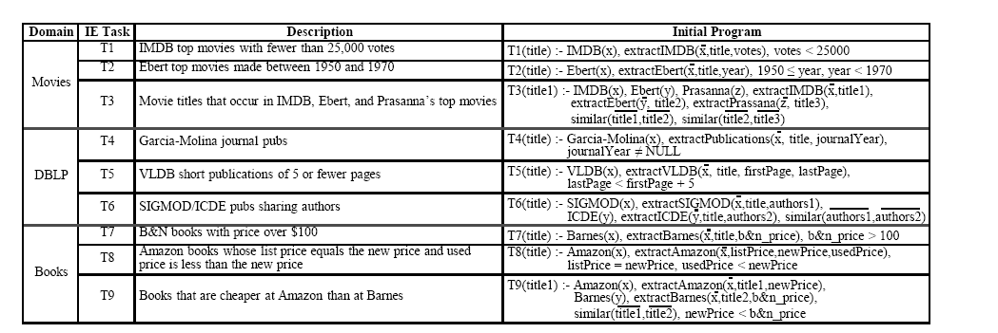

Slide 61
Methods:
Compare iFlex results with
Xlog (precise Xlog pgm and implement IE predicate using Perl, etc)
Manual ( manually inspect and collect answers from raw data)

Slide 62
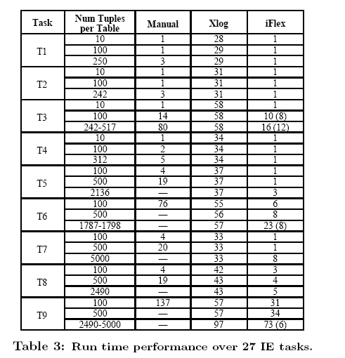
Comparison table:

Slide 63
Result Observations:
Manual does not scale well to large datasets
Xlog scales better; (mostly time spent in writing and debugging the Perl code corres. to various IE predicates. )
However, iFlex achieves significantly better performance than Xlog, reducing run time by 25-98% in all 27 scenarios.
The run-time results without the cleanup time
iFlex produces meaningful IE results quickly (x precise-IE method Xlog)
with the cleanup time
iFlex also produces precise IE results much faster than Xlog. Coz:
  U writes domain constraints declaratively in iFlex
  next-effort assistant
Notes:
U writes domain constraints declaratively in iFlex, than spend time implementing these constraints in procedural lang.
the next-effort assistant can help the developers refine the IE programs effectively,

Slide 64
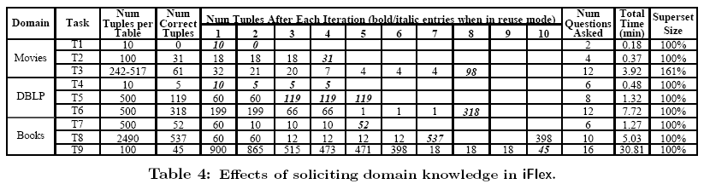
Effectiveness of Next Effort Assistant
Next effort assistant notifies developer when IE pgm has converged. It helped iFlex converge to correct results in 23 out of 27 cases.
Table shows iFlex’s performance per iteration, in nine randomly selected IE scenarios.

Slide 65
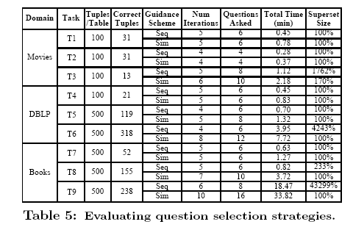
Evaluating question selection schemes:
Observation table:

Slide 66
Evaluating question selection schemes (contd.):
Compared sequential and simulation schemes for question selection
for each of the 9 IE scenarios in Table 5.
In all cases sequential was faster, because question selection was very efficient (i.e., no simulation required).
However, in 4/9 cases the questions asked via sequential selection were not nearly as useful for zooming in on the correct results as those asked via simulation.
The extracted results were as much as 433 times larger than the correct results, suggesting that the better results obtained via simulation are worth the additional cost when selecting questions.

Slide 67
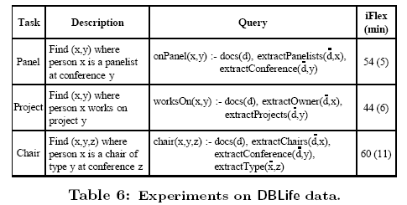
Evaluation on real world System
iFlex was made to run on over one day’s snapshot of the crawled data of DBLife, a structured Web portal(10007 Web pages, 198MB)
heterogeneous data set (incl. variety of Web pages -personal homepages, conference homepages, and the DB-World mailing list.)
iFlex was employed to write three IE programs (descbd in Fig 6) that correspond to similar programs in DBLife.
Result suggest that it proves quite efficient even on large data sets.

Slide 68
7.
Conclusion

Slide 69
Conclusion
iFlex relaxes the precise IE requirement to enable best effort IE.
Developers write an initial approx program P to obtain approx results quickly then refine P to obtain increasingly precise results.
Runs faster than precise IE stategy.
Saves effort when an approximate result can suffice users needs.

Slide 70
8.
Future Work

Slide 71
Future Work
Can possible consider more expressive languages and data models for approximate IE.
iFlex can be extended to explore the non-text specific requirements.
Exploring other execution semantics than superset semantics for query execution.
Next effort Assistant can be extended to address more types of feedback than just Question/Answering
iFlex can be applied to other contexts like
  Best effort data integration that seeks to provide approx answers over a set of data sources.

Slide 72
Questions?

