Slide 1
Unifying Data and Domain Knowledge Using Virtual Views
Lipyeow Lim
IBM T.J. Watson Research Ctr
Haixun Wang
IBM T.J. Watson Research Ctr.
Min Wang
IBM T.J. Watson Research Ctr.

Slide 2
Overview
Better integration of data management and knowledge management.
Unfortunately, current DBMSs, albeit improved by many extensions over the past years, are not ready to manipulate data in connection with knowledge.
Semantic Data Management
Domain Knowledge merged with DBMS framework so that users can query both data and domain knowledge as relational data.

Slide 3
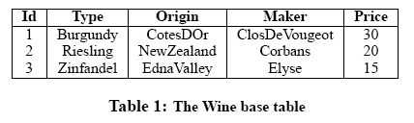
Motivation
Queries:
Which wine is from the United States?
Which one is red?

Slide 4
Benefits of DBMS
DBMS provides a wide range of transactional and analytical support that is indispensable in data processing.
SQL can insulate the users from the details of data representation and manipulation.
SQL offers query optimization.

Slide 5
Goal
To find wines that originate from the US, we may naively issue the following SQL query:
SELECT W.Id
FROM Wine AS W
WHERE W.Origin = ‘US’;
To find red wines, we may naively issue the following SQL query:
SELECT W.Id
FROM Wine AS W
WHERE W.hasColor = ‘red’;

Slide 6
Challenges
Ontology is currently represented as semi-structured data, using either OWL or RDF.
The relational data model remains ill-suited for storing and processing semi-structured data efficiently.
XML models come with a big storage and processing overhead.
Transitivity is difficult to express and process in an RDBMS.
Therefore neither pure XML databases or relational databases can do the task alone.

Slide 7
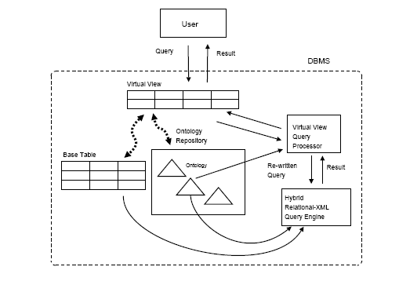
Approach
Framework

Slide 8
Approach
A virtual view is created by specifying how the data in relational tables relate to the domain knowledge encoded as ontologies in the ontology repository.
Ontology files registered with the ontology repository.
Class hierarchies and transitive properties are extracted into trees, and implications are extracted into an implication graph.
Framework processes the queries on the virtual view by re-writing them into queries on both the base table and the ontological information in the ontology repository.

Slide 9
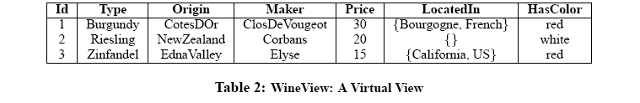
Virtual View
Virtual View incorporates both data and domain knowledge.
LocatedIn obtained from locatedIn property of ontology
HasColor obtained from:
(type = Zinfandel) ⇒ (hasColor = red)
(type = Riesling) ⇒ (hasColor = white)

Slide 10
Querying the Virtual View
To find wines that originate from the US, we issue the following SQL query against the virtual view:
SELECT W.Id
FROM WineView AS W
WHERE ‘US’ IN W.LocatedIn;
To find red wines, we issue the following SQL query against the virtual view:
SELECT W.Id
FROM WineView AS W
WHERE W.HasColor= ‘red’;

Slide 11
Virtual view creation
Definition 1 Create a Virtual View
CREATE VIRTUAL VIEW View(Column1, · · · , ColumnN) AS
SELECT head1, · · · , headN
FROM BaseTable AS T, Ontology AS O
WHERE constructor
AND p1 AND · · · AND pk
AND m1 AND · · · AND mj
Integration between data and domain :
Constructor
Constraints
Mappings

Slide 12
Virtual view creation (cont’d)
Constructor: O.type = expr
Instantiates ontology object of type O.type for a record in the relational table.
Constraints: p1,…,pk
Each pi can be a traditional boolean predicate on the relational table T, for example, T.price ≥ 30
Each pi can also be an ontological constraint, which is a triplet in the form of (Object1, Relation, Object2)
Mappings: m1,…,mk
Create a mapping between the schema of the base table and the properties in the ontology.
For example, W.origin = O.locatedIn

Slide 13
Example
CREATE VIRTUAL VIEW WineView(
Id, Type, Origin, Maker, Price,
LocatedIn, HasColor) AS
SELECT W.*,
O.locatedIn,
O.hasColor
FROM Wine AS W, WineOntology AS O
WHERE O.type=W.type /*constructor*/
AND (O.type isA ’Wine’) /*constraint*/
AND W.origin = O.locatedIn /*mapping*
/
View Triples

Slide 14
HYBRID RELATIONAL-XML DBMS
Hybrid relational-XML DBMSs for physical level support. Examples in this paper consider IBM’s DB2.
XML is supported as a basic data type. Users can create a table with one or more XML type columns.
CREATE TABLE ClassHierarchy (id integer, name VARCHAR(27), hierarchy XML)
To insert an XML document into a table, it must be parsed, for instance, with SQL/X function or XMLParse.

Slide 15
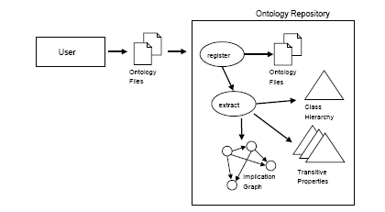
Ontology Repository

Slide 16
Ontology
The user registers each ontology file identifier (ID) via registerOntology( ontid, ontology File )
When an existing logical ontology in the repository needs to be removed, the stored procedure dropOntology( ontid ) is called with the ontology ID.
A Horn rule or clause is a logic expression of the form
H ← A1 ∧ . . . ∧ Am ∧ ∼Am+1 ∧ . . . ∧ ∼An

Slide 17
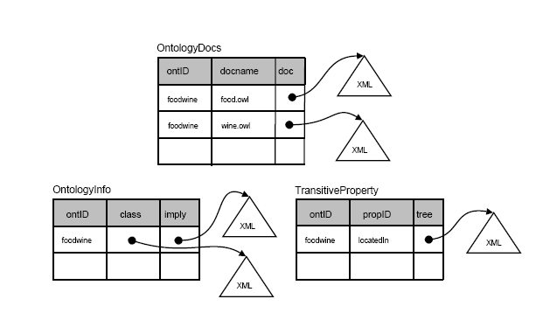
Ontology Tables
XML

Slide 18
Class Hierarchies
Correspond to subsumption rules dealing with:
the special subClassOf relationship subClassOf (A,C) ← subClassOf (A,B) ∧ subClassOf (B,C)
and isA relationship isA(B,X) ← isA(A,X) ∧ subClassOf (A,B).

Slide 19

<owl:Class rdf:ID="DessertWine">
<rdfs:subClassOf rdf:resource="#Wine" />
...
</owl:Class>
...
<owl:Class rdf:ID="WhiteWine">
<owl:intersectionOf rdf:parseType="Collection">
<owl:Class rdf:about="#Wine" />
<owl:Restriction>
<owl:onProperty rdf:resource="#hasColor" />
<owl:hasValue rdf:resource="#White" />
</owl:Restriction>
</owl:intersectionOf>
</owl:Class>
OWL Representation

Slide 20
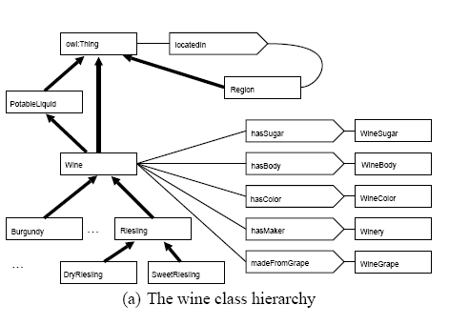
Ontology(Class hierarchy)

Slide 21
Transitive Properties
Corresponds to subsumption rules dealing with transitive relationships defined in the ontology by the ontology-author.
locatedIn(A,C) ← locatedIn(A,B) ∧ locatedIn(B,C)
The facts can be extracted from the ontology into a tree representation to facilitate query re-writing and processing.

Slide 22
OWL Representation
<owl:ObjectProperty rdf:ID="locatedIn">
<rdf:type rdf:resource ="&owl;TransitiveProperty" />
...
</owl:ObjectProperty>
Example: US
<Region rdf:ID="USRegion" />
<Region rdf:ID="CaliforniaRegion"> California Texas
<locatedIn rdf:resource="#USRegion" />
</Region>
<Region rdf:ID="Texas">
<locatedIn rdf:resource="#USRegion" />
</Region>

Slide 23
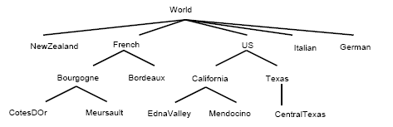
Transitive locatedIn Property

Slide 24
Implication Rules
Captures non-recursive rules encoded in the ontology ,represented internally as an implication graph.
An implication graph G is a directed acyclic graph consisting of two types of vertices and two types of edges.
Predicate nodes P(G) are associated with atoms in the of Horn clauses.
Conjunction nodes C(G) represent the conjunction of two or more atoms in the body of a Horn clause

Slide 25
OWL
<owl:Class rdf:about="#Zinfandel">
<rdfs:subClassOf>
<owl:Restriction>
<owl:onProperty rdf:resource="#hasColor" />
<owl:hasValue rdf:resource="#Red" />
</owl:Restriction>
</rdfs:subClassOf>
<rdfs:subClassOf>
<owl:Restriction>
<owl:onProperty rdf:resource="#hasSugar" />
<owl:hasValue rdf:resource="#Dry" />
</owl:Restriction>
</rdfs:subClassOf>
...
</owl:Class>
Can be converted into a conjunction of Horn Rules:
[isA(Zinfandel ,X) → hasColor(X,Red)] & [isA(Zinfandel ,X) → hasSugar(X,Dry)].

Slide 26
Ontology Properties (implications)
(type=RedBurgundy) ↔ (type=Burgundy) ∧ (type=RedWine)
(type=RedBurgundy) ← (madeFromGrape=PinotNoirGrape)
(type=RedBurgundy) ← (madeFromGrape.cardinality=1)
(type=RedWine) ← (type=Wine) ∧ (hasColor=red)
(type=Zinfandel) ← (hasColor=red)
(type=Zinfandel) ← (hasSugar=dry)

Slide 27
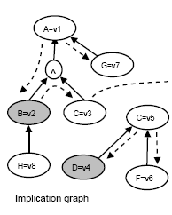
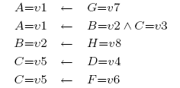
Implication Graph
Example

Slide 28
Query Processing
R denotes the set of recursive relations
View triples refer to the mapping between the ontology , the relation database and the virtual view.
A view triple (b, r, v) encodes a binary association between any pair of a base table b, a property or relationship r in the ontology, and a column v in the virtual view.
Notes:
Introduce an example

Slide 29
View Triples
relational view triples (W.id, ǫ, V.Id),
(W.type, ǫ, V.Type),
(W.origin, ǫ, V.Origin),
(W.maker , ǫ, V.Maker ),
(W.price, ǫ, V.Price)
virtual column triples (ǫ, O.locatedIn, V.LocatedIn),
(ǫ, O.hasColor, V.HasColor)
ontology triples (W.type, O.type, ǫ),
(W.origin, O.locatedIn, ǫ)
Query

Slide 30
Algorithm 1 REWRITE(Q,G,R, V)
Input: Q is a set of atomic predicates, G is the implication graph, R is the set of recursive implications, V is the view definition
Output: Q’ is the set of expanded predicate expression
1: Let Q = {A1,A2,A3, . . .}
2: Q′ =null;
3: for all Ai in Q do
4: Let Ai = (vcol , op, value)
5: (b, r, vcol) ← getViewTriple(V, vcol )
6: if r = ǫ then
7: Q′ ←Q′+ [ {(b, op, value)}
8: else
9: a ← findRuleNode(G,R, (r, op, value))
10: if a not found then
11: Q′← Q′ + {false}
12: else
13: A′← EXPAND(a, G, R, V)
14: if A′ = null then
15: Q′ ← Q′ + {false}
16: else
17: Q′ ← Q′ + Ai’
18: return Q′

Slide 31
Algorithm 1 REWRITE(Q,G,R, V)
Rewriting algorithm for a WHERE-clause Q in a query on a virtual view.
Takes as input the set of atoms from the WHERE-clause Q, the implication graph G, the set of recursive relationships R ,and the virtual view definition V, and outputs a rewritten query expression Q′.
The getViewTriple procedure retrieves from the DBMS catalog tables the view triple associated with the column in the atom.
If the column is a virtual column, EXPAND is called.

Slide 32
Algorithm 2 EXPAND(h,G,R, V)
Input: h is the node in implication graph G to be expanded, R is the set of
recursive relationships, and V is the virtual view definition
Output: e is the expanded predicate expression
1: if h is a ground node then
2: (b, r, v) ←getViewTriple(V, pred(h))
3: e ← {(b, op(h), val(h))}
4: if h is a recursive node then
5: e ← e +‘ISSUBSUMED( val(h), pred(h), b)’
6: /* R-Expansion */
7: if h is a recursive node then
8: for all s in subsumedAtoms(R, h) do
9: if s in P(G) then
10: for all rulebody in dependentExp(s,G) do
11: tmp←null
12: for all i in rulebody do
13: tmp ← tmp^EXPAND(i,G,R, V)
14: e← e || tmp
15: /* G-Expansion */
16: for all rulebody in dependentExp(h,G) do
17: tmp =null ;
18: for all I in rulebody do
19: tmp ← tmp^EXPAND(i,G,R, V)
20: e← e || tmp
21: return e

Slide 33
Algorithm 2 EXPAND(h,G,R, V)
If h is a ground node ,it means that h is associated with a base table column and can be checked against the base table column directly.
If h is also recursive, then an additional subsumption check needs to be added to the rewritten predicate.
For the case where h is not a ground node, it is clear that the algorithm needs to traverse the implication graph.
We also need to expand h with non-recursive rules contained in the implication graph G, i.e. G-expansions

Slide 34
Example
Consider the following SQL query on the virtual view WineView(id, hasColor)
SELECT V.Id
FROM WineView AS V
WHERE V.hasColor=v1;
where the virtual view definition consists of the following triples:
{(id, ǫ, id),(ǫ, A, hasColor),(type, B, ǫ),(origin, D, ǫ)}

Slide 35
Example
Algorithm 1 calls the EXPAND procedure to expand the query predicate.
Only B=v2 and D=v4 are ground nodes in G, so EXPAND tries to traverse G and the tree for C towards the ground nodes.
SELECT W.id
FROM Wine AS W
WHERE W.type=v2 AND W.origin=v4;
Implication Graph

Slide 36
OPTIMIZATION
Definition (Live and Dead Nodes) For a given virtual view definition,
a node n ∈ V(G) from the implication graph G is a live node if
n∈ P(G) and n is a ground node or a recursive node, or
there exists some u∈ Adj(n) such that u is a live node
Conversely, a node n that is not a live node is called a dead node

Slide 37
Optimization
Mark nodes in the implication graph G that are dead because there is no path from those nodes to any recursive or ground nodes.
The expansion of the atoms in a rule body can be safely skipped if at least one of the atoms is dead.
To prune the number of expansions due to R-expansion, mark nodes in the recursive tree R that are not associated with live nodes.
The fourth optimization uses memoization techniques to avoid traversing nodes in the implication graph more than once.

Slide 38
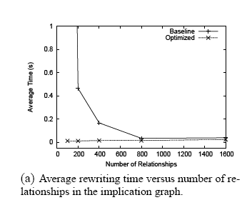
Experiments

Slide 39
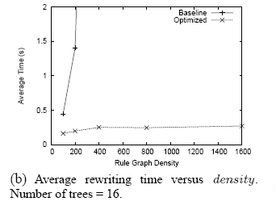
Experiments (cont’d)

Slide 40
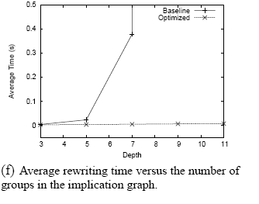
Experiments (cont’d)

