Slide 1
Lazy Query Evaluation for Active XML
Serge Abiteboul
Omar Benjelloun
Bogdan Cautis
Ioana Manolescu
Tova Milo
Nicoleta Preda

Slide 2
Outline
Introduction
Preliminaries
Finding relevant calls
Sequencing relevant calls
Using types
Faster relevance detection
Implementation and experiments
Conclusion

Slide 3
Outline
Introduction
Preliminaries
Finding relevant calls
Sequencing relevant calls
Using types
Faster relevance detection
Implementation and experiments
Conclusion

Slide 4
AXML documents
AXML stands for ‘Active’ XML
XML documents with embedded calls
to web services as a useful paradigm for distributed data
management on the Web
Contain both data as well as function calls to web services
Supports many features to control the activation of service calls embedded in documents.

Slide 5
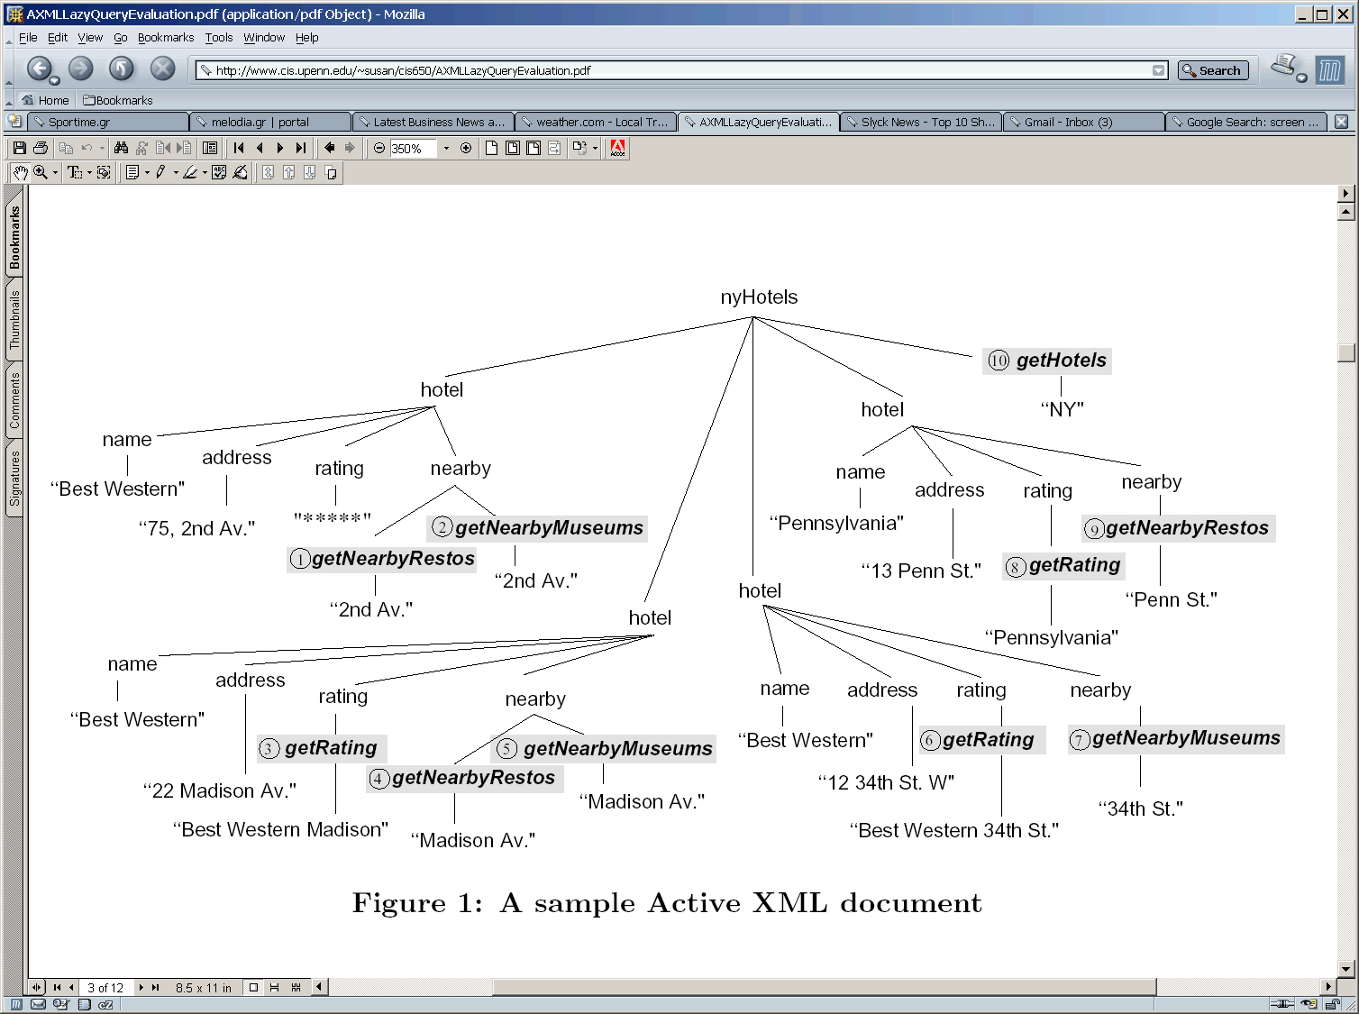
AXML structure
function nodes

Slide 6
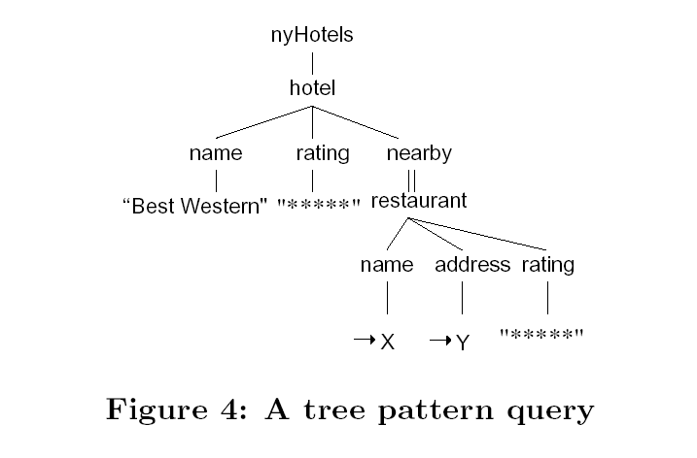
Tree pattern query

Slide 7
Approaches to query evaluation
Naïve approach : Invoking all calls recursively
- not efficient
Not-so-naïve approach: build a query processor that traverses the document top-down, and invokes the calls encountered while evaluating the query.
- mixing of query processing and service invocation would
result in bad performance
- forcing a particular query processing strategy eliminates the
opportunities for query optimization.

Slide 8
AXML query evaluation
Service calls may appear anywhere in the data
Service calls may appear dynamically in the results of previously invoked calls
Relevance of one call may depend on the result of another
Return types of the service calls should be taken into consideration

Slide 9
Lazy evaluation
What is ‘lazy’ evaluation?
  Avoid invocation of service elements which do not bring relevant data
  A service call specified as lazy is invoked only when its result may participate in the answer to a pending query
Example: query/goingOut/movies//show[title="The Hours"]/schedule
Avoided: /goingOut/restaurants
also, services under /goingOut/movies whose signature indicates that the returned data is irrelevant
The main contribution of this paper is an algorithm for the lazy evaluation of queries on AXML documents

Slide 10
The Lazy evaluation technique
The approach of lazy query evaluation makes use of the following techniques:
  - Computing the set of relevant service calls
  - Service calls sequencing
  - Pruning via typing
  - Service calls guide
  - Pushing queries

Slide 11
Outline
Introduction
Preliminaries
Finding relevant calls
Sequencing relevant calls
Using types
Faster relevance detection
Implementation and experiments
Conclusion

Slide 12
Preliminaries
Embedding
- Embedding of query ‘q’ into document ‘d’ is a match of a
given tree pattern query to the document ‘d’
- Result of embedding: bindings of the output variables on
the witness tree
Relevant calls
- Function calls that bring relevant data
Relevant Rewriting
- Expansion of the document after retrieval of data from the
relevant calls

Slide 13
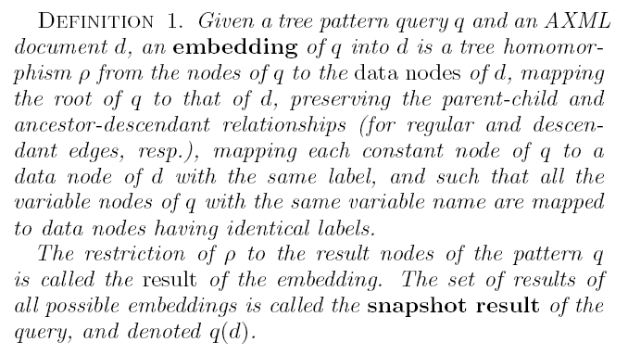
Formal definition of Embedding

Slide 14
Example of embedding

Slide 15
Example of embedding
If we evaluate getNearbyRestos()

Slide 16
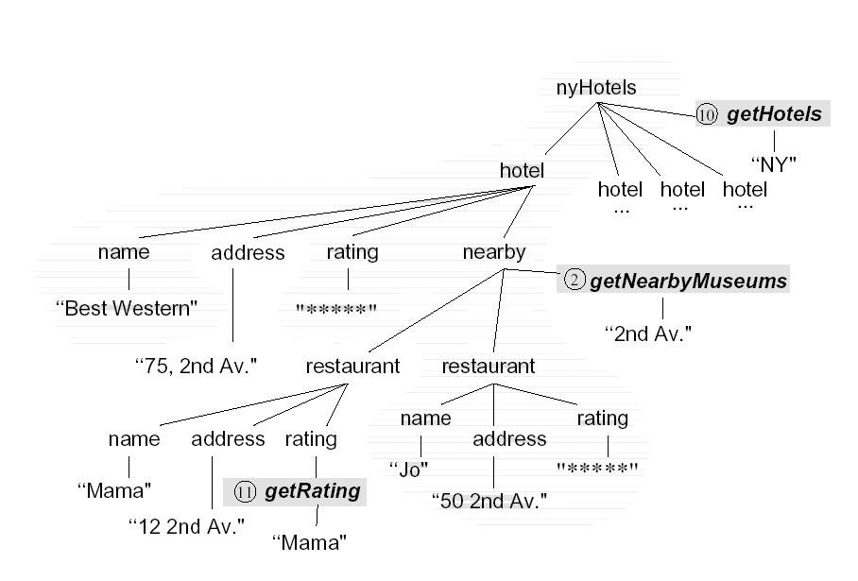
Example of embedding (cont’d)

Slide 17
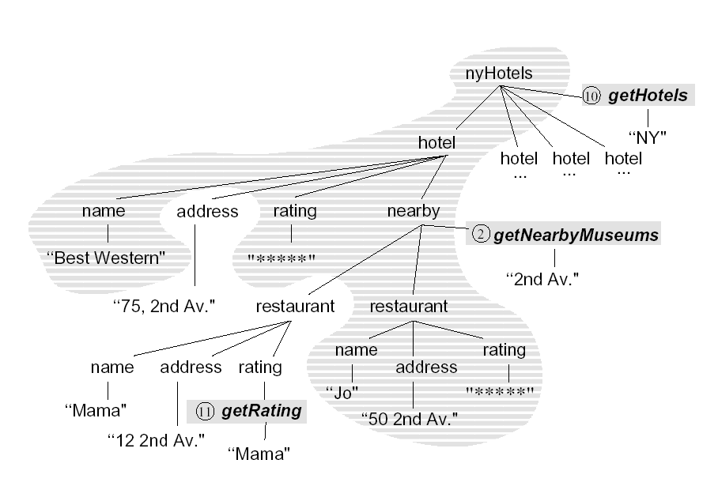
Example of embedding (cont’d)

Slide 18
Example of embedding (cont’d)
X
Y

Slide 19
Relevant calls
Relevant calls: Calls that indeed contribute to the resultant embedding.
For example, getNearbyRestos() is a relevant call,
and getNearbyMeuseums() is not.
In general, a function node is relevant, if there exists some rewriting of the document where some of the nodes it produces belongs to a match

Slide 20
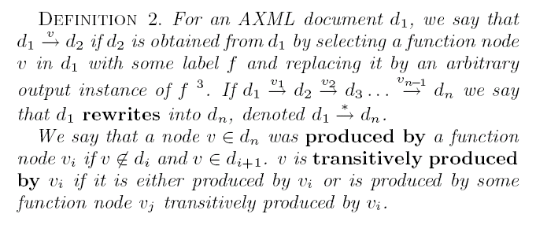
Relevant calls : Formal definition

Slide 21
Relevant rewriting and Completeness
Rewriting the document by invoking relevant function nodes produces relevant rewritings
In a process of making successive relevant calls, there might come a termination point where there can be no more relevant calls. The document ‘d’ is said to be complete for the given query ‘q’.

Slide 22
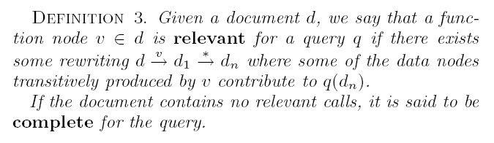
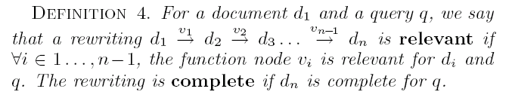
Relevant rewriting and Completeness

Slide 23
Outline
Introduction
Preliminaries
Finding relevant calls
Sequencing relevant calls
Using types
Faster relevance detection
Implementation and experiments
Conclusion

Slide 24
Efficient evaluation
Given an Active XML document d and a query q, find an efficient way to evaluate the query over the document
  Naïve approach: interleave query evaluation with function calls
  Better: try to compute (a superset of) the relevant functions calls for q and execute q over the rewriting of d (that results from executing these function calls)
  Efficiency tradeoff: time to compute approximation of set of relevant functions (larger for more accurate approx)
  Time to execute the function calls (smaller for more accurate approx) and time to execute query over resulting rewriting of document (smaller document for more accurate approx)

Slide 25
Linear path queries (LPQ)
/*()
/nyHotels/*()
/nyHotels/hotel/*()
/nyHotels/hotel/name/*()
/nyHotels/hotel/rating/*()
/nyHotels/hotel/nearby/*()
/nyHotels/hotel/nearby//*()
/nyHotels/hotel/nearby//restaurant/*()
/nyHotels/hotel/nearby//restaurant/name/*()
/nyHotels/hotel/nearby//restaurant/address/*()
/nyHotels/hotel/nearby//restaurant/rating/*()

Slide 26
LPQ continued
Correct, but usually inefficient
  Ignores filtering conditions in the path from the root or in other branches that could make some of the functions irrelevant (e.g. there is no chance that a getNearbyRestos() function node under a hotel is relevant, if the hotel rating is not “*****”)

Slide 27
Node Focused Queries (NFQ’s)
For each node in the query tree, replace it with an OR node (to add a branch *() to match any functions, similarly with LPQs)
Then, for every node v in the resulting query tree, create q_{v} = q – {v and its subtree}, with output node f_{v} pointing at the position of the *() OR-sibling of v
  - Each such query tree involves the path from the root to the node (as in LPQ) + any parts of the tree that would have to be matched anyway, for the whole query tree to match.

Slide 28
Example of NFQ
nyHotels
*
hotel
*
*
*
name
rating
nearby
*
*
*
“*****”
restaurant
*
*
*
name
address
rating
X
Y
“*****”

Slide 29
NFQ Example contd.
nyHotels
*
hotel
name
*
*
rating
nearby
*
*
“*****”
restaurant
*
*
*
name
address
rating
X
Y
“*****”

Slide 30
Example contd.
nyHotels
*

Slide 31
Example contd.
nyHotels

Slide 32
Example contd.
nyHotels
*

Slide 33
Example contd.
nyHotels
*
hotel
*
*
*
name
rating
nearby
*
*
*
“*****”
restaurant
*
*
*
name
address
rating
X
Y
“*****”

Slide 34
Example contd.
nyHotels
hotel
nearby
*
*
name
rating
*
*
*
“*****”

Slide 35
Example contd.
nyHotels
*
hotel
*
*
*
name
rating
nearby
*
*
*
“Best Western”
“*****”

Slide 36
Example contd.
nyHotels
hotel
nearby
*
*
name
rating
*
*
*
“Best Western”
“*****”

Slide 37
Outline
Introduction
Preliminaries
Finding relevant calls
Sequencing relevant calls
Using types
Faster relevance detection
Implementation and experiments
Conclusion

Slide 38
Sequencing relevant calls
Naïve NFQA algorithm:
  Evaluate all NFQs
  Pick one of the returned functions, say f_{v}
  Evaluate the function and rewrite the document (d d’)
  Until all NFQs return empty results (i.e., there are no more relevant calls)
After every loop, although the NFQs remain the same, their result can change (since evaluating functions at step 3 above can introduce new function nodes or make some results irrelevant)

Slide 39
Improving NFQA
“Predict” when NFQ results could not have possibly changed and avoid reevaluating them.
Identify dependences between NFQs and the effect of executing functions they return

Slide 40
Influence of NFQ’s
NFQ₁
NFQ₂
nyHotels
nyHotels
hotel
*
nearby
*
*
name
rating
*
*
*
“*****”
“Best Western”
NFQ₁ can influence NFQ₂, but not vice versa

Slide 41
Influence of NFQ’s
NFQ₁ may influence NFQ₂ iff the output function node of NFQ₁ is an ancestor (in the query tree) of the output node of NFQ₂
Two NFQs belong in the same layer if they may influence (directly or transitively) each other.
  Inside every layer, we have to reevaluate every NFQ after every function call

Slide 42
NFQ Layers
L₁ < L₂ iff some NFQ in L₁ may influence (directly or transitively) some NFQ in L₂
  We have to process L₁ before L₂ (without having to process L₁ again afterwards)
  When processing L₁ has finished, OR-nodes corresponding to returned functions are redundant and thus NFQs in L₂ can be simplified by removing them

Slide 43
Parallelizing calls
Let q^{lin} be the linear path from the root to the output node of NFQ q, not inclusive (note: q^{lin} is a regular expression)
Two NFQs q, q’ that belong to the same layer are independent iff there are no common words in the regular languages of q^{lin}, q’^{lin}
  E.g: //a, //b are independent
  But //a//c and //b//c are not: (e.g. both match /a/b/c)
If all NFQs in a layer are independent, we can call all functions returned by the same NFQ in a step of NFQA in parallel.

Slide 44
Outline
Introduction
Preliminaries
Finding relevant calls
Sequencing relevant calls
Using types
Faster relevance detection
Implementation and experiments
Conclusion

Slide 45
Using types
Use function return type to “predict” shape of data that a function call can return
  If this shape cannot match the (corresponding part of) the query pattern, they can be discarded
Refined NFQs
  Use set of function names of appropriate return type instead of *()
  Use F-guides (later) to make them even more refined

Slide 46
Refined NFQ’s
nyHotels
hotel
nearby
*
*
name
rating
*
*
“*****”

Slide 47
Refined NFQ’s
nyHotels
hotel
nearby
*
*
name
rating
getNearbyRestos
*
getRating
“Best Western”
“*****”

Slide 48
Pushing queries
Add sub-queries to the service calls to get precise data rather than getting all the data
For instance, rather than invoking getNearbyRestos() and getting all the near by restaurants, we would like to also ship the sub-query //restaurant[rating="*****",name=X,address=Y] (with X and Y marked as result nodes) with the call.
Reduce amount of (useless) data that are transferred (assuming functions correspond to remote (web) services), by filtering irrelevant matches and projecting only on output variable nodes

Slide 49
Outline
Introduction
Preliminaries
Finding relevant calls
Sequencing relevant calls
Using types
Faster relevance detection
Implementation and experiments
Conclusion

Slide 50
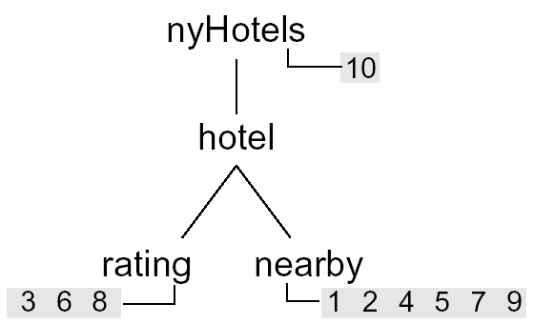
Function call guides
Function call guide: An access structure that provides information about the function calls that are present in the document. Used to speed up processing.
We use a tree structure that summarizes the paths that occur in a given document, containing a single occurrence of each path leading to a function call .
For each path we keep pointers to the corresponding function call nodes in the document.

Slide 51
Filtering techniques
Type based filtering: Discarding the functions whose output type does not satisfy the query sub-tree rooted at the end of the linear path by which they were retrieved.
NFQ filtering: Filter the function call candidates using the NFQs.

Slide 52
Outline
Introduction
Preliminaries
Finding relevant calls
Sequencing relevant calls
Using types
Faster relevance detection
Implementation and experiments
Conclusion

Slide 53
Implementation and experiments
Used ToXgene to generate AXML documents with function calls
Used the algorithms described here to implement a module that decides which services need to be invoked for query evaluation, and pushes, when possible, the relevant sub-queries to them.
Used customized query processor similar to ‘Xquery’
Experiments show effects of using NFQ filtering, F-Guides, Type checking and Sub-query pushing and also combination of all of them

Slide 54
Experimental setting
The document size is fixed to be 1.6MB and varied the number of function calls in the document by instructing ToXgene to set the content of, e.g., rating elements f% of the time as a call to getRating, and (100-f)% of the time as materialized data.
Queries:
Linear: hotels//hotel
Tree Pattern: hotels/hotel[rating=‘‘***’’]
/nearby/hotel[rating=‘‘***’’]
/nearby/hotel[rating=’’***’’]

Slide 55
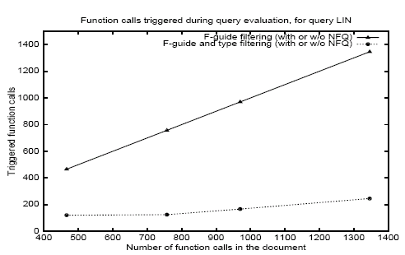
Experiments and results

Slide 56
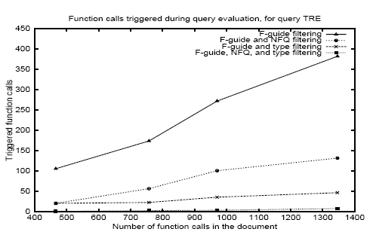
Experiments and results

Slide 57
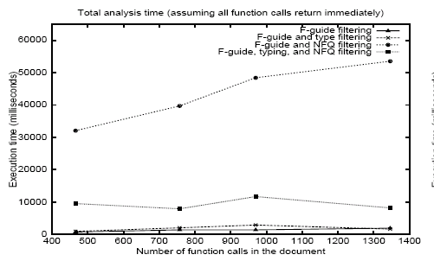
Experiments and results

Slide 58
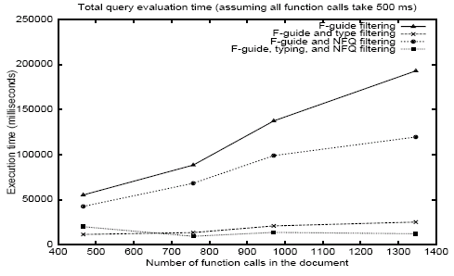
Experiments and results

Slide 59
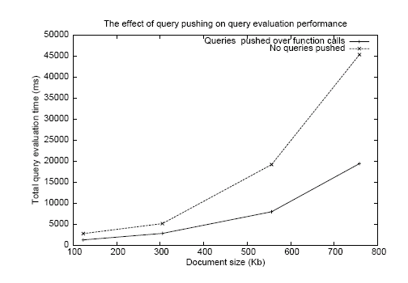
Effect of pusing subqueries

Slide 60
Outline
Introduction
Preliminaries
Finding relevant calls
Sequencing relevant calls
Using types
Faster relevance detection
Implementation and experiments
Conclusion

Slide 61
Conclusion
AXML – emerging technology
The paper emphasizes on optimizations to query evaluation on AXML documents using several algorithms
There are other works on the usage of AXML documents in special environments (eg. P2P data sharing networks). The techniques presented in this paper deals with a specific problem and is complimentary to these works
The techniques mentioned in this paper can be modified and customized for optimizing evaluation based the usage of AXML documents to obtain better results
Several techniques used in this paper are inspired by other works, but the novelty here is in customizing them to the problem at hand.

Slide 62
Thank you!

