Slide 1
An Approach to Optimize Data Processing in Business Processes
Marko Vrhovnik¹, Holger Schwarz¹, Oliver Suhre², Bernhard Mitschang¹,
Volker Markl³, Albert Maier², Tobias Kraft¹
¹Universität Stuttgart
²IBM Böblingen
³IBM Almaden
Presented by: Megha Ramesh Kumar
CSE 718
Professor : Michalis Petropoulos

Slide 2
Topics of Discussion:
Introduction
Workflow Languages And Data Management
Rule Based Optimization of Business Processes
Process Graph Model
Rewrite rules
Control Strategy
Conclusion

Slide 3
Introduction
Optimize business process revenues and profits.
Introduce a set or rewrite rules such that
Transform a business process into a more efficient one.
Improve execution wrt data management.
NO change in the semantics of the original process.
Semi-procedural process graph
Multi-stage control strategy
Case Study

Slide 4
Workflow Languages & Data Mgmt. Business Process Execution Language [BPEL]
It fosters a two-level programming model.
Function Layer
It consists of executable software components in the form of Web services that carry out basic activities.
Choreography Layer
It specifies a process model defining the execution order of activities.
BPEL offers many language constructs
Invoke activity
Assign activity
Sequence activity
ForEach activity

Slide 5
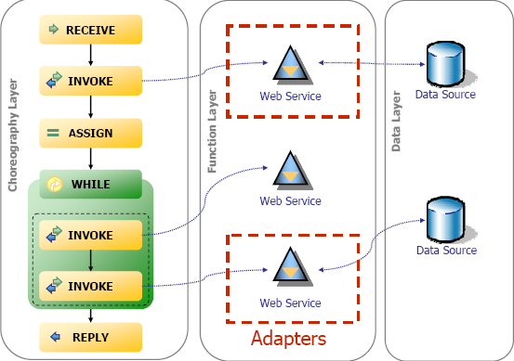
BPEL & Data Management

Slide 6
Database vendors pursue various approaches
IBM WebSphere Process Server
Allows to process data in a set oriented manner
BPEL/SQL
Oracle BPEL Process Manager
Provides XPath extension functions that are embedded in assign activities.
Statements to be executed on a remote database are provided as a parameter to the function.
Functions support any valid SQL statement
Query results are stored in set-oriented process variables
Microsoft Windows Workflow Foundation
Uses SQL activities to provide database processing as part of business processes.
Entire workflow , variables, activities are described by XOML.

Slide 7
Definitions
SQL Activities
Allows to pass data sets between activities by reference rather than by value.
Set reference variables
Refer to tables stored in a database system.
Set variables
Set-oriented data structure representing a table that is materialized in the process space.
Retrieve set activity
Specific SQL activity that allows to load data from a database system into the process space.

Slide 8
Sample Process

Slide 9
Sample Process

Slide 10
Sample Process

Slide 11
Sample Process

Slide 12
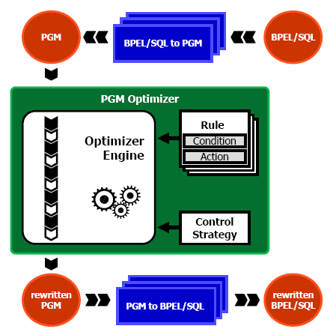
Rule Based Optimization of Business Processes
Optimizer Engine
Rewrite rules
Condition needed to preserve the semantics of the process.
It refers to the control flow dependencies and data flow dependencies of a process.
Action defines the transformations applied to a process provided the corresponding condition is fulfilled.

Slide 13
Rule Based Optimization of Business Processes
Optimizer Engine
Control strategy
Where on process structure
In what order to apply rules
Identify optimization spheres .
Define the order in which rule conditions are checked for applicability and the order in which rules are finally applied.

Slide 14
Rule Based Optimization of Business Processes
Optimization Spheres
Parts of a process for which applicable rewrite rules should be identified.
Determining such spheres is necessary, because if one applies rewrite rules across spheres, the semantics of a process may change.
Process Graph Model
PGM defines a process as a tuple (A, E_{c}, E_{d}, V, P)
A: set of process activities
E_{c}: Directed control flow edges
E_{d}: Directed data flow edges
V: Set of typed variable
P: Partners

Slide 15
Generality issues
PGM optimizer is independent from a specific workflow language and from the underlying database system.
Important pre-conditions
The optimizer engine needs to know the exact statements that are used in data management tasks.
The optimizer engine needs to know control flow dependencies as well as data dependencies.

Slide 16
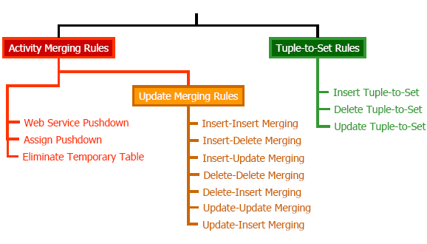
Classification of rewrite rules

Slide 17
Activity Merging Rules
Web Service Pushdown
Pushes an invoke activity into the SQL activity that depends on the Web service invocation.
Hence, web service becomes a part of the SQL statement.
Precondition:
DBMS supports web service calls.

Slide 18
Example

Slide 19
Example

Slide 20
Example

Slide 21
Assign Pushdown
It directly integrates an assign activity into an SQL activity.
We push the assign operation into the SQL statement replacing the considered variable through its definition. This allows to omit the assign activity.

Slide 22
Eliminate Temporary Table
If a table is created for each single process instance at process start up time, and if it is dropped as soon as the process instance has finished, we call it a temporary table.
This rule removes the usage of temporary tables within SQL statements of SQL activities.
This reduces the costs for the lifecycle management of temporary tables as well as for SQL processing.

Slide 23
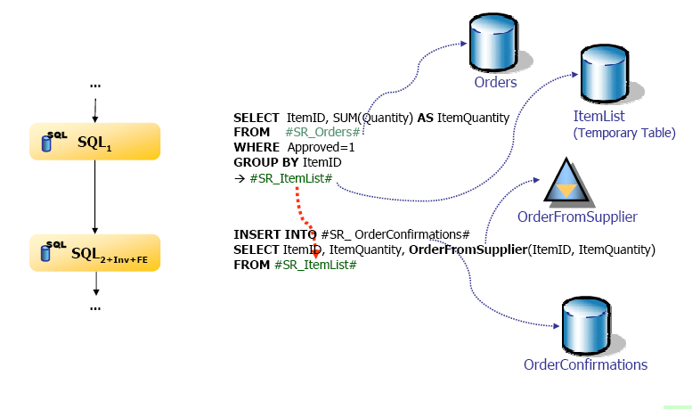
Example

Slide 24
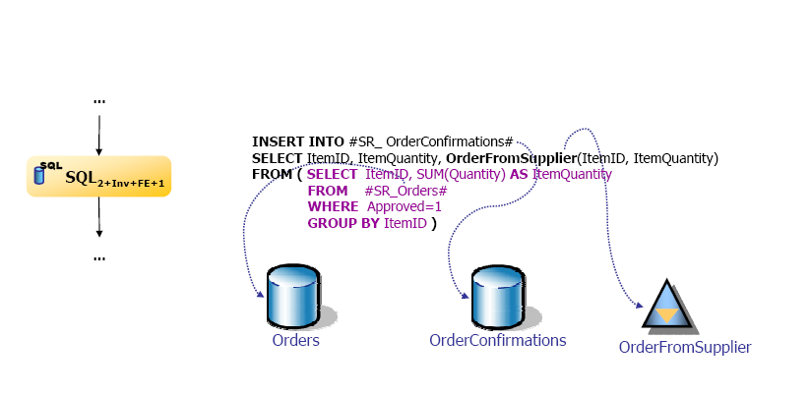
Example

Slide 25
The Insert Tuple-to-Set Rule
Insert Tuple to Set Rule:
Replace the ForEachActivity by a single SQL activity.
Set oriented.
Avoids calling a database at each step of the loop.
Two Conditions:
Semantics of the process has to remain unchanged.
Process representation that explicitly defines control flow and data dependencies is mandatory.
Assumptions:
Single data source.
Process without parallel activities referencing the same variable.

Slide 26
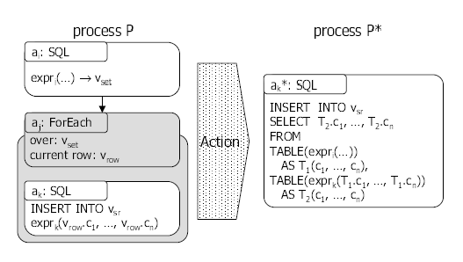
The Insert Tuple-to-Set Rule
Rule Conditions:
P is transformed into process P* V={v _{set,} v _{row,} v_{sr}}
V_{set} : set variable
V_{row} : a row of materialization set
V_{sr} : set reference variable
A is a set of activities

Slide 27
The Insert Tuple-to-Set Rule
Rule Conditions:
Activity Condition A1:
Activity a_{i} is of type SQL providing the results of query expression expr_{i} in a set variable.
Activity Condition A2:
ForEach activity a_{j} iterates over the set and provides the current row in a row variable v _{row}.
Activity Condition A3:
SQL activity a_{k} is the only activity in the loop body of a_{j}. It executes an INSERT statement .

Slide 28
The Insert Tuple-to-Set Rule
Rule Action
Transform a_{k} to a_{k}* by rewriting the SQL statement of a_{k}
We “pull up” the INSERT statement by joining expr_{i} with a correlated table reference containing the results of expression expr_{k} for each row. Due to the correlation between the joined tables within the FROM clause, we add the keyword TABLE to the table reference.

Slide 29
The Insert Tuple-to-Set Rule
Rule Action:
Replace a_{j} including a_{k} by a_{k}*
Remove a_{i} and adapt the control flow accordingly, that is, connect all direct preceding activities with all direct succeeding activities of a_{i}
This opens up optimization at the database level and thus leads to performance improvements

Slide 30
The Insert Tuple-to-Set Rule
Data Dependency Condition D1:
A single write-read data dependency based on v_{set} does exist between a_{i} and a_{j} , such that a_{i} writes v_{set} before a_{j} reads v_{set}
Data Dependency Condition D2:
There is a single write-read data dependency based on v_{row} between a_{j} and a_{k}, such that a_{j} writes v_{row} before a_{k} reads it

Slide 31
The Insert Tuple-to-Set Rule
Value Stability Condition S1:
v_{set} is stable, that is, it does not change between its definition and its usage
Value Stability Condition S2:
In each iteration of a_{j} , a_{k} reads that value of v_{row} that is provided by a_{j}

Slide 32
Control Strategy
It divides the overall process in several optimization spheres and applies rewrite rules considering their dependencies.
Our control strategy exploits dependencies among rewrite rules .
The application of any Activity Merging rule to the activities inside a ForEach activity may reduce the number of these activities to one.
In turn, this may enable the application of the Tuple-to-Set rule.

Slide 33
Control Strategy
The application of an Update Merging rule may reduce the number of updates on a table to a single one.
If such a single update is executed on a temporary table, the Eliminate Temporary Table rule might become applicable.
There is no specific order among the Tuple-to-Set Rule.

Slide 34
Enabling Relationships

Slide 35
Control Strategy
Merging activities produces more sophisticated SQL statements.
This enables optimization at the database level.
The performance gain depends on
The optimization potential of the SQL statements .
The capabilities of the query optimizer of the database management system that processes these statements.

Slide 36
Control Strategy
Scope Optimization Sphere (SOS)
Scope of a closed optimization sphere.
Loop Optimization Spheres (LOS)
They comprise a ForEach activity with its nested activities and all surrounding activities that are necessary for applying a Tuple-to-Set rule.

Slide 37
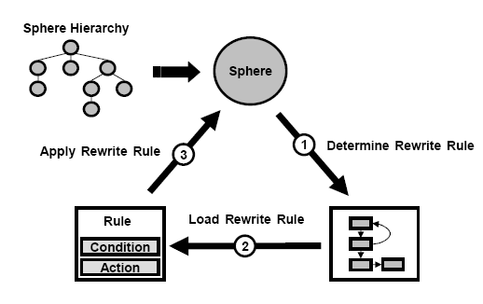
Control Strategy
Tree represents a hierarchical ordering on all optimization spheres.
We process all nested spheres prior to a enclosing sphere.
For each sphere type, we use a different control strategy.

Slide 38
Control Strategy

Slide 39
Algorithm
Algorithm : OptimizeSphere
Require: sphere s
Ensure: optimized sphere s
cs ← getControlStrategy(s)
while cs is not finished do
r ← getNextRule(cs)
while s is not fully traversed do
a ← getNextActivity(s)
m ← findMatch(a, s, r)
if m = ∅ then
applyRule(m, r)
end if
end while
end while

Slide 40
Algorithm
Algorithm OptimizeSphereHierarchy
Require: sphere-hierarchy sh
Ensure: optimized sphere-hierarchy sh
while sh is not fully traversed do
s ← getNextSphere(sh)
optimizeSphere(s)
end while

Slide 41
Experiments

Slide 42
Conclusion
Data management tasks are increasingly treated as first class citizens in workflow languages.
New optimization opportunities arise.
Applying rewrite rules to the definition of business processes results in remarkable performance improvements.
Main components of the optimizer engine:
set of rewrite rules
process graph model as internal representation of workflows
control strategy

Slide 43
Thank you

