Slide 1
Indexing Dataspaces
Presenter : Sravanth Palepu
CSE 718
Xin Dong | Alon Halevy
University of Washington | Google Inc.

Slide 2
Introduction
Dataspaces are collections of heterogeneous and partially unstructured data
Users do not have a single schema to which they can pose queries
So, it is important that queries are allowed to specify varying degrees of structure
This paper considers indexing support for queries that combine keywords and structure

Slide 3
Dataspaces
Dataspaces as a new abstraction for data management collections
In data management scenarios today it is rarely the case that all the data can be fit nicely into a conventional relational DBMS, or into any other single data model or system
Instead, developers are more often faced with a set of loosely connected data sources and thus must individually and repeatedly address low-level data management challenges across heterogeneous collections

Slide 4
Where do we need to manage Dataspaces
Personal data on one’s desktop, collections of data sources
In enterprises, government agencies, collaborative scientific
Projects, digital libraries, and large collections of structured sources on the Web

Slide 5
Once again – Aim
To build a system that enables users to interact with dataspaces through a search and query interface
Keeping two goals in mind :
1. much of the interaction with such a system is of exploratory nature
2. since there are many disparate data sources, the user cannot query the data using a particular schema

Slide 6
Classification of queries
1. Predicate Query –
A predicate query allows the user to specify both keywords and simple structural requirements,
  Example : paper with title ‘Birch’, authored by ‘Raghu’, and published in ‘SIGMOD 1996’
2. Neighborhood Query -
A neighborhood keyword query is specified by a set of keywords, but differs from traditional keyword search in that it also explores associations between data items
  Example : searching for “Birch” returns not only the papers and presentations that mention the Birch project, but also people working on Birch and conferences in which Birch papers have been published.

Slide 7
Existing approach?
Existing methods either build a separate index for each attribute in each data source to support structured queries on structured data, or
create an inverted list to support keyword search on unstructured data
Consequently, they fall short in the context of queries that combine keywords and structure

Slide 8
What’s the approach here?
Captures both text values and structural information using an extended inverted list
The index augments the text terms in the inverted list with labels denoting the structural aspects of the data like attribute tags and associations between data items

Slide 9
Quick Example
When an attribute tag is attached to a keyword, it means that this keyword appears as a value for that attribute
  Example : Whenever the keyword k appears in a value of the “a” attribute, there is a row in the inverted list for k//a//
When an association tag is attached to a keyword, it means that this keyword appears in an associated instance.
  Example : The inverted list will have a row for k//r//

Slide 10
Indexing Heterogeneous Data
The scenario used throughout the discussion is representative of data that may be extracted from multiple sources, some of which are only partially structured or not structured at all
The scenario includes a collection of files of various types (e.g., Latex and Bibtex files, Word documents, Powerpoint presentations, emails and contacts, and web pages) as well as some structured sources such as spreadsheets, XML files and databases
Associations are extracted between disparate items in the unstructured data and also from structured data sources

Slide 11
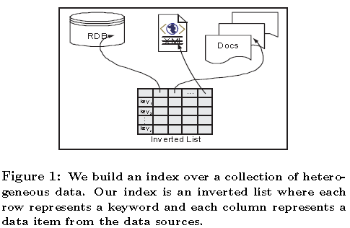
Answers?
Answers to queries are data items from the sources, such as files, rows in spreadsheets, tuples in relational database or elements in XML data

Slide 12
Model
Data from different data sources is modeled universally as a set of triples, which are referred to as a ‘triple base’
Each triple is either of the form
(instance, attribute, value) or
(instance, association, instance)
Thus, a triple base describes a set of instances and associations
An instance corresponds to a real-world object and is described by a set of attributes,
An association is a relationship between two instances

Slide 13
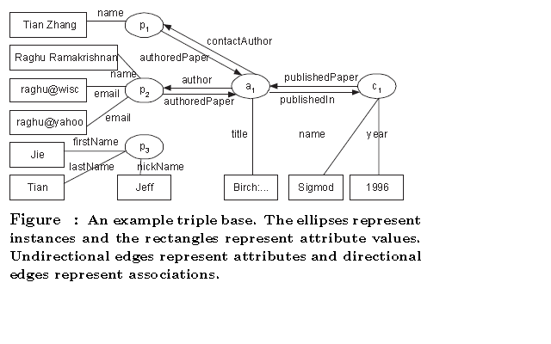
Example

Slide 14
Querying Heterogeneous Data –
Predicate Queries
Predicate queries describe the desired instances by a set of predicates, each specifying an attribute value or an associated instance
A predicate query contains a set of predicates of the form (v, {K₁, . . . , K_{n}}), where v is called a verb and is either an attribute name or an association name, and K₁, . . . ,K_{n} are keywords
The predicate is called an attribute predicate if v is an attribute, and an association predicate if v is an association

Slide 15
Semantics of predicate queries
The returned instances need to satisfy at least one predicate in the query
An instance satisfies an attribute predicate if it contains at least one of {K₁, . . . , K_{n}} in the values of attribute v or sub-attributes of v
An instance o satisfies an association predicate if there exists i, 1<=i<=n, such that o has an association v or sub-association of v with an instance o′ that has an attribute value K_{i}

Slide 16
Example
The query “Raghu’s Birch paper in Sigmod 1996” can be described with the following three predicates:
(title ‘Birch’), (author ‘Raghu’), (publishedIn ‘1996 Sigmod’)
The query is satisfied by instance a₁ in our example

Slide 17
Query Format
In practice, users can specify predicate queries in two ways:
1. they can specify a query through a user interface featuring drop-down menus that show all existing attribute or association labels.
2. they can compose the query in a certain syntax (such as the one shown in above example), specifying attribute or association labels that they know (such as those in data sources familiar to them)

Slide 18
Querying Heterogeneous Data –
Neighborhood Queries
Neighborhood keyword queries extend keyword search by taking associations into account
A neighborhood keyword query is a set of keywords,
K₁, . . . , K_{n}
An instance satisfies a neighborhood keyword query if either of the following holds:
1. The instance contains at least one of {K₁, . . . , K_{n}} in attribute values. In this case we call it a relevant instance
2. The instance is associated (in either direction) with a relevant instance. In this case we call it an associated instance.

Slide 19
Example
Consider the query “Birch”
Instance a₁ is a relevant instance as it contains “Birch” in the title attribute, and p₁, p₂, and c₁ are associated instances
Above query does not specify if “Raghu” should occur in an author attribute, or in an author sub-element, or in the attribute of another tuple that can be joined with the returned instance
Query answering explores the structure of the data to return associated relevant instances

Slide 20
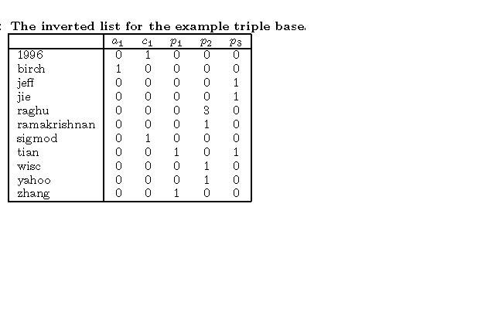
Index

Slide 21
Inverted Lists
Inverted lists do not capture any structure information:
In the example inverted list above, we cannot tell that “tian” occurs as p₁’s name (actually, first name) and p₃’s lastName.

Slide 22
Indexing Structure
Indexing Attributes :
Several ways to capture attribute types in indexing
Build an index for each attribute, but it can introduce a significant overhead to the index structure
Specify the attribute name in the cells of the inverted list
  For example, the cell (“tian”, p₁) in the Table above could be modified to record “name:1”. However, this method would considerably complicate query answering

Slide 23
Attribute inverted lists (ATIL)
Solution proposed captures attribute names with the indexed keywords to save both index space and lookup time
Whenever the keyword k appears in a value of the ‘a’ attribute, there is a row in the inverted list for k//a//
The cell (k//a//, I) records the number of occurrences of k in I’s a attributes
To answer a predicate query with attribute predicate
(A, {K₁, . . . , K_{n}}), we only need to do keyword search for
{K₁ //A//, . . . , K_{n}//A//}

Slide 24
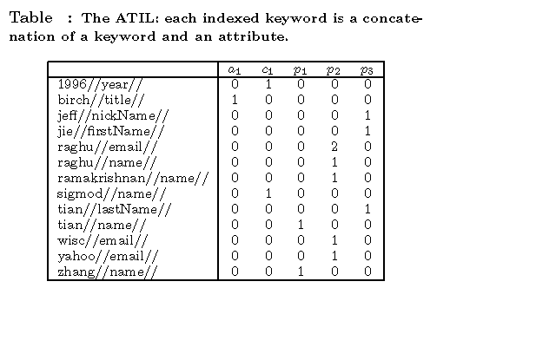
Attribute Inverted List (ATIL) Table

Slide 25
Example
For example, to answer the attribute predicate query “lastName, ‘Tian’”, we transform it into a keyword query “tian//lastName//”
In table above, the search will yield p₃ but not p₁.

Slide 26
Indexing Structure
Indexing Associations :
Consider the association predicate (R, {K₁, . . . , K_{n}) Instances satisfy the predicate if they have associations of type R with instances that contain some of the keywords K₁, . . . , K_{n} in attribute values.
A naive solution would perform a keyword search on keywords {K₁, . . . , K_{n}} and find a set of instances {l₁,. . . , l_{m}} that contain these keywords. Then, for each instance l_{k}, k in [1,m], we find associated instances

Slide 27
Drawback
This approach can be very expensive for two reasons
First, when m is large, iteratively finding associated instances for each l_{k} can be expensive
Second, a returned instance can be associated with one or more instances in {l₁, . . . , l_{m}}. Ranking the returned results requires counting the number of associated instances for each result, which can be expensive

Slide 28
Attribute-association inverted lists (AAIL)
Suppose the instance I has an association r with instances l₁, . . . , l_{n} in the triple base, and each of l₁, . . . , l_{n} has the keyword k in one of its attribute values
The inverted list will have a row for k//r// and a column I
The cell (k//r//, I) has the value n
An inverted list that captures both attribute and association information is called an attribute-association inverted list (AAIL)

Slide 29
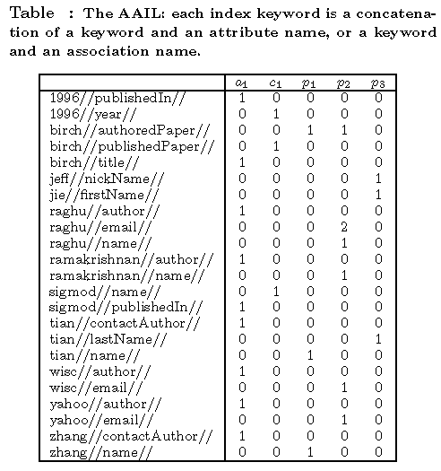
Attribute-association Inverted List (AATIL) Table

Slide 30
Example
Given an association predicate (R, {K₁, . . . , K_{n}}), we can answer it by posing the keyword query
{K₁ //R//, . . . , K_{n}//R//} over the AAIL
For example, when searching for “Raghu’s papers”, the query contains an association predicate “author ‘Raghu’” and so we look up keyword “raghu//author//”
Based on the AAIL table above, we return instance a₁

Slide 31
Indexing Hierarchies
For the query “name ‘Tian’”, we wish to return instances p₁ and p₃, rather than only p₁
A simple method to incorporate hierarchies would be to first find all descendants of the name attribute (in this example, they are firstName, lastName and nickName), then expand the keyword query by considering descendant attributes as well,
(so search “tian//name// OR tian//firstName// OR tian//lastName// OR tian//nickName//”)
However, this method requires multiple index lookups and thus can be expensive.

Slide 32
Solution provided
Based on integrating the hierarchy information into the index structure
Introduces two possible solutions, and then combine their features and introduce a hybrid indexing scheme

Slide 33
Attribute inverted lists with duplication (Dup-ATIL) – First Solution
First solution duplicates a row that includes an attribute name for each of its ancestors in the hierarchy
If the keyword k appears in the value of attribute a₀, and a is an ancestor of a₀ in the hierarchy (a could also be a₀), then there is a row k//a//
The cell (k//a//, I) records the number of occurrences of k in values of the a attribute and a’s sub-attributes of I

Slide 34
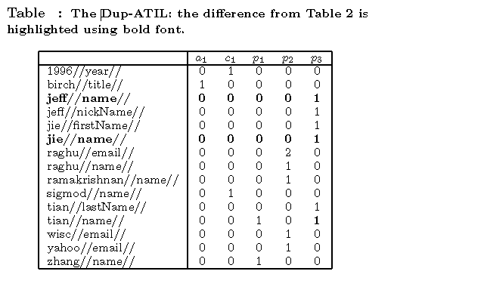
Dup-ATIL Table

Slide 35
Example
We index instance p₃ not only on “jie//firstName//”, “tian//lastName//”, and “jeff// nickName//”, but also on “jie//name//”, “tian//name//”, and “jeff//name//”
Thus, in the inverted list, row “tian//name//” also records one occurrence for instance p₃, and there are new rows “jie//name//” and “jeff//name//”, each recording one occurrence for instance p₃.
Now consider searching a person with name “Tian”.
We transform the query “name ‘Tian’” into keyword search “tian//name//” and return instances p₁ and p₃.

Slide 36
(Dup-ATIL) Pro/Con
On the one hand, a Dup-ATIL has the benefit of simple query answering
But on the other hand, it may considerably expand the size of the index because of the duplication
The size of the Dup-ATIL will be especially affected if the attribute hierarchy contains long paths from the root attribute to the leaf attributes and most values in the triple base belong to leaf attributes

Slide 37
Attribute inverted lists with hierarchies (Hier-ATIL)
Second solution, which does not affect the number of rows in the inverted list. Instead, the keyword in every row includes the entire hierarchy path.

Slide 38
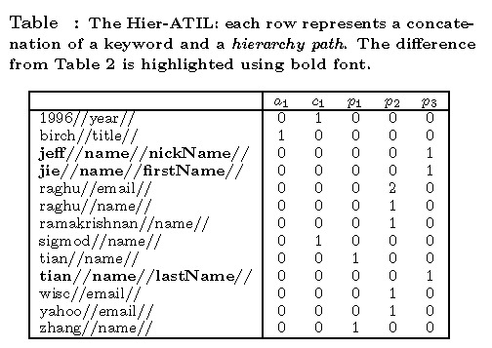
Hier-ATIL Table

Slide 39
Hier-ATIL Contd
A Hier-ATIL captures the hierarchy information using hierarchy paths, which have a nice feature: the hierarchy path of an attribute A is a prefix of the hierarchy paths of A’s descendant attributes.
Thus, we can transform an attribute predicate into a prefix search
Specifically, consider a query predicate (A, {K₁, . . . , K_{n}}) We transform it into a prefix search: K₁ //A//, . . . , K_{n} //A//
For example, we can transform the query predicate “name ‘Tian’” into a prefix search “tian//name//*” and so return both p₁ and p₃

Slide 40
(Hier-ATIL) Pro/Con
Unlike Dup-ATIL, building a Hier-ATIL does not increase the number of indexed keywords.
Although it can lengthen many of the indexed keywords, real indexing systems typically record a keyword only by the difference from its previous keyword
  For example, given a keyword k₁ and a succeeding keyword k₂, where the maximal common prefix of k₁ and k₂ is p, an index can record k₂ by the length of p and k₂’s suffix that differs from k₁
Thus, building a Hier-ATIL introduces only a small overhead
However, with Hier-ATIL we need to answer a predicate query by transforming it into a prefix search, which can be more expensive than a keyword search.

Slide 41
Hybrid attribute inverted list (Hybrid-ATIL)
Hybrid-ATIL builds an inverted list that can answer any prefix search (ending with “//”) by reading no more than t rows, where t is a threshold given as input to the algorithm
The indexed keyword in a summary row is of the form p//, where p = k// a₀// . . . //a_{l}//, k is a keyword, and a₀// . . . //a_{l}// is a hierarchy path for attribute a_{l}
Rows whose indexed keywords start with p are said to be shadowed by the summary row p//. Note that keywords in summary rows end with an additional // to be distinguished from ordinary rows
The cell (p//, I) has the sum of the occurrence counts of I in p//’s shadowed rows

Slide 42
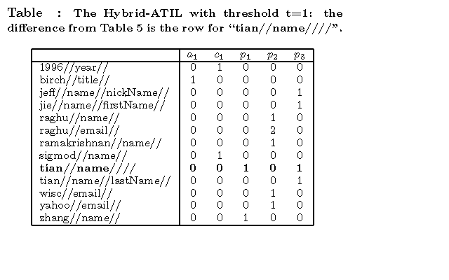
Hybrid-ATIL Table

Slide 43
Example
The query predicate “name ‘Jeff’ ” is transformed into prefix search “jeff//name//*”
In Table above, only keyword “jeff//name//nickName//” contains this prefix, so we return instance p3
The query predicate “name ‘Tian’ ” is transformed into prefix search “tian//name//*”. As the Hybrid-ATIL contains a summary row with indexed keyword “tian//name////”, we can directly return instances p1 and p3 without considering other keywords

Slide 44
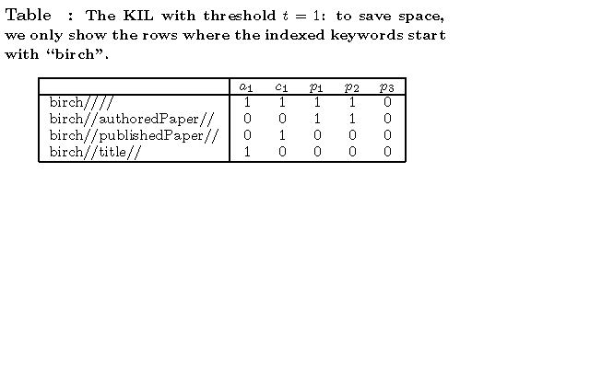
Example Table

Slide 45
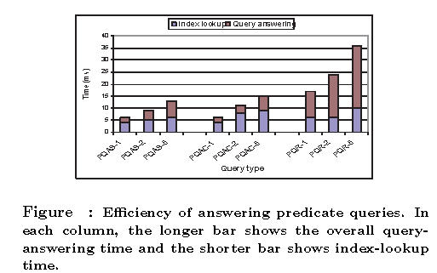
EXPERIMENTAL EVALUATION

Slide 46
Terms
Considered four types of queries:
• PQAS: Predicate queries with only attribute clauses where the attributes do not have sub-attributes;
• PQAC: Predicate queries with only attribute clauses where the attributes do have sub-attributes;
• PQR: Predicate queries with only association clauses;
• NKQ: Neighborhood keyword queries (we did not distinguish between relevant and associated instances).

Slide 47
Indexing and Searching
Tested the efficiency of the KIL, the hybrid hierarchical index
It takes 11.6 minutes to build the KIL and its size is 15.2MB
On average it took 15.2 milliseconds to answer a predicate query with no more than 5 clauses, and took 224.3 milliseconds to answer a neighborhood keyword query with no more than 5 keywords

Slide 48
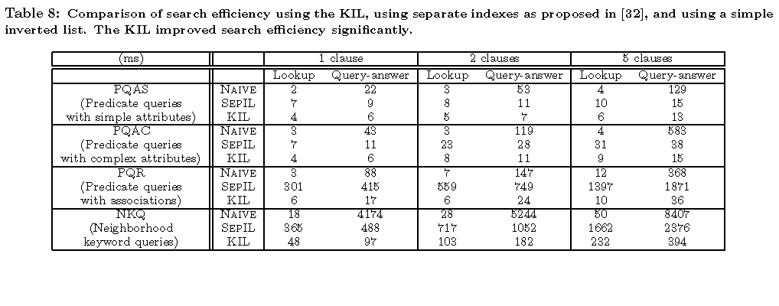
Comparison Table

Slide 49
Conclusion
Novel indexing method that is designed to support flexible querying over dataspaces
Querying mechanism allows users to specify structure when they can, but also to fall back on keywords otherwise
Validated the techniques with a set of experiments which showed that incorporating structure into inverted lists can considerably speed up query answering
Plan to extend index to support value heterogeneity and to investigate appropriate ranking algorithms for our context

