Slide 1
Database Seminar
spring 2008
Supervisor: Dr. Michalis Petropoulos
Presented by: Sergey Chernokozinskiy

Slide 2
Detecting Anomalous Access Patterns in Relational Databases
Ashish Kamra
Evimaria Terzi
Elisa Bertino

Slide 3
Overview
Intrusion Detection (ID) techniques is an important component of any strong security solution.
In this paper, authors proposed a novel Intrusion Detection mechanism for DBMS.
ID mechanism mainly aimed to identify insider threats, e.g. users with legal privileges who act differently then they supposed.
The mechanism is based on mining SQL queries stored in database audit log files.
The result of the mining process is used to form profiles that can model normal database access behavior and identify intruders.

Slide 4
Overview cont.
The key idea underlying the paper’s approach is to build profiles of normal user behavior interacting with a database.
Two different scenarios are considered while forming the profiles:
The database has a Role Based Access Control (RBAC). One or more roles are assigned to each user and privileges are assigned to roles. ID system builds a profile for each role.
Suits databases with large user population
No roles associated to users. Thus all users are clustered in groups (clusters of similar behaviors) to form concise profiles.

Slide 5
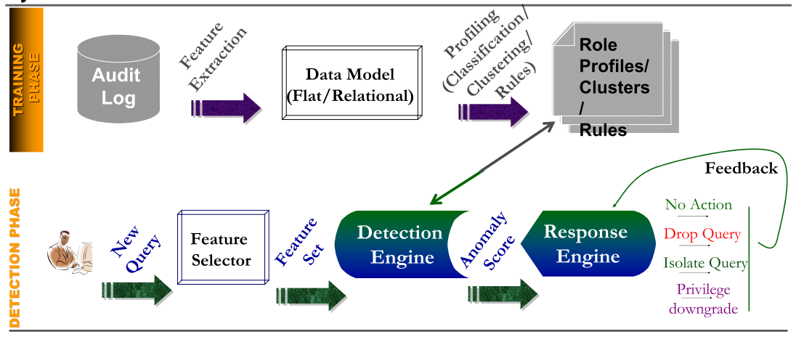
System architecture

Slide 6
Mechanisms for forming profiles
Supervised Learning : When database roles are available, create role profiles and use a naïve Bayes classifier to detect anomalous queries
Unsupervised Learning : When no roles are available, group users into clusters using clustering techniques and detect anomalies using outlier detection techniques

Slide 7
Methodology
Methodology
Clustering problem
RBAC
RBAC is not available
Detection phase
K-means
K-centers
Naïve Bayes Classifier
(NBC)
Detection phase
Classification problem
Naïve Bayes Classifier
(NBC)
Statistical test

Slide 8
Data representation. Log files
There is an assumption that users interact with the database through commands, where each command is a different entry in the log file.
SELECT [DISTINCT] {TARGET-LIST}
FROM {RELATION-LIST}
WHERE {QUALIFICATION}
Each log entry transforms to specific format that can be analyzed later. This format contains 5 fields and thus called a quiplet.
Thus the log file can be viewed as a list of quiplets.
Quiplets are basic units for forming profiles.

Slide 9
Data representation cont.
Each quiplet contains:
SQL Command
Projection Relation Information
Projection Attribute Information
Selection Relation Information
Selection Attribute Information
or (short notation)
Q(c; P_{R}; P_{A}; S_{R}; S_{A})
and
can be represented by one of three different representation levels (each level is characterized by a different amount of recorded information).

Slide 10
Three levels of quiplets representation
Coarse quiplet or c-quiplet (most naive representation):
Definition 1: A coarse quiplet or c-quiplet is a representation of a log record of the database audit log file. Each c-quiplet consists of 5 fields:
SQL-CMD
PROJ-REL-COUNTER
PROJ-ATTR-COUNTER
SEL-REL-COUNTER
SEL-ATTR-COUNTER
Example:
R1 = (A1;B1;C1;D1) R2 = (A2;B2;C2;D2)
SELECT R1.A1, R1.C1, R2.B2, R2.D2
FROM R1, R2
WHERE R1.B1 = R2.B2
Select < 2 >< 4 >< 2 >< 2 >
c-quiplet is sufficient in the case of a small number of well-separated roles

Slide 11
Three levels of quiplets representation cont.
Medium-grain quiplet or m-quiplet:
Definition 2: A medium-grain quiplet or m-quiplet is a data object which corresponds to a single entry of the database log file and consists of 5 fields:
SQL-CMD
PROJ-REL-BIN[]
PROJ-ATTR-COUNTER[]
SEL-REL-BIN[]
SEL-ATTR-COUNTER[]
Example:
R1 = (A1;B1;C1;D1) R2 = (A2;B2;C2;D2)
SELECT R1.A1, R1.C1, R2.B2, R2.D2
FROM R1, R2
WHERE R1.B1 = R2.B2
Select < 1, 1 > < 2, 2 > < 1, 1 > < 1, 1 >

Slide 12
Three levels of quiplets representation cont.
Fine quiplet or f-quiplet:
Definition 3: A fine quiplet or f-quiplet is a detailed representation of a log entry. It consists of 5 fields:
SQL-CMD
PROJ-REL-BIN[]
PROJ-ATTR-BIN[][]
SEL-REL-BIN[]
SEL-ATTR-BIN[][]
Example:
R1 = (A1;B1;C1;D1) R2 = (A2;B2;C2;D2)
SELECT R1.A1, R1.C1, R2.B2, R2.D2
FROM R1, R2
WHERE R1.B1 = R2.B2
Select < 1,1 > < [1,0,1,0], [0,1,0,1] > <1,1> <[0,1,0,0], [0,1,0,0]>

Slide 13
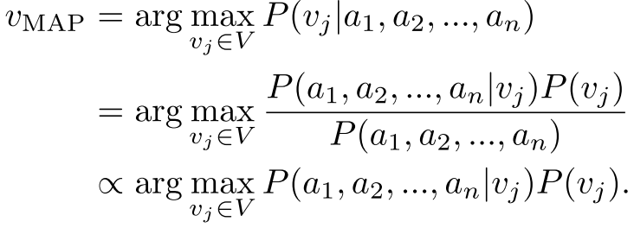
Classifier. RBAC-administered databases.
Naive Bayes Classiﬁer (NBC)
a set of training examples D_{T} is provided.
a new instance with attribute values (a₁, ..., a_{n}) is given.
the goal is to predict the target value (v_{MAP}), or the class, of this new instance.
Using
Bayes
Theorem

Slide 14
Classifier. RBAC-administered databases.
Easy to calculate
Is hard for large datasets
Make an assumption that the attribute
values are conditionally independent
This reduces signiﬁcantly the computational cost since
calculating each one of the P (a_{i}|v_{j} ) requires only a frequency
count over the tuples in the training data with
class value equal to v_{j}.

Slide 15
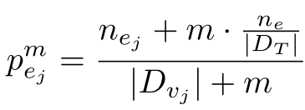
NCB - Classifier.
(*)
- is the number of times event e occurs in the particular class v_{j}
- gives the good estimation but what if
is very small?
Then (*) will give zero as a result!!!
To avoid this use m – estimate:
- is the number of times event e occurs in the entire dataset
m - is a constant

Slide 16
Classifier. Quiplets
Let R denotes the set of roles.
c-quiplet
m-quiplet

Slide 17
Classifier. Quiplets
f-quiplet

Slide 18
Classifier. ID task
For every new query, its r_{MAP} is predicted by the trained classiﬁer
if r_{MAP} is different from the original role associated with the query, an anomaly is detected
For the NEW appropriated queries the classiﬁer can be updated in a straightforward manner by increasing the frequency count of the relevant attributes
The ID suits the requirements when more than one role is assigned to the user

Slide 19
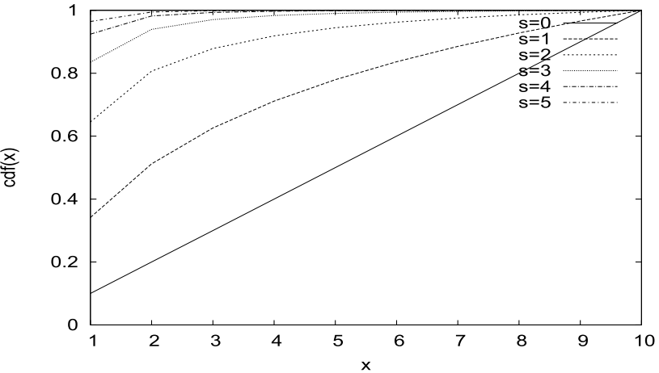
Experimental Evaluation. Zipf
Zipf distribution. Cumulative Distribution Function
Many types of data can be described by a Zipfian distribution

Slide 20
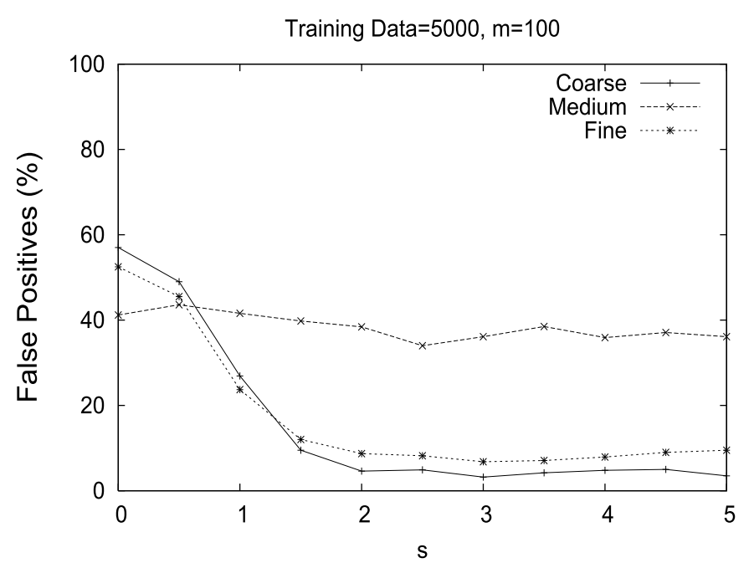
Experimental Evaluation
4 roles. Synthetic Dataset:
Read only. Table: Zipf (100,s). Col: Zipf (20,s)
Read only. Table: R_Zipf (100,s). Col: R_Zipf (20,s)
Read-write. Select (0.1), Delete (0.1), Insert (0.1), Update (0.7) Table: Zipf (100,s). Col: Zipf (20,s)
Read-write. Select (0.1), Delete (0.1), Insert (0.1), Update (0.7) Table: R_Zipf (100,s). Col: R_Zipf (20,s)

Slide 21
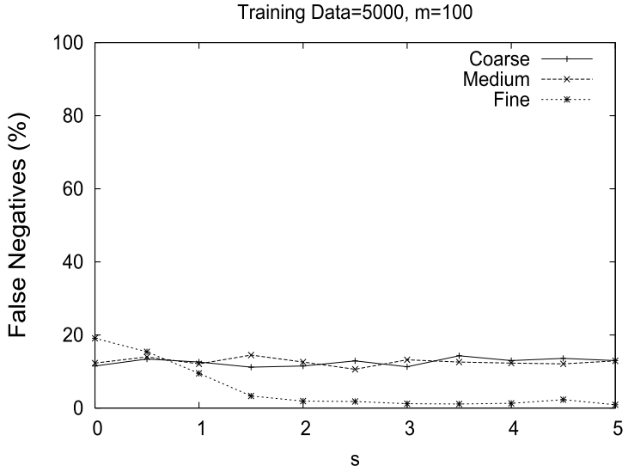
Experimental Evaluation cont.
4 roles. Synthetic Dataset :
Read only. Table: Zipf (100,s). Col: Zipf (20,s)
Read only. Table: R_Zipf (100,s). Col: R_Zipf (20,s)
Read-write. Select (0.1), Delete (0.1), Insert (0.1), Update (0.7) Table: Zipf (100,s). Col: Zipf (20,s)
Read-write. Select (0.1), Delete (0.1), Insert (0.1), Update (0.7) Table: R_Zipf (100,s). Col: R_Zipf (20,s)

Slide 22
Experimental Evaluation cont.
8 roles. Real Dataset:
8368 SQL Traces
130 Tables
1201 Columns
7583 Select, 213 Insert and 572 Update Commands

Slide 23
Classifier. Unsupervised anomaly detection.
The role information is not available in the audit log files
The method involves partitioning of the training data into clusters
The method maintains a mapping for every user to its representative cluster (the cluster that contains the maximum number of training records for that user after the clustering phase)

Slide 24
Classifier. Clustering algorithms
k-centers
Input: the set of data points and their distances and the desired number of clusters k
Output: the ﬂat k-clustering
The algorithm can be applied if the data used for creating user profiles are free from intruders
The algorithm is expected to create profiles reasonably close to the real ones
K=3

Slide 25
Classifier. Clustering algorithms cont.
k-means
Used when some outliers in data may exist
A significant advantage of the algorithm is that updates of the clusters can be executed in constant time.

Slide 26
Anomaly detection methodology
Find the representative cluster (C_{z}) for query z issued by user U. The representative cluster is obtained by simply looking up the user-cluster mapping created during the clustering phase.
Two different approaches for the detection phase:
To use the naive Bayes classiﬁer and treat the clusters as the classiﬁer classes.
Determine if z is an outlier in cluster C_{z} with the help of a statistical test (in principle any test can be used)

Slide 27
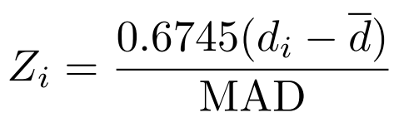
Anomaly detection methodology cont.
Statistical test
MAD (Median of Absolute Deviation)
d_{i} – distance of data point i from the cluster center it belongs to
d – the median value of the d_{i}’s for i = 1,2,… n
if |Z_{i}| > D then d_{i} is an outlier. D has to be experimentally evaluated (D = 1.5)

Slide 28
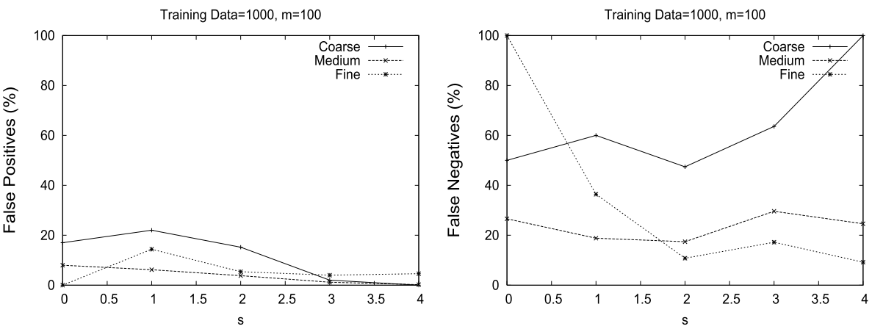
Experimental Evaluation. k-means
Naïve Bayes Detection Methodology

Slide 29
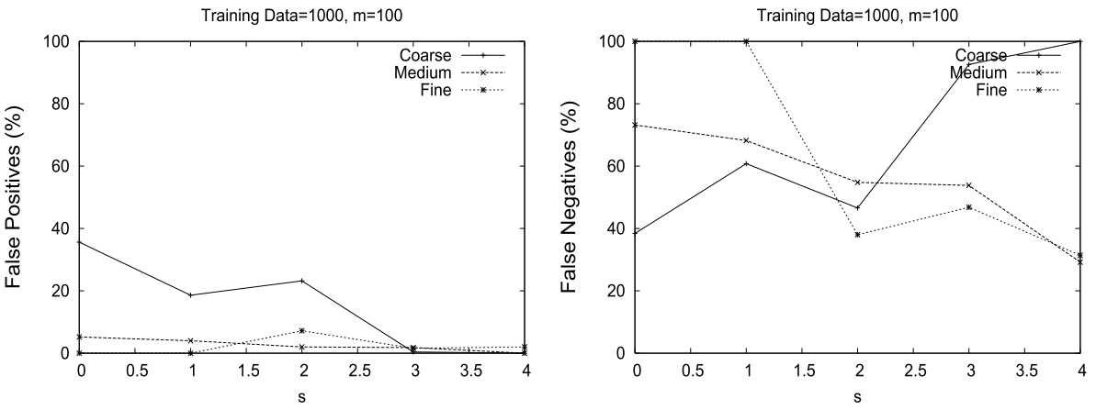
Experimental Evaluation. k-centers
Naïve Bayes Detection Methodology

Slide 30
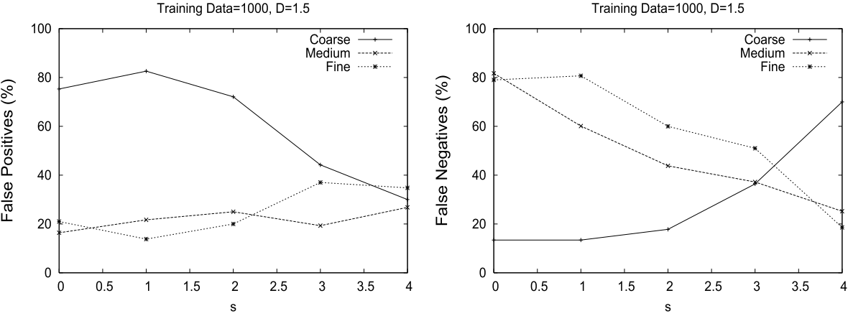
Experimental Evaluation. k-means
The Outlier Detection Methodology

Slide 31
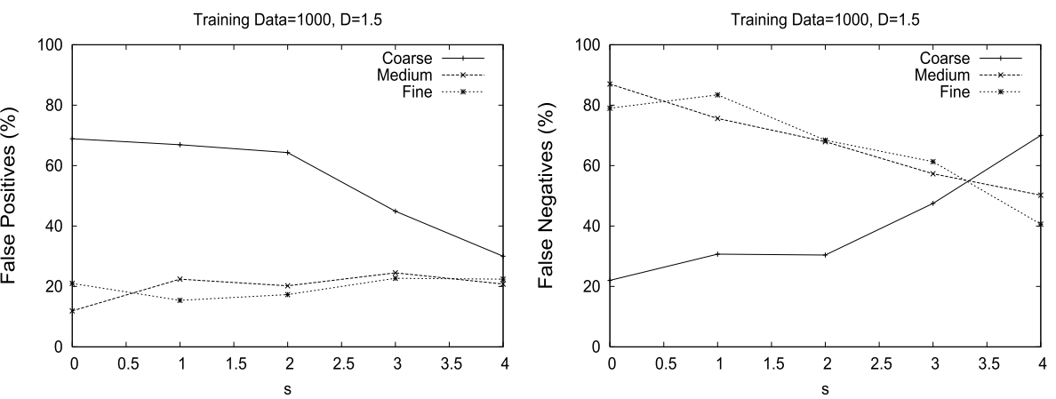
Experimental Evaluation. k-centers
The Outlier Detection Methodology

Slide 32
Conclusion and future work
Conclusion
In most cases f-quiplet capture the access pattern of the users much better than either c- or m-quiplet
Experiments have shown that results for k-means are better then those for the k-centers
Future work
Consider not only syntax but also semantics of queries in terms of the data values used in the predicates and the amount of data “accessed”
Further research in the area of the intrusion response system

Slide 33
Identification of Malicious Transactions in Database Systems
Yi Hu
Brajendra Panda

Slide 34
Overview
In the paper proposed the intrusion detection method by using data dependency relationships among transactions
The method uses Petri-Nets to model normal data update patterns at user task level
By data dependencies they refer to the data access correlations between two or more data items
Data dependencies are read set, pre-write set, and post-write set

Slide 35
Database model and Assumptions
Database model
The model requires that the database log records the identification information of the user submitting the transaction to the DBMS
The database log must keep track of the starting and ending times of each transaction (timestamps)
Assumptions
They consider only the case that the intruder has no access to the database. So the main focus are the only legitimate users
The total number of transactions a normal user can use is limited

Slide 36
Data Dependencies. Read set
The transaction must read all data items in one data item set of the read set before the transaction updates this data item
The notation is rs(x)
Example
Update Table1 set x = a + b + c where …
Before updating x, the value of a, b, and c must be read. So {a, b, c} ∈ rs(x)

Slide 37
Data Dependencies. Pre-Write set
The transaction must write all data items in the specified order in one data item set of the pre-write set before the transaction updates this data item.
The notation is ws0(x)
Example
Update Table1 set x = a + b + c where …
Update Table1 set y = x + u where …
Update Table1 set z = x + w + v where …
When x is updated, y and z are updated subsequently. So {x, y} ∈ ws0(z)

Slide 38
Static Semantic Analyzer
Consider all possible transactions one user may use
Find all read, pre-write, post-write sets
Example 1
Transaction 1
Update Table1 set x = a + b + c where …
Update Table1 set y = x + u where …
Update Table1 set z = x + w + v where …
 | Read Set | Pre-write Set | Post-write Set
x | { {a, b, c} } | { ∅} | { {y, z} }
y | { {x, u} } | { {x} } | { ∅}
z | { {x, w, v} } | { {x, y} } | { ∅}

Slide 39
Static Semantic Analyzer cont.
Example 1 cont.
Transaction 2
Update Table1 set x = a + d where…
Update Table1 set w = x + c where …
 | Read Set | Pre-write Set | Post-write Set
x | { {a, b, c}, {a, d} } | { ∅ } | { {y, z}, {w} }
y | { {x, u} } | { {x} } | { ∅ }
z | { {x, w, v} } | { {x, y} } | { ∅ }
w | { {x, c} } | { {x} } | { ∅ }
Result of static semantic analysis after two transactions T1 and T2 are analyzed

Slide 40
Static Semantic Analyzer cont.
Example 2
T_{i} : r[y], r[a], r[q], r[b], r[c], w[x], r[x],r[w], r[v], w[z],
r[x], r[u], w[y], r[c],r[d],r[e]
Data item x
the read set is satisfied {a, b, c}
the pre-write set is satisfied {∅}
cannot check the post-write set at this time
Data item z
the read set is satisfied {x, y, w}
pre-write set is NOT satisfied. x is updated but y is not
the anomaly is detected

Slide 41
Data Dependency at User Task Level
Individually each transaction may satisfies the read, pre-write and post-write sets. But the group of such transactions might carry anomalous activity
The idea is to use training phase to find out what data items are updated and determine the sequence of updates
In the training phase, a user task is executed extensively to make sure almost all different cases for this user task are performed
From the training phase write-chain is constructed. Write-chain is a sequence of data items that are always updated together and have complete order among these data items
To construct write-chain for a data item x it’s necessary to consider rs(x) and w1(x)

Slide 42
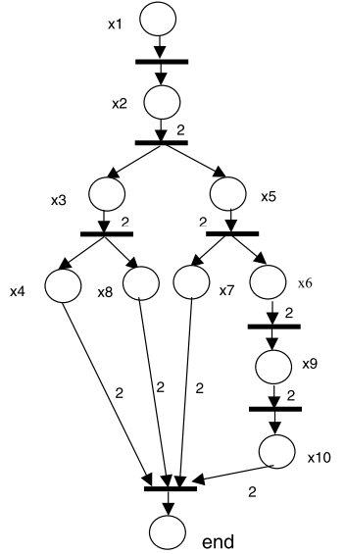
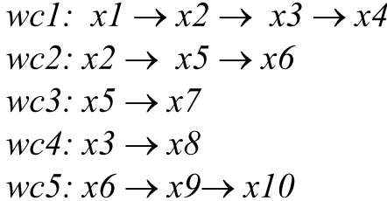
Petri-Net Implementation of User Task Level
x3, x1, x2, x4,
x1, x2, x3, x8,

