Slide 1
SCALABLE SEMANTIC WEB DATA MANAGEMENT USING VERTICAL PARTITIONING
By –
Sneha Godbole

Slide 2
Introduction
What is Semantic Web?
RDF
RDF Triples
Improving RDF Data Organization
Property Table
Vertically Partitioned Tables
Extending Column Oriented DBMS
More optimization
Materialized Path Expressions
RDF Benchmark
Evaluations
Results

Slide 3
What is Semantic Web?
Extension of World Wide Web
Enables sharing and integration of data across different applications and organizations.
Can be thought of as globally linked database
Components – XML, Resource Description Framework (RDF) and Web Ontology Language (OWL)

Slide 4
Resource Description Framework(rdf)
Used for describing resources on the Web
Provides a model for data and a syntax so that independent parties can exchange and use it
Represents data as statements about resources using a graph connecting resource nodes and their property values with labeled arcs representing properties
Syntactically the graph can be represented in XML syntax

Slide 5
Example Rdf Graph
title
XYZ
MNO
title
ID1
author
language
ID3
Fox, Joe
English
copyright
type
2001
type
type
ID6
BookType
copyright
2004
DVDType
ABC
type
title
artist
ID4
Orr, Tim
title
ID2
copyright
DEF
1985
language
1985
French
copyright
type
GHI
title
CDType
type
ID5

Slide 6
RDF Triples
A triple can be formed which represents a statement as <subject, property, object>
Serge Abiteboul wrote a book called “Foundations of Databases”.
subject – Serge Abiteboul
property – wrote a book
object – “Foundations of Databases”
The sky has the color blue.
subject – The sky
property – has the color
object - blue

Slide 7
Example rdf triple….
Subj. | Prop. | Object
ID1 | type | BookType
ID1 | title | “XYZ”
ID1 | author | “Fox, Joe”
ID1 | copyright | “2001”
ID2 | type | CDType
ID2 | title | “ABC”
ID2 | artist | “Orr,Tim”
ID2 | copyright | “1985”
ID2 | language | “French”
Subj. | Prop. | Object
ID3 | type | BookType
ID3 | title | “MNO”
ID3 | language | “English”
ID4 | type | DVDType
ID4 | title | “DEF”
ID5 | type | CDType
ID5 | title | “GHI”
ID5 | copyright | “1995”
ID6 | type | BookType
ID6 | copyright | “2004”

Slide 8
Problem with RDF
Related triples are stored in a single RDF table
Complex queries will require many self-joins over this table
Constraints – size of memory, index lookup
As RDF triples increase, the RDF table may exceed size of memory
Using joins requires index lookup or scan which reduces performance
Real world queries complicate query optimization and limits the benefit of indices

Slide 9
SQL query on RDF triples table
Query to get title of the book(s) Joe Fox wrote in 2001
SELECT C.obj
FROM TRIPLES AS A,
TRIPLES AS B,
TRIPLES AS C
WHERE A.subj = B.subj,
AND B.subj = C.subj,
AND A.prop = ‘copyright’
AND A.obj = “2001”
AND B.prop = ‘author’
AND B.obj = “Fox,Joe”
AND C.prop = ‘title’

Slide 10
Improving RDF data organization
Method 1 – Property Table
Method 2 – Vertically Partitioned Table

Slide 11
Property Table
Denormalized RDF tables are physically stored in a wider, flattened representation
For example – find sets of properties that tend to be defined together
Example-
If “title”, “author” and “copyright” are all properties that tend to be defined for subjects that represent book entities, then a property table containing subject as the key and “title”, “author” and “copyright” as other attributes can be created to store entities of type “book” (clustered property table)
Cluster similar sets of subjects together in the same table (property-class table)
Advantage
Reduces subject-subject self joins
Notes:
Example – Suppose that “title”, “author” and “isbn” are all properties that tend to be defined for subjects that represent book entities. Thus a table containing subject as the key and “title”, “author” and “isbn” as the other attributes might be created to store entities of type “book”.

Slide 12
Clustered property table example
Property Table
Left over triples table
Sub | Type | Title | cpyrt
ID1 | BookType | “XYZ” | “2001”
ID2 | CDType | “ABC” | “1985”
ID3 | BookType | “MNO” | NULL
ID4 | DVDType | “DEF” | NULL
ID5 | CDType | “GHI” | “1995”
ID6 | BookType | NULL | “2004”
Subj. | Prop. | Obj.
ID1 | author | “Fox,Joe”
ID2 | artist | “Orr,Tim”
ID2 | language | “French”
ID3 | language | “English”

Slide 13
Property-class table example
Class: BookType
Class: CDType
Left-over triples table
Sub | Title | Auth. | cpyrt
ID1 | “XYZ” | “Fox,Joe” | “2001”
ID3 | “MNO” | NULL | NULL
ID6 | NULL | NULL | “2004”
Subject | Property | Object
ID2 | language | “French”
ID3 | language | “English”
ID4 | type | DVDType
ID4 | title | “DEF”
Sub | Title | Auth | cpyrt
ID2 | “ABC” | “Orr,Tim” | “1985”
ID5 | “GHI” | NULL | “1985”

Slide 14
Problems with property tables
If table is made narrow with fewer property columns, table is less sparse but a query confined to one property table is reduced
If table is made wider including more property columns, more NULLs and hence more unions and joins in queries
Further complexity is added by multi-valued attributes as they cannot be added in the same table with other attributes
Queries that do not select on property class type are generally problematic for property-class tables
Queries that have unspecified property values are problematic for clustered property tables

Slide 15
Let us consider two-column tables
Type Title Copyright
Language
Author Artist
ID1 | BookType
ID2 | CDType
ID3 | BookType
ID4 | DVDType
ID5 | CDType
ID6 | BookType
ID1 | “XYZ”
ID2 | “ABC”
ID3 | “MNO”
ID4 | “DEF”
ID5 | “GHI”
ID1 | “2001”
ID2 | “1985”
ID3 | “1995”
ID4 | “2004”
ID2 | “French”
ID3 | “English”
ID1 | “Fox,Joe”
ID2 | “Orr,Tim”

Slide 16
Vertically Partitioned Approach
Triples table is divided into n two column tables
n is the number of unique properties in the data
In each table first column is subject and second column is object
Helps fast linear merge joins as tables are sorted by subject

Slide 17
Advantages of Vertically Partitioned Approach
Support for multi-valued attributes
Eg – ID1 has two authors
Support for heterogeneous records
Eg – subjects that do not define a particular property are simply eliminated from the table for that property (Author table in previous example)
Only those properties accessed by a query need to be read
Fewer unions and fast joins
Since all data for a particular property is located in the same table, union clauses are less common
ID1 | “Fox, Joe”
ID1 | “Green, John”

Slide 18
Disadvantage of Vertically Partitioned Approach
Inserts into vertically partitioned tables is slow

Slide 19
Extending a column-oriented dbms
Idea – store tables as collections of columns rather than as collections of rows
Disadvantages of row-oriented databases –
If only a few attributes are accessed per query, entire rows have to be read into memory from disk
This wastes bandwidth
In column-oriented databases only those columns relevant to a query need to be read
One disadvantage can be that inserts might be slower
More advantages ➢

Slide 20
Column-stores may be used because…
Tuple headers are stored separately
Databases store tuple metadata at the beginning of tuple
C-Store puts header information in separate columns
Effective tuple width is on the order of 8 bytes as compared to 35 bytes for row-store
Thus, gives 4-5 times quicker scans
Optimizations for fixed-length tuples
In row-stores variable length attribute makes entire tuple variable length
This requires use of pointers and an extra function call to tuple interface
In C-Store, fixed-length attributes are stored as arrays

Slide 21
Column-stores may be used because…[contd.]
Column-oriented data compression
Since each attribute is stored separately, it can be compressed separately using an algorithm best suited for that column.
Eg – subject ID column is monotonically increasing array of integers and can be compressed
Carefully optimized column merge code
Merging columns is a common operation on column stores
Hence merging code is carefully optimized
Eg – extensive prefetching is used when merging multiple columns so that disk seeks between columns do not dominate query time

Slide 22
More Optimization Opportunities
Materialized Path Expressions
Subject-object joins are replaced by cheaper subject-subject joins
We can add a new column representing materialized path expression
Inference queries are a common operation on Semantic Web data which can be accelerated using this method.

Slide 23
Example
All books whose authors were born in 1860
Book1
SELECT B.subj
FROM triples AS A,
triples AS B
WHERE A.prop = wasBorn
AND A.obj = “1860”
AND A.subj = B.obj
AND B.prop = “Author”
Author
Joe Green
wasBorn
1860

Slide 24
SELECT A.subj
FROM predtable AS A
WHERE A.author:wasBorn = “1860”
Book1
Author
Joe Green
Author:wasBorn
wasBorn
1860

Slide 25
RDF benchmark
A benchmark developed for evaluating performance of the three RDF databases
Barton Data
Longwell Overview
Longwell Queries

Slide 26
Barton data
Barton Libraries dataset
RDF/XML syntax is converted to triples using Redland parser
Duplicate triples and triples with long literal values are eliminated
Triples with subject URIs that were overloaded to correspond to several real-world entities are eliminated
Resulted dataset
50,255,599 triples left
221 unique properties (82 are multi-valued)
77% of triples have a multi-valued property

Slide 27
Longwell Overview
Longwell is a tool developed by Simile project
Provides a GUI for RDF data exploration in web browser
Shows list of currently filtered resources(RDF subjects) in main portion of the screen and a list of filters in panels along the side
Each panel represents a property that is defined on the current filter and contains popular object values for that property along with corresponding frequencies
Currently Longwell only runs a small fraction of Barton data – 9375 records

Slide 28
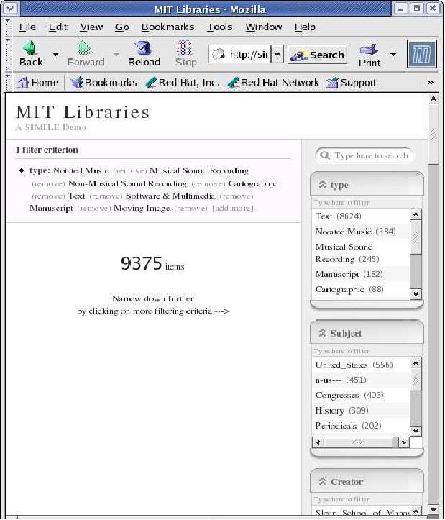
Longwell Screenshot

Slide 29
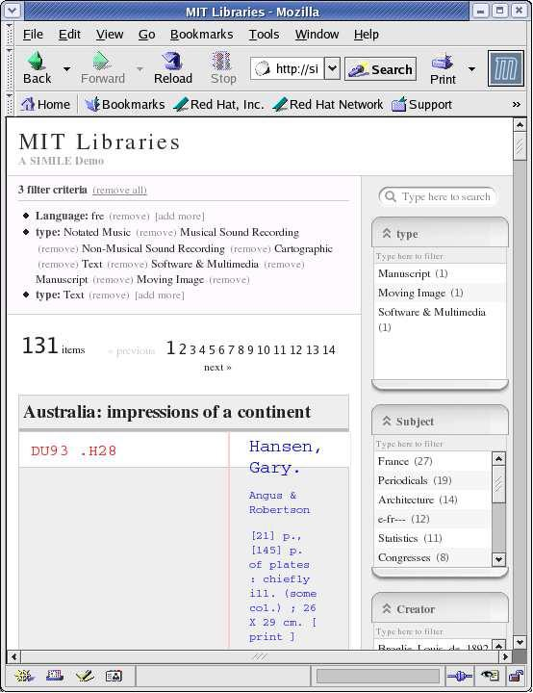
Screenshot after clicking on ‘fre’ in the language property panel

Slide 30
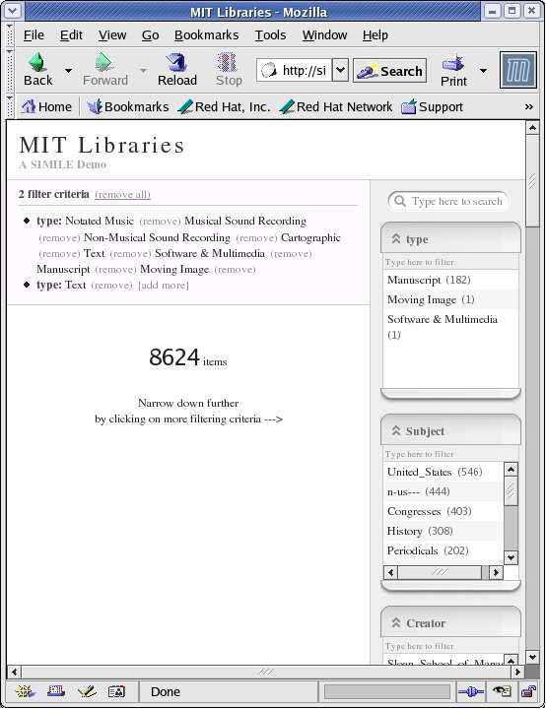
Screenshot after clicking on ‘text’ in the type property panel

Slide 31
Longwell Queries
Query 1 (Q1)– Calculate the opening panel displaying the counts of the different types of data in the RDF store. For eg: Type: Text has a count of 1,542,280 and Type: NotatedMusic has a count of 36,441.
Query 2 (Q2)– The user selects Type:Text from the previous panel. Longwell must then display a list of other defined properties for resources of Type:Text and also calculate frequency of these properties.
Query 3 (Q3)– For each property defined on items of Type:Text, populate the property panel with counts of popular object values for that property. For eg: property Edition has 8 items with value “[1st_ed._reprinted]”
Query 4 (Q4)– This query recalculates all of the property-object counts from Q3 if user clicks on “French” value in “Language” property panel.

Slide 32
Query 5 (Q5)- Here a type of
inference is performed. If there are triples of the form (X Records Y) and (Y Records Z) then we can infer that X is of type Z.
Query 6 (Q6)- Here, the inference in first step of Q5 and the property frequency calculation of Q2 are combined to extract information in aggregate about items that are either directly known to be of Type:Text or inferred to be of Type:Text through Q5 Records inference.
Query 7 (Q7)- This is a simple triple selection query with no aggregation or inference. The user tries to learn what a particular property actually means by selecting other properties that are defined along with a particular value of this property.

Slide 33
Evaluation
Goals are –
To study the performance tradeoffs between all representations to understand when a vertically partitioned approach performs better (or worse) than the property tables solution
To improve performance as much as possible over the triple-store schema

Slide 34
System specifications
System data
- 3.0 GHz Pentium IV
- RedHat Linux
28 properties are selected over which queries will be run
PostgreSQL Database
- Triple-store schema, property table and vertically partitioned schema
C-Store : vertically partitioned schema

Slide 35
Store implementation details
Triple store
- tested on Sesame and Postgres
- only Q5 and Q7 tested on Sesame
- 1400.94 secs for Q5 and 79.98 secs for Q7
- Postgres executes these queries 2-3 times faster
and total storage required was 8.3 GB
Property table store
- clustered property tables implemented
- property tables created for each query
containing only columns accessed by that query
- storage space required 14 GB

Slide 36
Store implementation details contd…
Vertically partitioned store in Postgres
- contains one table per property
- each table has subject and object column
- storage needs 5.2 GB
C-Store
- properties stored on disk in separate files, in
blocks of 64 KB
- each property contains 2 columns like vertically
partitioned store
- storage needs 2.7 GB

Slide 37
Query implementation details
Q1
Triple store
Aggregation can directly occur on column after property = Type selection is performed
Other 3 schemas
Aggregate object values for Type table

Slide 38
Q2
Triple store
Selection on property = Type and object = Text
Self join on subject to find what other properties are defined for these subjects
Aggregation over properties of newly joined triples table
Property table
Selection predicate Type=Text is applied followed by counts of non-NULL values for each of the 28 columns written to a temporary table
Counts selected out of temporary table and unioned together
Vertically Partitioned and Column store
Select subjects for which the Type table has object value Text
Store these in temporary table, t
Union results of joining each property’s table with t
Count all elements of resulting joins

Slide 39
Q3
Triple store
Same as Q2 but aggregation involves group by both property and object value
Property table
Selection predicate Type=Text as in Q2 but aggregation on all columns is not possible in a single scan of property table
Vertically Partitioned and Column store
Same as in Q2
GROUP BY on object column of each property after merge joining with subject temporary table
Union on aggregated results from each property

Slide 40
Q4
Triple store
Selection for property = Language and object=French
This selection joined with Type Text selection (self join on subject)
Self-join on subject again
Property table
Same as in Q3 but adds an extra selection predicate on Language = French
Vertically Partitioned and Column store
Same as in Q3 except that the temporary table of subjects is further narrowed down by a join with subjects whose Language table has subject=French

Slide 41
Q5
Triple store
Selection on property=Origin and object=DLC
Self-join on subject
Property table
Selection predicate applied on Origin=DLC
Records column of resulting tuples is projected and self joined with subject column of original property table
type values of join results are extracted
Vertically Partitioned and Column store
The object=DLC selection on Origin property
Join with Records table
Subject-object join on Records objects with Type subjects to attain inferred types

Slide 42
Q6
Triple store
Simple selection predicate to find subjects that are directly of Type : Text
Subject-object join through records property to find subjects that are inferred to be of Type Text
Self-join on subject to find other properties defined on this working set of subjects
A count aggregation on these defined properties
Property table,Vertically Partitioned and Column store
Create temporary tables by methods in Q2 and Q5
Aggregation in a similar fashion to Q2

Slide 43
Q7
Triple store
Selection on Point property
Two self-joins to extract Encoding and Type values for subjects that passed the predicate
Property table
Filter on Point accessed by an index
Union on the result of projection out of property table once for each of the two possible array values of Type
Vertically Partitioned and Column store
Join filtered Point table’s subject with those of Encoding and Type tables

Slide 44
Results
Query Time(in seconds)

Slide 45
Query 6 performance as number of triples scale
Query Time(in seconds)
Number of Triples(millions)

Slide 46
Query times for Q5 and Q6 after the Records:Type path is materialized
 | Q5 | Q6
Property Table | 39.49 (17.5% faster) | 62.6 (38% faster)
Vertical Partitioning | 4.42 (92% faster) | 65.84 (22% faster)
C-Store | 2.57 (84% faster) | 2.70 (75% faster)

Slide 47
Comparing a wider property table with a property table containing only the required columns for the query
Query | Wide Property Table | Property Table % slowdown
Q1 | 60.91 | 381%
Q2 | 33.93 | 85%
Q3 | 584.84 | 1%
Q4 | 44.96 | 58%
Q5 | 76.34 | 60%
Q6 | 154.33 | 53%
Q7 | 24.25 | 298%
Query times in seconds

Slide 48
Conclusion
RDF triples store scales extremely poorly because multiple self joins are required
Property tables are used less because of their complexity and inability to handle multi valued attributes
Newly introduces vertically partitioned tables give similar performance like property tables but are easier to implement

