Slide 1
Presenter
Kyungho Jeon
(kyunghoj@buffalo.edu)

Slide 2
What is Stream Processing Engine?
Traditional DBMS
Assume “pull”-based model
Data is passive
User is active and submits various queries
Stream Processing Engine
Data is active and pushed to a system
The system evaluates (predefined) queries
The results are pushed to users or applications
Notes:
Compare Traditional DBMS with Stream Processing engine

Slide 3
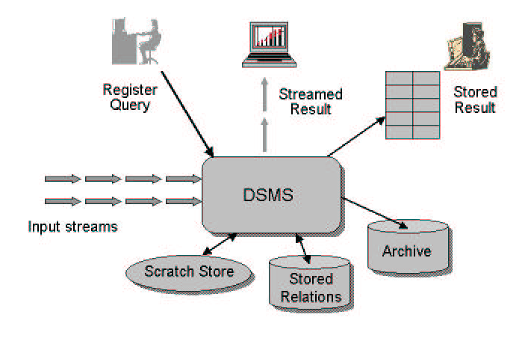
Stream Processing Engine
http://infolab.stanford.edu/stream
Union, Join, Filter, Aggregate…
Notes:
How SPE works? Even though it could store or archive data, the basic operation is to process input streams and output results in stream. Diagram is from Stanford STREAM document.

Slide 4
Stream Operators [Aurora, CIDR 2003]
Filter(p)
Produces output stream consisting of all tuples in its input stream that satify p.
Union
produces an output stream consisting of all tuples on its n input streams
Wsort
Time-bounded windowed sort
Join
And more…
Notes:
More specifically, what kind of operations are

Slide 5
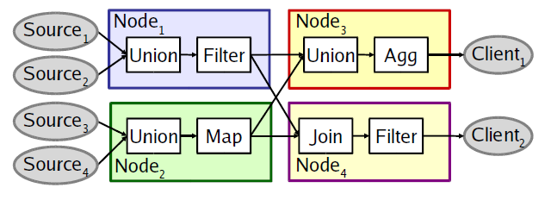
Distributed Stream Processing Engine
Data sources push records continuously
Operators process windows of records
Source: Fault-tolerance in the Borealis Distributed Stream Processing System, ACM TODS Vol 33 Issue 1, March 2008
Notes:
What is a distributed stream processing engine? There are multiple processing nodes, Data sources push tuples continuously, and operators process windows of tuples.

Slide 6
Before Borealis [CIDR 2005]
Aurora [VLDB 2002, CIDR 2003]
Centralized stream processing engine
Aurora* and Medusa [CIDR 2003]
Distributed stream processing engine
Then, why another system?
Fundamental mismatches between real-world requirements and the systems
Let’s see what the new requirements are…
Notes:
State of the art (at the time) and Motivation of the research

Slide 7
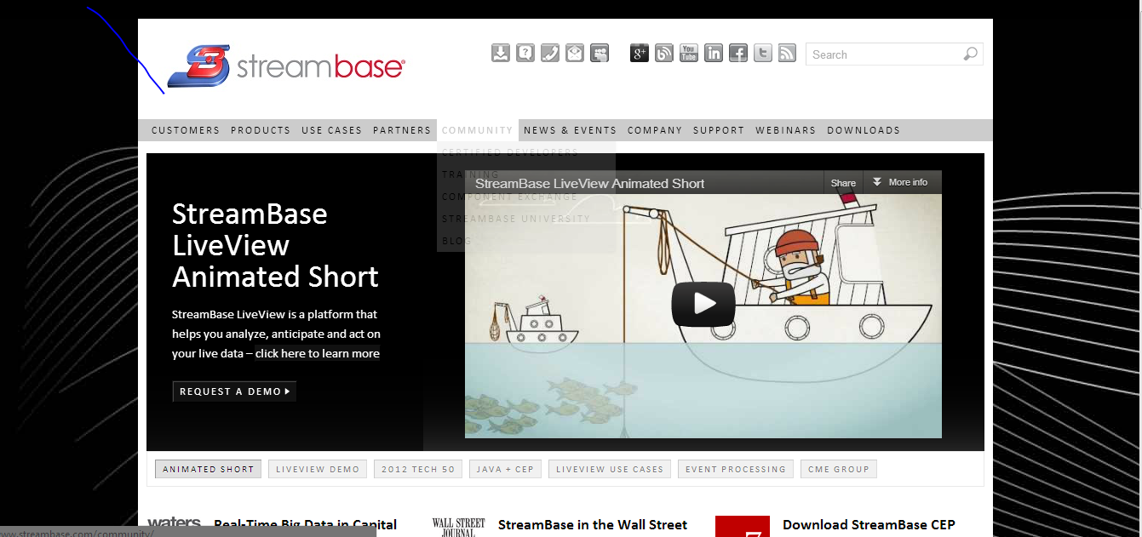
Current Status
Notes:
StreamBase was founded by team members of Aurora and Borealis projects…

Slide 8
Second-generation SPE
Ability to modify various data and query attributes at run time
Dynamic revision of query results
On-line modification of continuous queries
Distributed, heterogeneous environment
Scalable, distributed resource allocation and optimization
Fault tolerance
Notes:
Requirements of the second-gen SPE and very high level solution idea
Dynamic revision -> revisions to previous tuples should be handled
Query modification -> depending on system load/context, it should be able to modify queries
Distributed -> multiple computer nodes, multiple physical site
Heterogeneous -> not only computing nodes in data center, but also sensor devices

Slide 9
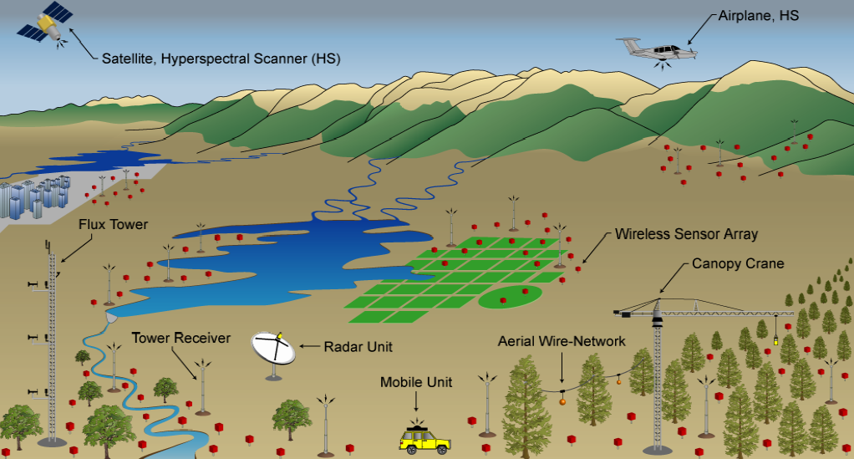
Source: http://www.eecs.harvard.edu/~mdw/course/cs260r
Notes:
An example of a distributed sensing. Each sensor could be a processing unit, too.

Slide 10
Terms
Message: input tuple, delete tuple, revision tuple
Query Diagram
The collection of continuous queries submitted to Borealis can be seen as one giant network of operators (aka query diagram)
Site: A Borealis Server, or a sensor network behind a sensor proxy interface
Downstream/Upstream
Region: a group of nodes

Slide 11
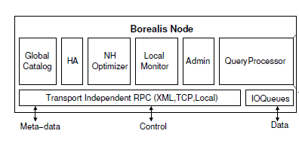
Borealis Architecture
Notes:
This shows a Borealis node. These are the major components in it. But I am not going to talk about every component in this diagram. (Partly because the diagram is just a design… )
The most important component is QP. “Admin” controls QP by setting up locally running queries and move query diagram fragments to and from remote Borealis nodes.
Other than the QP, a Borealis node has modules which communicate with their peers on other Borealis nodes to take collaborative actions.
For example, the Neighborhood (NH) Optimizer uses local load information as well as information from other Neighborhood Optimizers to improve load balance between nodes. A single node can run several optimization algorithms that make load management decisions at different levels of granularity. (Section 5)
Let’s take a look at Query Processor.
/*
HA – High Availability: monitor each other node and take over processing for one another in case of failure
Local Monitor collects performance-related statistics
Global catalog – holds information about the complete query network and the location of all query fragments
*/

Slide 12
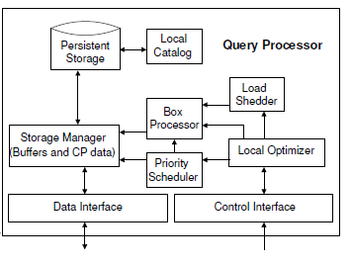
Query Processor
Notes:
QP is where actual query processing takes place.
System control messages issued by the Admin goes to the Local Optimizer. Then, local Optimizer communicates with major run-time components of the QP to give performance improving directions.
A QP has,
Priority scheduler: determines the order of box execution based on tuple priorities (each message
Box Processor: one for each different type of box, that can change behaviors on the fly based on control messages from Local Optimizer
Load shedder: which discards low-priority tuples when the node is overloaded

Slide 13
Data Model
Extended Aurora data model
Aurora model: Append-only sequences of tuples
A tuple: (k₁, … k_{n}, a₁, … a_{m})
Insertion (+, t)
Deletion (-, t)
Replacement (⬅, t)
Each message may carry QoS-related fields
Notes:
Borealis data model is extended from Aurora, but support deletion, replacement.
As in Aurora, each tuple may carry QoS fields. QoS model will be discussed a few slides later.

Slide 14
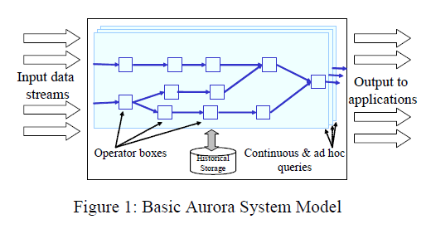
Aurora Query Model
Source: Scalable Distributed Stream Processing, CIDR 2003
Notes:
Similar to Dryad and M-R. Query model is based on boxes and arrows similar to Aurora. Boxes represent query operators and arrows represent data flow.

Slide 15
Query Model
Boxes and Arrows (from Aurora)
Connection Points (CPs)
Each operator processes revision messages based on its available message history and emits other revision messages
CPs buffer stream messages that compose the message history
Change Box semantics using Control Lines
Notes:
Query model is based on boxes and arrows similar to Aurora. Boxes represent query operators and arrows represent data flow. Queries support revision messages, so each operator processes revision messages based on its available message history, and emits other revision messages as output.
Connection points buffer stream messages that compose the message history.
It is able to change box semantics on the fly using control lines.

Slide 16
Quality of Service Model
A QoS model forms the basis of resource management decisions in Borealis
Messages are supplied with a Vector of Metrics (VM)
Content-related properties
e.g., message importance
Performance-related properties
e.g., message arrival time, total resource consumed for processing, …
The attributes of the VM are predefined and identical on all streams
Score function
VM ➔ a value in [0, 1], current predicted impact of a message on QoS
Notes:
In Borealis, resource management decisions are based on QoS model.
there is a universal, parameterizable ScoreFunction for an instantiation of the Borealis System that
takes in VM and returns a value in [0, 1], that shows the current predicted impact of a message on QoS.

Slide 17
Dynamic Revision of Query Results
Revision messages arise:
The input contains them – the previous input has an error
The system has shed load (by dropping messages), but the system buffered the dropped messages
Time travel into the past or future (details later)

Slide 18
Revisions and Replayability
Revision processing ➔ must replay the past
Query diagram must be “replayable”
Revision processing
Replay from the point of the revision? Wasteful.
Process and generate “deltas”
Notes:
Processing of a revision message must replay a portion of the past with a new or modiﬁed value. Therefore, a query diagram must be replay-able. However, processing revisions by replaying from the point of revision is unnecessary and wasteful because in many cases, revisions on the input affect only a limited subset of output tuples. So Borealis processes and generates “deltas” showing only the effects of revisions.

Slide 19
Revision Processing Scheme
Basic idea
Replaying the diagram with previously processed inputs (the diagram history)
But using the revised values of the message in place of the original values
To minimize the number of output tuples generated, the box would replay the original diagram history as well as the revised diagram history, and
emit revision messages that specify the differences between the outputs that result

Slide 20
Processing Revision
Filter(p)
$$(←, t^{′}=\left(k, v^{′}\right))$$
CP
Diagram history
$$(+, t=\left(k, v\right))$$
Notes:
CP is per-input structure. Will be described more later.

Slide 21
Processing Revision
Filter(p)
$$(←, t^{′}=\left(k, v^{′}\right))$$
CP
$$(←, t^{′}=\left(k, v^{′}\right))$$
$$if p\left(t\right)=p\left(t^{′}\right)= true$$
Diagram history
$$(+, t=\left(k, v\right))$$

Slide 22
Processing Revision
Filter(p)
$$(←, t^{′}=\left(k, v^{′}\right))$$
CP
$$(−, t=\left(k, v\right))$$
$if p\left(t\right)=true and$ $p\left(t^{′}\right)=false$
Diagram history
$$(+, t=\left(k, v\right))$$

Slide 23
Processing Revision
Filter(p)
$$(←, t^{′}=\left(k, v^{′}\right))$$
CP
$$(+, t′=\left(k, v′\right))$$
$if p\left(t\right)=false and$ $p\left(t^{′}\right)=true$
Diagram history
$$(+, t=\left(k, v\right))$$

Slide 24
Dynamic Modification of Queries

Slide 25
Basic Model
Operator
Input
Output
Control
e.g., if the operator is a filter, control message can contain a new predicate function
Notes:
Control lines carry messages with revised box parameters and new box functions. For example, a control message to a Filter box may contain a reference to a boolean-valued function to replace its predicate.

Slide 26
Control-Line Example Use
Map
A selection of parameterizable functions applicable to operators
bind new parameters to free variables
within a function deﬁnition
Convert input ➔ importance $1≤i ≤5$
Handle: 10: F(x) = rand % 6 > x
Handle: 11: G(x) = rand % 6 > 0
Bind
(10)
(11)
Function Storage Base
Filter
Notes:
Function storage base has a selection of parameterizable functions applicable to operators.
Example. To illustrate the use of control lines and the Bind operator, consider the example in Figure 2, which will automatically decrease the selectivity of a Filter box if it begins to process important data. Assume that the Map operator is used to convert input messages into an importance value ranging from 1 to 5. The Bind box subtracts the importance value from 5 and binds this value to x in function 10. This creates a new function (with handle 11), which is then sent to the Filter box. This type of automatic selectivity adjusting is useful in applications with expensive operators or systems near overload, where processing unimportant data can be costly.

Slide 27
Time Travel
Application Requirement
Rewind history and then repeat, or
Move forward into the future (simulation)
Implemented using Connection Point (CP) Views
CP: stores message history from a specified arc
Independent views of a CP
View range
specifies the data from the CP to which each CP view has access
Defined by start_time and max_time
Moves as new data arrives to the CP or fixed
Past: generates deletion messages
Future: generates predicted messages

Slide 28
CP Views
Operator2
Operator1
Operator3
CPView12
Start_time
max_time
CPView13
Start_time
max_time

Slide 29
Time Travel
view range
specifies the data from the CP to which each CP view has access
Defined by start_time and max_time
Moves as new data arrives to the CP or fixed
Operations on CP views
Replay: replays a specified set of messages within view’s range
Undo: produces deletion messages for a specified set of messages

Slide 30
Borealis Optimizer
Purpose
Optimize processing across a combined sensor and server network
QoS-based
Scalability
Large volumes of data by multiple distributed data sources
Multi-resource, Multi-metric optimization challenge!!!

Slide 31
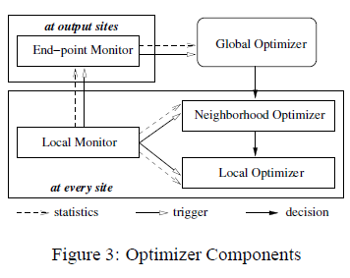
Optimizer Overview
Notes:
Borealis optimization consists of multiple collaborating monitoring and optimization components.
Monitors: There are two types of monitors. First, a local monitor (LM) runs at each site and produces a collection of local statistics, which it forwards periodically to the end-point monitor (EM). LM maintains various box- and site-level statistics regarding utilization and queuing delays for various resources including CPU, disk, bandwidth, and power (only relevant to sensor proxies). Second, an endpoint monitor (EM) runs at every site that produces Borealis outputs. EM evaluates QoS for every output message and keeps statistics on QoS for all outputs for the site.
Optimizers. There are three levels of collaborating optimizers. At the lowest level, a local optimizer runs at every site and is responsible for scheduling messages to be processed as well as deciding where in the locally running diagram to shed load, if required. A neighborhood optimizer
also runs at every site and is primarily responsible for load balancing the resources at a site with those of its immediate neighbors. At the highest level, a global optimizer is responsible for accepting information from the end-point monitors and making global optimization decisions.
Control Flow. Monitoring components run continuously and trigger optimizer(s) when they detect problems (e.g., resource overload) or optimization opportunities (e.g., neighbor with signiﬁcantly lower load). But an optimizer each level tries to handle problems itself.
The local monitor triggers the local optimizer or neighborhood optimizer while the end-point monitors trigger the global optimizer. Each optimizer tries to resolve the situation itself. If it can not achieve this within a pre-deﬁned time period, monitors trigger the optimizer at the higher level. This approach strives to handle problems locally when possible because in general, local decisions are cheaper to make and realize, and are less disruptive. Another implication is that transient problems are dealt with locally, whereas more persistent problems potentially require global intervention.

Slide 32
Optimization
Initial Diagram Distribution
Dynamic Optimization
Local Optimization
Neighborhood Optimization
Global Optimization

Slide 33
Initial Diagram Distribution (1/2)
Performed by the Global Optimizer
Goal
To produce a “feasible” allocation of boxes and tables to sites using preliminary statistics
Placement of read and write boxes with the Borealis tables they access
Cost
A combination of per-site I/O costs and networked access costs
Latency and throughput of reads and writes to tables

Slide 34
Initial Diagram Distribution (2/2)
Two phase strategy
1) Identifies a set of “candidate” groups of boxes and tables that should be co-located
2) appropriately assign the remaining boxes

Slide 35
Dynamic Optimization
Local Optimization
Applies various local techniques when the local monitor triggers problems
e.g., overload ➔ initiate load shedding
Scheduling Boxes
Evaluate the predicted QoS score function on each msg
Compute the average QoS gradient for each box
Schedule the box with the highest QoS gradient
Priority scheduling
Process important messages first

Slide 36
Dynamic Optimization
Neighborhood Optimization
Balance resource usage and optimize resource utilization between local and neighboring sites
Select the best boxes to move
Improve resource utilization most with minimum load migration overhead
Based on network bandwidth and latency

Slide 37
Dynamic Optimization
Global optimization: react to messages from EM
Lifetime problem
Move operators between sensors and servers
Coverage problem
Dropped tuples due to wireless tx
Move high inter-node communication nodes out of the sensor network
Throughput problem
Locate the bottleneck by searching backward from output
Load migration
Latency problem

Slide 38
Fault Tolerance
Replication
Running multiple copies of the same query network on distinct processing node
Give the user explicit control
Consistency vs. Availability

Slide 39
Conclusion
Next-gen SPE challenges and solution design discussed
Dynamic result and query modification
Scalable, QoS-based resource allocation and optimization
Fault tolerance

Slide 40
Thank You!

