Slide 1
First Semester course advisement
CSE 199: Internet, Computing, and Society

Slide 2
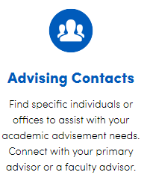
Who is My Advisor?
School of Engineering and Applied Sciences
Office of Undergraduate Education
716-645-2775/410 Bonner Hall/ubengineer@buffalo.edu

Slide 3
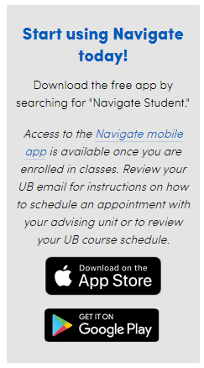
How Do I Meet With My Academic Advisor?
Schedule an appointment on Navigate, or by calling 716-645-2775
Meet with an Honors advisor (Honors College students only)
What can Navigate do for you?
Make an appointment. Instantly schedule a meeting with an academic advisor or tutor.
Set alerts and reminders. Stay on top of your to-do list and important deadlines.
Locate campus resources. Connect to resources and support throughout campus.
Sync your class schedule with your phone calendar. See your whole schedule in one calendar view.
Find Study Buddies. Start or join a study group with other students from your classes.
Explore majors. Discover best-fit majors and career information.

Slide 4
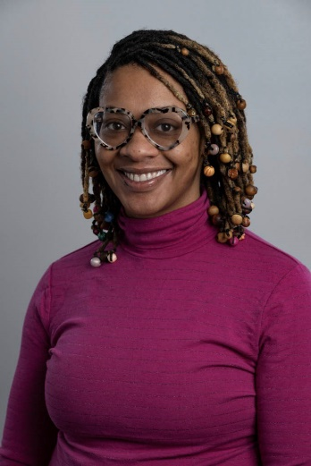
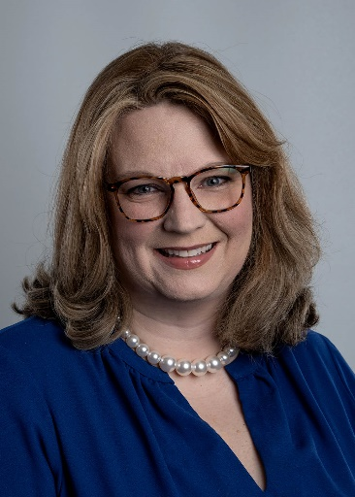
SEAS Student Success Coaching
What does a SEAS Student Success Coach do?
Serves as a first point of contact and referral specialist to campus and community resources.
Setting goals for the semester and forming a plan to achieve them.
Navigating UB’s many services such as tutoring, wellness coaching, etc.
Getting organized.
Preparing for appointments with academic advisors, faculty or tutors.
Identifying your strengths and improving your self-advocacy skills.
Transitioning/adapting to college and the UB student experience.
Amari Yarber
Student Success Coach
Jennifer Paterson
Student Success Coach
To see if you have been assigned a coach, please check the SEAS portal, HUB or Navigate to see your assignment and to schedule an appointment.
If you do not have an assigned student success coach, and you are interested in joining the program, please visit with your assigned academic advisor for more information.

Slide 5
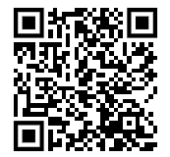
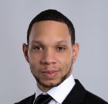
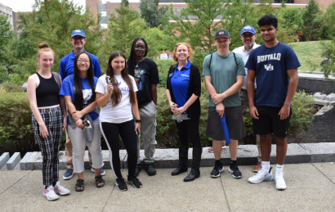
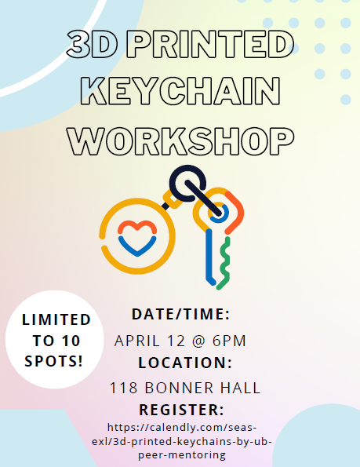
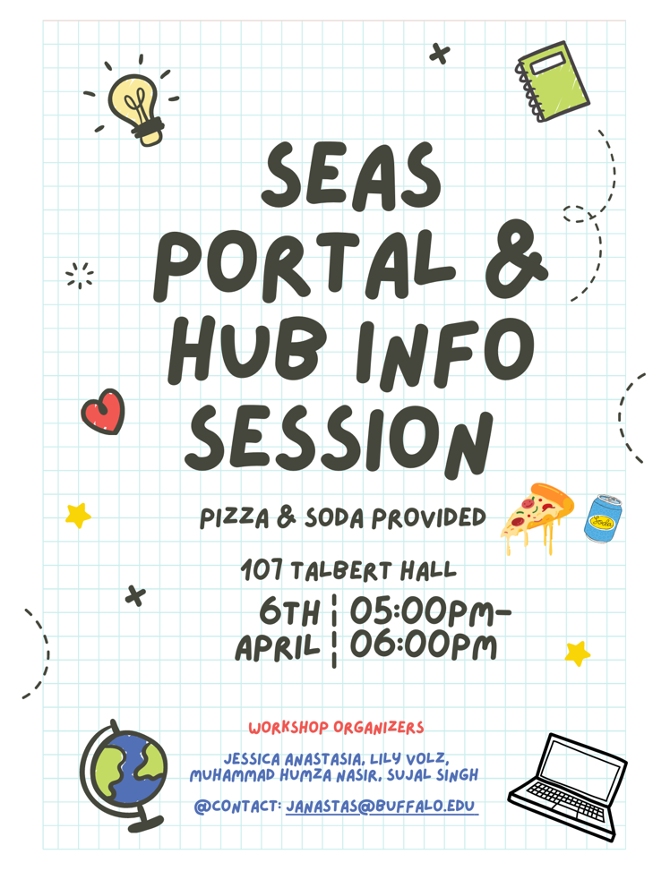
UBThrive STEM Success Peer Mentoring
Use this code to sign up for a mentor!
What does a Peer Mentor do?
Provide academic adjustment and social-emotional support
Connect students to valuable campus resources
Develop peer-to-per relationships based on shared experiences
Help first-year students navigate the campus, develop connections, and form a sense of community in SEAS and STEM
Improve support and success for historically marginalized students in STEM
Create workshops, information sessions, and social events for first year students…..
Troy Williams,
Coordinator of Student Support and Peer Mentoring
troywill@buffalo.edu
UBThrive Peer Mentors at Welcome Weekend 2022
To see if you have been assigned a mentor, check your Success Team in Navigate.
If you do not have a mentor and want to sign up, go to: https://academics.eng.buffalo.edu/survey/take?survey=MenteeAPP23, or contact Troy, or…use the QR Code!

Slide 6
Where Can I Find Academic Help?
Google is your friend!
Click here…
…to find free academic support!

Slide 7
Fall Semester Reminder: Course Resignation
Deadline: Friday, November 10th @ 11:59 p.m.
Definition: Dropping a class after the last day of drop/add (7th instructional day)
Academic Implications
Off-sequence – see online flowsheets for pre-requisite and co-requisite information
Limited Enrollment Courses (Course Enrollment Control Policy) - MTH 141, CHE 107, ENG 105 – repeating students may not register until first day of open enrollment
Financial Implications
Full time status = 12 credits
Federal Financial Aid
NYS Financial Aid – TAP, STEM, Excelsior Awards
Visa Implications (International Students)
Students are not permitted to resign CSE 199 on their own!
Must obtain permission from an advisor prior to 4:00 pm on Nov. 10th

Slide 8
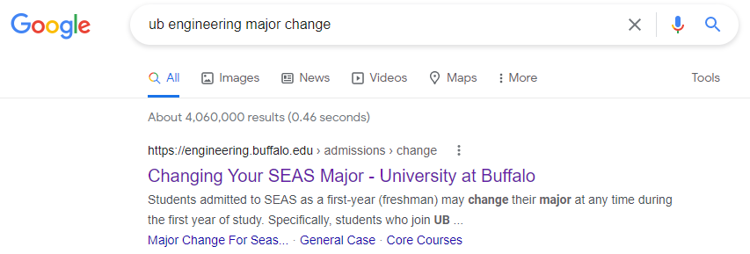
What if I Want to Change My Major?
SEAS students may change their major at any time during the first year of study.
Fall 2023 first year students should request a major change no later than May 31, 2024.
If you wait until your second year (or later…not advised!) then you will need to meet the formal admission criteria:
Core courses for engineering: MTH 141, MTH 142, CHE 107, PHY 107
Core courses for computer science: MTH 141, CSE 115, CSE 116, CSE 191
There are fast track options – see our Major Change Policy for details and minimum GPAs:
https://engineering.buffalo.edu/home/academics/undergrad/admissions/change.html.

Slide 9
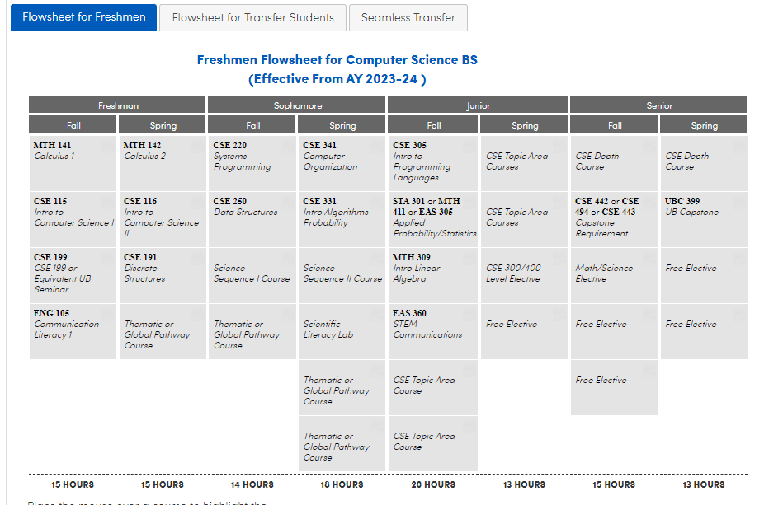
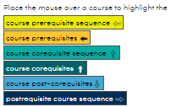
Spring Enrollment: Flowsheet Overview
Online Interactive Flowsheets
Course Sequencing
Link to Catalog Description and Class Schedule
Important Advisement Notes
Flowsheet Directory

Slide 10
What Classes Should I Take in Spring? Computer Engineering
Mathematics:
C or better in MTH 114 or MRA scores of 70
MTH 114, Precalculus
MTH 141 or MTH 136/137, Calculus 1
MTH 142 or MTH 138/139, Calculus 2
MTH 241 Calculus 3, or MTH 306 Differential Equations (both are required)
Physics:
Calc 1 Co-Req
PHY 107, Engineering Physics 1
PHY 108/158, Engineering Physics 2 + Lab
Programming:
Calc 1 Co-Req
CSE 115, Intro to CS 1
CSE 116, Intro to CS 2
CSE 191, Discrete Structures
UB Curriculum (Gen Ed):
ENG 105, Communication Literacy 1
Thematic Pathway 1
Global Pathway 1
UB Curriculum Requirements are not sequential and can be taken in any order.

Slide 11
What Classes Should I Take in Spring? Computer Science
Mathematics:
C or better in MTH 114 or MRA scores of 70
MTH 114, Precalculus
MTH 141 or MTH 136/137, Calculus 1
MTH 142 or MTH 138/139, Calculus 2
Note: Computer Science BA majors can take MTH 121-122, MTH 131-Technical Elective, or MTH 141-142 to satisfy the Calculus Sequence
Programming:
Calc 1 Co-Req
CSE 115, Intro to CS 1
CSE 116, Intro to CS 2
CSE 191, Discrete Structures
UB Curriculum (Gen Ed):
ENG 105, Communication Literacy 1
Pathway
Scientific Literacy 1
Scientific Literacy 2 + Lab
Computer Science BS: chose from BIO 200, CHE 101, CHE 113, CHE 105, CHE 107, CHE 108, CHE 127 & 128 (both required to complete SLI Lab component), GLY 101, GLY 102, GLY 103, GLY 105, PHY 107, PHY 108, PHY 117, PHY 118, PHY 158
Computer Science BA: choose any UB-approved Scientific Literacy sequence
UB Curriculum Requirements are not sequential, can be taken in any order.

Slide 12
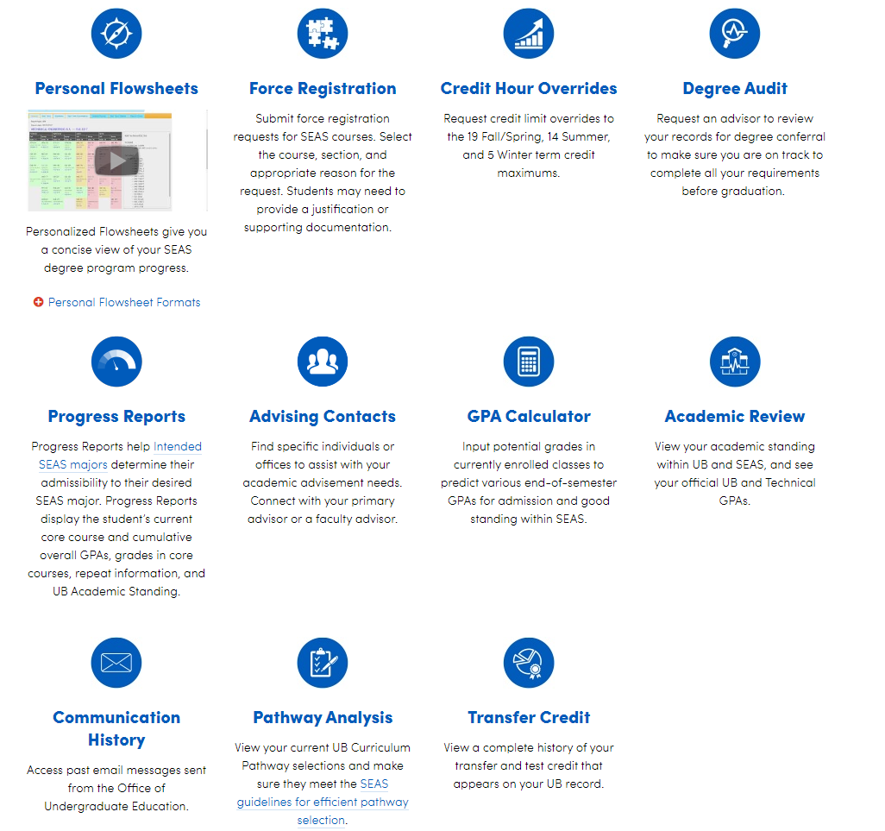
Use the SEAS Academic Portal!
Google “UB SEAS Portal”
-or-
Go to engineering.buffalo.edu and scroll to the bottom to log in!
Watch this video for details!

Slide 13
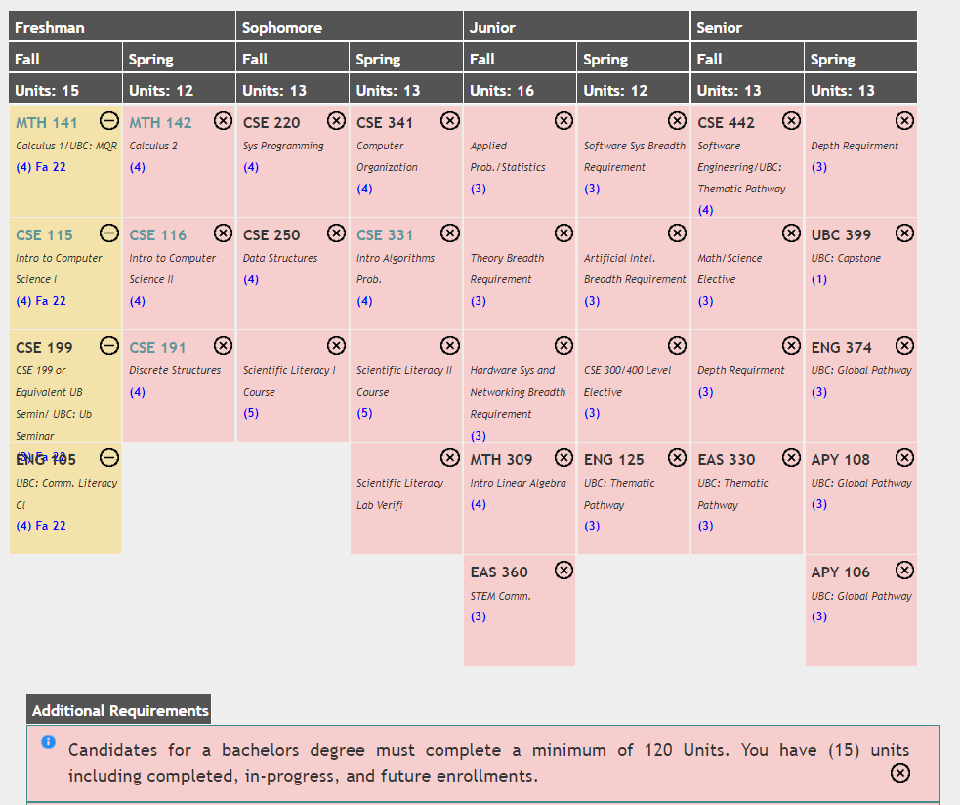
SEAS Personal Flowsheets:
Your Four-Year Plan
Courses you are enrolled in this fall…
And courses you will take in the future!

Slide 14
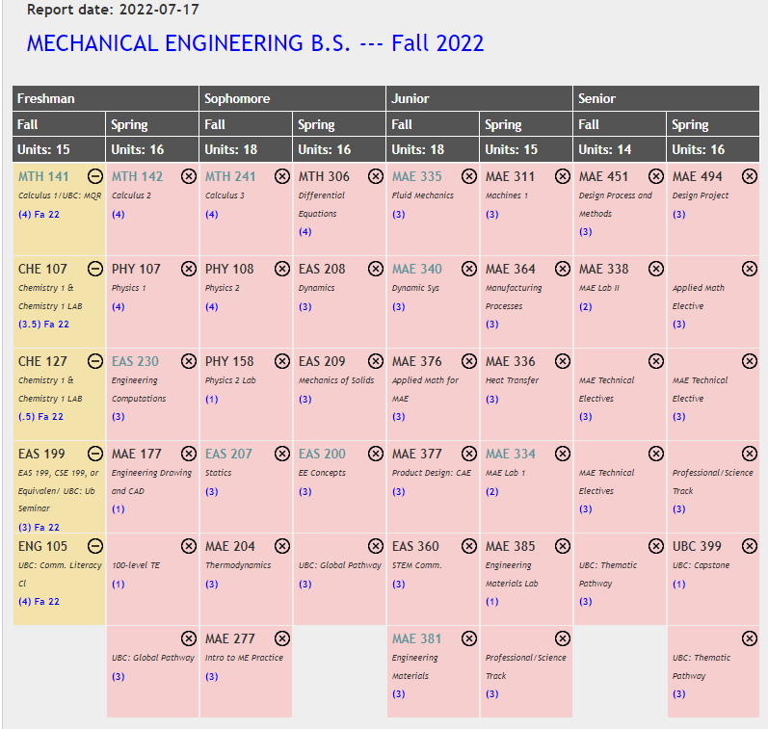
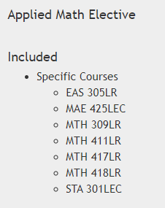
How to Read Your Flowsheet
Report Date tells you when the flowsheet was last updated.
Not sure what courses satisfy requirements? Click the box!
Click on the course abbreviation (ex. “EAS 208”) to see the catalog description and view when it is offered!
When should you take your pathways? Check your flowsheet!

Slide 15
UB Curriculum: Pathway Advisement
Select your Pathways strategically!
Computer Engineering: choose CSE 450 and CSE 453 and the List 3 courses
Computer Science: choose CSE 442 as Thematic List 3 and choose any Global List 3 class without prerequisites
Notes:
Note: UGC 211 (AP US) may be used for diversity but does not count in a pathway.
Note: Pre-req, co-req, major restrictions

Slide 16
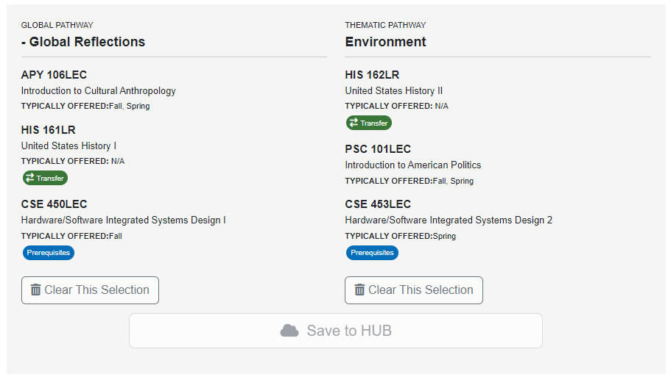
Example: Computer Engineering Major
Include any pathway credit completed in high school!
Make sure course 3 is a major requirement!

Slide 17
You Will Register for Spring Classes!
View tutorial videos on the SEAS Portal Home Page to learn how to register using HUB and Schedule Builder…
Learn how to create your spring schedule, or
…learn how to add, drop/resign, and swap classes via HUB

Slide 18
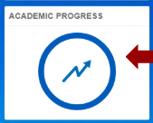
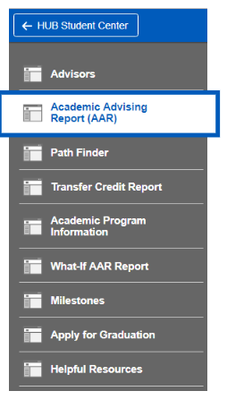
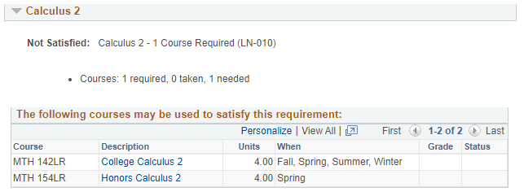
HUB Academic Advisement Report
The HUB Academic Advisement Report (AAR) is an advising tool that tracks progress toward graduation by showing how courses taken meet graduation requirements. The AAR summarizes all General Education and Major requirements, indicating those that have been satisfied; computes cumulative and technical GPAs; totals all credit hours taken; lists repeated courses and grades; notes Incomplete courses; indicates test scores and credits granted for AP and CLEP examinations; and lists all transfer and UB courses taken.
To access your AAR, log on to the HUB Student Center and select the “Academic Progress” tile. Then click on “Academic Advising Report (AAR).
Requirements display as satisfied or not satisfied, with a list of courses that can be used to satisfy the requirement.

Slide 19
Questions?
School of Engineering and Applied Sciences
Office of Undergraduate Education
410 Bonner Hall
716-645-2775
Email: UBEngineer@buffalo.edu for general questions, or your advisor for specific questions!

