Slide 1
Fine-grained minimal overhead value-based core power gating on GPGPU
Christopher Fritz
CSE691, May 2015
cvfritz@buffalo.edu

Slide 2
Agenda
Background – fine-grained power gating
Background – GPGPU
Prior Art
Our fine-grained value-based power gating method
Ispass Benchmarks, GPGPU-Sim, and GPUWattch
Cadence leakage reduction results
Implementation in GPUWattch model
GPGPU savings results
Conclusion and references

Slide 3
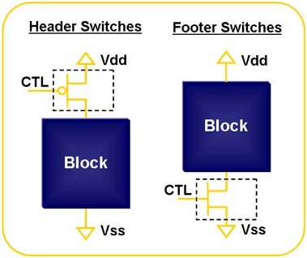
Fine-grained Power Gating
Disable individual components (gates, etc) within a module when not needed
Contrast to coarse grained – disable an entire module, core, etc.^{1,2}
Use virtual VDD or virtual ground to control power supply to module through sleep transistor
Typically either header switches or footer switches used (not both)²

Slide 4
GPGPU
General purpose computing on GPU³
Perform computations typically executed on CPU
Uses massive parallelism of GPU cores
Definitions⁴:
Kernel: GPU is programmed in sequence of sequentially executed kernels
SM: Streaming multiprocessor – executes multiple threads in parallel, contains small cache
Warp: collection of (usually 32) threads which all execute on one SM at the same time
SIMT: Single input, multiple thread programming model – every thread in a warp executes the same instruction at the same time (similar to SIMD)

Slide 5
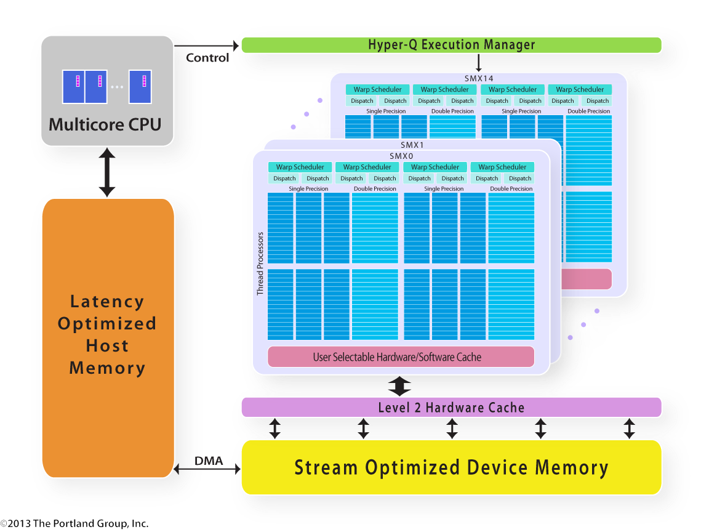
GPGPU Hardware
Each thread processor on each SM has ALU and FPU = lots of opportunities for power gating!

Slide 6
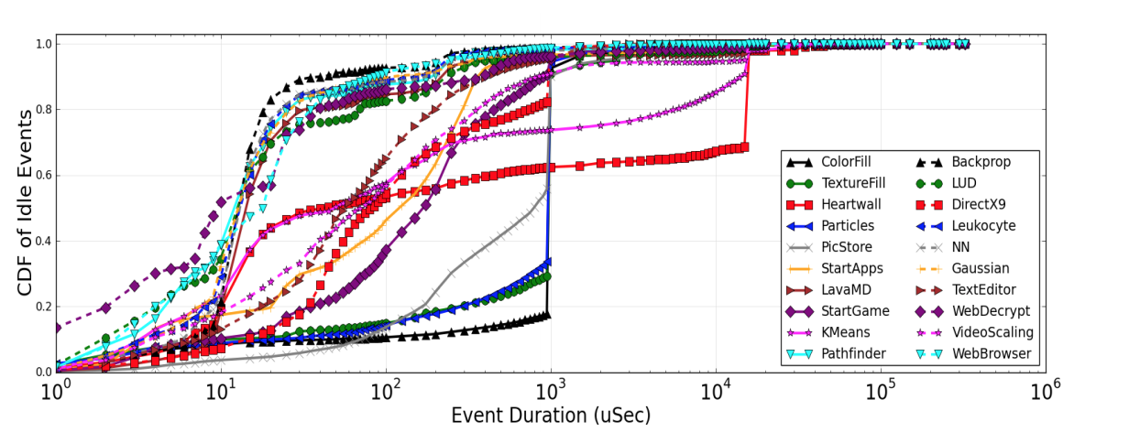
Major current research area
Researchers at AMD research, including M. Arora, M. Schulte, N. Jayasena, I. Paul have published numerous papers and patents in the past 3 years
Most recent work from Feb. 2015, iEEE HPCA Symposium entitled “Understanding idle behavior and power gating mechanisms in the context of modern benchmarks on CPU-GPU integrated systems”¹⁶

Slide 7
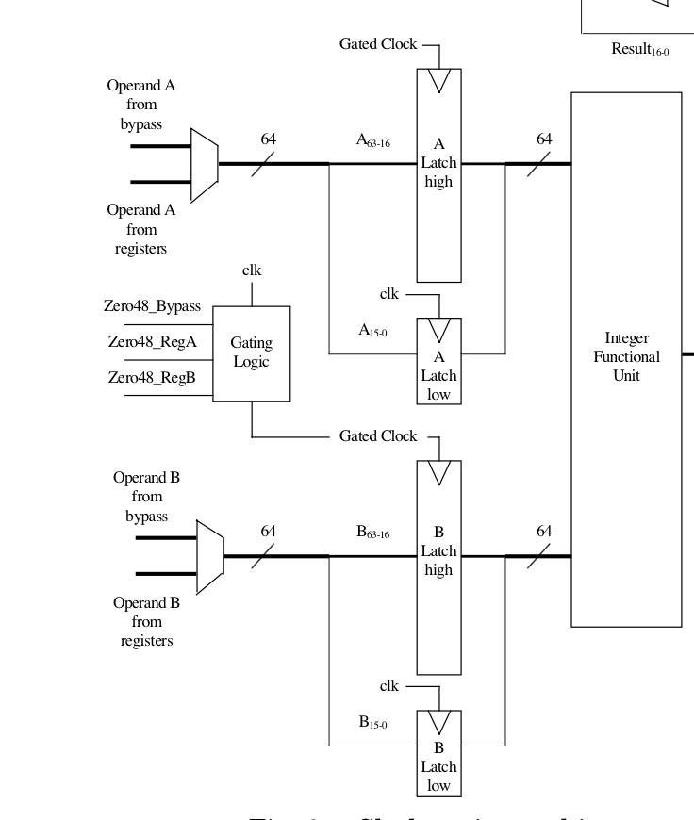
Value-based Clock Gating
Use data inputs to functional units to save power – use different datapaths
Brooks and Martonosi (Princeton, 2001)⁵ mux in zeros to N most significant bits if all N are zero.
Arithmetic circuits will output zeros for those bits anyway
Demonstrated dynamic power reductions of up to 70% when running SPEC benchmark!
Can we use the same principle in power gating instead?

Slide 8
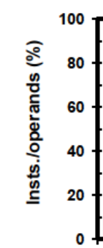
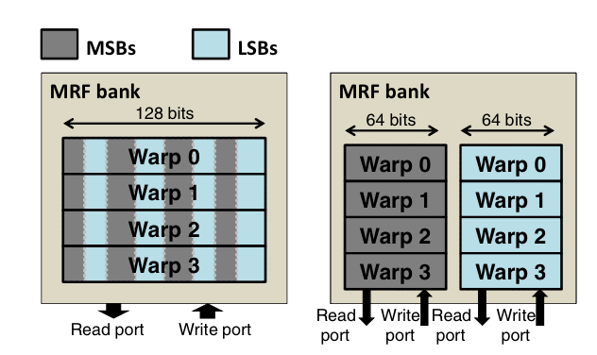
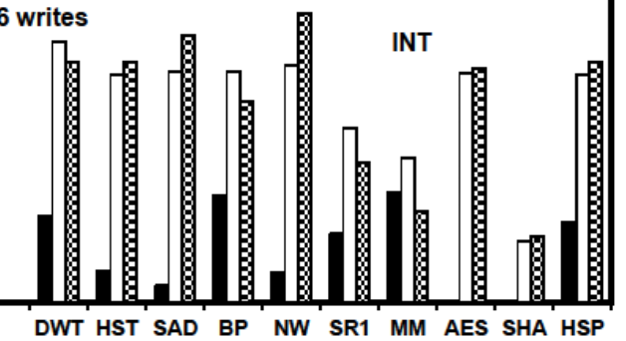
Value-based Power Saving on GPGPU
GPGPU research is of current interest
Shulte (AMD) et al. (2013)⁶ showed that up to 60% of all instructions in GPU benchmarks have operands/results that can be represented by 16 or fewer bits
They then demonstrated using an alternate 16 bit datapath when the upper bits are sign extended bits
Savings in dynamic power of up to 41%

Slide 9
Our method overview
Single arithmetic circuit – rather (or in addition to) bypassing parts of circuit, shut off the entire portion of the circuit.
Challenge: any extra overhead (even a single gate) will quickly cancel the gains
Example: Kogge-Stone adder: if one of the input pairs is zero, the entire section of the circuit corresponding to those inputs can be shut off
GPU has hundreds of ALUs
Significant power saving opportunities.

Slide 10
Determine gating condition with (almost) no overhead
Any CLA adder circuit first uses half-adder to compute the propagate and generate bits
d
We also want to derive - could use this value directly as the power gate control for a footer switch connected to the ground inputs of all of the gates corresponding to bit I
We can get this for “free” – using complementary passtransistor logic and the fact that any XOR gate must produce the complement of at least one input

Slide 11
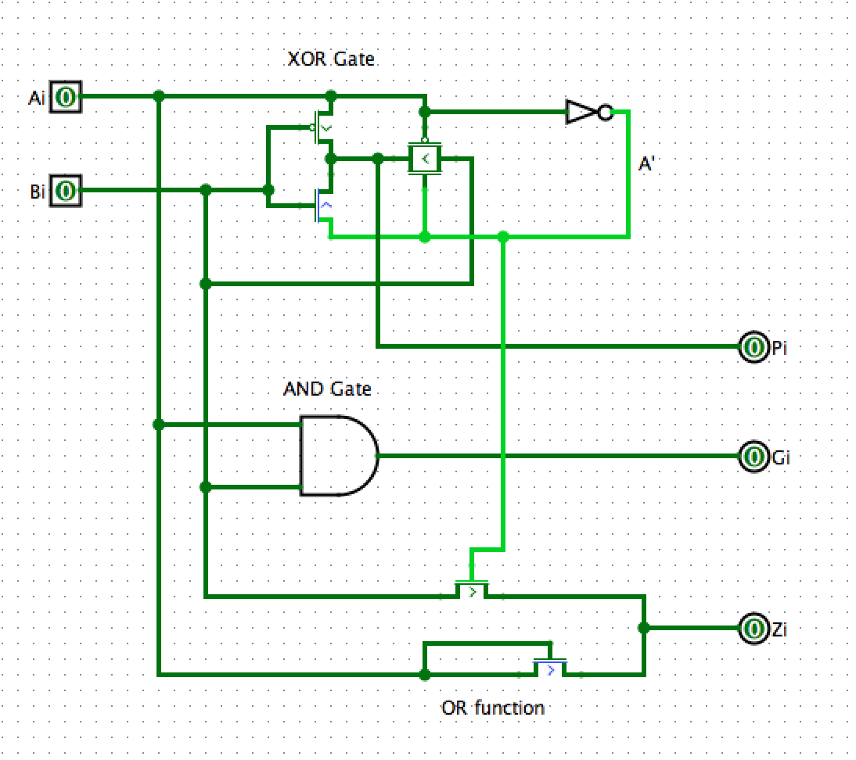
Power gating condition
CPL adds nearly 0 dynamic or leakage power. Output is connected directly to footer switch gate::
Minimal overhead!
Standard half-adder
Simple idea, but this circuit consumes the same power with or without this part! (proved in Cadence)
Additional OR stage

Slide 12
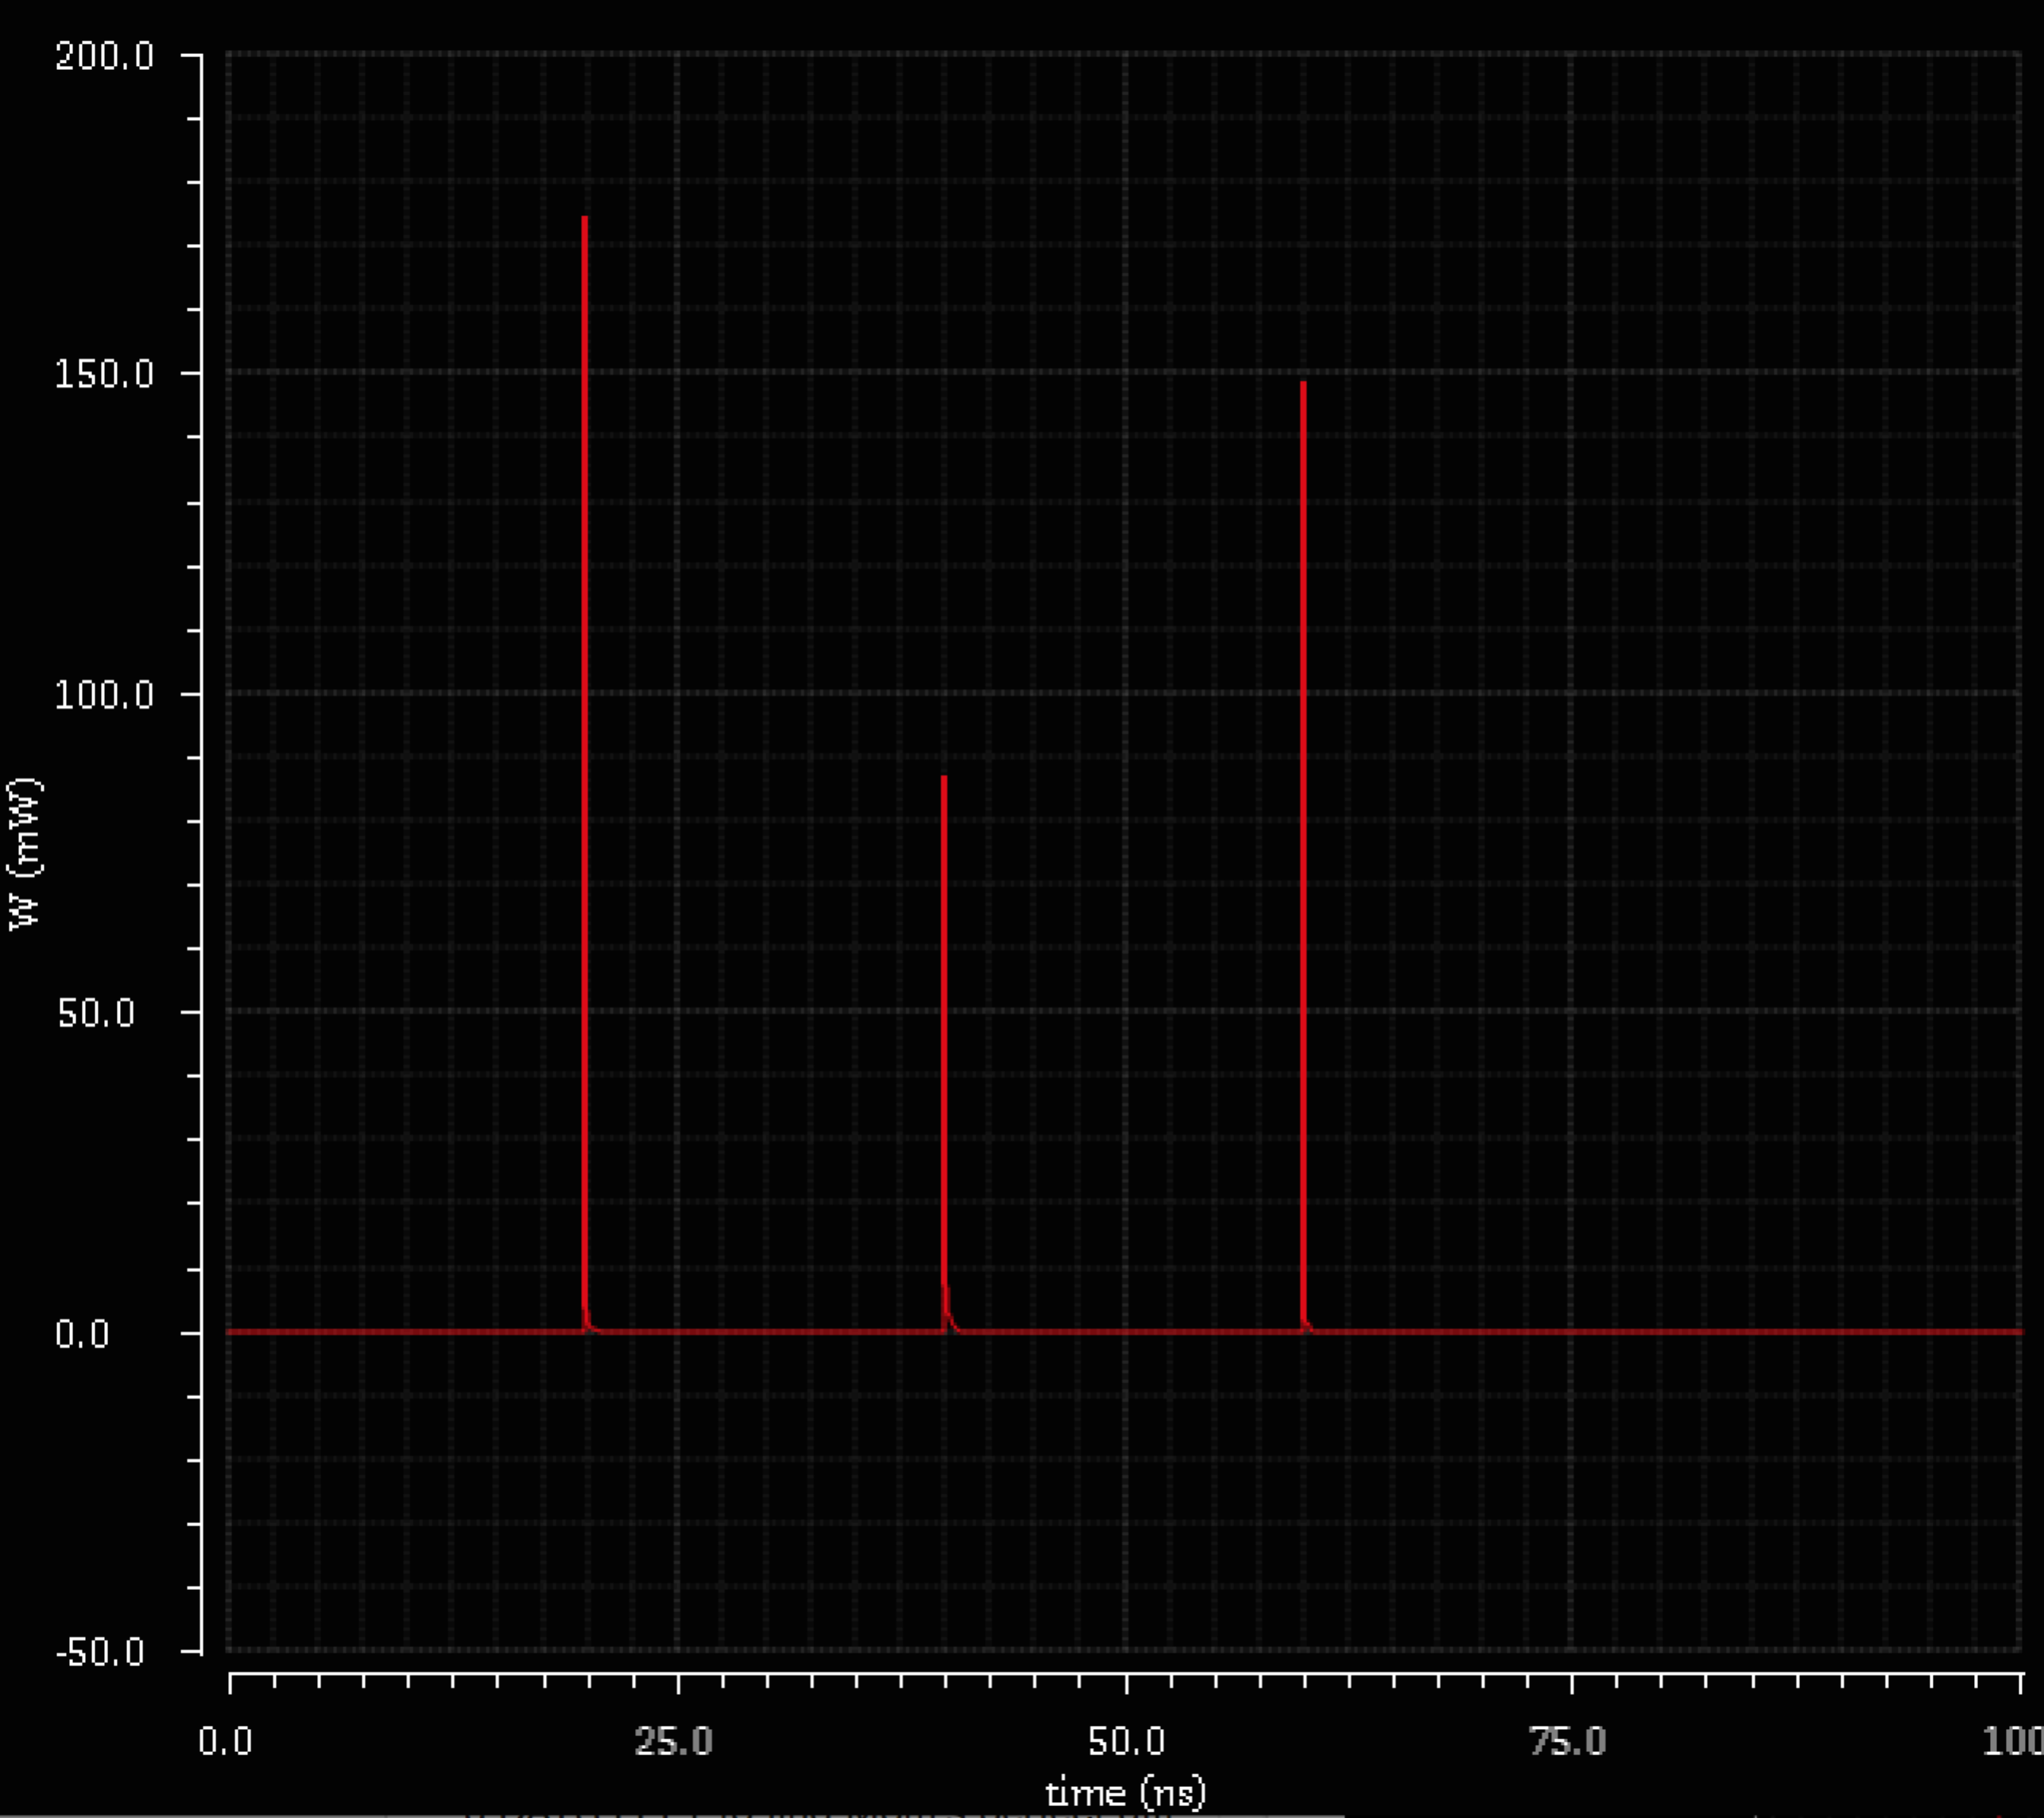
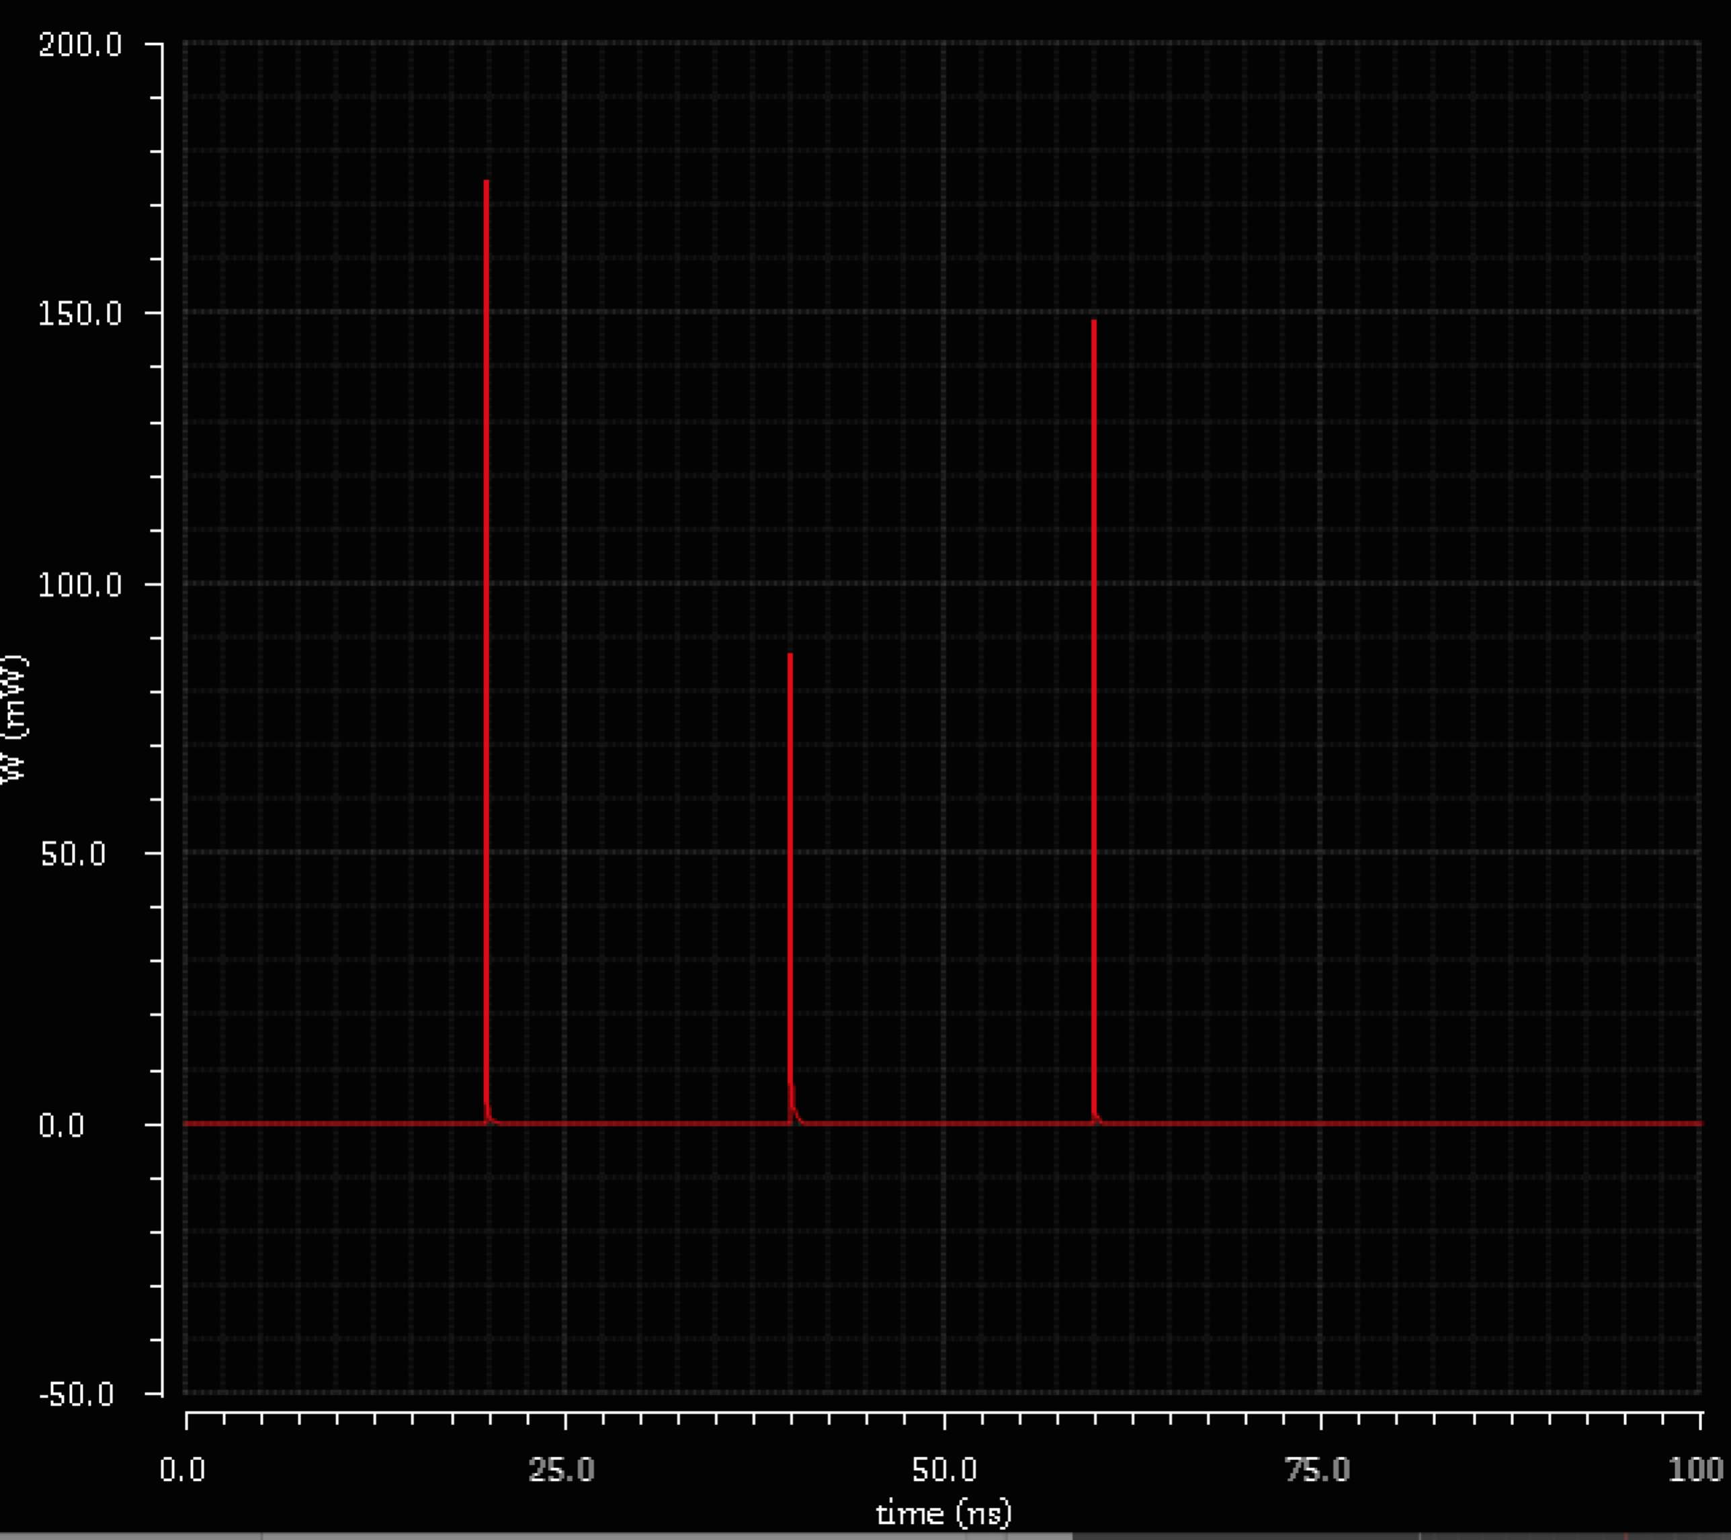
No power overhead
Half adder module consumes 3.655pJ with or without additional stage
Not novel of course, but particularly well suited trick to derive power gating logic with no overhead/need for break even point.

Slide 13
Power gating of adder slices
Slices of adder can be shut off in real-time based if both input operands in corresponding slice are zero.
This means on the order of 15 gates per bit!
But due to in-rush current concerns we will only apply to upper 16 MSB.
LSBs far less likely to be zero for extended periods

Slide 14
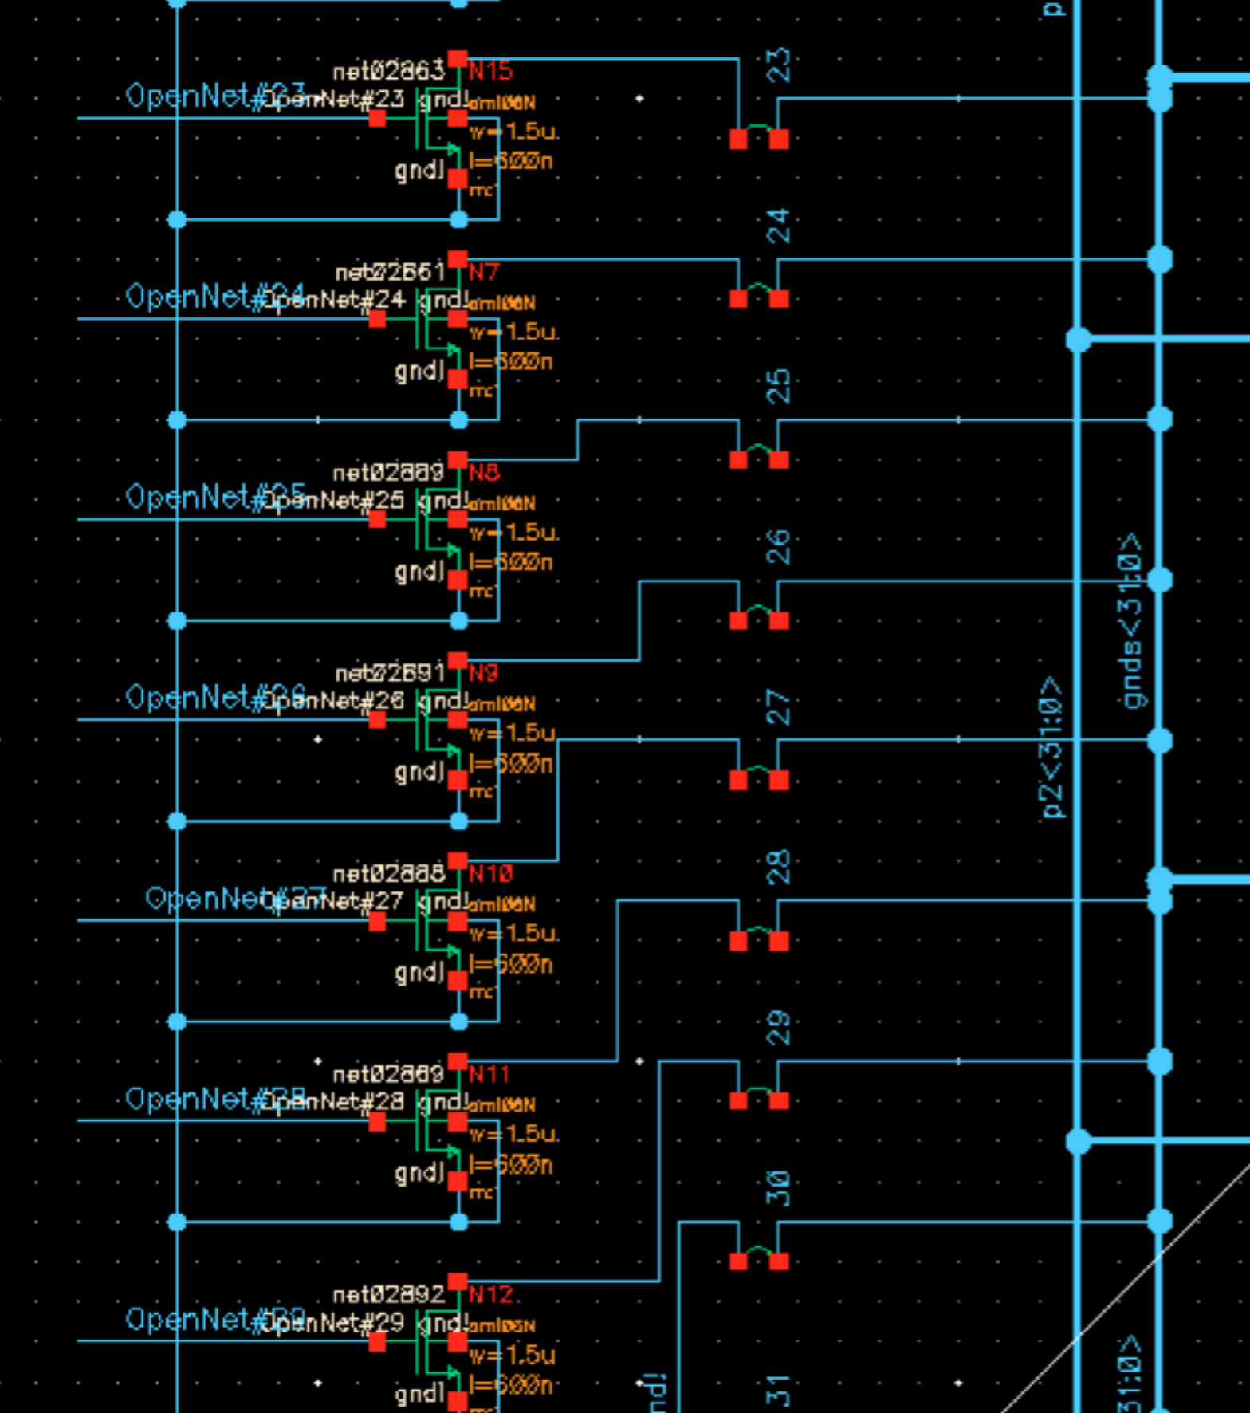
Modified adder topology
Footer switch control signals come from the OR stages added to the P/G computing half-adder modules
Pure gain in leakage power savings when inputs are zero, minimal penalty for wakeup

Slide 15
In-rush current
One large concern with power gating is in-rush current^{7,8}
When a power-gated subcircuit is to be re-enabled, a momentary rush of current flows causing two problems
1 – nonzero delay before circuit can be used, as capacitances charging
2 – ringing of supply rails interfering with other modules⁸
1) If we only apply the power gating method to the upper 16 bits, the propagation delay through the critical path in the lower half of the circuit is longer than the recharging delay!
2) Only problem when many modules become ungated together⁷. Unlikely in this application (ringing never observed in simulation)

Slide 16
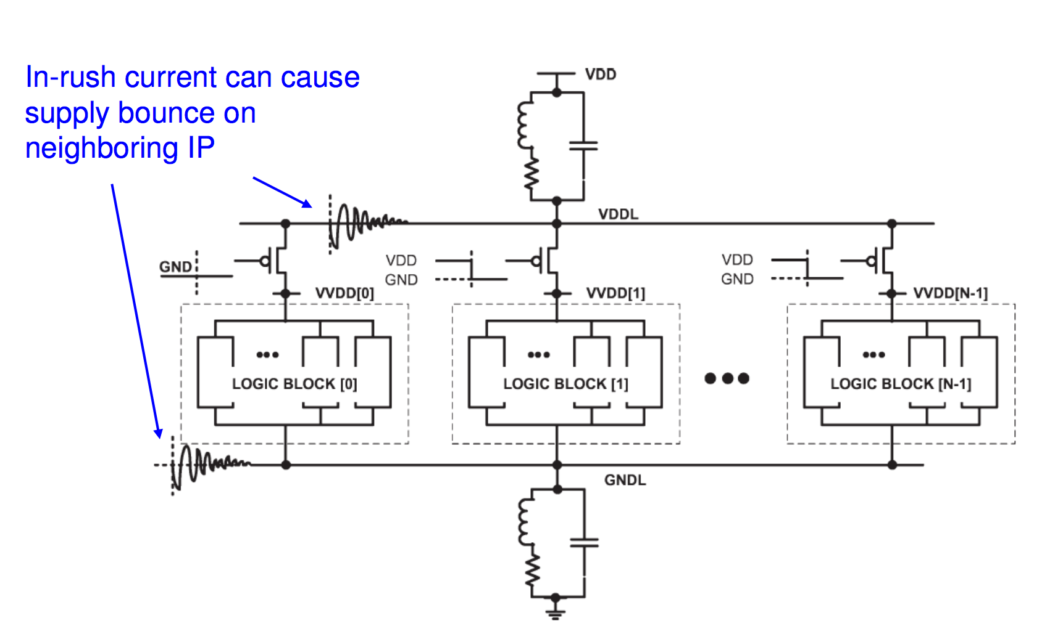
In-rush Current Control
S. Kosonocky (AMD) and many others^{8,9} have demonstrated methods of controlling the in-rush current by staggering the wake-up sequence for different power gated modules

Slide 17
Leakage Power Savings
Simulations run with 32 bit Kogge Stone adder. Power gating performed on upper N MSBs, 1 < N < 17.
Leakage power savings grows almost linearly as we allow power gating on more bits
NOTE: This is assuming all of the input pairs are ZERO for the inputs with power gates applied.
We will derive the actual fair reduction based on how likely it is for these input pairs to be zero

Slide 18
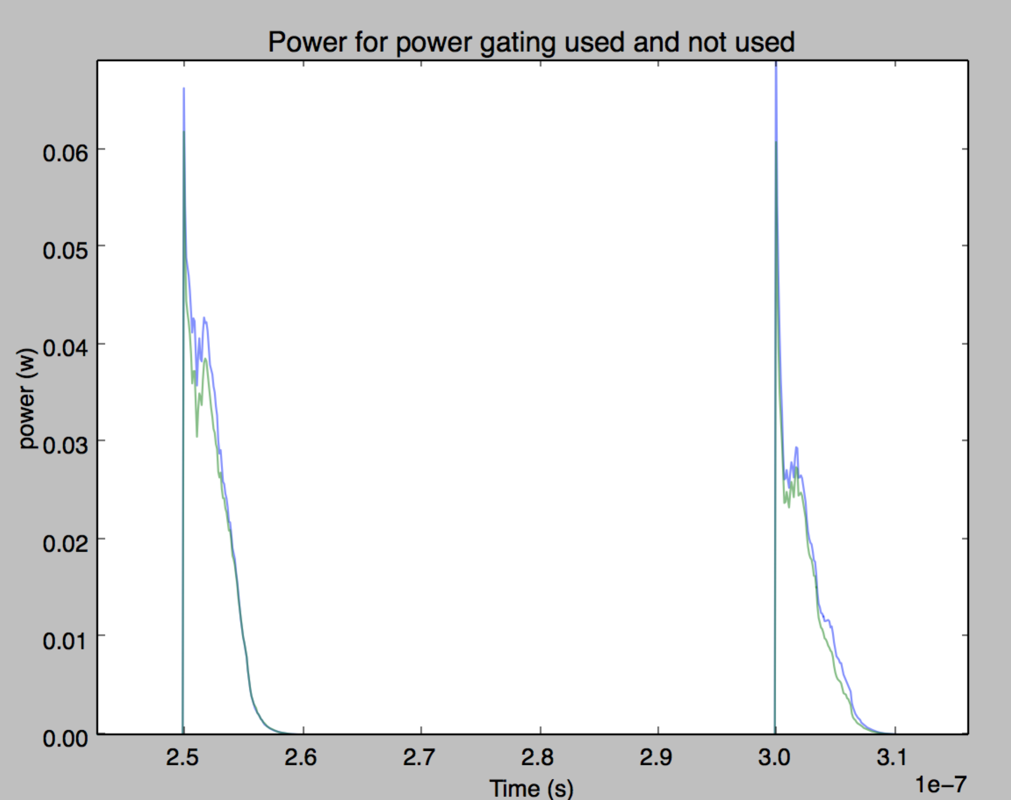
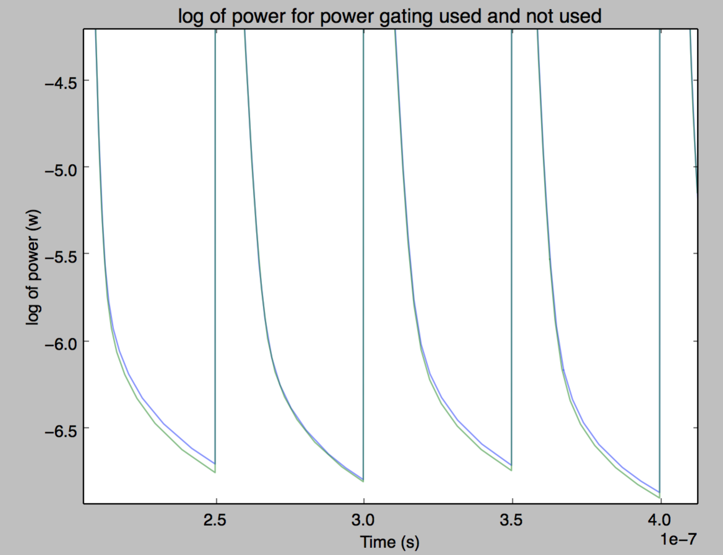
Leakage power savings – 8 MSB
With 8 MSBs having all zero inputs, leakage power savings are approximately 25%

Slide 19
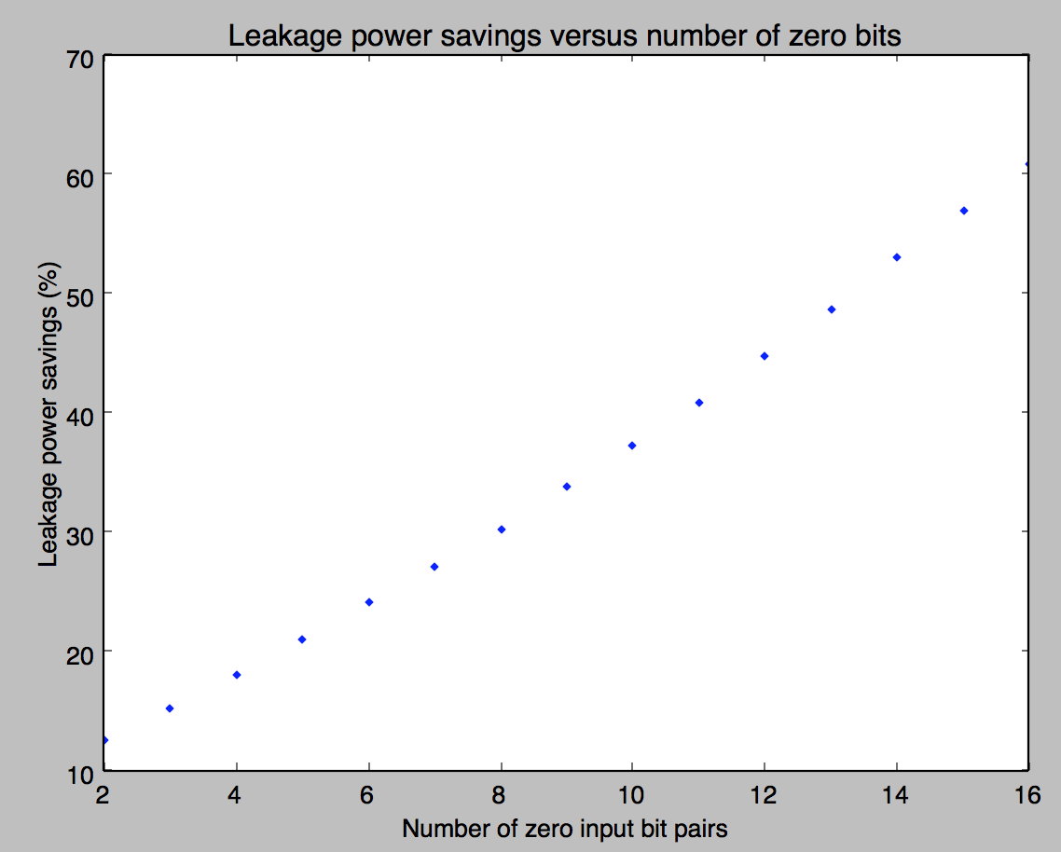
Leakage power savings
Since more logic is concentrated under higher bits, it makes sense that we save > 50% of leakage power when 16 bits are power gated

Slide 20
Savings on GPGPU
First, define the savings as a function of number of bits that can be power gated as L_{i}
Next, we need to know realistically how often we can fully represent the operands and results with fewer than or equal to i bits
We can get a clue from Schulte’s work⁶ – on average over the benchmarks, 64% of the time, 16 bits is enough to represent the inputs/outputs
Let’s assume that the probability (call it z_{i}) we can use i bits, 16 < i < 32, grows linearly to 100%

Slide 21
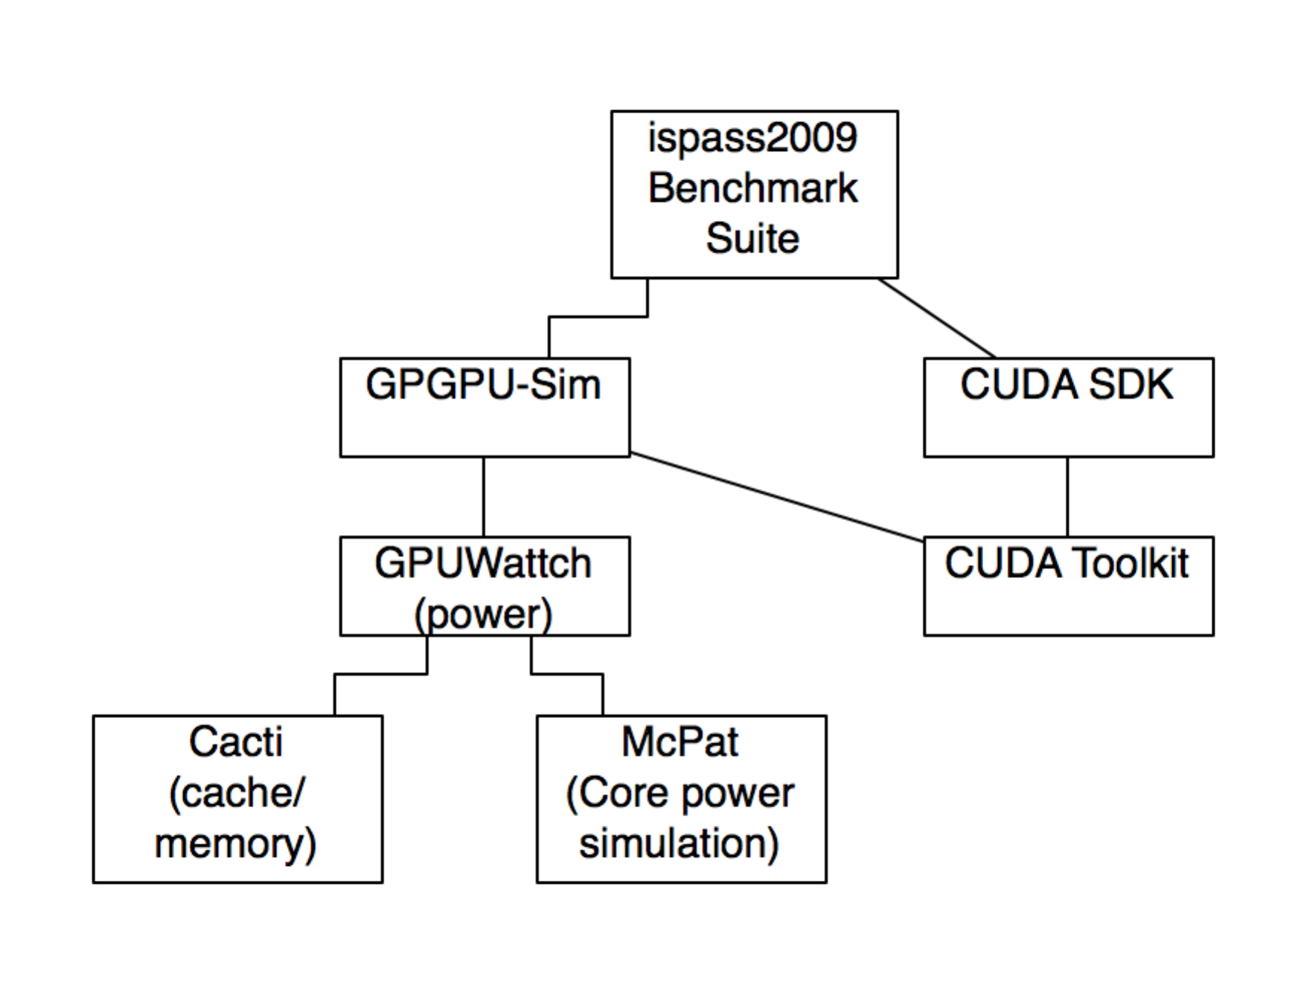
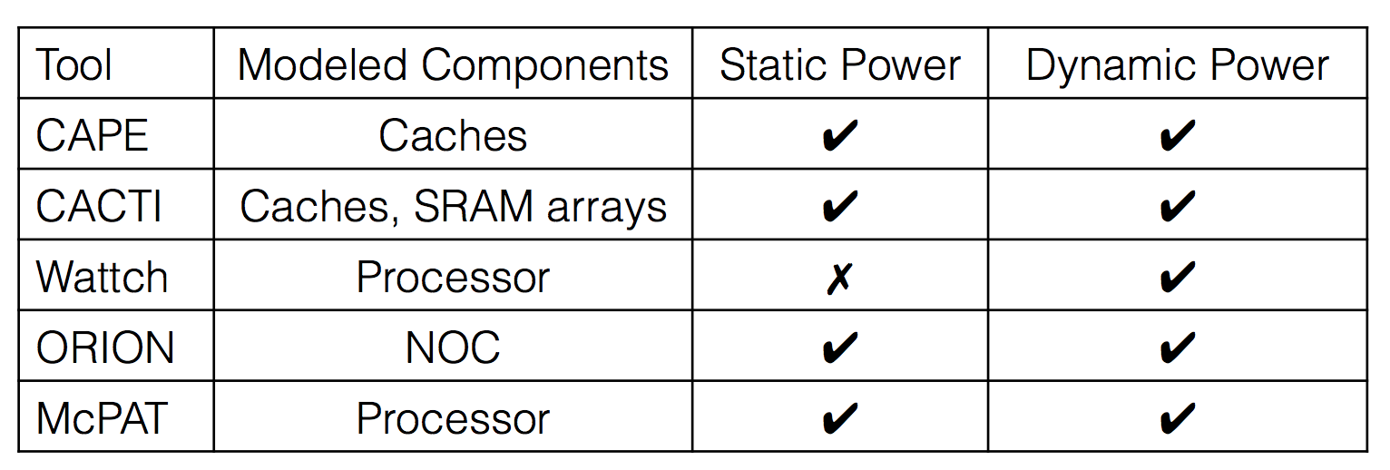
GPGPU-Sim¹⁰ and GPUWattch¹¹
Very commonly used and powerful GPU simulator for GP applications, and corresponding power simulator
Verified independently with real hardware testing¹¹
Each cycle:
GPGPU-Sim determines which units are accessed and how many times
GPUWattch provides per-access energy for each unit¹²
Small model modification here

Slide 22
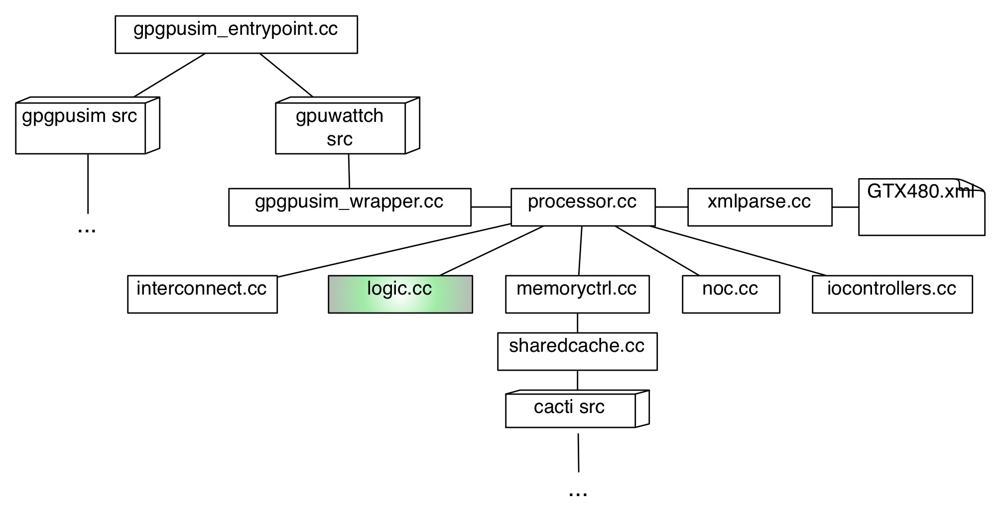
GPGPU-Sim + GPUWattch Software

Slide 23
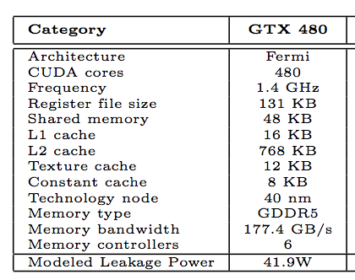
Modification of GPUWattch
Prior art:
Schulte modified GPUWattch for multiple datapath simulations⁶
Y. Wang (Univ. of South Florida, 2014 dissertation)¹³ used a very similar idea to ours but for cache leakage power reduction, also by modifying GPUWattch
Simulations run on GeForce GTX 480
Nominal leakage power modeled as 41W¹¹

Slide 24
Modification of GPUWattch
Simulations show core power consumption as ~57% of total leakage power (the rest is cache, control logic, etc.)
55% of that is consumed by arithmetic components
As a result, we model that we can save ~18% of the total leakage power, using that on average 56% of the ALU leakage power will be saved.
NOTE: We are assuming we achieve approximately the same savings using FPU, MUL units as adder
Seems fair, but needs simulating!

Slide 25
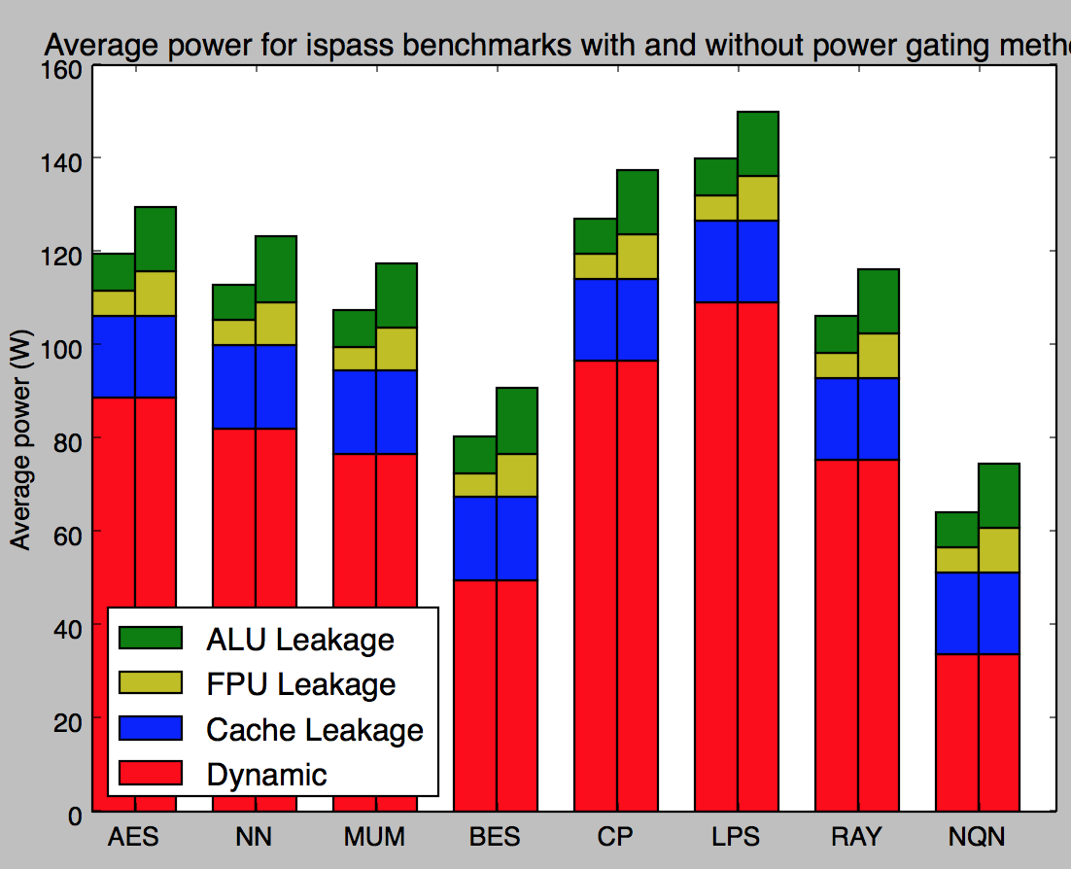
GPGPU Results
Our method
Base usage

Slide 26
Comments
Can gain higher savings by investigating use on FPU as well
Can use alongside Yang’s method for Cache power reduction for combined savings
Can use internal to Schulte’s separated datapaths for static and dynamic power savings
Essentially “free” power saving (other than the few CPL, footer transistors) – no delay penalty

Slide 27
Method | Authors | Platform | Type of power | Advertised savings
Clock gating portions of ALU | Brooks, Martonosi (2000)⁵ | CPU | Dynamic | 45-60%
Multiple datapaths based on zero inputs | Schulte, Kim, Gilani (2013)⁶ | GPGPU | Dynamic | 25%
Coarse-grained tournament prediction core power gating | Arora, Jayasena, Schulte, AMD (2015)¹⁵ | CPU | Static
Coarse-grained power gating on INT/FP units with gating aware scheduling | Abdel-Majeed, Wong, Annavaram (2013)¹⁴ | GPGPU | Static | 31%*
Value based individual cache array shutdown | Wang (2014)¹³ | GPGPU Cache | Static | 51%
Our Method |  | GPGPU | Static | 44%**
*Integer unit static power savings, average
**Integer unit static power savings, average, assumptions as on slide 17

Slide 28
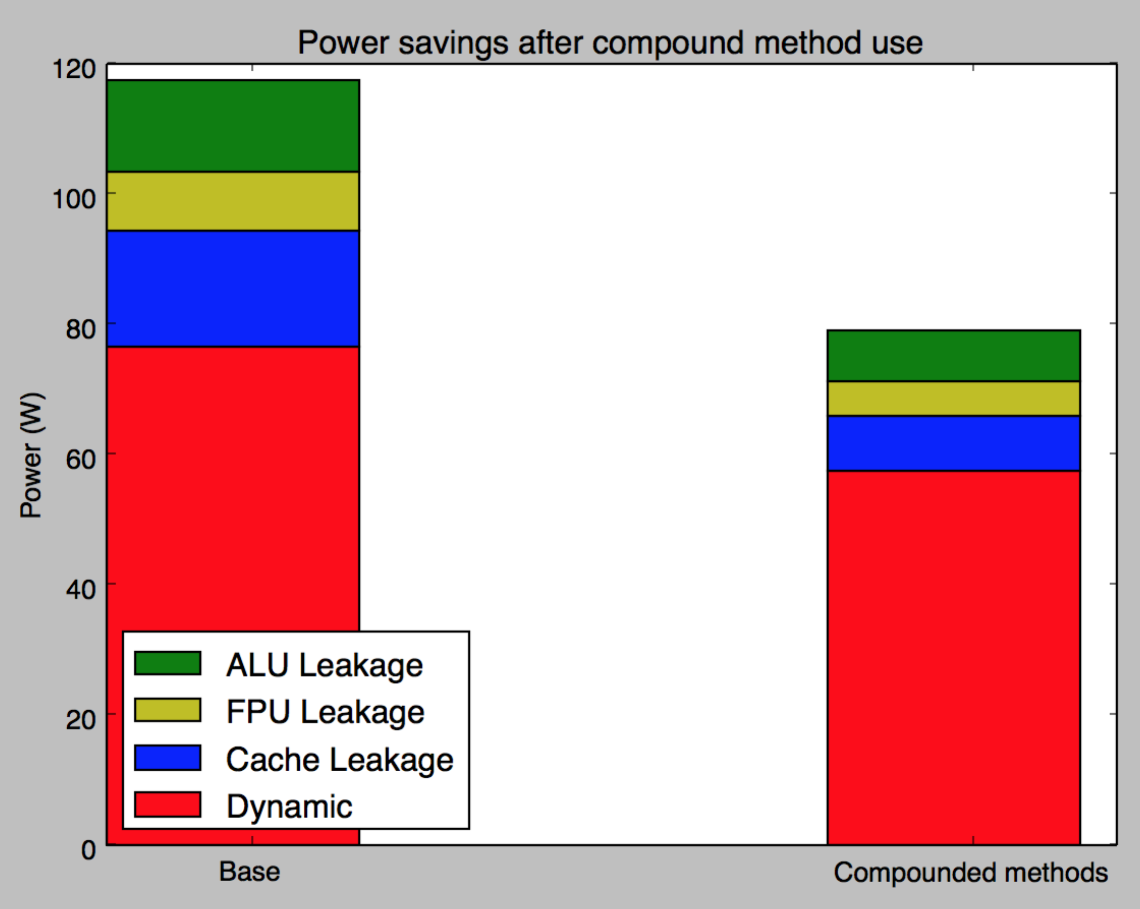
Compounding methods
Since our method operates at a very low level, it can be compounded and used with other methods
For example, using Schulte’s multiple data path for dynamic power reduction and Wang’s cache power reduction technique:

Slide 29
Conclusion
Our method introduces power gating with virtually no overhead by using data to deactivate slices of arithmetic circuit
We have a technically sound method for realtime fine grained power gating of arithmetic circuits
Especially good potential on GPGPU where many ALUs in use at once
Need more simulation to prove out
Use on whole ALU, FPU
Effect of in-rush current on frequently-switching data
Actual values for z_{i} from slide 17

Slide 30
References
Henry, M. Emerging Power-Gating Techniques for Low Power Digital Circuits. Doctoral dissertation 2011. Virginia Polytechnic Institute, Blacksburg VA
Hu, Z. Buyuktosunoglu, A. Srinivasan, V. IBM Watson Research Center. Microarchitectural Techniques for Power Gating of Execution Units, 2004 ACM ISLPED.
Owens, J. Luebke, D. Govindaraju, N. Harris, M. A Survey of General Purpose Computation on Graphics Hardware. Eurographics 2005, State of the Art Reports, August 2005, pp. 21-51.
NVIDIA’s Next Generation CUDA Compute Architecture: Fermi. White Paper, 2009 NVIDIA Corporation.
Brooks, D. Martonosi, M. Value-Based Clock Gating and Operation Packing: Dynamic Strartegies for Improving Processor Power and Performance. ACM Transactions on Computer Systems, Vol. 18, No. 2, 2000, Pages 89–126.
Schulte, M. Kim, N.S. Power-efficient computing for compute-intensive GPGPU applications. 2013 IEEE 19th International Symposium on High Performance Computer Architecture (HPCA2013)
Teng, S.K. Power Gate Optimizaqtion Method for In-Rush Current and Power Up Time. Intel Corp, 2011.
Kosonoky, S. Practical Power Gating and Dynamic Voltage/Frequency Scaling. AMD, Inc. 2011
Suhwan Kim, Chang Jun Choi, Deog-Kyoon Jeong, Stephen Kosonocky, Sung Bae Park, Reducing Ground-Bounce Noise and Stabilizing the Data-Retention Voltage of Power-Gating Structures, IEEE Transactions on Electron Devices, Vol. 55, NO. 1, January 2008
Bakhoda, A. Yuan, G. Fung, W. Wong, T. Aamodt, T. Analyzing CUDA Workloads Using a Detailed GPU Simulator. IEEE International Symposium on Performance Analysis of Systems and Software, 2009. ISPASS 2009.
Leng, J. Hetherington, T. ElTanawy, A. Kin, N.S. GPUWattch: Enabling Energy Optimizations in GPGPUs. International Symposium on Computer Architecture (ISCA) 2013.
Leng, J. Fung, W. Kim, N.S. GPUWattch + GPGPU-Sim: An Integrated Framework for Performance and Energy Optimizations in Manycore Architectures. GPGPU-Sim/GPUWattch Tutorial (MICRO 2013).
Wang, Y. Performance and Power Optimization of GPU Architectures for General-purpose Computing. Doctoral Dissertation 2014, University of South Florida.
Abdel-Majeed, M. Wong, D. Annavaram, M. Warped gates: gating aware scheduling and power gating for GPGPUs. Proceedings of the 46th Annual IEEE/ACM International Symposium on Microarchitecture, 2013
M. Arora, N. Jayasena, M. Schulte, “Prediction for power gating”, US Patent US 20150067357 A, 2015
M. Arora, S. Manne, I. Paul, N. Jayasena, D. Tullsen, “Understanding idle behavior and power gating mechanisms in the context of modern benchmarks on CPU-GPU integrated systems”, 2015 IEEE International Symposium on High Performance Computer Architecture

Slide 31
Appendix: Future work, Tools
Major effort in getting GPGPU-Sim, GPUWattch, CUDA, ispass Benchmarks Suite set up.
Also learned the details of the software C++ design for modification.
Would like to make these tools/knowledge available for research use!
Developed some Python scripts to automate
Conversion of behavioral VHDL to structural. Similar to RTL compiler but could be useful in some cases.
Creation of spectre stimulus. Could also do with spectre stimulus file, but could be useful in some cases

