Slide 1
CSE 486/586 Distributed Systems
Android Programming
Steve Ko
Computer Sciences and Engineering
University at Buffalo

Slide 2

Recap
What to put on top of physical networks?
  Layers providing survivability
Where to put functionalities?
  Fate-sharing & end-to-end arguments
  IP layer doesn’t provide much
  TCP handles most of the survivability issues
TCP & UDP: the two transport protocols of the Internet
What interface do applications see?
  Socket API

Slide 3
Today
Basic Android programming interleaved with a review of PA1
Mainly programming model and components

Slide 4
The Hack: Emulator Port Forwarding
AVD0
IP: 10.0.2.15
AVD1
IP: 10.0.2.15
10000
10000
VR0
VR1
Host
IP: 10.0.2.2
11108
11112

Slide 5
Three Most Important Things
Read the documentation.
  You will not be able to do anything without reading the documentation.
  Learn how to use the APIs.
  Learn how to use the constructs, e.g., AsyncTask, Messenger, etc.
Do it; write your code.
  No learning without doing
Learn how to debug.
  Using LogCat, DDMS, etc.

Slide 6
Android Programming Model
No main()
Four main components: Activity, Service, ContentProvider, BroadcastReceiver
  You need to implement at least one of them to write an Android app.
Event-driven
Permissions
  For certain APIs, you need to request permissions in AndroidManifest.xml.
  These APIs are called protected APIs or sensitive APIs
  Many permissions, e.g., internet, external storage, etc.

Slide 7
What? No main()?
There is a main()! It’s just that it’s hidden.
Zygote starts at boot.
Launcher sends a message to start an activity.
Zygote forks a new VM instance that loads ActivityThread.
  ActivityThread has the real main() for an app.
ActivityThread calls the app’s onCreate(), onStart(), etc.

Slide 8
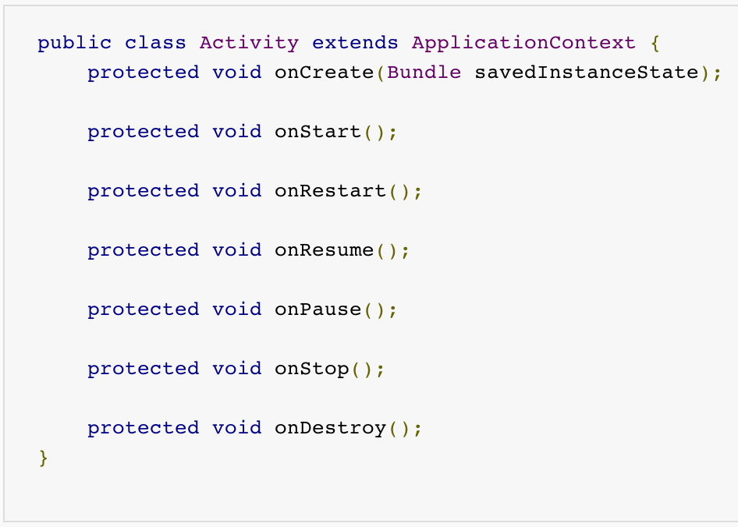
Example - Activity

Slide 9
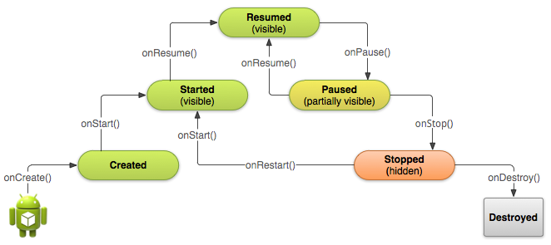
Example - Activity

Slide 10
Declare in AndroidManifest.xml
<manifest ... >
...
<application ... >
<activity android:name=".ExampleActivity" />
...
</application>
</manifest>

Slide 11
CSE 486/586 Administrivia
PA 2 will be out by the end of this week.
Please use Piazza; all announcements will go there.
Please come to my office during the office hours!
  Give feedback about the class, ask questions, etc.

Slide 12
Services
A service runs in the background with no UI for long-running operations.
  Playing music, sending/receiving network messages, …
  Subclass of android.app.Service
Started service
  A service is "started" when an application component (such as an activity) starts it by calling startService(). Once started, a service can run in the background indefinitely, even if the component that started it is destroyed.
Bound service
  A service is "bound" when an application component binds to it by calling bindService(). A bound service offers a client-server interface that allows components to interact with the service, send requests, get results, and even do so across processes with interprocess communication (IPC).

Slide 13
How to Write a Service
Declare in AndroidManifest.xml
Implement necessary methods in Service

Slide 14
Declare in AndroidManifest.xml
<manifest ... >
...
<application ... >
<service android:name=".ExampleService" />
...
</application>
</manifest>

Slide 15
Necessary Methods
onStartCommand()
  The system calls this method when another component, such as an activity, requests that the service be started, by calling startService().
onBind()
  The system calls this method when another component wants to bind with the service (such as to perform RPC), by calling bindService().
onCreate()
  The system calls this method when the service is first created, to perform one-time setup procedures (before it calls either onStartCommand() or onBind()).
onDestroy()
  The system calls this method when the service is no longer used and is being destroyed.

Slide 16
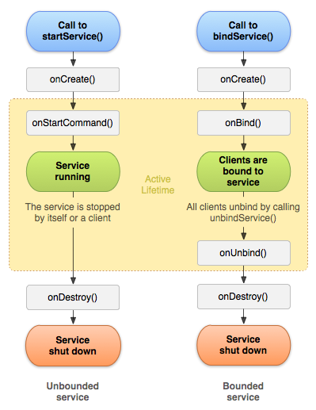
Service Lifecycle

Slide 17
Content Providers
A content provider provides a table view of data.
If you write a content provider, any client application with the permission can enter/read/update/delete data items in your content provider.
A client application (that uses your content provider) uses ContentResolver to interact with your content provider.
You need to extend ContentProvider and implement necessary methods.

Slide 18
How a Client Interacts
Table identification → URI (android.net.Uri)
  E.g., content://user_dictionary/words
Insert
  public final Uri ContentResolver.insert (Uri url, ContentValues values)
Update
  public final int ContentResolver.update (Uri uri, ContentValues values, String where, String[] selectionArgs)
Query
  public final Cursor ContentResolver.query (Uri uri, String[] projection, String selection, String[] selectionArgs, String sortOrder)
Delete
  public final int ContentResolver.delete (Uri url, String where, String[] selectionArgs)

Slide 19
How to Write a Content Provider
Declare in AndroidManifest.xml
Define a URI that client apps will use
Define permissions
Implement necessary methods in ContentProvider
When implementing ContentProvider, use either the Android file system or SQLite as the actual data storage.

Slide 20
Declare in AndroidManifest.xml
<manifest ... >
...
<application ... >
<provider android:name=".ExampleProvider" />
...
</application>
</manifest>

Slide 21
Defining a URI
Typical format
  content://<authority>/<table name>
  Authority: a global (Android-wide) name for the provider
    E.g., edu.buffalo.cse.cse486.proj1.provider
  Table name: the name of a table that the provider exposes
    Note: a provider can expose more than one table.
Should be added to AndroidManifest.xml
  E.g., <provider android:authorities=“edu.buffalo.cse.cse486.proj1.provider” …>…</provider>

Slide 22
Define Permissions
Should define permissions (for others) in AndroidManifest.xml
android:permission: Single provider-wide read/write permission.
  E.g., <provider android:permission=“edu.buffalo.cse.cse486.proj1.provider.permission.USE_PROJ1_PROVIDER” …>…</provider>
android:readPermission: Provider-wide read permission.
android:writePermission: Provider-wide write permission.

Slide 23
Necessary Methods
query()
  Retrieve data from your provider.
insert()
  Insert a new row into your provider.
update()
  Update existing rows in your provider.
delete()
  Delete rows from your provider.
getType()
  Return the MIME type corresponding to a content URI.
onCreate()
  Initialize your provider. The Android system calls this method immediately after it creates your provider. Notice that your provider is not created until a ContentResolver object tries to access it.
These need to handle concurrent accesses (need to be thread-safe)

