Slide 1
CSE 486/586 Distributed Systems
Google Spanner
Steve Ko
Computer Sciences and Engineering
University at Buffalo

Slide 2
Recap
Digital certificates
  Binds a public key to its owner
  Establishes a chain of trust
TLS
  Provides an application-transparent way of secure communication
  Uses digital certificates to verify the origin identity
Authentication
  Needham-Schroeder & Kerberos

Slide 3
Google Spanner
Geo-distributed database
  Multiple datacenters, not just a single cluster
Like Dynamo, it’s a combination of traditional techniques with some new twists.
Traditional concepts used
  Distributed transactions
  Paxos
  Two-phase locking
  Two-phase commit
  Linearizability (well, this is more of a property.)
New twists
  Relational data model + key-value store
  TrueTime used for synchronization and consistency
Notes:
What does Spanner prefer? Availability or consistency? Among the concepts, what concepts point to the answer? Dynamo & Spanner deal with different application scenarios.

Slide 4
Google Spanner
Overcomes limitations of two other storage systems popular in Google---Bigtable and Megastore.
Bigtable does not support strong consistency, only eventual.
Bigtable’s data model is not easy to maintain.
Megastore provides strong consistency and easier-to-maintain data model (more like a relational database), but low performance.
  Gmail, Picasa, Calendar, Play Store, AppEngine all used Megastore then.
Transaction support brings lots of benefit.

Slide 5
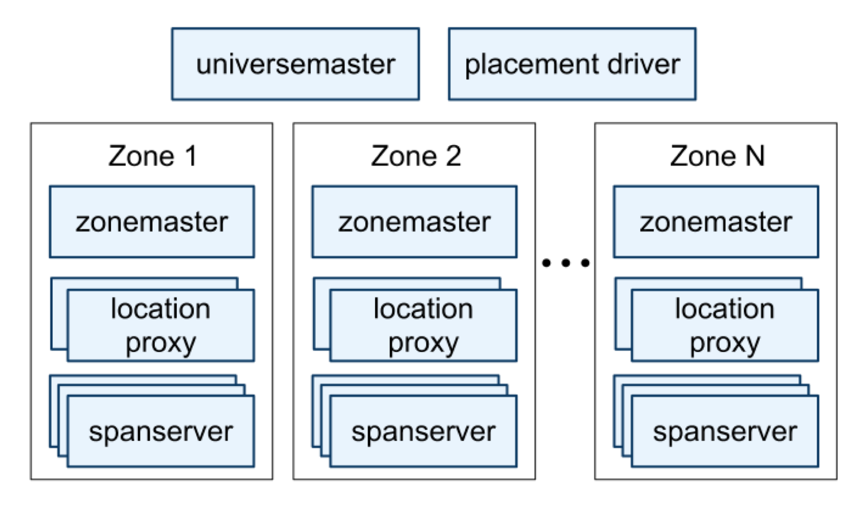
System Overview
Universes and Zones
Notes:
Universe master: control and debugging console
Placement master: data movement controller
Zonemaster assigns data to spanservers
Spanservers store/serve data. There are up to several thousands of spanservers per zone.
Location proxies are used by clients to locate which spanservers.

Slide 6
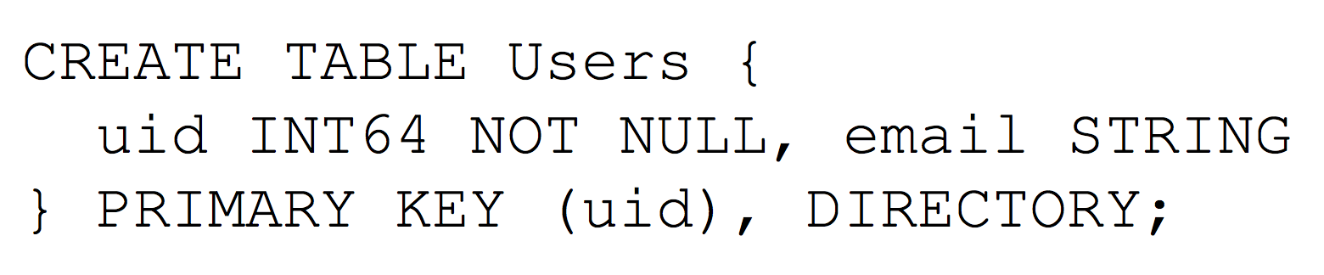
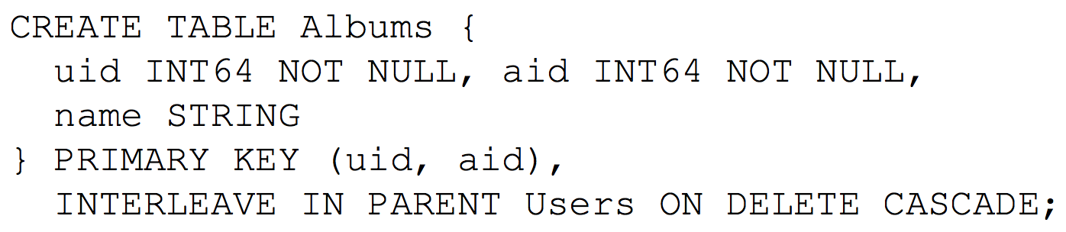
Data Model
Spanservers manage tablets (100~1000).
  A table contains multiple, mostly contiguous, of: (key, timestamp) -> value
  This makes it more like a multi-version database than a key-value store.
Relational data mode & support for SQL-like queries

Slide 7
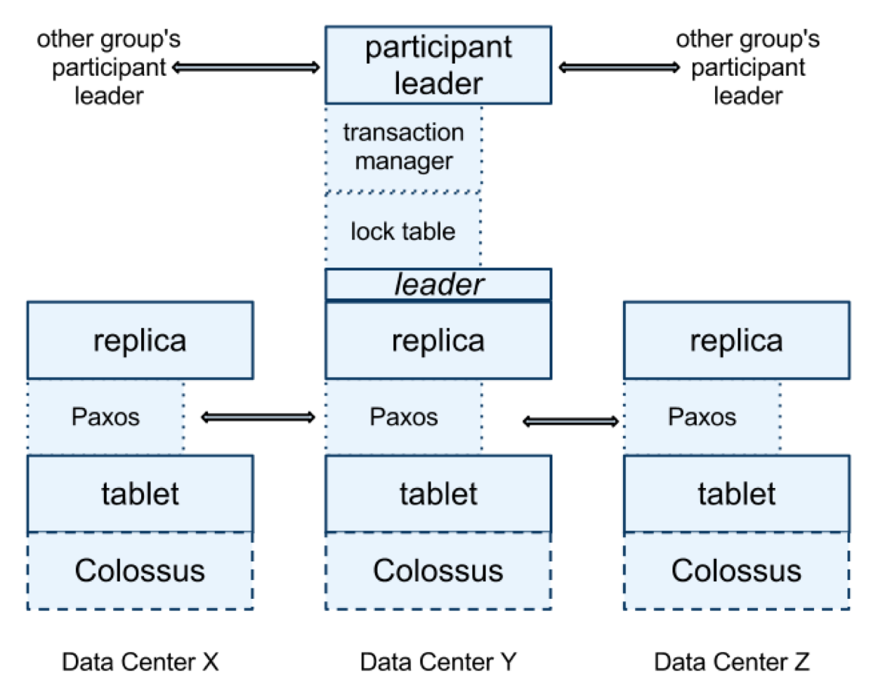
Spanserver
Combination of many techniques
Paxos Group
Notes:
Replicas elect a leader.
Replicas run Paxos for replication consistency.
The leader has a lock table that implements two-phase locking.
The leader becomes the transaction manager that uses the lock table to support distributed transactions.
The participant leaders, if involved in a distributed transaction, perform two-phase commit.

Slide 8
CSE 486/586 Administrivia
PA4 due 5/9
Final: 5/14, Wednesday, 3:30pm – 6:30pm
  Norton 112

Slide 9
Paxos Group Leader Election
The leader election uses leases.
Protocol
  A potential leader sends requests to others.
  Others reply back with lease votes.
  If the requester receives a quorum, it becomes the leader.
Notes:
A lease is a soft state.
Soft state vs. hard state?
A lease has a benefit when the server fails. It expires automatically.

Slide 10
Transactions
Read-write transactions
  Combination of reads and writes
  Standalone writes
Read-only transactions
  Only reads
  Pre-declared
Snapshot reads
  Reads of a past version, not the most up-to-date version
  A client-specified timestamp, upper-bounded, or Spanner-picked.

Slide 11
Transaction Ordering
Necessary guarantee for linearizability
  If T1 finishes before T2, then T2 should see the result of T1.
Spanner uses physical time to achieve this.
Each transaction gets a physical (not logical) timestamp.
Transactions are ordered based on their timestamps.
  Spanner’s Paxos group decides in what order transactions should be committed according to the timestamps.
Transaction ordering guarantee
  If T1 commits at time1 and T2 starts at time2 where time1 < time2, then T1’s timestamp should be less than T2’s.
What is critical in this scenario?
  Physical time synchronization!

Slide 12
Time Synchronization: TrueTime
Each data center has
  GPS and atomic clocks
  These two provide very fine-grained clock synchronization down to a few milliseconds.
  Every 30 seconds, there’s maximum 7 ms difference.
Multiple synchronization daemons per data center
  GPS and atomic clocks can fail in various conditions.
  Sync daemons talk to each other within a data center as well as across data centers.
TrueTime API exposes uncertainty.
  TT.now(): returns an interval [earliest, latest]
  TT.after(t): true if t has definitely passed
  TT.before(t): true if t has definitely not arrived

Slide 13
TrueTime for Transaction Ordering
This is simplified.
Principle: using TrueTime, always pick a clock value that is not uncertain.
Commit timestamp is assigned after a commit request is received at the coordinator leader.
  For transaction T(i), pick S(i) > TT.now().latest: this ensures that actual TT.now() has definitely passed.
The coordinator leader starts two-phase commit.
  This takes time and at some point of time all commits will be done.
  The coordinator leader makes sure that no read can read the outcome of the commit until TT.after(S(i)) is true.
  This makes sure that the commit time has definitely passed.

Slide 14
Combatting Replica Asynchrony
Asynchrony still exists in replicas, i.e., different replicas proceed at different speeds.
  Some replicas can be ready to serve a write, some others might not.
Each replica maintains safe time (t_safe).
  t_safe means up to what time the replica is up-to-date.
Replica can serve read requests up to the safe time value.
  A read request at time t can be served at a replica when t_safe >= t.
Safe time is basically the timestamp from the last fully-committed, fully-replicated transaction (write).

Slide 15
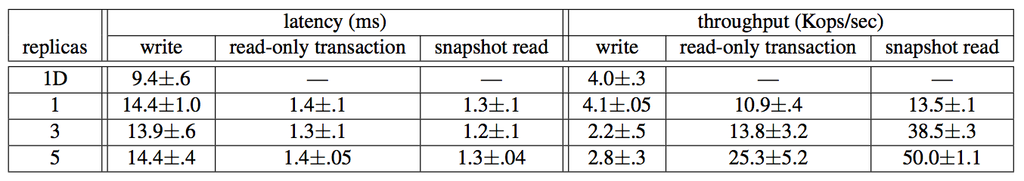
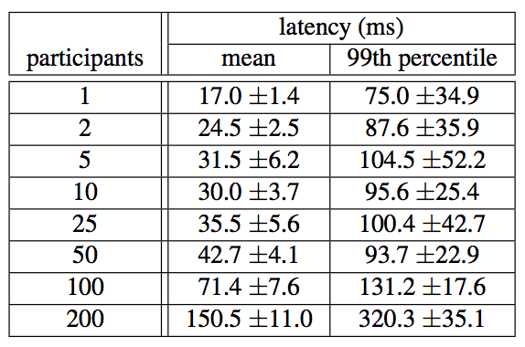
Some Performance Numbers
Read/write across data centers within 1 ms latency
Two-phase commit (transactions)

Slide 16
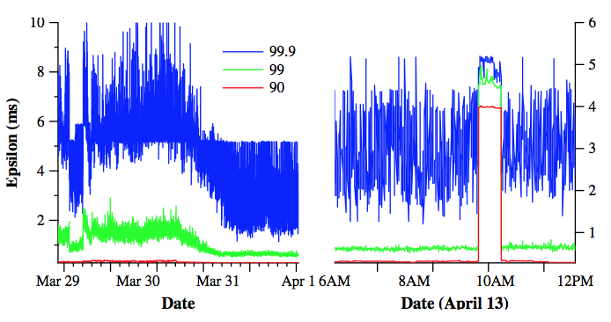
TrueTime Performance
Clock difference distribution

Slide 17
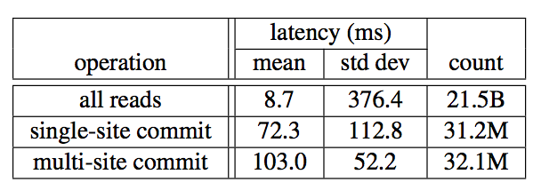
F1-Perceived Latency
F1 is Google’s ad backend

Slide 18
Summary
Spanner
  Geo-distributed database
  Supports a relational data model with a SQL-like language
  Supports distributed transactions with linearizability
Transaction ordering for linearizability
  TrueTime-based timestamps
  Principle: using a time value that is certain
TrueTime
  TT.now() returns an interval [earliest, latest].
  TT.after(t) is true if t has definitely passed.
  TT.before(t) is true if t has definitely not arrived.

Slide 19
Acknowledgements
These slides contain material developed and copyrighted by Indranil Gupta (UIUC), Jennifer Rexford (Princeton) and Michael Freedman (Princeton).

