Slide 1
CSE 486/586 Distributed Systems
Wrap-up
Steve Ko
Computer Sciences and Engineering
University at Buffalo

Slide 2
CSE 486/586 Administrivia
PA4 due this Friday @ 1:59pm
Final: 5/14, Wednesday, 3:30pm – 6:30pm
  Norton 112
  Everything
  No restroom use (this quickly becomes chaotic)
  Bring an erasure, if you’d like.
Important things about the final week
  PA4 scores will be released by Wednesday.
  Thursday and Friday office hours are for PA4.
  No TA office hours from Monday to Wednesday
  I will still hold my office hours on Monday.
  Scoring will hopefully be done by the end of the week.

Slide 3
Building a Distributed System
“The number of people who know how to build really solid distributed systems…is about ten”
  Scott Shenker, Professor at UC Berkeley
Are you confident now?
What were the most interesting topic to you?

Slide 4
Things We Discussed (Midterm)
Networking basics (feat. the Internet)
Failure detection
Time synchronization
Logical time & global states
P2P & DHT
Reliable multicast
Consensus basics
Mutual exclusion & leader election
RPC

Slide 5
Things We Discussed
Transactions & concurrency control
Replication
Gossiping
Distributed file systems
Paxos
BFT
Security

Slide 6
The Way I See It
We’ve learned some of the building blocks & fundamental results…
  Networking basics, failure detection, logical time, reliable multicast, mutual exclusion, leader election, transactions, concurrency control, replication, gossiping, Paxos, BFT, …
…and how real systems get built using those…
  P2P, DHT, Dynamo, Spanner, …
…and also got some experience in building/using the fundamental building blocks…
  Ordered multicast for messaging, a DHT, and a replicated key-value storage

Slide 7
Distributed Systems 10 Questions
Course goal: answering 10 questions on distributed systems
  At the end of the semester, if you can answer only 10 questions about distributed systems, you’ll probably get an A.
  Easy enough!
What are those questions?
  Organized in 6 themes
  1~2 questions in each theme
  A few (or several) lectures to answer each question

Slide 8
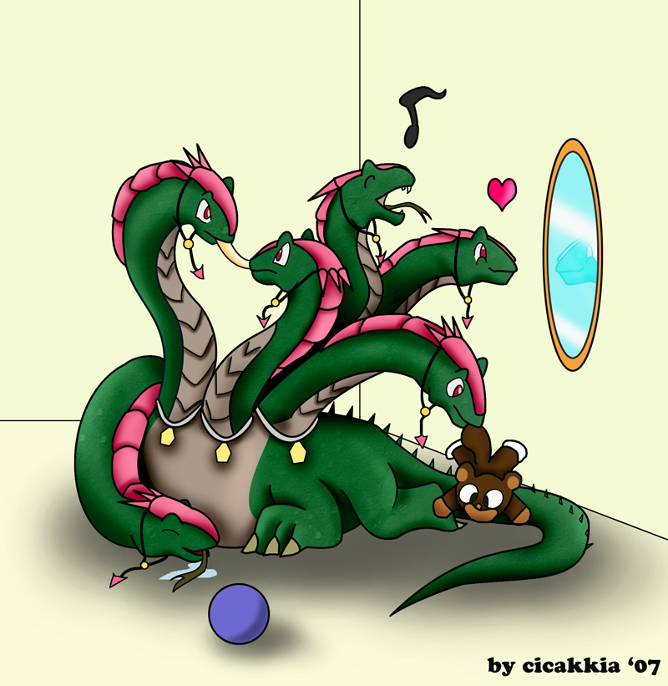
Theme 1: Hint
What’s up?
Hey!

Slide 9
Theme 1: Communications
Q1: how do you talk to another machine?
  A: Networking basics
  Know how to use socket now?
Q2: how do you talk to multiple machines at once?
  A: Multicast
  What is “reliable multicast”?
  What orderings are there for ordered multicast?
Q3: can you call a function/method/procedure running in another machine?
  A: RPC
  What is a stub compiler (generator)?

Slide 10
Theme 2: Hint
I thought I was doing it…
I’m shaking my tail.
What? I’m doing it too!

Slide 11
Theme 2: Concurrency
Q4: how do you control access to shared resources?
  A: Distributed mutual exclusion, leader election, etc.
  Ring election? Modified ring election? Bully algorithm?

Slide 12
Theme 3: Hint
I want to shake my tail.
OK
No, I don’t want to.
No way!

Slide 13
Theme 3: Consensus
Q5: how do multiple machines reach an agreement?
  A: it’s impossible! (the FLT result), but algorithms do exist that get around the impossibility (Paxos, BFT, etc.)
  What are the phases for Paxos?

Slide 14
Theme 4: Hint
Who has a brain?
I do.
I don’t.

Slide 15
Theme 4: Storage Management
Q6: how do you locate where things are and access them?
  A: DHT, distributed file systems, etc.
  Consistent hashing?

Slide 16
Theme 5: Hint
I have a feeling that something went wrong…
zzz…

Slide 17
Theme 5: Non-Byzantine Failures
Q7: how do you know if a machine has failed?
  A: Failure detection
  What is the fundamental limit of a failure detector?
Q8: how do you program your system to operate continually even under failures?
  A: Replication, gossiping
  Linearizability? Sequential consistency? One-copy seriarizability?

Slide 18

Theme 6: Hint
We’re under attack!

Slide 19
Theme 6: Byzantine Failures
Q9: how do you deal with attackers?
  A: Security
  What is onion routing?
Q10: what if some machines malfunction?
  A: Byzantine fault tolerance
  To tolerate f faulty nodes, how many nodes do we need in total?

Slide 20
Acknowledgements
These slides contain material developed and copyrighted by Indranil Gupta (UIUC).

