Slide 1
CSE 486/586 Distributed Systems
Case Study: Facebook Haystack
Steve Ko
Computer Sciences and Engineering
University at Buffalo

Slide 2
Recap
DNS
  Hierarchical servers
  Root servers, top-level domain servers, authoritative servers
CDN
  Distributing read-only contents
  Servers distributed world-wide
  Server selection through DNS redirection

Slide 3

Understanding Your Workload
Engineering principle
  Make the common case fast, and rare cases correct
  (From Patterson & Hennessy books)
  This principle cuts through generations of systems.
Example?
  CPU Cache
Knowing common cases == understanding your workload
  E.g., read dominated? Write dominated? Mixed?

Slide 4
Content Distribution Workload
What are the most frequent things you do on Facebook?
  Read/write wall posts/comments/likes
  View/upload photos
  Very different in their characteristics
Read/write wall posts/comments/likes
  Mix of reads and writes so more care is necessary in terms of consistency
  But small in size so probably less performance sensitive
Photos
  Write-once, read-many so less care is necessary in terms of consistency
  But large in size so more performance sensitive

Slide 5
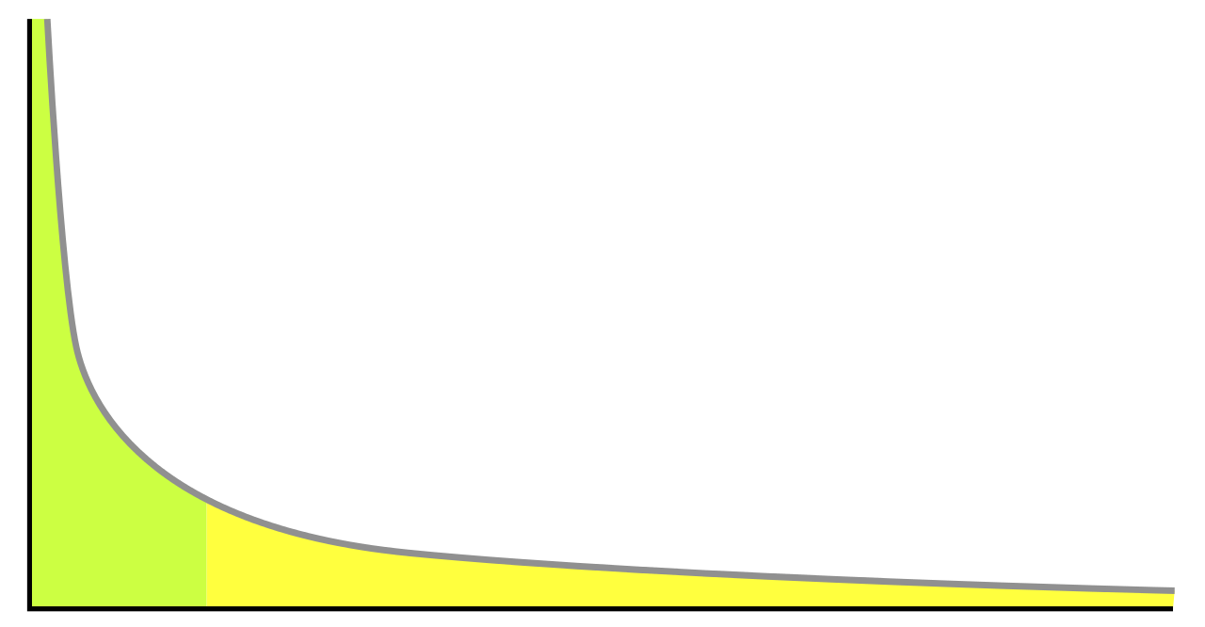
Content Distribution Problem
Power law (Zipf distribution)
  Models a lot of natural phenomena
  Social graphs, media popularity, wealth distribution, etc.
  Happens in the Web too.
Popularity
Items sorted by popularity

Slide 6
Facebook’s Photo Distribution Problem
“Hot” photos
  Popular, a lot of views
“Warm” photos (long-tail)
  Unpopular, but still a lot of views in aggregate
Popularity
Items sorted by popularity

Slide 7
“Hot” Photos
How would you serve these photos?
Caching should work well.
  Many views for popular photos
Where should you cache?
  Close to users
What system gives you this ability?
  CDN (from last lecture)

Slide 8
“Warm” Photo Problem
Characteristics
  Not so much popular
  Not entirely “cold,” i.e., occasional views
  A lot in aggregate
  Does not want to cache everything in CDN due to diminishing returns
Facebook stats (in their 2010 paper)
  260 billion images (~20 PB)
  1 billion new photos per week (~60 TB)
  One million image views per second at peak
  Approximately 10% not served by CDN, but still a lot

Slide 9
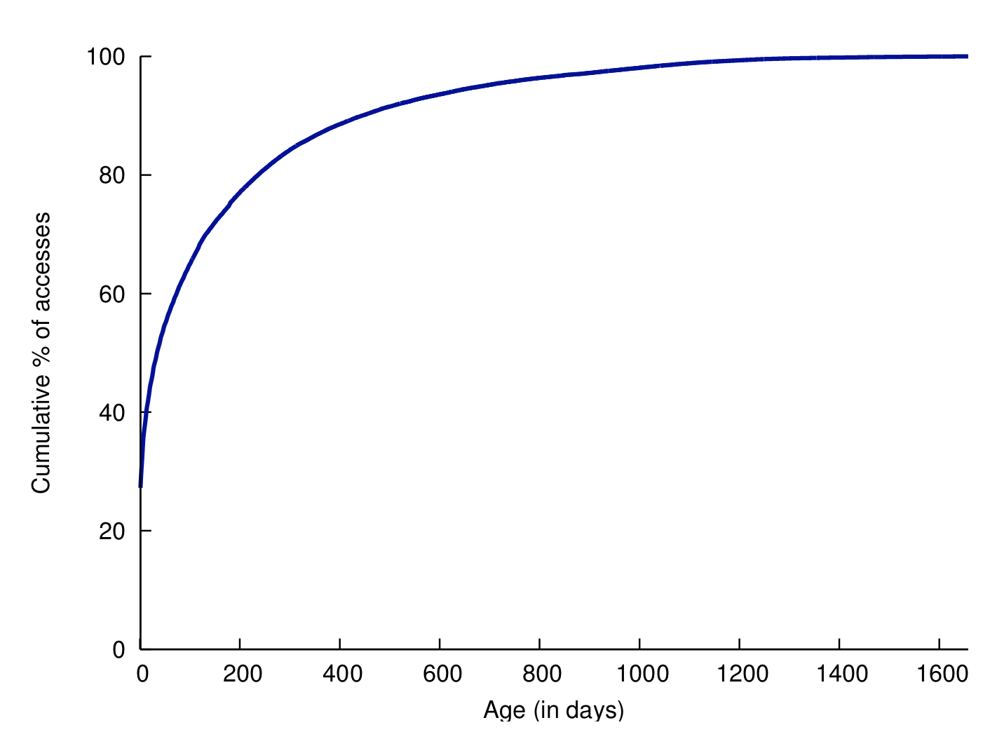
Popularity Comes with Age

Slide 10
Facebook Photo Storage
Three generations of photo storage
  NFS-based (today)
  Haystack (today)
  f4 (next time)
Characteristics
  After-CDN storage
  Each generation solves a particular problem observed from the previous generation.

Slide 11
CSE 486/586 Administrivia
PA4 due 5/8
  Please start now!

Slide 12
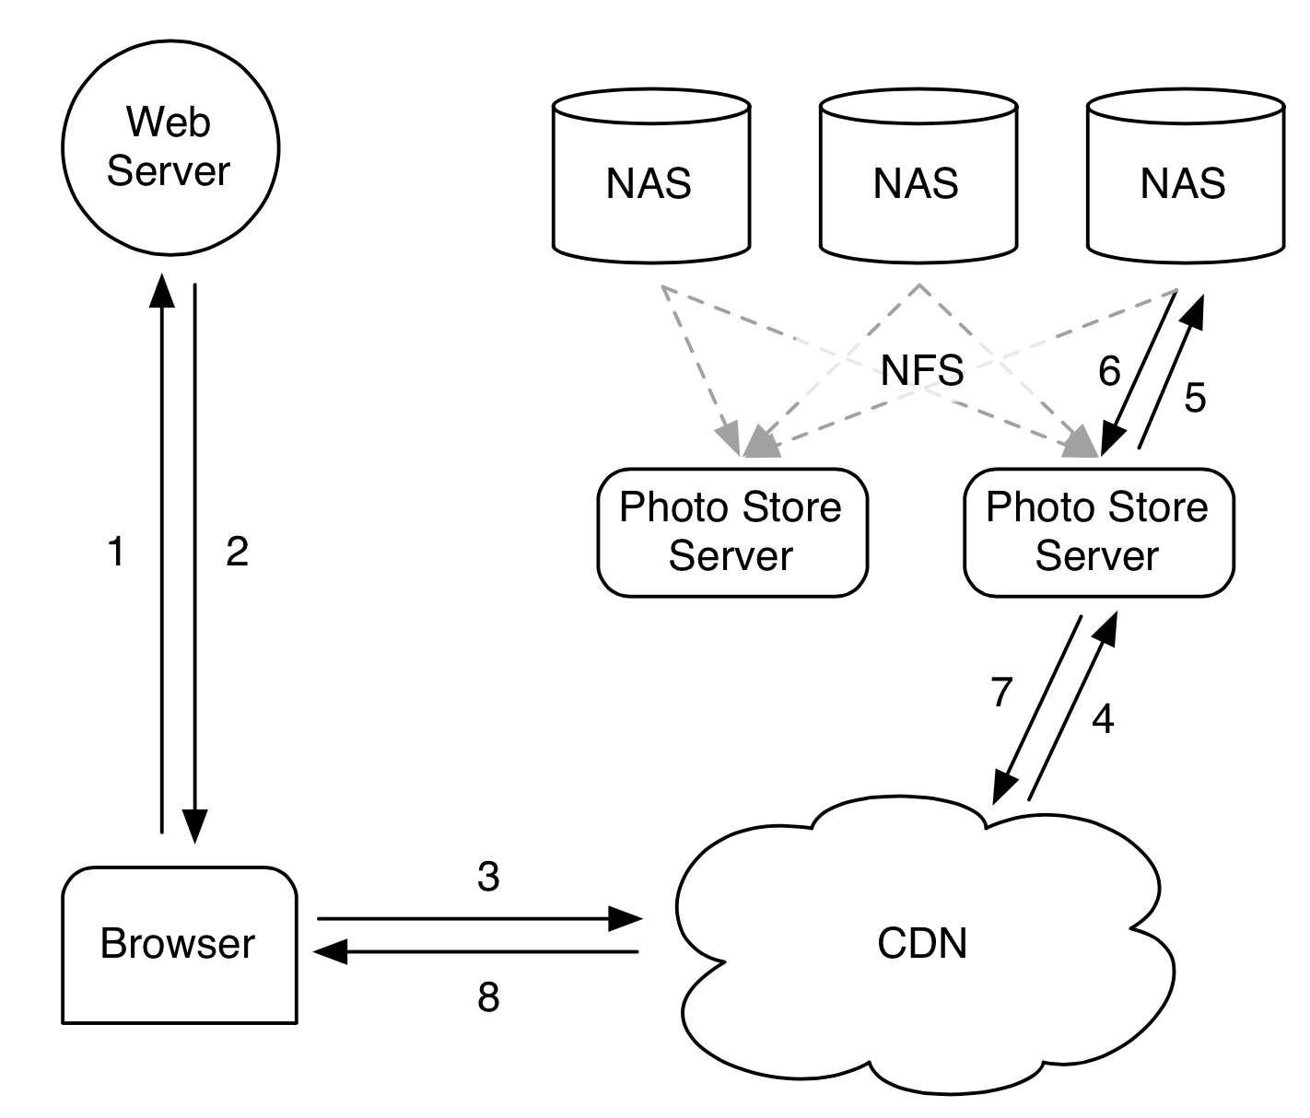
1st Generation: NFS-Based
Notes:
Browser sends an HTTP request
Web server returns a CDN URL. (Akamai)
If CDN has it, returns
If not, retrieves from the photo store.

Slide 13
1st Generation: NFS-Based
Each photo → single file
Observed problem
  Thousands of files in each directory
  Extremely inefficient due to meta data management
  10 disk operations for a single image: chained filesystem i-node reads for its directory and itself & the file read
In fact, a well-known problem with many files in a directory
  Be aware when you do this.

Slide 14
2nd Generation: Haystack
Custom-designed photo storage
What would you try?
  Starting point: One big file with many photos
Reduces the number of disk operations required to one
  All meta data management done in memory
Design focus
  Simplicity
  Something buildable within a few months
Three components
  Directory
  Cache
  Store

Slide 15
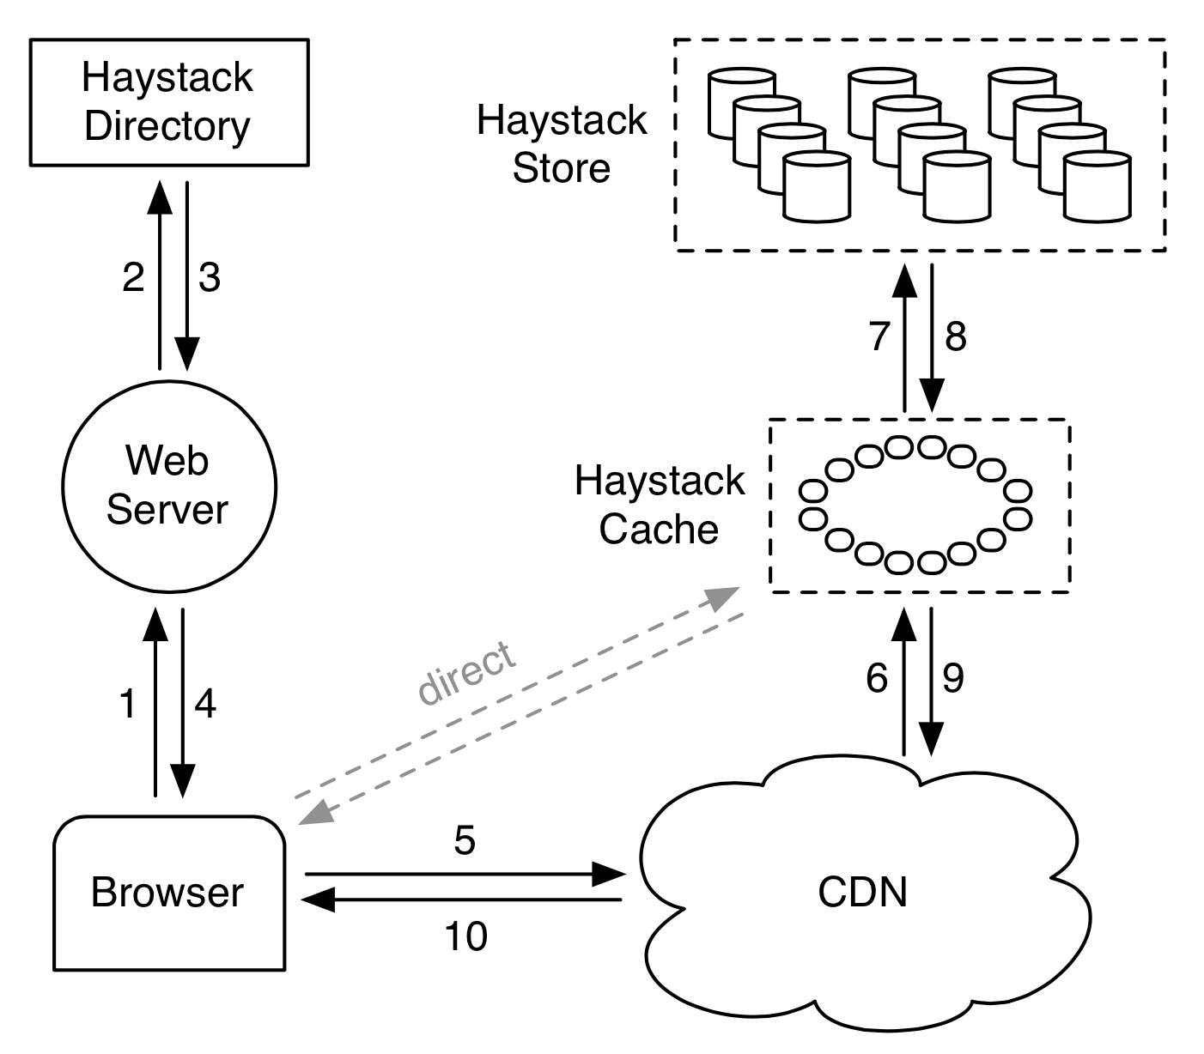
Haystack Architecture
Notes:
Browser HTTP request
Directory lookup for photos (Web server constructs these URLs)
Depending on the URL, browser contacts CDN or Cache.

Slide 16
Haystack Directory
Helps the URL construction for an image
  http://⟨CDN⟩/⟨Cache⟩/⟨Machine id⟩/⟨Logical volume, Photo⟩
  Staged lookup
  CDN strips out its portion.
  Cache strips out its portion.
  Machine strips out its portion
Logical & physical volumes
  A logical volume is replicated as multiple physical volumes
  Physical volumes are stored.
  Each volume contains multiple photos.
  Directory maintains this mapping

Slide 17
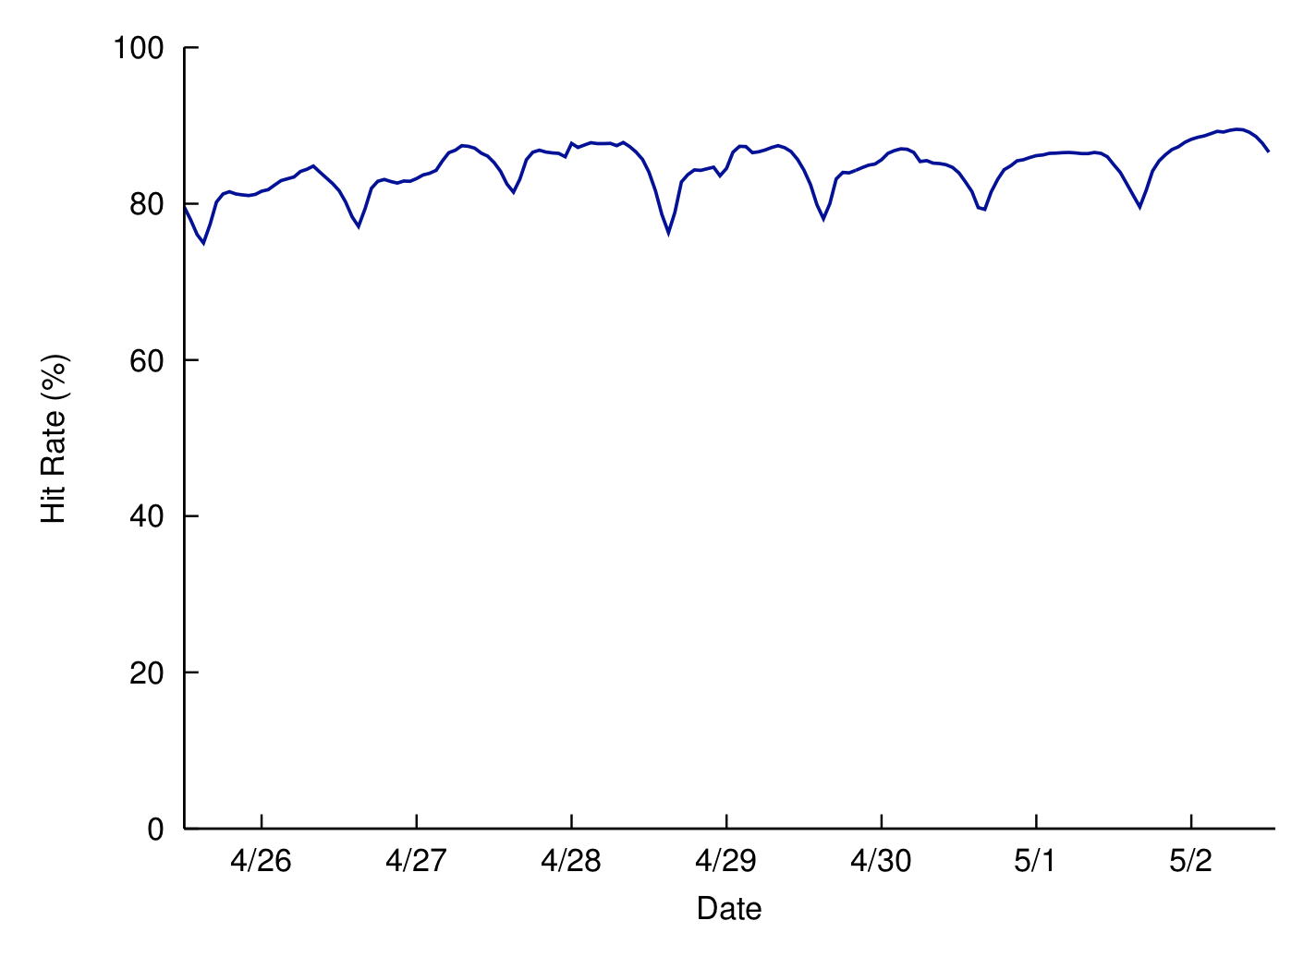
Haystack Cache
Facebook-operated CDN using DHT
  Photo IDs as the key
Further removes traffic to Store
  Mainly caches newly-uploaded photos
High cache hit rate (due to caching new photos)

Slide 18
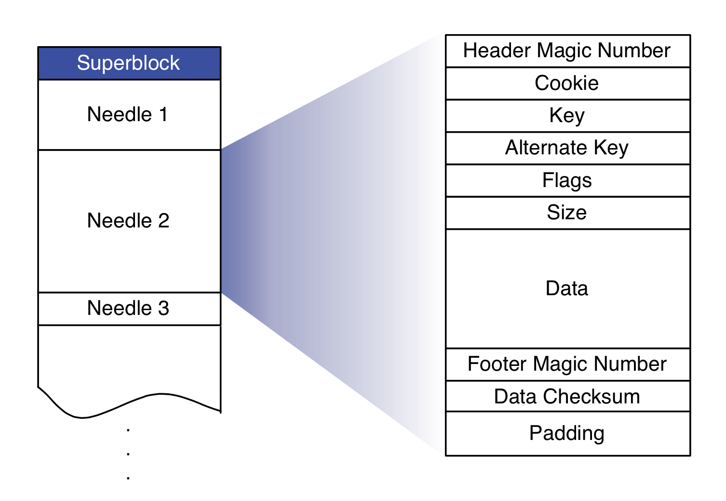
Haystack Store
Maintains physical volumes
One volume is a single large file (100GB) with many photos (needles)
Notes:
Cookie: random number embedded in the URL
Key: photo id
Alternate key: photo size key (small, medium, etc.)
Flags: delete status
Padding for 8-byte alignment

Slide 19
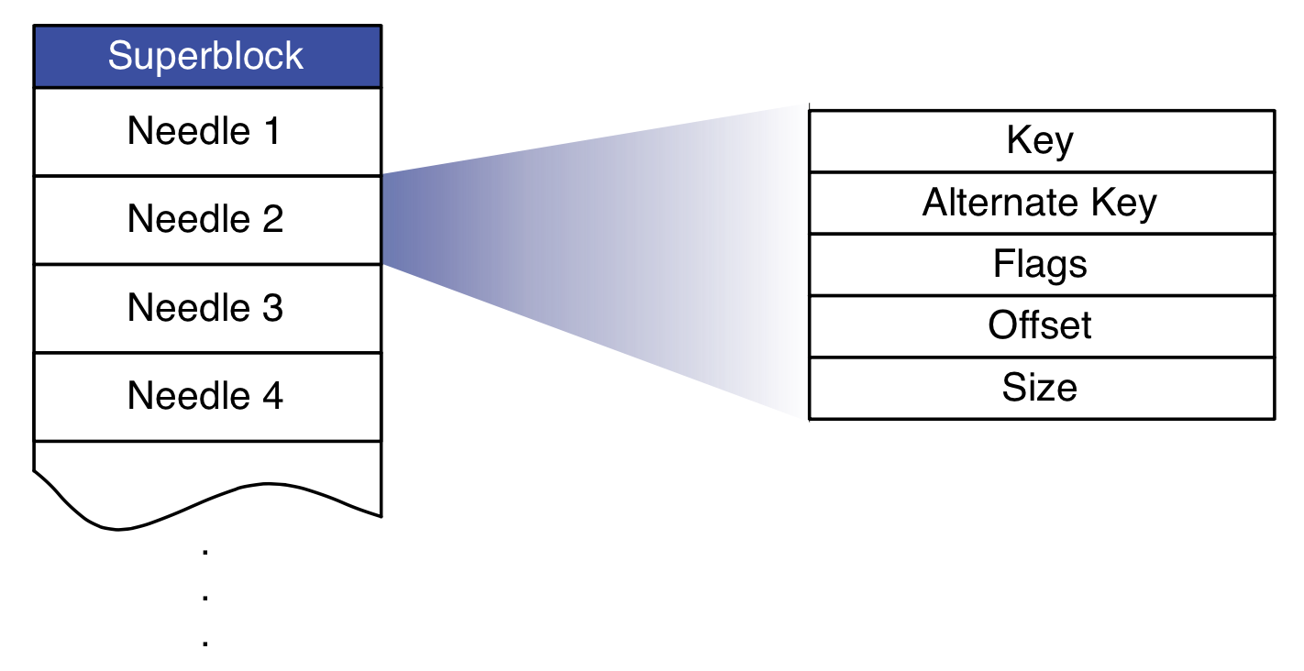
Haystack Store
Metadata managed in memory
  (key, alternate key) to (flags, size, volume offset)
  Quick lookup for both read and write
  Disk operation only required for actual image read
Write/delete
  Append-only
  Delete is marked, later garbage-collected.
Indexing
  For fast memory metadata construction

Slide 20
Daily Stats with Haystack
Photos uploaded: ~120 M
Haystack photos written: ~1.44 B
Photos viewed: 80 – 100 B
  Thumbnails: 10.2%
  Small: 84.4%
  Medium: 0.2%
  Large: 5.2%
Haystack photos read: 10 B

Slide 21
Summary
Two different types of workload for a social networking Web service
  Posts: read/write
  Photos: write-once, read-many
Photo workload
  Zipf distribution
  “Hot” photos can be handled by CDN
  “Warm” photos have diminishing returns.
Haystack: Facebook’s 2nd generation photo storage
  Goal: reducing disk I/O for warm photos
  One large file with many photos
  Metadata stored in memory
  Internal CDN

