Slide 1
CSE 486/586 Distributed Systems
Case Study: Facebook f4
Steve Ko
Computer Sciences and Engineering
University at Buffalo

Slide 2
Recap
Engineering principle
  Make the common case fast, and rare cases correct
Power law
Haystack
  A design for warm photos
  Problem observed from NFS: too many disk operations
  Mostly just one disk operation required for a photo
  A large file used to contain many photos

Slide 3
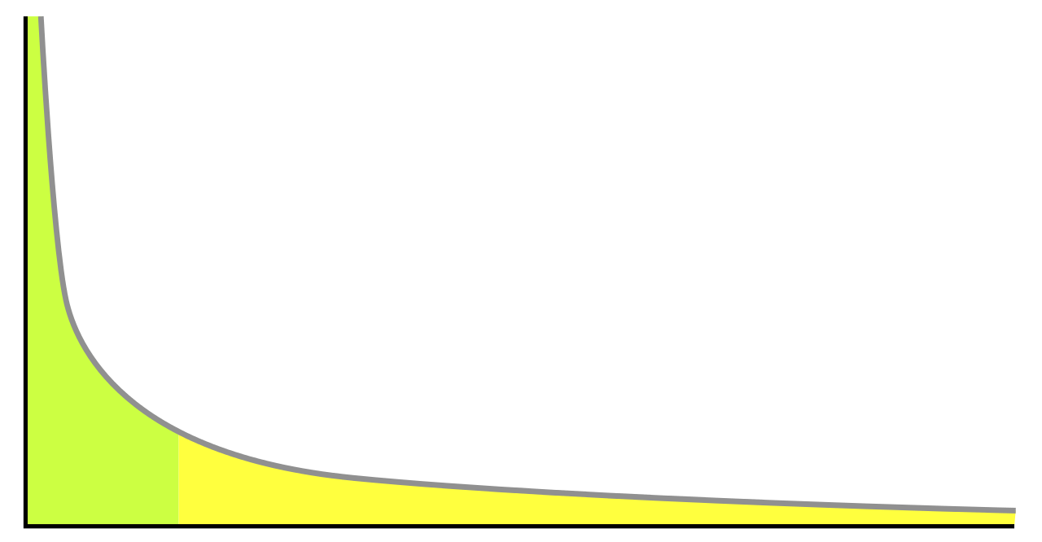
f4: Breaking Down Even Further
Hot photos: CDN
Warm photos: Haystack
Very warm photos: f4
Why? Storage efficiency
Popularity
Items sorted by popularity

Slide 4
CDN / Haystack / f4
Storage efficiency became important.
  Static contents (photos & videos) grew quickly.
Haystack is concerned about throughput, not efficiently using storage space.
Very warm photos don’t quite need a lot of throughput.
Design question: Can we design a system that is more optimized for storage efficiency for very warm photos?

Slide 5
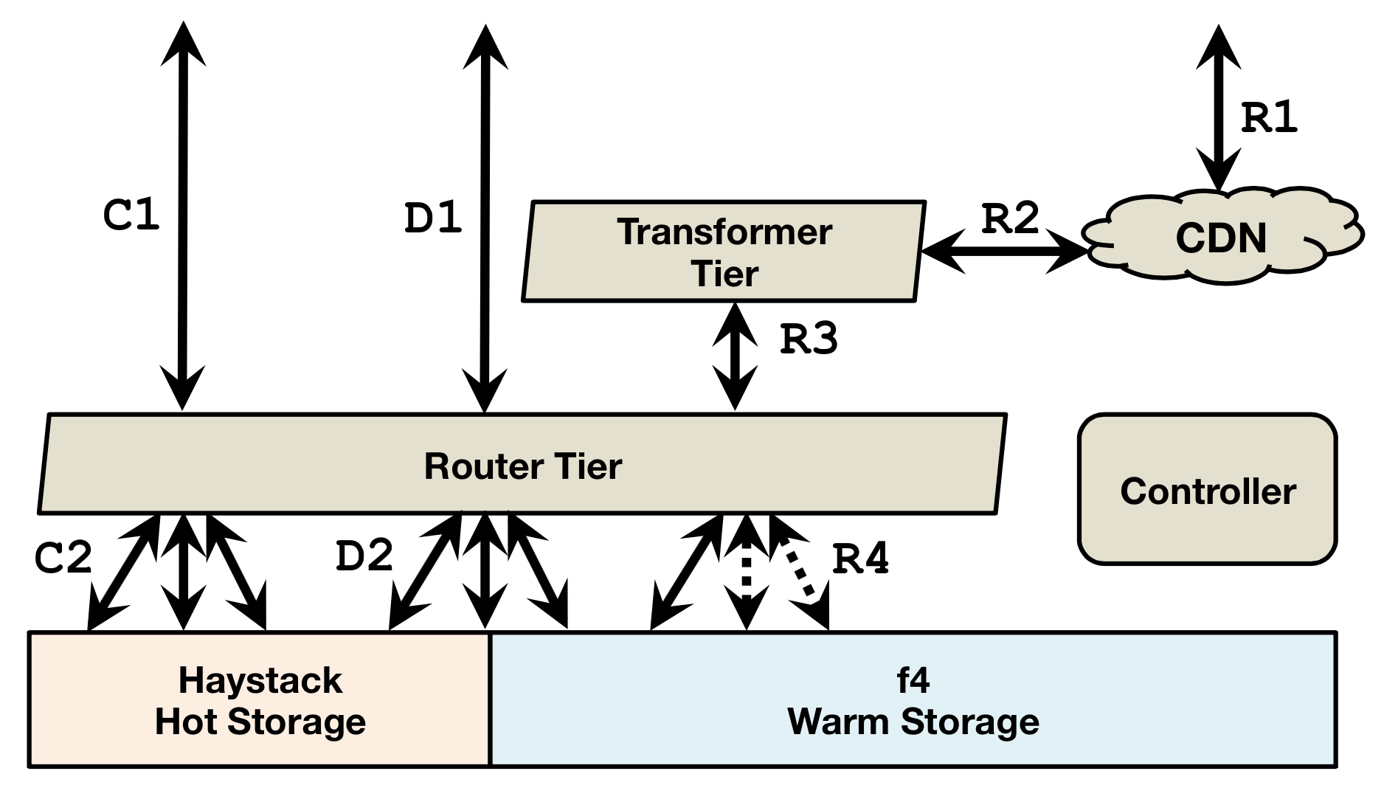
CDN / Haystack / f4
CDN absorbs much traffic for hot photos/videos.
Haystack’s tradeoff: good throughput, but somewhat inefficient storage space usage.
f4’s tradeoff: less throughput, but more storage efficient.
  ~ 1 month after upload, photos/videos are moved to f4.

Slide 6
Why Not Just Use Haystack?
Recall
  Haystack store maintains large files (many photos in one file).
  Each file is replicated 3 times, two in a single data center, and one additional in a different data center.
Each file is placed in RAID disks.
  RAID: Redundant Array of Inexpensive Disks
  RAID provides better throughput with good reliability.
  Haystack uses RAID-6, where each file block requires 1.2X space usage.
  With 3 replications, each file block spends 3.6X space usage to tolerate 4 disk failures in a datacenter as well as 1 datacenter failure.
f4 reduces this to 2.1X space usage with the same fault-tolerance guarantee.

Slide 7
The Rest
What RAID is and what it means for Haystack
  Will talk about RAID-0, RAID-1, RAID-4, and RAID-5
  Haystack’s replication based on RAID
How f4 uses erasure coding
  f4 relies on erasure coding to improve on the storage efficiency.
  f4’s replication based on erasure coding
How Haystack and f4 stack up

Slide 8

RAID
Using multiple disks that appear as a one big disk in a single server for throughput and reliability
Throughput
  Multiple disks working independently & in parallel
Reliability
  Multiple disks redundantly storing file blocks
Simplest? (RAID-0)
0
2
3
4
5
6
7
8
9
10
11
12

Slide 9
RAID-0
More often called striping
Better throughput
  Multiple blocks in a single stripe can be accessed in parallel across different disks.
  Better than a single large disk with the same size
Reliability?
  Not so much
Full capacity
0
1
2
3
4
5
6
7
8
9
10
11

Slide 10
RAID-1
More often called mirroring
Throughput
  Read from a single disk, write to two disks
Reliability
  1 disk failure
Capacity
  Half
0
0
1
1
2
2
3
3
4
4
5
5

Slide 11
CSE 486/586 Administrivia
PA4 due 5/8
  Please start now!

Slide 12
RAID-4
Striping with parity
  Parity: conceptually, adding up all the bits
  XOR bits, e.g., (0, 1, 1, 0) → P: 0
  Almost the best of both striping and mirroring
Parity enables reconstruction after failures
  (0, 1, 1, 0) → P: 0
How many failures?
  With one parity bit, one failure
0
1
2
3
P0
4
5
6
7
P1
8
9
10
11
P2

Slide 13
RAID-4
Read
  Can be done directly from a disk
Write
  Parity update required with a new write
  E.g., existing (0, 0, 0, 0), P:0 & writing 1 to the first disk
  XOR of the old bit, the new bit, and the old parity bit
  One write == one old bit read + one old parity read + one new bit write + one parity computation + one parity bit write
Reconstruction read
  E.g., (0, X, 1, 0) → P: 0
  XOR of all bits
Write to the failed disk
  E.g., existing (X, 0, 0, 0), P:0 & writing 1 to the first disk
  Parity update: XOR of all existing bits and the new bit

Slide 14
RAID-4
Throughput
  Similar to striping for regular ops, except parity updates
  After a disk failure: slower for reconstruction reads and parity updates (need to read all disks)
Reliability
  1 disk failure
Capacity
  Parity disks needed
0
1
2
3
P0
4
5
6
7
P1
8
9
10
11
P2

Slide 15
RAID-5
Any issue with RAID-4?
  All writes involve the parity disk
  Any idea to solve this?
RAID-5
  Rotating parity
  Writes for different stripes involve different parity disks
0
1
2
3
P0
5
6
7
P1
4
10
11
P2
8
9

Slide 16
Back to Haystack & f4
Haystack uses RAID-6, which has 2 parity bits, with 12 disks.
  Stripe: 10 data disks, 2 parity disks, failures tolerated: 2
  (RAID-6 is much more complicated though.)
  Each data block is replicated twice in a single datacenter, and one additional is placed in a different datacenter.
Storage usage
  Single block storage usage: 1.2X
  3 replications: 3.6X
How to improve upon this storage usage?
  RAID parity disks are basically using error-correcting codes
  Other (potentially more efficient) error-correcting codes exist, e.g., Hamming codes, Reed-Solomon codes, etc.
  f4 does not use RAID, rather handles individual disks.
  f4 uses more efficient Reed-Solomon code.

Slide 17
Back to Haystack & f4
(n, k) Reed-Solomon code
  k data blocks, (n-k) parity blocks, n total blocks
  Can tolerate up to f==(n-k) block failures
  Need to go through coder/decoder for read/write, which affects the throughput
  Upon a failure, any k blocks can reconstruct the lost block.
f4 reliability with a Reed-Solomon code
  Disk failure/host failure
  Rack failure
  Datacenter failure
  Spread blocks across racks and across data centers
k data blocks
f parity blocks

Slide 18
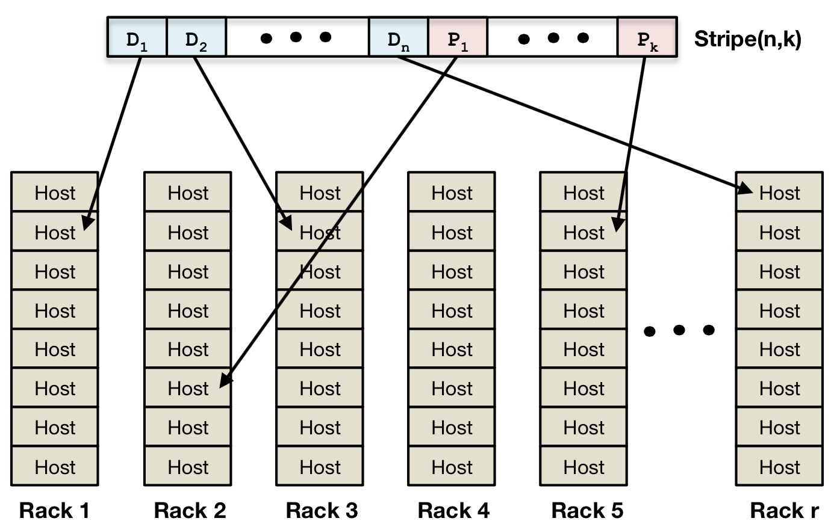
f4: Single Datacenter
Within a single data center, (14, 10) Reed-Solomon code
  This tolerates up to 4 block failures
  1.4X storage usage per block
Distribute blocks across different racks
  This tolerates two host/rack failures

Slide 19
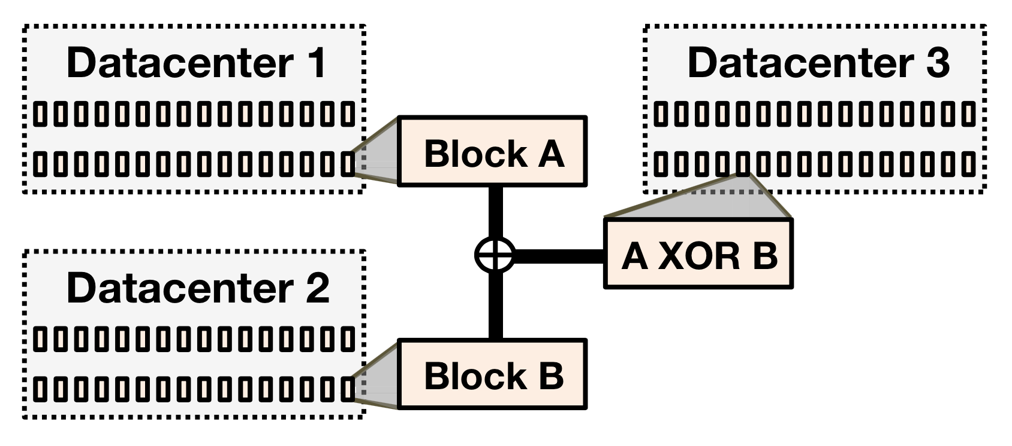
f4: Cross-Datacenter
Additional parity block
  Can tolerate a single datacenter failure
Average space usage per block: 2.1X
  E.g., average for block A & B: (1.4*2 + 1.4)/2 = 2.1
With 2.1X space usage,
  4 host/rack failures tolerated
  1 datacenter failure tolerated

Slide 20
Haystack vs. f4
Haystack
  Per stripe: 10 data disks, 2 parity disks, 2 failures tolerated
  Replication degree within a datacenter: 2
  4 total disk failures tolerated within a datacenter
  One additional copy in another datacenter (for tolerating one datacenter failure)
  Storage usage: 3.6X (1.2X for each copy)
f4
  Per stripe: 10 data disks, 4 parity disks, 4 failures tolerated
  Reed-Solomon code achieves replication within a datacenter
  One additional copy XOR’ed to another datacenter, tolerating one datacenter failure
  Storage usage: 2.1X

Slide 21
Summary
Facebook photo storage
  CDN
  Haystack
  f4
Haystack
  RAID-6 with 3.6X space usage
f4
  Reed-Solomon code
  Block distribution across racks and datacenters
  2.1X space usage

