Slide 1
CSE 486/586 Distributed Systems Data Analytics
Steve Ko
Computer Sciences and Engineering
University at Buffalo

Slide 2
Recap
RPC enables programmers to call functions in remote processes.
IDL (Interface Definition Language) allows programmers to define remote procedure calls.
Stubs are used to make it appear that the call is local.
Semantics
Cannot provide exactly once
At least once
At most once
Depends on the application requirements

Slide 3
Two Questions We’ll Answer
What is data analytics?
What are the programming paradigms for it?

Slide 4
Example 1: Scientific Data
CERN (European Organization for Nuclear Research) @ Geneva: Large Hadron Collider (LHC) Experiment
300 GB of data per second
“15 petabytes (15 million gigabytes) of data annually – enough to fill more than 1.7 million dual-layer DVDs a year”

Slide 5
Example 2: Web Data
Google
20+ billion web pages
~20KB each = 400 TB
~ 4 months to read the web
And growing…
1999 vs. 2009: ~ 100X
Yahoo!
US Library of Congress every day (20TB/day)
2 billion photos
2 billion mail + messenger sent per day
And growing…

Slide 6
Data Analytics
Computations on very large data sets
How large? TBs to PBs
Much time is spent on data moving/reading/writing
Shift of focus
Used to be: computation (think supercomputers)
Now: data

Slide 7
Popular Environment
Environment for storing TBs ~ PBs of data
Cluster of cheap commodity PCs
As we have been discussing in class…
1000s of servers
Data stored as plain files on file systems
Data scattered over the servers
Failure is the norm
How do you process all this data?

Slide 8
Turn to History
Dataflow programming
Data sources and operations
Data items go through a series of transformations using operations.
Very popular concept
Many examples
Even CPU designs back in 80’s and 90’s
SQL, data streaming, etc.
Challenges
How to efficiently fetch data?
When and how to schedule different operations?
What if there’s a failure (both for data and computation)?
0
1
+
2
*

Slide 9
Dataflow Programming
This style of programming is now very popular with large clusters.
Many examples
MapReduce, Pig, Hive, Dryad, Spark, etc.
Two examples we’ll look at
MapReduce and Pig

Slide 10
What is MapReduce?
A system for processing large amounts of data
Introduced by Google in 2004
Inspired by map & reduce in Lisp
OpenSource implementation: Hadoop by Yahoo!
Used by many, many companies
A9.com, AOL, Facebook, The New York Times, Last.fm, Baidu.com, Joost, Veoh, etc.

Slide 11
Background: Map & Reduce in Lisp
Sum of squares of a list (in Lisp)
(map square ‘(1 2 3 4))
Output: (1 4 9 16)
[processes each record individually]
1
2
3
4
f
f
f
f
1
4
9
16

Slide 12
Background: Map & Reduce in Lisp
Sum of squares of a list (in Lisp)
(reduce + ‘(1 4 9 16))
(+ 16 (+ 9 (+ 4 1) ) )
Output: 30
[processes set of all records in a batch]
4
9
16
f
f
f
returned
initial
1
5
14
30

Slide 13
Background: Map & Reduce in Lisp
Map
processes each record individually
Reduce
processes (combines) set of all records in a batch

Slide 14
What Google People Have Noticed
Keyword search
Find a keyword in each web page individually, and if it is found, return the URL of the web page
Combine all results (URLs) and return it
Count of the # of occurrences of each word
Count the # of occurrences in each web page individually, and return the list of <word, #>
For each word, sum up (combine) the count
Notice the similarities?
Map
Reduce
Map
Reduce

Slide 15
What Google People Have Noticed
Lots of storage + compute cycles nearby
Opportunity
Files are distributed already! (GFS)
A machine can processes its own web pages (map)
CPU
CPU
CPU
CPU
CPU
CPU
CPU
CPU
CPU
CPU
CPU
CPU
CPU
CPU
CPU
CPU
CPU
CPU
CPU
CPU
CPU
CPU

Slide 16
Google MapReduce
Took the concept from Lisp, and applied to large-scale data-processing
Takes two functions from a programmer (map and reduce), and performs three steps
Map
Runs map for each file individually in parallel
Shuffle
Collects the output from all map executions
Transforms the map output into the reduce input
Divides the map output into chunks
Reduce
Runs reduce (using a map output chunk as the input) in parallel

Slide 17
Programmer’s Point of View
Programmer writes two functions – map() and reduce()
The programming interface is fixed
map (in_key, in_value) -> list of (out_key, intermediate_value)
reduce (out_key, list of intermediate_value) -> (out_key, out_value)
Caution: not exactly the same as Lisp

Slide 18
Inverted Indexing Example
Word -> list of web pages containing the word
every ->
http://m-w.com/…
http://answers.….
…
its ->
http://itsa.org/….
http://youtube…
…
Input: web pages
Output: word-> urls

Slide 19
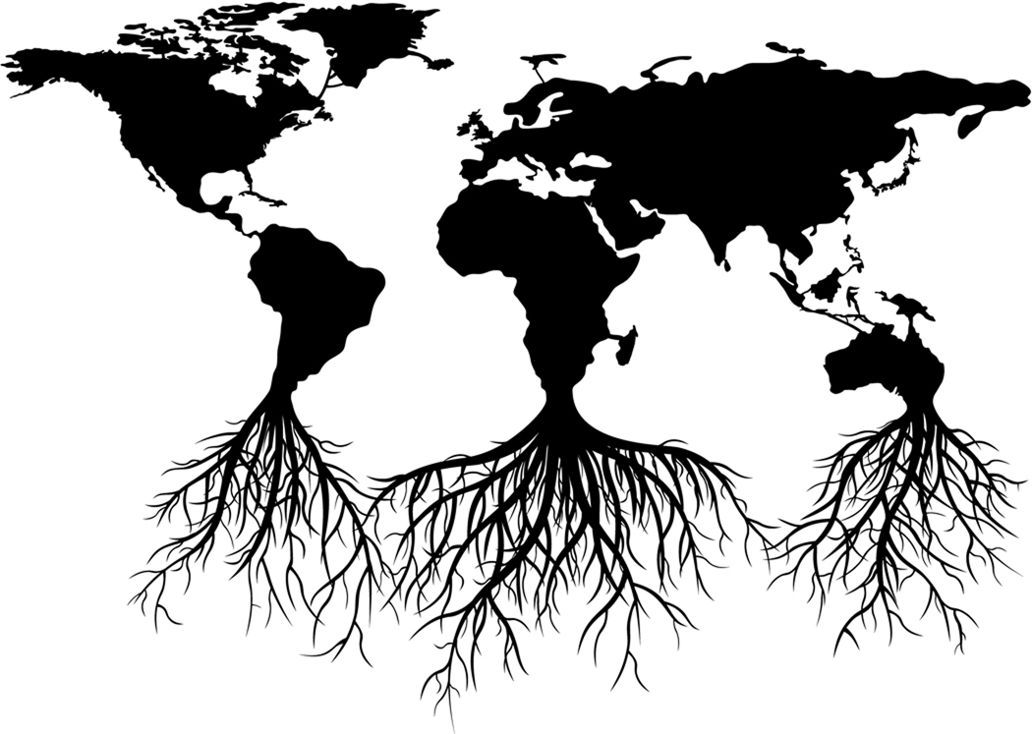
Map
Interface
Input: <in_key, in_value> pair => <url, content>
Output: list of intermediate <key, value> pairs => list of <word, url>
<every, http://url0.com>
<happy, http://url0.com>
<family, http://url0.com>
…
key = http://url0.com
value = “every happy family is alike.”
map()
<every, http://url1.com>
<unhappy, http://url1.com>
<family, http://url1.com>
…
key = http://url1.com
value = “every unhappy family is unhappy in its own way.”
Map Input: <url, content>
Map Output: list of <word, url>

Slide 20
Shuffle
MapReduce system
Collects outputs from all map executions
Groups all intermediate values by the same key
<every, http://url0.com>
<happy, http://url0.com>
<family, http://url0.com>
…
every -> http://url0.com
http://url1.com
happy -> http://url0.com
<every, http://url1.com>
<unhappy, http://url1.com>
<family, http://url1.com>
…
unhappy -> http://url1.com
family -> http://url0.com
http://url1.com
Map Output: list of <word, url>
Reduce Input: <word, list of urls>

Slide 21
Reduce
Interface
Input: <out_key, list of intermediate_value>
Output: <out_key, out_value>
every -> http://url0.com
http://url1.com
<every, “http://url0.com,
http://url1.com”>
reduce()
happy -> http://url0.com
<happy,
“http://url0.com”>
unhappy -> http://url1.com
<unhappy,
“http://url1.com”>
family -> http://url0.com
http://url1.com
<family, “http://url0.com,
http://url1.com”>
Reduce Input: <word, list of urls>
Reduce Output: <word, string of urls>

Slide 22
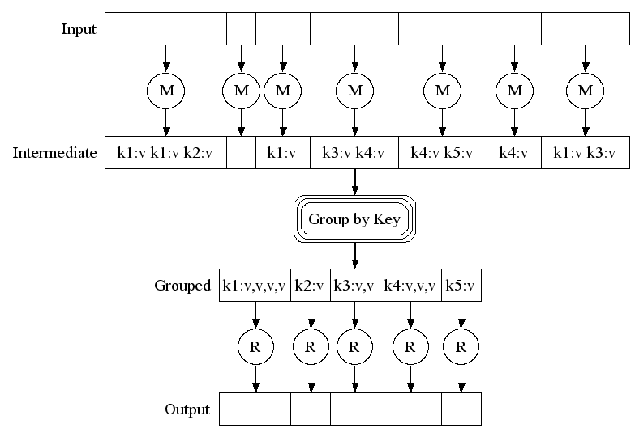
Execution Overview
Map phase
Shuffle phase
Reduce phase

Slide 23
Implementing MapReduce
Externally for user
Write a map function, and a reduce function
Submit a job; wait for result
No need to know anything about the environment (Google: 4000 servers + 48000 disks, many failures)
Internally for MapReduce system designer
Run map in parallel
Shuffle: combine map results to produce reduce input
Run reduce in parallel
Deal with failures

Slide 24
Execution Overview
Master
Input files sent to map tasks
Intermediate keys partitioned into reduce tasks
M
R
M
Input Files
R
Output
M
Reduce workers
Map workers

Slide 25
Task Assignment
Master
Worker pull
Worker signals idle
Master assigns task
Task retrieves data
Task executes
M
R
M
Input Splits
R
Output
M
Reduce workers
Map workers

Slide 26
Fault-tolerance: Re-execution
Master
Re-execute on failure
1
M
1
R
M
Input Splits
R
Output
M
Reduce workers
Map workers

Slide 27
Machines Share Roles
Master
So far, logical view of cluster
In reality
Each cluster machine stores data
And runs MapReduce workers
Lots of storage + compute cycles nearby
M
M
R
R
M
M
R
R
M
M
R
R

Slide 28
Problems of MapReduce
Any you can think of?
There’s only two functions you can work with (not expressive enough sometimes.)
Functional-style (a barrier for some people)
Turing completeness (or computationally universal)
If it can simulate a single-taped Turing machine.
Most general languages (C/C++, Java, Lisp, etc.) are.
SQL is.
MapReduce is not.

Slide 29
Pig
Why Pig?
MapReduce has limitations: only two functions
Many tasks require more than one MapReduce
Functional thinking: barrier for some
Pig
Defines a set of high-level simple “commands”
Compiles the commands and generates multiple MapReduce jobs
Runs them in parallel

Slide 30
Pig Example
load ‘/data/visits’;
group visits by url;
foreach gVisits generate url, count(visits);
load ‘/data/urlInfo’;
join visitCounts by url, urlInfo by url;
group visitCounts by category;
foreach gCategories generate top(visitCounts,10);

Slide 31
Pig Example
Load Visits
Map₁
Group by url
Reduce₁
Map₂
Foreach url
generate count
Load Url Info
Join on url
Reduce₂
Map₃
Group by category
Reduce₃
Foreach category
generate top10(urls)

Slide 32
Summary
Data analytics shifts the focus from computation to data.
Many programming paradigms are emerging.
MapReduce
Pig
Many others

Slide 33
More Details
Papers
J. Dean and S. Ghemawat, “MapReduce: Simplified Data Processing on Large Clusters,” OSDI 2004
C. Olston, B. Reed, U. Srivastava, R. Kumar, and A. Tomkins, “Pig Latin: A Not-So-Foreign Language For Data Processing,” SIGMOD 2008
URLs
http://hadoop.apache.org/core/
http://wiki.apache.org/hadoop/
http://hadoop.apache.org/pig/
http://wiki.apache.org/pig/
Slides
http://labs.google.com/papers/mapreduce-osdi04-slides/index.html
http://www.systems.ethz.ch/education/past-courses/hs08/map-reduce/slides/intro.pdf
http://www.cs.uiuc.edu/class/sp09/cs525/L4tmp.B.ppt
http://infolab.stanford.edu/~usriv/talks/sigmod08-pig-latin.ppt

Slide 34
Acknowledgements
These slides contain material developed and copyrighted by Indranil Gupta (UIUC).

