Slide 1
CSE 486/586 Distributed Systems Logical Time
Steve Ko
Computer Sciences and Engineering
University at Buffalo

Slide 2
Last Time
Clock skews do happen
Cristian’s algorithm
One server
Server-side timestamp and one-way delay estimation
NTP (Network Time Protocol)
Hierarchy of time servers
Estimates the actual offset between two clocks
Designed for the Internet

Slide 3
Then a Breakthrough…
We cannot sync multiple clocks perfectly.
Thus, if we want to order events happened at different processes (remember the ticket reservation example?), we cannot rely on physical clocks.
Then came logical time.
First proposed by Leslie Lamport in the 70’s
Based on causality of events
Defined relative time, not absolute time
Critical observation: time (ordering) only matters if two or more processes interact, i.e., send/receive messages.

Slide 4

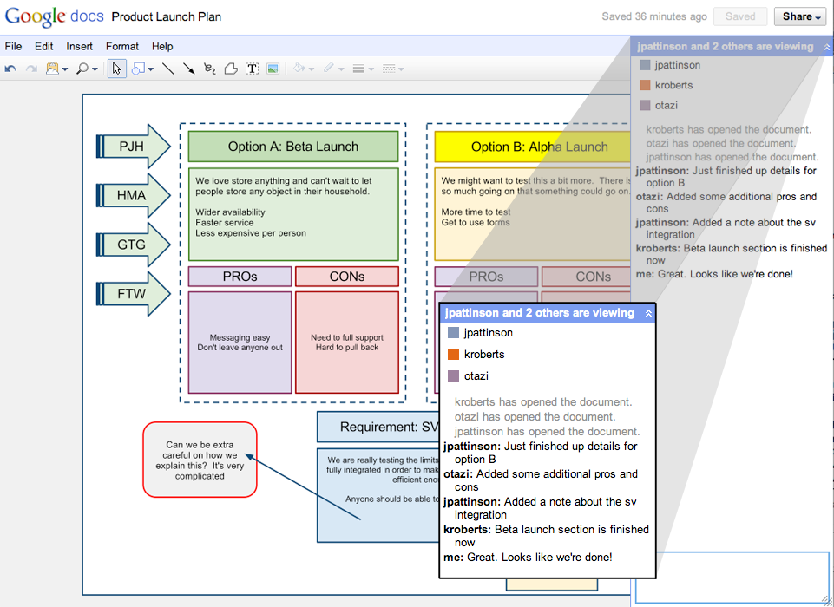
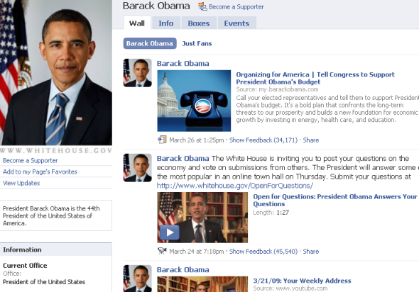
Ordering Basics
Why did we want to synchronize physical clocks?
What we need: Ordering of events.
Arises in many different contexts…

Slide 5
Abstract View
Background: we’ll think of a program as a collection of actions: instruction, send, and receive events.
Above is what we will deal with most of the time.
This is the execution view of a distributed system.
Ordering question: what do we ultimately want?
Taking two events and determine the ordering of the two.
Physical time

Slide 6
What Ordering?
Ideal?
Perfect physical clock synchronization
Reliably?
Events in the same process
Send/receive events
Physical time
Notes:
Must explain that reliably we can determine the two types of ordering

Slide 7
Lamport Timestamps
Goal: take any two events, and determine the ordering of the two.
It uses a single number to do so.
Physical time

Slide 8
Logical Clocks
Lamport algorithm assigns logical timestamps:
All processes use a counter (clock) with initial value of zero
A process increments its counter when a send or an instruction happens at it. The counter is assigned to the event as its timestamp.
A send (message) event carries its timestamp
For a receive (message) event the counter is updated by max(local clock, message timestamp) + 1
Define a logical relation happened-before (→) among events:
On the same process: a → b, if time(a) < time(b)
If p1 sends m to p2: send(m) → receive(m)
(Transitivity) If a → b and b → c then a → c
Shows causality of events

Slide 9
CSE 486/586 Administrivia
PA2A is out. Two points:
Multicast: Need to send each message to every instance including the one that sends the message. Just create 5 connections (5 sockets) and send a message 5 times through different connections.
ContentProvider: Don’t call it directly. Don’t share anything with the main activity. Consider it an almost separate app only accessible via ContentResolver.
Please pay attention to your coding style.

Slide 10
Find the Mistake: Lamport Logical Time
Physical Time
p 1
0
1
2
4
3
1
p 2
3
4
0
2
2
3
6
p 3
4
0
3
5
6
8
4
7
p 4
0
5
6
7
n
Clock Value
timestamp
Message

Slide 11
Corrected Example: Lamport Logical Time
Physical Time
p 1
0
1
2
8
7
1
p 2
3
8
0
2
2
3
6
p 3
4
0
3
5
9
10
4
7
p 4
0
5
6
7
n
Clock Value
timestamp
Message

Slide 12
One Issue
Physical Time
p 1
0
1
2
8
7
1
p 2
3
8
0
2
2
3
6
p 3
4
0
3
5
9
10
4
7
p 4
0
5
6
7
n
Clock Value
3 and 7 are logically concurrent events
timestamp
Message
Notes:
Lamport clock has “true” happened-before and “false” happened-before (concurrent events).

Slide 13
Vector Timestamps
With Lamport clock
e “happened-before” f ⇒ timestamp(e) < timestamp (f), but
timestamp(e) < timestamp (f) ⇒ e “happened-before” f
Idea?
Each process keeps a separate clock & pass them around.
Each process learns about what happened in all others.
X
Physical time

Slide 14
Vector Logical Clocks
Vector Logical time addresses the issue:
All processes use a vector of counters (logical clocks), i^{th} element is the clock value for process i, initially all zero.
Each process i increments the i^{th} element of its vector upon an instruction or send event. Vector value is timestamp of the event.
A send(message) event carries its vector timestamp (counter vector)
For a receive(message) event, V_{receiver}[j] =
Max(V_{receiver}[j] , V_{message}[j]), if j is not self,
V_{receiver}[j] + 1, otherwise
Key point
You update your own clock. For all other clocks, rely on what other processes tell you and get the most up-to-date values.

Slide 15
Find a Mistake: Vector Logical Time
Physical Time
p 1
1,0,0,0
2,0,0,0
4,0,2,2
0,0,0,0
3,0,2,2
(1,0,0,0)
p 2
1,2,0,0
(4,0,2,2)
0,0,0,0
1,1,0,0
(2,0,0,0)
(1,2,0,0)
(2,0,2,2)
p 3
0,0,0,0
2,0,2,0
2,0,1,0
2,2,3,0
4,2,4,2
4,2,5,3
(2,0,2,0)
(2,0,2,3)
p 4
0,0,0,0
2,0,2,2
2,0,2,1
2,0,2,3
n,m,p,q
Vector logical clock
(vector timestamp)
Message

Slide 16
Comparing Vector Timestamps
VT₁ = VT₂,
iff VT₁[i] = VT₂[i], for all i = 1, … , n
VT₁ <= VT₂,
iff VT₁[i] <= VT₂[i], for all i = 1, … , n
VT₁ < VT₂,
iff VT₁ <= VT₂ & ∃ j (1 <= j <= n & VT₁[j] < VT₂ [j])
VT₁ is concurrent with VT₂
iff (not VT₁ <= VT₂ AND not VT₂ <= VT₁)

Slide 17
The Use of Logical Clocks
Is a design decision
NTP error bound
Local: a few ms
Wide-area: 10’s of ms
If your system doesn’t care about this inaccuracy, then NTP should be fine.
Logical clocks impose an arbitrary order over concurrent events anyway
Breaking ties: process IDs, etc.

Slide 18
Summary
Relative order of events enough for practical purposes
Lamport’s logical clocks
Vector clocks
Next: How to take a global snapshot

Slide 19
Acknowledgements
These slides contain material developed and copyrighted by Indranil Gupta at UIUC.

