Slide 1
CSE 486/586 Distributed Systems
Web Content Distribution---2
Case Study: Facebook Haystack
Steve Ko
Computer Sciences and Engineering
University at Buffalo

Slide 2

Recap
Engineering principle
  Make the common case fast, and rare cases correct
  (From Patterson & Hennessy books)
  This principle cuts through generations of systems.
Example?
  CPU Cache
Knowing common cases == understanding your workload
  E.g., read dominated? Write dominated? Mixed?

Slide 3
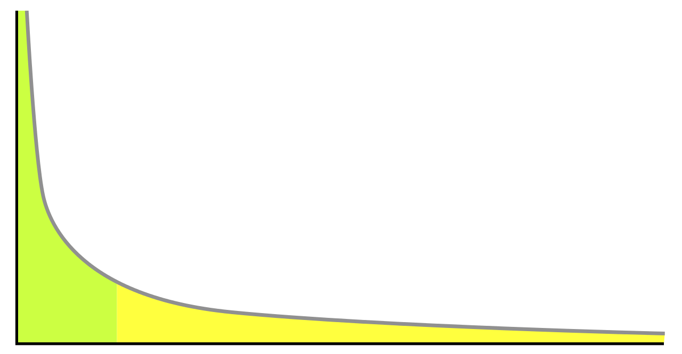
Recap
“Hot” vs. “very warm” vs. “warm” photos
  Hot: Popular, a lot of views
  Very warm: Somewhat popular, still a lot of views
  Warm: Unpopular, but still a lot of views in aggregate
Popularity
Items sorted by popularity

Slide 4
“Very warm” and “warm” Photos
Hot photos are served by a CDN.
Warm photo characteristics
  Not so much popular
  Not entirely “cold,” i.e., occasional views
  A lot in aggregate
  Does not want to cache everything in CDN due to diminishing returns
Facebook stats (in their 2010 paper)
  260 billion images (~20 PB)
  1 billion new photos per week (~60 TB)
  One million image views per second at peak
  Approximately 10% not served by CDN, but still a lot

Slide 5
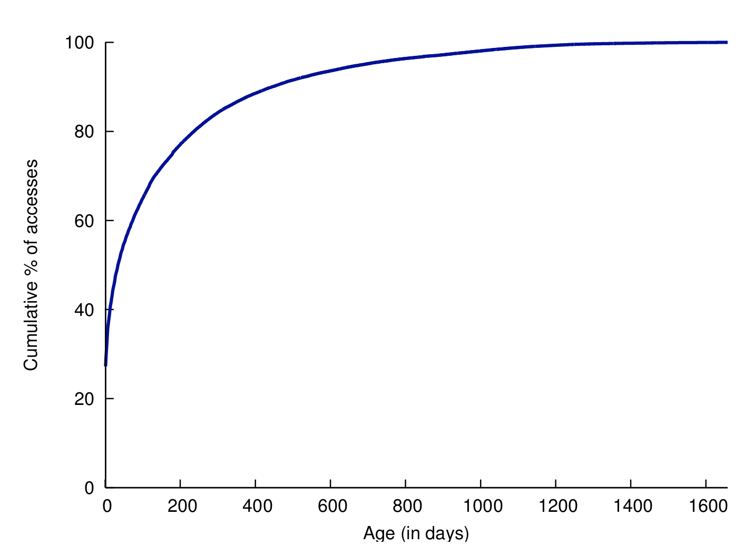
Popularity Comes with Age

Slide 6
Facebook Photo Storage
Three generations of photo storage
  NFS-based (today)
  Haystack (today): Very warm photos
  f4 (next time): Warm photos
Characteristics
  After-CDN storage
  Each generation solves a particular problem observed from the previous generation.

Slide 7
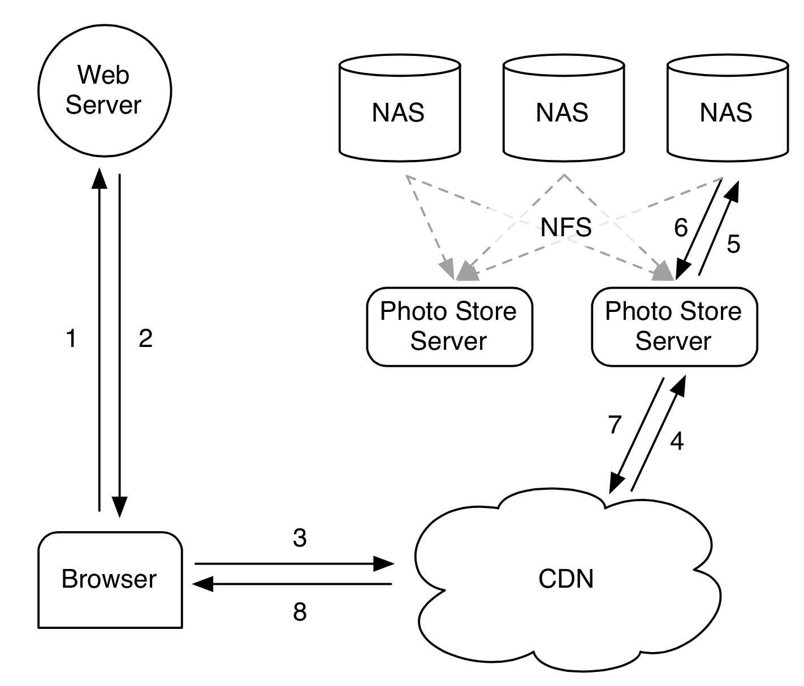
1st Generation: NFS-Based
Notes:
Browser sends an HTTP request
Web server returns a CDN URL. (Akamai)
If CDN has it, returns
If not, retrieves from the photo store.

Slide 8
1st Generation: NFS-Based
Each photo → single file
Observed problem
  Thousands of files in each directory
  Extremely inefficient due to meta data management
  10 disk operations for a single image: chained filesystem inode reads for its directory and itself & the file read
In fact, a well-known problem with many files in a directory
  Be aware when you do this.
  The inode space (128 or 256 bytes) runs out.
  A lot of operations necessary for meta data retrieval.

Slide 9
CSE 486/586 Administrivia
Final: 5/18/2017, Thursday, 6 pm – 8 pm, Knox 110

Slide 10
2nd Generation: Haystack
Custom-designed photo storage
What would you try? (Hint: too many files!)
  Starting point: One big file with many photos
Reduces the number of disk operations required to one
  All meta data management done in memory
Design focus
  Simplicity
  Something buildable within a few months
Three components
  Directory
  Cache
  Store

Slide 11
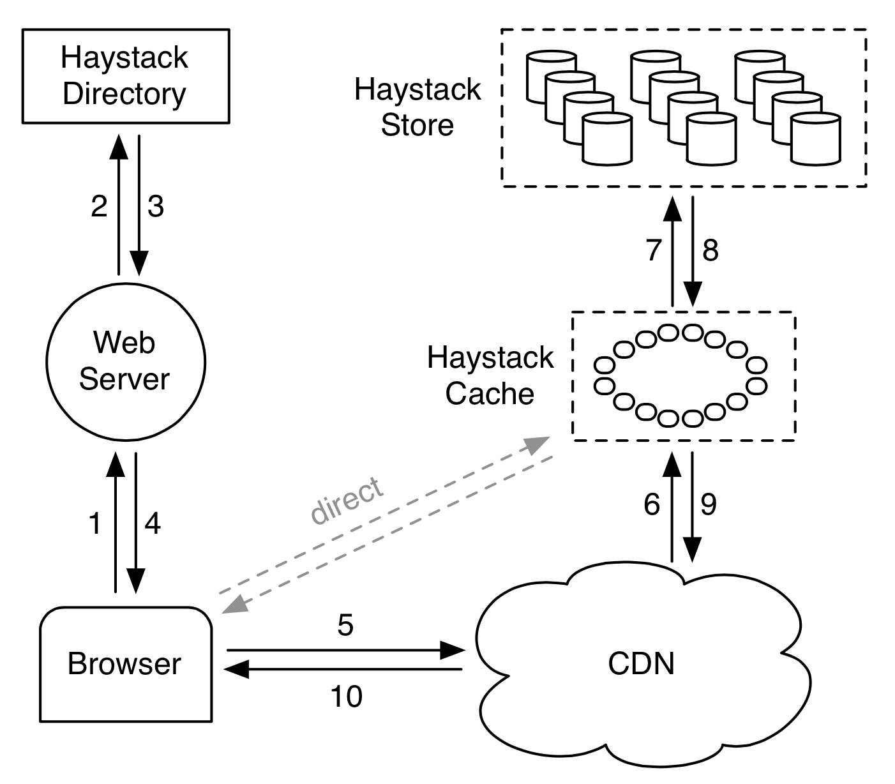
Haystack Architecture
Notes:
Browser HTTP request
Directory lookup for photos (Web server constructs these URLs)
Depending on the URL, browser contacts CDN or Cache.

Slide 12
Haystack Directory
Helps the URL construction for an image
  http://⟨CDN⟩/⟨Cache⟩/⟨Machine id⟩/⟨Logical volume, Photo⟩
  Staged lookup
  CDN strips out its portion.
  Cache strips out its portion.
  Machine strips out its portion
Logical & physical volumes
  A logical volume is replicated as multiple physical volumes
  Physical volumes are stored.
  Each volume contains multiple photos.
  Directory maintains this mapping

Slide 13
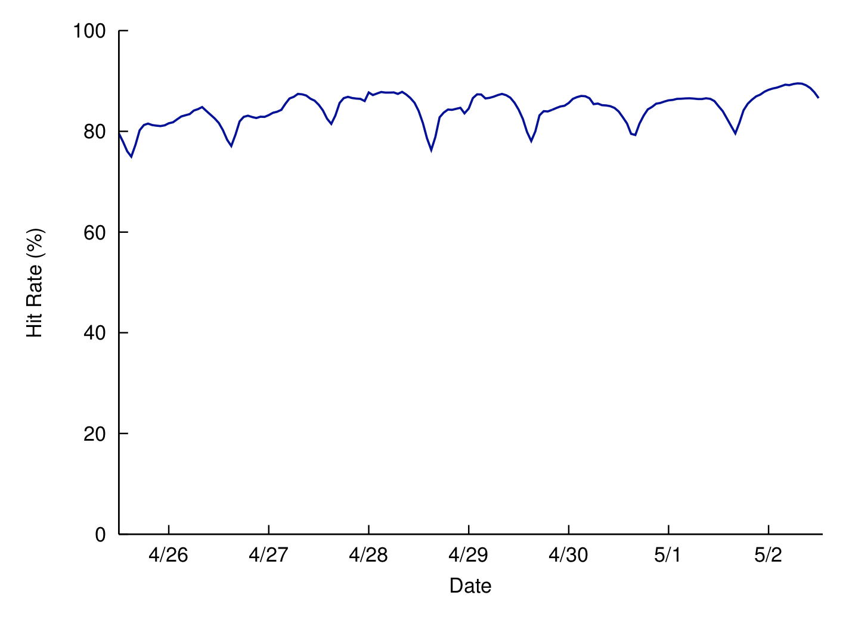
Haystack Cache
Facebook-operated CDN using DHT
  Photo IDs as the key
Further removes traffic to Store
  Mainly caches newly-uploaded photos
High cache hit rate (due to caching new photos)

Slide 14
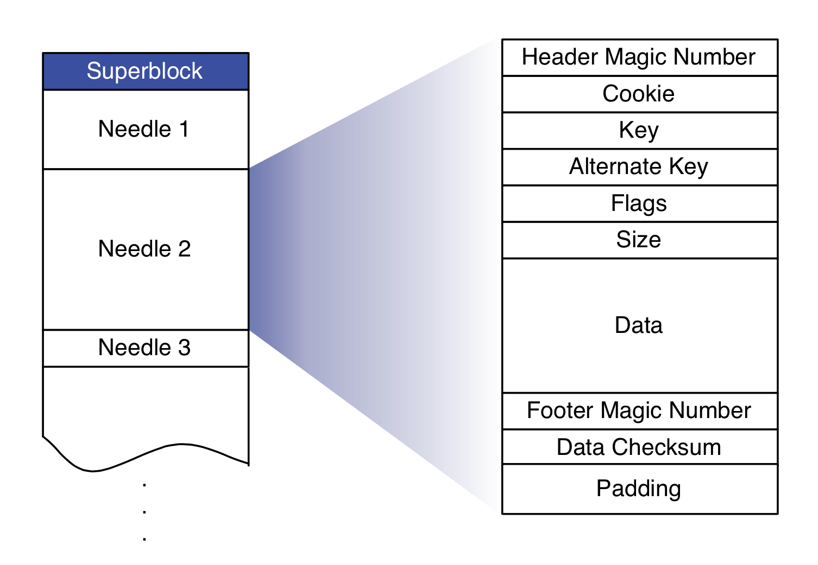
Haystack Store
Maintains physical volumes
One volume is a single large file (100GB) with many photos (needles)
Notes:
Cookie: random number embedded in the URL
Key: photo id
Alternate key: photo size key (small, medium, etc.)
Flags: delete status
Padding for 8-byte alignment

Slide 15
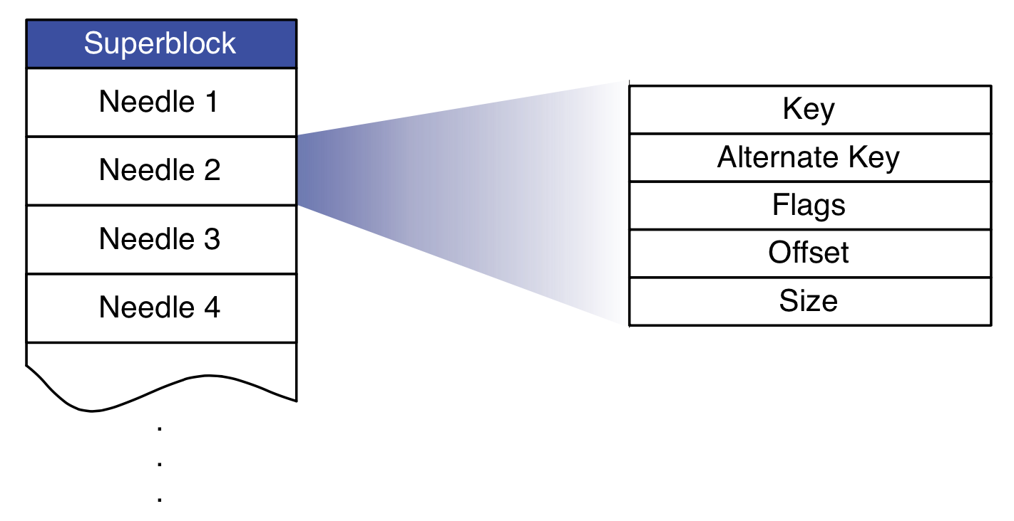
Haystack Store
Metadata managed in memory
  (key, alternate key) to (flags, size, volume offset)
  Quick lookup for both read and write
  Disk operation only required for actual image read
Write/delete
  Append-only
  Delete is marked, later garbage-collected.
Indexing
  For fast memory metadata construction

Slide 16
Daily Stats with Haystack
Photos uploaded: ~120 M
Haystack photos written: ~1.44 B
Photos viewed: 80 – 100 B
  Thumbnails: 10.2%
  Small: 84.4%
  Medium: 0.2%
  Large: 5.2%
Haystack photos read: 10 B

Slide 17
Summary
Two different types of workload for a social networking Web service
  Posts: read/write
  Photos: write-once, read-many
Photo workload
  Zipf distribution
  “Hot” photos can be handled by CDN
  “Warm” photos have diminishing returns.
Haystack: Facebook’s 2nd generation photo storage
  Goal: reducing disk I/O for warm photos
  One large file with many photos
  Metadata stored in memory
  Internal CDN

