Slide 1
CSE 490/590 Computer Architecture
Introduction
Steve Ko
Computer Sciences and Engineering
University at Buffalo

Slide 2
What is Computer Architecture?
Application
Gap too large to bridge in one step
(but there are exceptions, e.g. magnetic compass)
Physics
In its broadest definition, computer architecture is the design of the abstraction layers that allow us to implement information processing applications efficiently using available manufacturing technologies.

Slide 3
Abstraction Layers in Modern Systems
Application
Algorithm
Programming Language
Operating System/Virtual Machines
Instruction Set Architecture (ISA)
CSE 490/590
Microarchitecture
Gates/Register-Transfer Level (RTL)
Circuits
Devices
Physics

Slide 4
Architecture continually changing
Applications suggest how to improve technology, provide revenue to fund development
Improved technologies make new applications possible
Applications
Technology
Cost of software development makes compatibility a major force in market
Compatibility

Slide 5
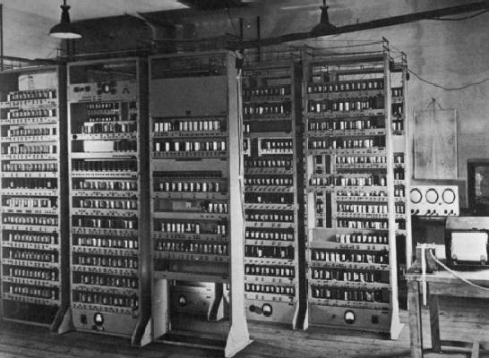
Computing Devices Then…
EDSAC, University of Cambridge, UK, 1949

Slide 6
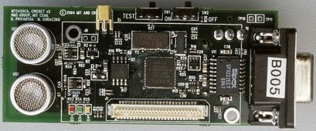

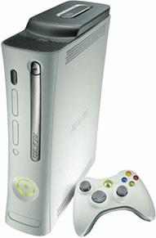
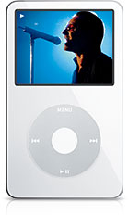

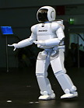
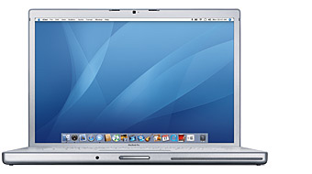

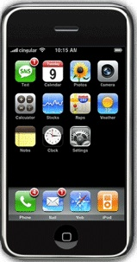

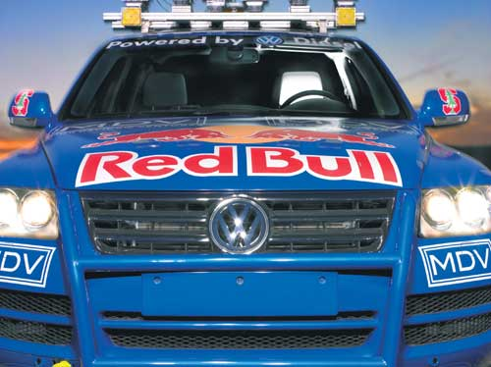
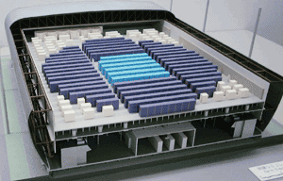
Computing Devices Now
Sensor Nets
Cameras
Games
Set-top boxes
Media Players
Laptops
Servers
Robots
Routers
Smart phones
Automobiles
Supercomputers

Slide 7
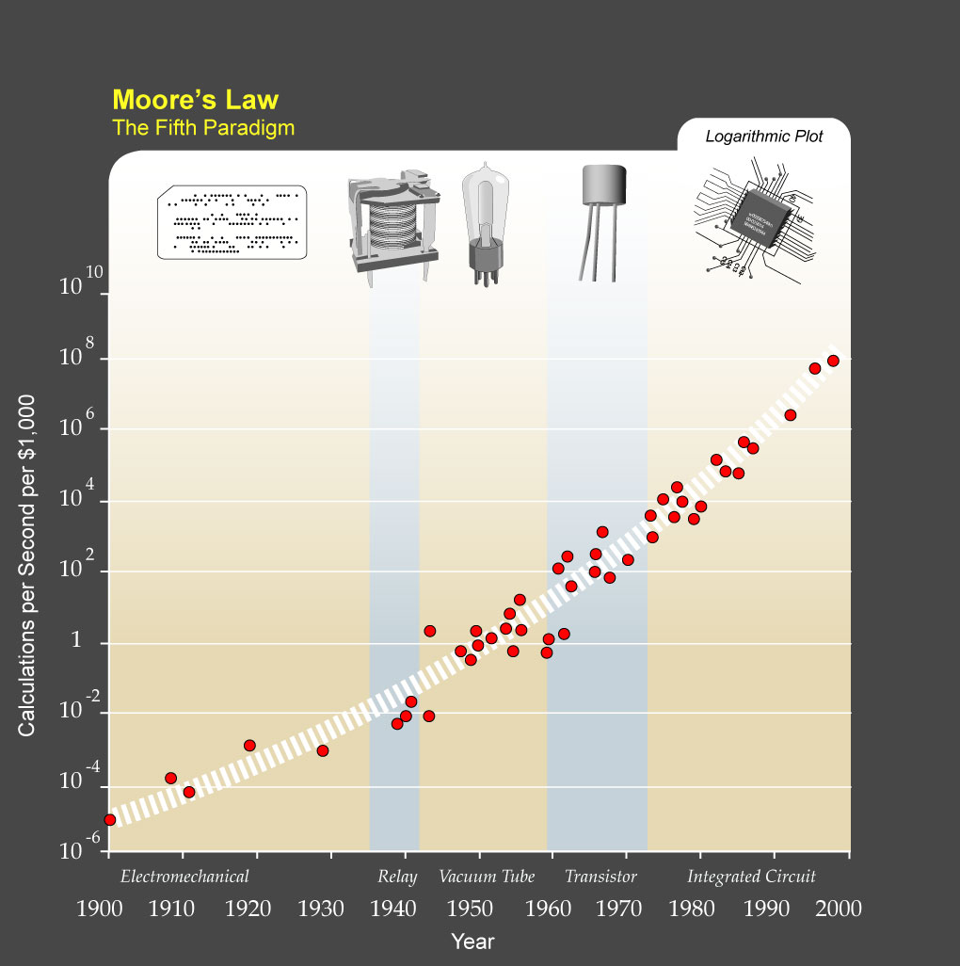
?
Major Technology Generations
CMOS
Bipolar
nMOS
Vacuum Tubes
pMOS
Relays
[from Kurzweil]
Electromechanical

Slide 8
Uniprocessor Performance
From Hennessy and Patterson, Computer Architecture: A Quantitative Approach, 4th edition, October, 2006
What happened????
VAX : 25%/year 1978 to 1986
RISC + x86: 52%/year 1986 to 2002
RISC + x86: ??%/year 2002 to present

Slide 9
The End of the Uniprocessor Era
Single biggest change in the history of computing systems

Slide 10
Crossroads: Conventional Wisdom in Comp. Arch
Old Conventional Wisdom: Power is free, Transistors expensive
New Conventional Wisdom: “Power wall” Power expensive, Xtors free
(Can put more on chip than can afford to turn on)
Old CW: Sufficiently increasing Instruction Level Parallelism via compilers, innovation (Out-of-order, speculation, VLIW, …)
New CW: “ILP wall” law of diminishing returns on more HW for ILP
Old CW: Multiplies are slow, Memory access is fast
New CW: “Memory wall” Memory slow, multiplies fast
(200 clock cycles to DRAM memory, 4 clocks for multiply)
Old CW: Uniprocessor performance 2X / 1.5 yrs
New CW: Power Wall + ILP Wall + Memory Wall = Brick Wall
  Uniprocessor performance now 2X / 5(?) yrs
⇒ Sea change in chip design: multiple “cores”
(2X processors per chip / ~ 2 years)
    More simpler processors are more power efficient

Slide 11
Déjà vu all over again?
Multiprocessors imminent in 1970s, ‘80s, ‘90s, …
“… today’s processors … are nearing an impasse as technologies approach the speed of light..”
David Mitchell, The Transputer: The Time Is Now (1989)
Transputer was premature
⇒ Custom multiprocessors strove to lead uniprocessors
⇒ Procrastination rewarded: 2X seq. perf. / 1.5 years
“We are dedicating all of our future product development to multicore designs. … This is a sea change in computing”
Paul Otellini, President, Intel (2004)
Difference is all microprocessor companies switch to multiprocessors (AMD, Intel, IBM, Sun; all new Apples 2 CPUs)
⇒ Procrastination penalized: 2X sequential perf. / 5 yrs
⇒ Biggest programming challenge: 1 to 2 CPUs

Slide 12
Problems with Sea Change
Algorithms, Programming Languages, Compilers, Operating Systems, Architectures, Libraries, … not ready to supply Thread Level Parallelism or Data Level Parallelism for 1000 CPUs / chip,
Architectures not ready for 1000 CPUs / chip
  Unlike Instruction Level Parallelism, cannot be solved by just by computer architects and compiler writers alone, but also cannot be solved without participation of computer architects
This 4th Edition of textbook Computer Architecture: A Quantitative Approach explores shift from Instruction Level Parallelism to Thread Level Parallelism / Data Level Parallelism

Slide 13
CSE 490/590 Course Focus
Understanding the design techniques, machine structures, technology factors, evaluation methods that will determine the form of computers in 21st Century
Technology
Parallelism
Programming
Languages
Applications
Interface Design
(ISA)
Computer Architecture:
• Organization
• Hardware/Software Boundary
Compilers
Operating
Measurement & Evaluation
Systems
History

Slide 14
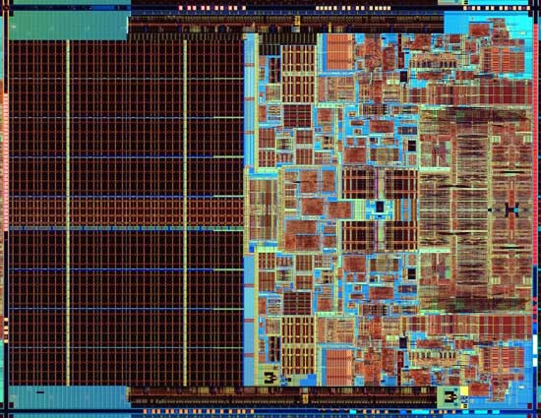
CSE 490/590 Executive Summary
What you’ll understand and experiment with in CSE 490/590
The processor of focus in traditional architecture courses
Plus, the technology behind chip-scale multiprocessors (CMPs)
Notes:
Photo is of an Intel Conroe (Core 2 Duo Desktop processor). Photo taken from Intel web site.

Slide 15
CSE 490/590 Administrivia
Instructor: Steve Ko
Office: 210 Bell Hall, stevko@buffalo.edu
Office Hours: Wed. 9am-12PM
TAs: Safwan Weshah, srwshah@buffalo.edu
Jangyoung Kim, jangyoun@buffalo.edu
Office Hours: TBD
Lectures: MWF, 12pm-12:50pm, 97 Alumni
Recitations: M 9am-9:50am, W 10am-10:50am, F 11am-11:50am
Text: Computer Architecture: A Quantitative Approach,
4th Edition (Oct, 2006)
Web page: http://www.cse.buffalo.edu/~stevko/courses/cse490/spring11
Lectures available online the morning before class
Notes:
This slide is for the 3-min class administrative matters.
Make sure we update Handout #1 so it is consistent with this slide.

Slide 16
CSE 490/590 Structure and Syllabus
(Tentative) Five modules
  Simple machine design (ISAs, microprogramming, unpipelined machines, Iron Law, simple pipelines)
  Memory hierarchy (DRAM, caches, optimizations) plus virtual memory systems, exceptions, interrupts
  Complex pipelining (score-boarding, out-of-order issue)
  Explicitly parallel processors (vector machines, VLIW machines, multithreaded machines)
  Multiprocessor architectures (cache coherence, memory models, synchronization)
Notes:
This is the 1st slide of the “Course Structure and Course Philosophy” section of the lecture.
Need to emphasis that for exams, our goal is the test your knowledge. It is not our goal to test how well your perform under time pressure.

Slide 17
CSE 490/590 Course Components
2 Quizzes (20%)
2 Exams
  In-class, closed-book, no calculators or computers.
  Based on lectures and problem sets
  Midterm 20%
  Final 25%
35% Projects
  One project to get you familiarized with the BASYS2 board (5%)
  Another more substantial project you can choose from a list (30%)
  The list will be up before the project 1 deadline.

Slide 18
Recitations & HW Assignments
It is very, very important to attend the recitations.
Why?
  For the first 5 weeks, we will cover Verilog and how to use BASYS2 board.
  This is different from previous offerings.
To counter the load, I will slow down in the beginning.
Projects are a big part of this course.
There will be homework assignments, but we will not grade them.
  The main purpose is to help you understand the materials.

Slide 19
Late Submission & Regrading
Late submission
  Submissions are always due in the beginning of the class.
  Late submissions will result in 20% penalty a day.
  After 5 days, it’ll be 0%.
Regrading
  Regrade requests are due no later than 1 week.
  Regrade requests must be clearly written and attached to the assignment.
  When submitted, everything will be regraded, not just the one you have a question on. This may result in a lower grade.
  Work done in pencil will not be considered.

Slide 20
Purchase BASYS2 Board!
You need to purchase it as soon as possible!
http://www.digilentinc.com/Products/Detail.cfm?Prod=BASYS2
Get the student version ($49)

Slide 21
And in conclusion …
Computer Architecture >> ISAs and RTL
CSE 490/590 is about interaction of hardware and software, and design of appropriate abstraction layers
Computer architecture is shaped by technology and applications
  History provides lessons for the future
Computer Science at the crossroads from sequential to parallel computing
  Salvation requires innovation in many fields, including computer architecture
Read Chapter 1 for next time!

Slide 22
Acknowledgements
These slides heavily contain material developed and copyright by
  Krste Asanovic (MIT/UCB)
  David Patterson (UCB)
And also by:
  Arvind (MIT)
  Joel Emer (Intel/MIT)
  James Hoe (CMU)
  John Kubiatowicz (UCB)
MIT material derived from course 6.823
UCB material derived from course CS252

