Slide 1
CSE 490/590 Computer Architecture
Intro II & Trends
Steve Ko
Computer Sciences and Engineering
University at Buffalo

Slide 2
Instruction Set Architecture: Critical Interface
software
instruction set
hardware
Properties of a good abstraction
  Lasts through many generations (portability)
  Used in many different ways (generality)
  Provides convenient functionality to higher levels
  Permits an efficient implementation at lower levels

Slide 3
Example: MIPS
r0
r1
°
°
°
r31
0
Programmable storage
2^32 x bytes
31 x 32-bit GPRs (R0=0)
32 x 32-bit FP regs (paired DP)
HI, LO, PC
Data types ?
Format ?
Addressing Modes?
PC
lo
hi
  Arithmetic logical
  Add, AddU, Sub, SubU, And, Or, Xor, Nor, SLT, SLTU,
  AddI, AddIU, SLTI, SLTIU, AndI, OrI, XorI, LUI
  SLL, SRL, SRA, SLLV, SRLV, SRAV
  Memory Access
  LB, LBU, LH, LHU, LW, LWL,LWR
  SB, SH, SW, SWL, SWR
  Control
  J, JAL, JR, JALR
  BEq, BNE, BLEZ,BGTZ,BLTZ,BGEZ,BLTZAL,BGEZAL
32-bit instructions on word boundary

Slide 4
Instruction Set Architecture
“... the attributes of a [computing] system as seen by the programmer, i.e. the conceptual structure and functional behavior, as distinct from the organization of the data flows and controls the logic design, and the physical implementation.” – Amdahl, Blaauw, and Brooks, 1964
SOFTWARE
-- Organization of Programmable
Storage
-- Data Types & Data Structures:
Encodings & Representations
-- Instruction Formats
-- Instruction (or Operation Code) Set
-- Modes of Addressing and Accessing Data Items and Instructions
-- Exceptional Conditions

Slide 5
ISA vs. Computer Architecture
Old definition of computer architecture
= instruction set design
  Other aspects of computer design called implementation
  Insinuates implementation is uninteresting or less challenging
New view is computer architecture >> ISA
Architect’s job much more than instruction set design; technical hurdles today more challenging than those in instruction set design

Slide 6
Comp. Arch. is an Integrated Approach
What really matters is the functioning of the complete system
  hardware, runtime system, compiler, operating system, and application
  In networking, this is called the “End to End argument”
Computer architecture is not just about transistors, individual instructions, or particular implementations
  E.g., Original RISC projects replaced complex instructions with a compiler + simple instructions

Slide 7
Computer Architecture is
Design and Analysis
Architecture is an iterative process:
Searching the space of possible designs
At all levels of computer systems
Creativity
Cost /
Performance
Analysis
Good Ideas
Mediocre Ideas
Bad Ideas

Slide 8
What Computer Architecture brings to Table
Other fields often borrow ideas from architecture
Quantitative Principles of Design
  Take Advantage of Parallelism
  Principle of Locality
  Focus on the Common Case
  Amdahl’s Law
  The Processor Performance Equation
Careful, quantitative comparisons
  Define, quantify, and summarize relative performance
  Define and quantify relative cost
  Define and quantify dependability
  Define and quantify power

Slide 9
1) Taking Advantage of Parallelism
Increasing throughput of server computer via multiple processors or multiple disks
Detailed HW design
  Carry lookahead adders uses parallelism to speed up computing sums from linear to logarithmic in number of bits per operand
  Multiple memory banks searched in parallel in set-associative caches
Pipelining: overlap instruction execution to reduce the total time to complete an instruction sequence.
  Not every instruction depends on immediate predecessor ⇒ executing instructions completely/partially in parallel possible
  Classic 5-stage pipeline:
  1) Instruction Fetch (Ifetch),
  2) Register Read (Reg),
  3) Execute (ALU),
  4) Data Memory Access (Dmem),
  5) Register Write (Reg)

Slide 10
Pipelined Instruction Execution
Time (clock cycles)
Cycle 1
Cycle 2
Cycle 3
Cycle 4
Cycle 5
Cycle 6
Cycle 7
I
n
s
t
r.
O
r
d
e
r
Ifetch
Reg
ALU
DMem
Reg
Ifetch
Reg
ALU
DMem
Reg
Ifetch
Reg
ALU
DMem
Reg
Ifetch
Reg
ALU
DMem
Reg

Slide 11
Limits to pipelining
Hazards prevent next instruction from executing during its designated clock cycle
  Structural hazards: attempt to use the same hardware to do two different things at once
  Data hazards: Instruction depends on result of prior instruction still in the pipeline
  Control hazards: Caused by delay between the fetching of instructions and decisions about changes in control flow (branches and jumps).
Time (clock cycles)
I
n
s
t
r.
O
r
d
e
r
Ifetch
Reg
ALU
DMem
Reg
Ifetch
Reg
ALU
DMem
Reg
Ifetch
Reg
ALU
DMem
Reg
Ifetch
Reg
ALU
DMem
Reg

Slide 12
2) The Principle of Locality
The Principle of Locality:
  Program access a relatively small portion of the address space at any instant of time.
Two Different Types of Locality:
  Temporal Locality (Locality in Time): If an item is referenced, it will tend to be referenced again soon (e.g., loops, reuse)
  Spatial Locality (Locality in Space): If an item is referenced, items whose addresses are close by tend to be referenced soon
  (e.g., straight-line code, array access)
Last 30 years, HW relied on locality for memory perf.
P
$
MEM
Notes:
The principle of locality states that programs access a relatively small portion of the address space at any instant of time.
This is kind of like in real life, we all have a lot of friends. But at any given time most of us can only keep in touch with a small group of them.
There are two different types of locality: Temporal and Spatial. Temporal locality is the locality in time which says if an item is referenced, it will tend to be referenced again soon.
This is like saying if you just talk to one of your friends, it is likely that you will talk to him or her again soon.
This makes sense. For example, if you just have lunch with a friend, you may say, let’s go to the ball game this Sunday. So you will talk to him again soon.
Spatial locality is the locality in space. It says if an item is referenced, items whose addresses are close by tend to be referenced soon.
Once again, using our analogy. We can usually divide our friends into groups. Like friends from high school, friends from work, friends from home.
Let’s say you just talk to one of your friends from high school and she may say something like: “So did you hear so and so just won the lottery.”
You probably will say NO, I better give him a call and find out more.
So this is an example of spatial locality. You just talked to a friend from your high school days. As a result, you end up talking to another high school friend. Or at least in this case, you hope he still remember you are his friend.
+3 = 10 min. (X:50)

Slide 13
Levels of the Memory Hierarchy
Capacity
Access Time
Cost
Staging
Xfer Unit
CPU Registers
100s Bytes
300 – 500 ps (0.3-0.5 ns)
Registers
Upper Level
Instr. Operands
prog./compiler
1-8 bytes
faster
L1 and L2 Cache
10s-100s K Bytes
~1 ns - ~10 ns
$1000s/ GByte
L1 Cache
Blocks
cache cntl
32-64 bytes
L2 Cache
cache cntl
64-128 bytes
Main Memory
G Bytes
80ns- 200ns
~ $100/ GByte
Blocks
Memory
Pages
OS
4K-8K bytes
Disk
10s T Bytes, 10 ms
(10,000,000 ns)
~ $1 / GByte
Disk
Files
user/operator
Mbytes
Larger
Tape
infinite
sec-min
~$1 / GByte
Tape
Lower Level

Slide 14
3) Focus on the Common Case
Common sense guides computer design
  Since its engineering, common sense is valuable
In making a design trade-off, favor the frequent case over the infrequent case
  E.g., Instruction fetch and decode unit used more frequently than multiplier, so optimize it 1st
  E.g., If database server has 50 disks / processor, storage dependability dominates system dependability, so optimize it 1st
Frequent case is often simpler and can be done faster than the infrequent case
  E.g., overflow is rare when adding 2 numbers, so improve performance by optimizing more common case of no overflow
  May slow down overflow, but overall performance improved by optimizing for the normal case
What is frequent case and how much performance improved by making case faster => Amdahl’s Law

Slide 15
4) Amdahl’s Law
Best you could ever hope to do:

Slide 16
Amdahl’s Law example
New CPU 10X faster
I/O bound server, so 60% time waiting for I/O
Apparently, its human nature to be attracted by 10X faster, vs. keeping in perspective its just 1.6X faster

Slide 17
5) Processor performance equation
CPI
inst count
Cycle time
CPU time = Seconds = Instructions x Cycles x Seconds
Program Program Instruction Cycle
Inst Count CPI Clock Rate
Program X
Compiler X (X)
Inst. Set. X X
Organization X X
Technology X

Slide 18
CSE 490/590 Administrivia
Jangyoung Kim’s Office Hours
  Office: 232 Bell
  Office Hours: MWF, 1pm – 2pm
Please check the web page: http://www.cse.buffalo.edu/~stevko/courses/cse490/spring11
Don’t forget: Recitations start from next week!
Disclaimer: Lecture notes are heavily based on UC Berkeley’s materials.

Slide 19
Technology Trends

Slide 20
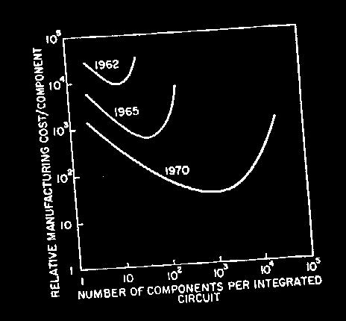
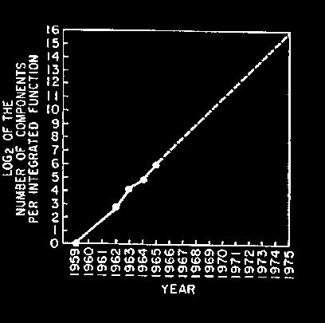
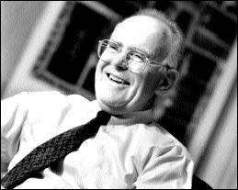
Moore’s Law: 2X transistors / “year”
“Cramming More Components onto Integrated Circuits”
  Gordon Moore, Electronics, 1965
# on transistors / cost-effective integrated circuit double every N months (12 ≤ N ≤ 24)

Slide 21
Tracking Technology Performance Trends
Drill down into 4 technologies:
  Disks,
  Memory,
  Network,
  Processors
Compare ~1980 Archaic (Nostalgic) vs.
~2000 Modern (Newfangled)
  Performance Milestones in each technology
Compare for Bandwidth vs. Latency improvements in performance over time
Bandwidth: number of events per unit time
  E.g., M bits / second over network, M bytes / second from disk
Latency: elapsed time for a single event
  E.g., one-way network delay in microseconds,
  average disk access time in milliseconds

Slide 22
Disks: Archaic(Nostalgic) v. Modern(Newfangled)
CDC Wren I, 1983
3600 RPM
0.03 GBytes capacity
Tracks/Inch: 800
Bits/Inch: 9550
Three 5.25” platters
Bandwidth:
0.6 MBytes/sec
Latency: 48.3 ms
Cache: none
Seagate 373453, 2003
15000 RPM (4X)
73.4 GBytes (2500X)
Tracks/Inch: 64000 (80X)
Bits/Inch: 533,000 (60X)
Four 2.5” platters
(in 3.5” form factor)
Bandwidth:
86 MBytes/sec (140X)
Latency: 5.7 ms (8X)
Cache: 8 MBytes

Slide 23
Latency Lags Bandwidth (for last ~20 years)
Performance Milestones
Disk: 3600, 5400, 7200, 10000, 15000 RPM (8x, 143x)
(latency = simple operation w/o contention
BW = best-case)
Notes:
Disk: 33X BW, 6X latency

Slide 24
Memory: Archaic (Nostalgic) v. Modern (Newfangled)
1980 DRAM
(asynchronous)
0.06 Mbits/chip
64,000 xtors, 35 mm²
16-bit data bus per module, 16 pins/chip
13 Mbytes/sec
Latency: 225 ns
(no block transfer)
2000 Double Data Rate Synchr.
(clocked) DRAM
256.00 Mbits/chip (4000X)
256,000,000 xtors, 204 mm²
64-bit data bus per
DIMM, 66 pins/chip (4X)
1600 Mbytes/sec (120X)
Latency: 52 ns (4X)
Block transfers (page mode)

Slide 25
Latency Lags Bandwidth (last ~20 years)
Performance Milestones
Memory Module: 16bit plain DRAM, Page Mode DRAM, 32b, 64b, SDRAM,
DDR SDRAM (4x,120x)
Disk: 3600, 5400, 7200, 10000, 15000 RPM (8x, 143x)
(latency = simple operation w/o contention
BW = best-case)
Notes:
DRAM: 120X BW, 4X latency
Jog between 3rd and 4th point is because a lot of time between 32b Fast page mode and 64b

Slide 26
LANs: Archaic (Nostalgic)v. Modern (Newfangled)
Ethernet 802.3
Year of Standard: 1978
10 Mbits/s
link speed
Latency: 3000 μsec
Shared media
Coaxial cable
Ethernet 802.3ae
Year of Standard: 2003
10,000 Mbits/s (1000X)
link speed
Latency: 190 μsec (15X)
Switched media
Category 5 copper wire
"Cat 5" is 4 twisted pairs in bundle
Coaxial Cable:
Plastic Covering
Twisted Pair:
Braided outer conductor
Insulator
Copper core
Copper, 1mm thick,
twisted to avoid antenna effect

Slide 27
Latency Lags Bandwidth (last ~20 years)
Performance Milestones
Ethernet: 10Mb, 100Mb, 1000Mb, 10000 Mb/s (16x,1000x)
Memory Module: 16bit plain DRAM, Page Mode DRAM, 32b, 64b, SDRAM,
DDR SDRAM (4x,120x)
Disk: 3600, 5400, 7200, 10000, 15000 RPM (8x, 143x)
(latency = simple operation w/o contention
BW = best-case)
Notes:
Network: 1000X BW, 13X Latency

Slide 28
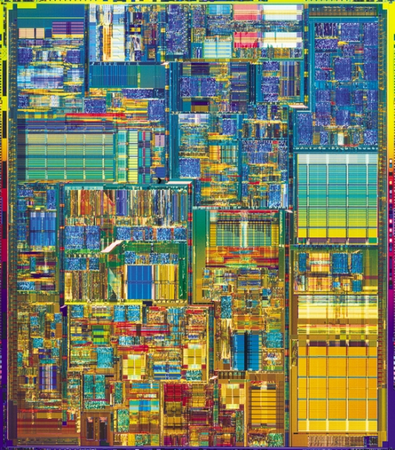
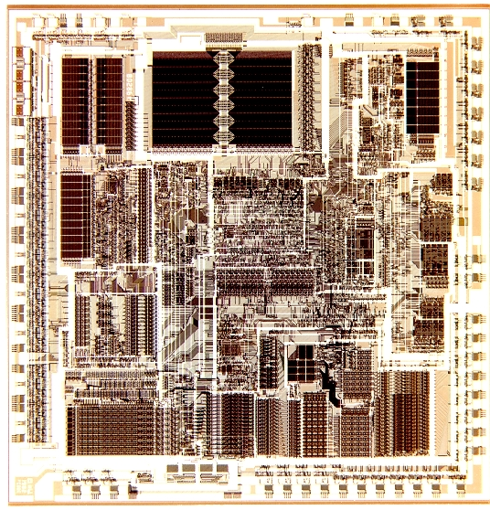
CPUs: Archaic (Nostalgic) v. Modern (Newfangled)
1982 Intel 80286
12.5 MHz
2 MIPS (peak)
Latency 320 ns
134,000 xtors, 47 mm²
16-bit data bus, 68 pins
Microcode interpreter,
separate FPU chip
(no caches)
2001 Intel Pentium 4
1500 MHz (120X)
4500 MIPS (peak) (2250X)
Latency 15 ns (20X)
42,000,000 xtors, 217 mm²
64-bit data bus, 423 pins
3-way superscalar,
Dynamic translate to RISC, Superpipelined (22 stage),
Out-of-Order execution
On-chip 8KB Data caches,
96KB Instr. Trace cache,
256KB L2 cache

Slide 29
Latency Lags Bandwidth (last ~20 years)
Performance Milestones
Processor: ‘286, ‘386, ‘486, Pentium, Pentium Pro, Pentium 4 (21x,2250x)
Ethernet: 10Mb, 100Mb, 1000Mb, 10000 Mb/s (16x,1000x)
Memory Module: 16bit plain DRAM, Page Mode DRAM, 32b, 64b, SDRAM,
DDR SDRAM (4x,120x)
Disk : 3600, 5400, 7200, 10000, 15000 RPM (8x, 143x)
CPU high,
Memory low
(“Memory Wall”)
Notes:
Processor: 2250X, 22X Latency

Slide 30
Rule of Thumb for Latency Lagging BW
In the time that bandwidth doubles, latency improves by no more than a factor of 1.2 to 1.4
  (and capacity improves faster than bandwidth)
Stated alternatively:
Bandwidth improves by more than the square of the improvement in Latency

Slide 31
6 Reasons Latency Lags Bandwidth
1. Moore’s Law helps BW more than latency
  Faster transistors, more transistors,
  more pins help Bandwidth
    MPU Transistors: 0.130 vs. 42 M xtors (300X)
    DRAM Transistors: 0.064 vs. 256 M xtors (4000X)
    MPU Pins: 68 vs. 423 pins (6X)
    DRAM Pins: 16 vs. 66 pins (4X)
  Smaller, faster transistors but communicate
  over (relatively) longer lines: limits latency
    Feature size: 1.5 to 3 vs. 0.18 micron (8X,17X)
    MPU Die Size: 35 vs. 204 mm² (ratio sqrt ⇒ 2X)
    DRAM Die Size: 47 vs. 217 mm² (ratio sqrt ⇒ 2X)

Slide 32
6 Reasons Latency Lags Bandwidth (cont’d)
2. Distance limits latency
  Size of DRAM block ⇒ long bit and word lines
  ⇒ most of DRAM access time
  Speed of light and computers on network
  1. & 2. explains linear latency vs. square BW?
3. Bandwidth easier to sell (“bigger=better”)
  E.g., 10 Gbits/s Ethernet (“10 Gig”) vs.
  10 μsec latency Ethernet
  4400 MB/s DIMM (“PC4400”) vs. 50 ns latency
  Even if just marketing, customers now trained
  Since bandwidth sells, more resources thrown at bandwidth, which further tips the balance

Slide 33
6 Reasons Latency Lags Bandwidth (cont’d)
4. Latency helps BW, but not vice versa
  Spinning disk faster improves both bandwidth and rotational latency
    3600 RPM ⇒ 15000 RPM = 4.2X
    Average rotational latency: 8.3 ms ⇒ 2.0 ms
    Things being equal, also helps BW by 4.2X
  Lower DRAM latency ⇒
  More access/second (higher bandwidth)
  Higher linear density helps disk BW
  (and capacity), but not disk Latency
    9,550 BPI ⇒ 533,000 BPI ⇒ 60X in BW

Slide 34
6 Reasons Latency Lags Bandwidth (cont’d)
5. Bandwidth hurts latency
  Queues help Bandwidth, hurt Latency (Queuing Theory)
  Adding chips to widen a memory module increases Bandwidth but higher fan-out on address lines may increase Latency
6. Operating System overhead hurts
Latency more than Bandwidth
  Long messages amortize overhead;
  overhead bigger part of short messages

Slide 35
Summary of Technology Trends
For disk, LAN, memory, and microprocessor, bandwidth improves by square of latency improvement
  In the time that bandwidth doubles, latency improves by no more than 1.2X to 1.4X
Lag probably even larger in real systems, as bandwidth gains multiplied by replicated components
  Multiple processors in a cluster or even in a chip
  Multiple disks in a disk array
  Multiple memory modules in a large memory
  Simultaneous communication in switched LAN
HW and SW developers should innovate assuming Latency Lags Bandwidth
  If everything improves at the same rate, then nothing really changes
  When rates vary, require real innovation

Slide 36
Acknowledgements
These slides heavily contain material developed and copyright by
  Krste Asanovic (MIT/UCB)
  David Patterson (UCB)
And also by:
  Arvind (MIT)
  Joel Emer (Intel/MIT)
  James Hoe (CMU)
  John Kubiatowicz (UCB)
MIT material derived from course 6.823
UCB material derived from course CS252

