Slide 1
CSE 490/590 Computer Architecture
Multithreading I
Steve Ko
Computer Sciences and Engineering
University at Buffalo

Slide 2
Last time…
Superscalar suffers from the sequential nature of the ISA
VLIW instructions consists of multiple operations
Techniques such as loop unrolling, software pipelining, and trace scheduling gives an opportunity to extract ILP necessary in VLIW

Slide 3
Rotating Register Files
Problems: Scheduled loops require lots of registers,
Lots of duplicated code in prolog, epilog
Solution: Allocate new set of registers for each loop iteration

Slide 4
Rotating Register File
P7
P6
RRB=3
P5
P4
P3
R1
+
P2
P1
P0
Rotating Register Base (RRB) register points to base of current register set. Value added on to logical register specifier to give physical register number. Usually, split into rotating and non-rotating registers.

Slide 5
Rotating Register File
(Previous Loop Example)
Three cycle load latency encoded as difference of 3 in register specifier number (f4 - f1 = 3)
Four cycle fadd latency encoded as difference of 4 in register specifier number (f9 – f5 = 4)
ld f1, ()
fadd f5, f4, ...
sd f9, ()
bloop
ld P9, ()
fadd P13, P12,
sd P17, ()
bloop
RRB=8
ld P8, ()
fadd P12, P11,
sd P16, ()
bloop
RRB=7
ld P7, ()
fadd P11, P10,
sd P15, ()
bloop
RRB=6
ld P6, ()
fadd P10, P9,
sd P14, ()
bloop
RRB=5
ld P5, ()
fadd P9, P8,
sd P13, ()
bloop
RRB=4
ld P4, ()
fadd P8, P7,
sd P12, ()
bloop
RRB=3
ld P3, ()
fadd P7, P6,
sd P11, ()
bloop
RRB=2
ld P2, ()
fadd P6, P5,
sd P10, ()
bloop
RRB=1

Slide 6
Cydra-5:
Memory Latency Register (MLR)
Problem: Loads have variable latency
Solution: Let software choose desired memory latency
Compiler schedules code for maximum load-use distance
Software sets MLR to latency that matches code schedule
Hardware ensures that loads take exactly MLR cycles to return values into processor pipeline
  Hardware buffers loads that return early
  Hardware stalls processor if loads return late

Slide 7
Multithreading
Difficult to continue to extract instruction-level parallelism (ILP) or data-level parallelism (DLP) from a single sequential thread of control
Many workloads can make use of thread-level parallelism (TLP)
  TLP from multiprogramming (run independent sequential jobs)
  TLP from multithreaded applications (run one job faster using parallel threads)
Multithreading uses TLP to improve utilization of a single processor

Slide 8
Pipeline Hazards
t0
t1
t2
t3
t4
t5
t6
t7
t8
t9
t10
t11
t12
t13
t14
LW r1, 0(r2)
LW r5, 12(r1)
ADDI r5, r5, #12
SW 12(r1), r5
F
D
X
M
W
F
D
D
D
D
X
M
W
F
F
F
F
D
D
D
D
X
M
W
F
F
F
F
D
D
D
D
Each instruction may depend on the next
What is usually done to cope with this?

Slide 9
Multithreading
How can we guarantee no dependencies between instructions in a pipeline?
-- One way is to interleave execution of instructions from different program threads on same pipeline
Interleave 4 threads, T1-T4, on non-bypassed 5-stage pipe
t0
t1
t2
t3
t4
t5
t6
t7
t8
t9
T1: LW r1, 0(r2)
T2: ADD r7, r1, r4
T3: XORI r5, r4, #12
T4: SW 0(r7), r5
T1: LW r5, 12(r1)
F
D
X
M
W
Prior instruction in a thread always completes write-back before next instruction in same thread reads register file
F
D
X
M
W
F
D
X
M
W
F
D
X
M
W
F
D
X
M
W

Slide 10
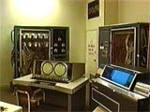
CDC 6600 Peripheral Processors
(Cray, 1964)
First multithreaded hardware
10 “virtual” I/O processors
Fixed interleave on simple pipeline
Pipeline has 100ns cycle time
Each virtual processor executes one instruction every 1000ns
Accumulator-based instruction set to reduce processor state
Notes:
Was objective was to cope with long I/O latencies?

Slide 11
Simple Multithreaded Pipeline
X
PC
1
GPR1
PC
1
I$
IR
GPR1
PC
1
GPR1
PC
1
GPR1
D$
Y
+1
2
Thread select
2
Have to carry thread select down pipeline to ensure correct state bits read/written at each pipe stage
Appears to software (including OS) as multiple, albeit slower, CPUs

Slide 12
Multithreading Costs
Each thread requires its own user state
  PC
  GPRs
Also, needs its own system state
  virtual memory page table base register
  exception handling registers
Other overheads:
  Additional cache/TLB conflicts from competing threads
  (or add larger cache/TLB capacity)
  More OS overhead to schedule more threads (where do all these threads come from?)

Slide 13
Thread Scheduling Policies
Fixed interleave (CDC 6600 PPUs, 1964)
  Each of N threads executes one instruction every N cycles
  If thread not ready to go in its slot, insert pipeline bubble
Software-controlled interleave (TI ASC PPUs, 1971)
  OS allocates S pipeline slots amongst N threads
  Hardware performs fixed interleave over S slots, executing whichever thread is in that slot
Hardware-controlled thread scheduling (HEP, 1982)
  Hardware keeps track of which threads are ready to go
  Picks next thread to execute based on hardware priority scheme
Notes:
Software-controlled interleave, S > N. Wheel with the threads in each slot. If thread is ready to go
It goes, else NOP, I.e., pipeline bubble.

Slide 14
CSE 490/590 Administrivia
HW2 & midterm solution out
Quiz 2 (next Friday 4/8): After midterm until next Monday

Slide 15
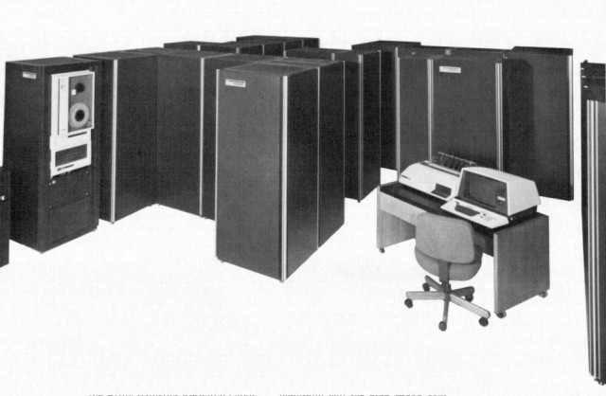
Denelcor HEP
(Burton Smith, 1982)
First commercial machine to use hardware threading in main CPU
  120 threads per processor
  10 MHz clock rate
  Up to 8 processors
  precursor to Tera MTA (Multithreaded Architecture)
Notes:
Would be nice to add a slide on the implementation…

Slide 16
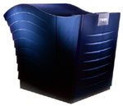
Tera MTA (1990-)
Up to 256 processors
Up to 128 active threads per processor
Processors and memory modules populate a sparse 3D torus interconnection fabric
Flat, shared main memory
  No data cache
  Sustains one main memory access per cycle per processor
GaAs logic in prototype, 1KW/processor @ 260MHz
  Second version CMOS, MTA-2, 50W/processor
  New version, XMT, fits into AMD Opteron socket, runs at 500MHz

Slide 17
MTA Pipeline
Issue Pool
Inst Fetch
Every cycle, one VLIW instruction from one active thread is launched into pipeline
Instruction pipeline is 21 cycles long
Memory operations incur ~150 cycles of latency
W
M
A
C
W
Write Pool
Memory Pool
W
Retry Pool
Interconnection Network
Memory pipeline
Notes:
Memory unit is busy, or sync operation failed retry.
Just goes around the memory pipeline.

Slide 18
Coarse-Grain Multithreading
Tera MTA designed for supercomputing applications with large data sets and low locality
  No data cache
  Many parallel threads needed to hide large memory latency
Other applications are more cache friendly
  Few pipeline bubbles if cache mostly has hits
  Just add a few threads to hide occasional cache miss latencies
  Swap threads on cache misses
Notes:
Tera --- 256 mem-ops/cycle * 150 cycles/mem-op = 38K instructions-in-flight…
Tera not very successful, 2 machines sold.
Changed their name back to Cray!

Slide 19
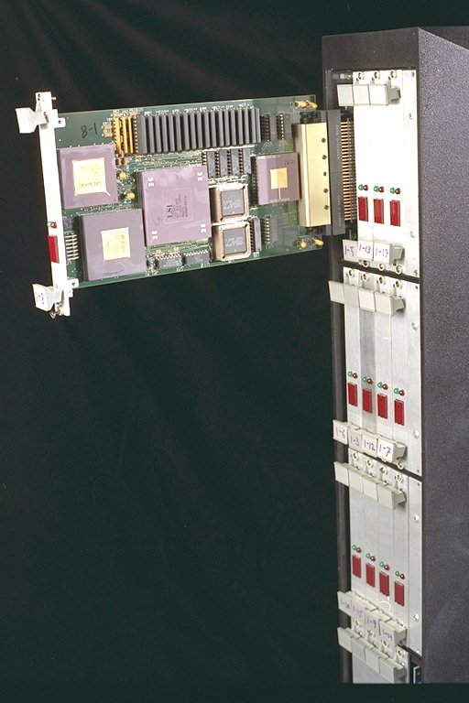
MIT Alewife (1990)
Modified SPARC chips
  register windows hold different thread contexts
Up to four threads per node
Thread switch on local cache miss

Slide 20
IBM PowerPC RS64-IV (2000)
Commercial coarse-grain multithreading CPU
Based on PowerPC with quad-issue in-order five-stage pipeline
Each physical CPU supports two virtual CPUs
On L2 cache miss, pipeline is flushed and execution switches to second thread
  short pipeline minimizes flush penalty (4 cycles), small compared to memory access latency
  flush pipeline to simplify exception handling

Slide 21
Simultaneous Multithreading (SMT) for OoO Superscalars
Techniques presented so far have all been “vertical” multithreading where each pipeline stage works on one thread at a time
SMT uses fine-grain control already present inside an OoO superscalar to allow instructions from multiple threads to enter execution on same clock cycle. Gives better utilization of machine resources.

Slide 22
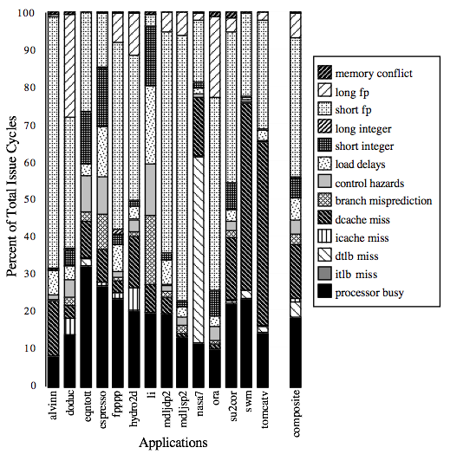
For most apps, most execution units lie idle in an OoO superscalar
For an 8-way superscalar.
From: Tullsen, Eggers, and Levy,
“Simultaneous Multithreading: Maximizing On-chip Parallelism”, ISCA 1995.

Slide 23
Acknowledgements
These slides heavily contain material developed and copyright by
  Krste Asanovic (MIT/UCB)
  David Patterson (UCB)
And also by:
  Arvind (MIT)
  Joel Emer (Intel/MIT)
  James Hoe (CMU)
  John Kubiatowicz (UCB)
MIT material derived from course 6.823
UCB material derived from course CS252

