Slide 1
CSE 490/590 Computer Architecture VLIW
Steve Ko
Computer Sciences and Engineering
University at Buffalo

Slide 2
Last time…
BTB allows prediction very early in pipeline
In practice, use BHT and BTB together
Speculative store buffer holds store values before commit to allow load-store forwarding
Can execute later loads past earlier stores when addresses known, or predicted no dependence

Slide 3
Datapath: Branch Prediction and Speculative Execution
Update predictors
Branch
Prediction
Branch
Resolution
kill
kill
kill
kill
PC
Fetch
Decode & Rename
Reorder Buffer
Commit
Reg. File
Branch
Unit
ALU
MEM
Store Buffer
D$
Execute

Slide 4
Superscalar Control Logic Scaling
Issue Width W
Issue Group
Previously Issued Instructions
Lifetime L
Each issued instruction must somehow check against W*L instructions, i.e., growth in hardware ∝ W*(W*L)
For in-order machines, L is related to pipeline latencies and check is done during issue (interlocks or scoreboard)
For out-of-order machines, L also includes time spent in instruction buffers (instruction window or ROB), and check is done by broadcasting tags to waiting instructions at write back (completion)
As W increases, larger instruction window is needed to find enough parallelism to keep machine busy => greater L
=> Out-of-order control logic grows faster than W² (~W³)

Slide 5
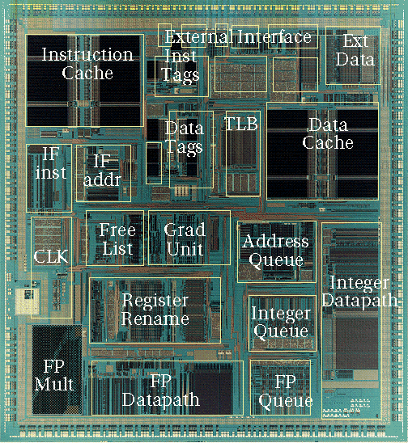
Out-of-Order Control Complexity: MIPS R10000
Control Logic
[ SGI/MIPS Technologies Inc., 1995 ]

Slide 6
Sequential ISA Bottleneck
Sequential source code
Superscalar compiler
Sequential machine code
a = foo(b);
for (i=0, i<
Find independent operations
Schedule operations
Superscalar processor
Check instruction dependencies
Schedule execution

Slide 7
VLIW: Very Long Instruction Word
Int Op 1
Int Op 2
Mem Op 1
Mem Op 2
FP Op 1
FP Op 2
Two Integer Units,
Single Cycle Latency
Two Load/Store Units,
Three Cycle Latency
Two Floating-Point Units,
Four Cycle Latency
Multiple operations packed into one instruction
Each operation slot is for a fixed function
Constant operation latencies are specified
Architecture requires guarantee of:
Parallelism within an instruction => no cross-operation RAW check
No data use before data ready => no data interlocks

Slide 8
VLIW Compiler Responsibilities
Schedules to maximize parallel execution
Guarantees intra-instruction parallelism
Schedules to avoid data hazards (no interlocks)
Typically separates operations with explicit NOPs

Slide 9
Early VLIW Machines
FPS AP120B (1976)
scientific attached array processor
first commercial wide instruction machine
hand-coded vector math libraries using software pipelining and loop unrolling
Multiflow Trace (1987)
commercialization of ideas from Fisher’s Yale group including “trace scheduling”
available in configurations with 7, 14, or 28 operations/instruction
28 operations packed into a 1024-bit instruction word
Cydrome Cydra-5 (1987)
7 operations encoded in 256-bit instruction word
rotating register file

Slide 10
CSE 490/590 Administrivia
HW2 is out
Midterm solution will be up today
Quiz 2 (next Friday 4/8)

Slide 11
Loop Execution
for (i=0; i<N; i++)
B[i] = A[i] + C;
Int1
Int 2
M1
M2
FP+
FPx
loop:
add r1
ld
Compile
loop: ld f1, 0(r1)
add r1, 8
fadd f2, f0, f1
sd f2, 0(r2)
add r2, 8
bne r1, r3, loop
fadd
Schedule
add r2
bne
sd
How many FP ops/cycle?
1 fadd / 8 cycles = 0.125

Slide 12
Loop Unrolling
for (i=0; i<N; i++)
B[i] = A[i] + C;
Unroll inner loop to perform 4 iterations at once
for (i=0; i<N; i+=4)
{
B[i] = A[i] + C;
B[i+1] = A[i+1] + C;
B[i+2] = A[i+2] + C;
B[i+3] = A[i+3] + C;
}
Need to handle values of N that are not multiples of unrolling factor with final cleanup loop

Slide 13
Scheduling Loop Unrolled Code
Unroll 4 ways
loop: ld f1, 0(r1)
ld f2, 8(r1)
ld f3, 16(r1)
ld f4, 24(r1)
add r1, 32
fadd f5, f0, f1
fadd f6, f0, f2
fadd f7, f0, f3
fadd f8, f0, f4
sd f5, 0(r2)
sd f6, 8(r2)
sd f7, 16(r2)
sd f8, 24(r2)
add r2, 32
bne r1, r3, loop
Int1
Int 2
M1
M2
FP+
FPx
loop:
ld f1
ld f2
ld f3
add r1
ld f4
fadd f5
Schedule
fadd f6
fadd f7
fadd f8
sd f5
sd f6
sd f7
add r2
bne
sd f8
How many FLOPS/cycle?
4 fadds / 11 cycles = 0.36

Slide 14
Software Pipelining
Unroll 4 ways first
Int1
Int 2
M1
M2
FP+
FPx
loop: ld f1, 0(r1)
ld f2, 8(r1)
ld f3, 16(r1)
ld f4, 24(r1)
add r1, 32
fadd f5, f0, f1
fadd f6, f0, f2
fadd f7, f0, f3
fadd f8, f0, f4
sd f5, 0(r2)
sd f6, 8(r2)
sd f7, 16(r2)
add r2, 32
sd f8, -8(r2)
bne r1, r3, loop
ld f1
ld f2
ld f3
add r1
ld f4
prolog
ld f1
fadd f5
ld f2
fadd f6
ld f3
fadd f7
add r1
ld f4
fadd f8
loop:
ld f1
sd f5
fadd f5
iterate
ld f2
sd f6
fadd f6
add r2
ld f3
sd f7
fadd f7
add r1
bne
ld f4
sd f8
fadd f8
sd f5
fadd f5
sd f6
fadd f6
epilog
add r2
sd f7
fadd f7
bne
sd f8
fadd f8
How many FLOPS/cycle?
4 fadds / 4 cycles = 1
sd f5

Slide 15
Software Pipelining vs. Loop Unrolling
Loop Unrolled
Wind-down overhead
performance
Startup overhead
time
Loop Iteration
Software Pipelined
performance
time
Loop Iteration
Software pipelining pays startup/wind-down costs only once per loop, not once per iteration

Slide 16
What if there are no loops?
Branches limit basic block size in control-flow intensive irregular code
Difficult to find ILP in individual basic blocks
Basic block

Slide 17
Trace Scheduling [ Fisher,Ellis]
Pick string of basic blocks, a trace, that represents most frequent branch path
Use profiling feedback or compiler heuristics to find common branch paths
Schedule whole “trace” at once
Add fixup code to cope with branches jumping out of trace

Slide 18
Problems with “Classic” VLIW
Object-code compatibility
have to recompile all code for every machine, even for two machines in same generation
Object code size
instruction padding wastes instruction memory/cache
loop unrolling/software pipelining replicates code
Scheduling variable latency memory operations
caches and/or memory bank conflicts impose statically unpredictable variability
Knowing branch probabilities
Profiling requires an significant extra step in build process
Scheduling for statically unpredictable branches
optimal schedule varies with branch path

Slide 19
VLIW Instruction Encoding
Group 1
Group 2
Group 3
Schemes to reduce effect of unused fields
Compressed format in memory, expand on I-cache refill
used in Multiflow Trace
introduces instruction addressing challenge
Mark parallel groups
used in TMS320C6x DSPs, Intel IA-64
Provide a single-op VLIW instruction
Cydra-5 UniOp instructions

Slide 20
Acknowledgements
These slides heavily contain material developed and copyright by
Krste Asanovic (MIT/UCB)
David Patterson (UCB)
And also by:
Arvind (MIT)
Joel Emer (Intel/MIT)
James Hoe (CMU)
John Kubiatowicz (UCB)
MIT material derived from course 6.823
UCB material derived from course CS252

